Slide 1
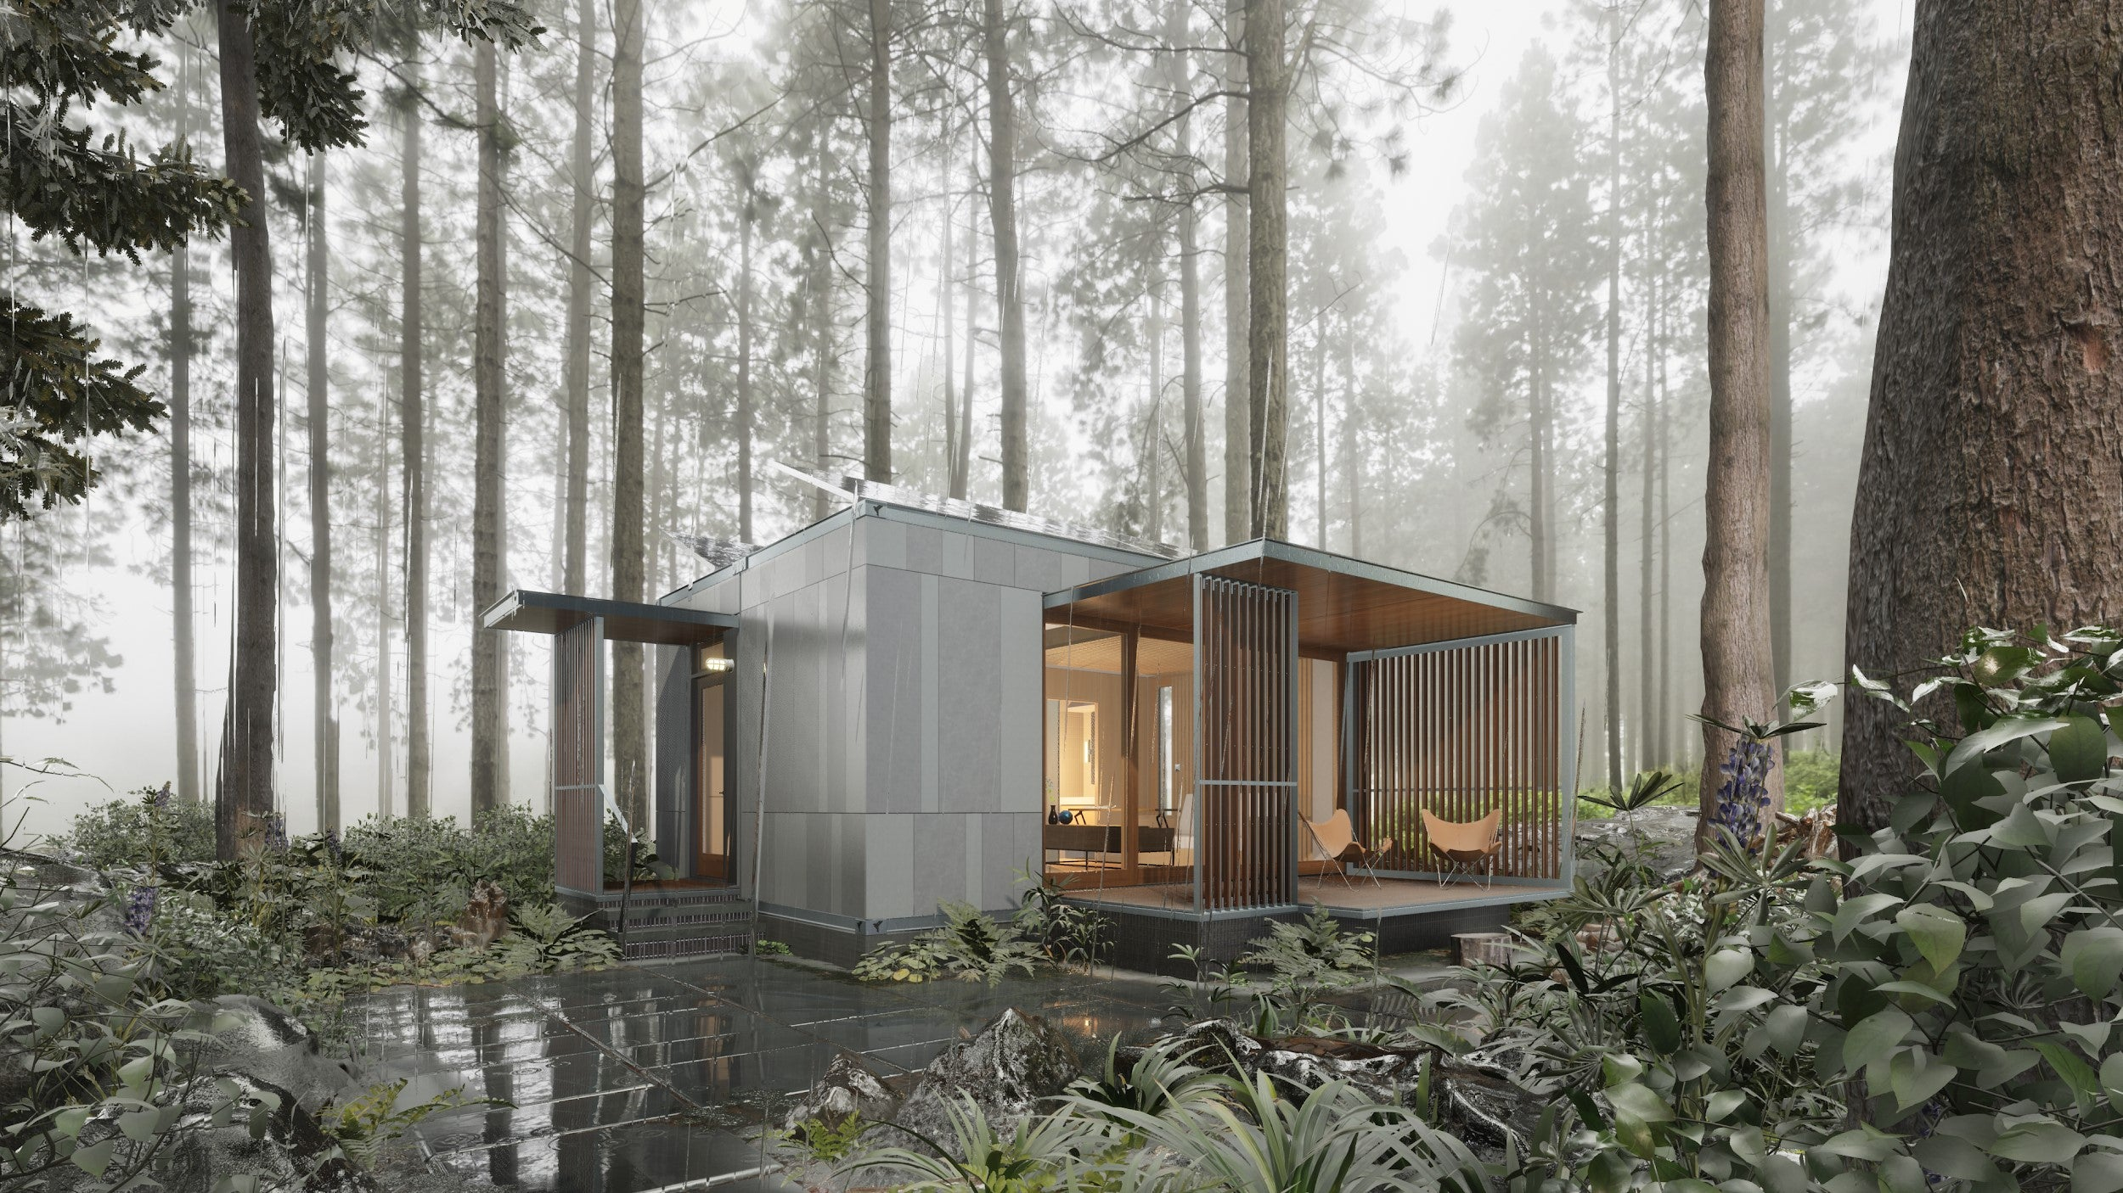
A NEW SOLUTION FOR ATTAINABLE HOUSING
TREVOR BARGER
MODERATOR | FAICP CUD
Founder – Espiritu Loci
ANGELICA GUEVARA
Downtown Transformation Project Manager, City of Mesa
MICHAEL FRARY
Factory Built Building Supervisor, Arizona Department of Housing
Notes:
This page will be the backdrop as people arrive. We will have this up while intros are made. Please keep your intros brief, as attendees are eager to hear the project conversation.

Slide 2
What if we could transform the way people live?
Notes:
The following slides to #46 go very quickly flipping through photos while asking the questions.

Slide 3
What if houses were designed like yachts?

Slide 5
© ZenniHome Holdings, Inc.

Slide 6
What if interiors were appointed like private jets?

Slide 8
© ZenniHome Holdings, Inc.

Slide 9
What if houses were built to factory specifications?

Slide 10
© ZenniHome Holdings, Inc.

Slide 11
© ZenniHome Holdings, Inc.

Slide 12
© ZenniHome Holdings, Inc.

Slide 13
What if robotic furniture could make each room more useful?

Slide 18
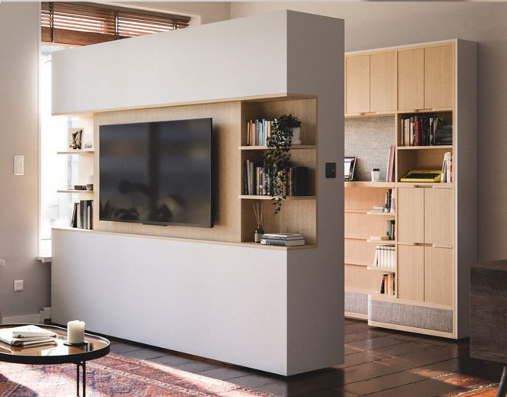

Slide 21
What if houses could be shipped anywhere in the country?

Slide 23
© ZenniHome Holdings, Inc.

Slide 24
© ZenniHome Holdings, Inc.

Slide 25
© ZenniHome Holdings, Inc.

Slide 26
What if houses could be off the grid?

Slide 27
Solar Panels
Separate Gray and Black Water Systems

Slide 28
What if houses could be stacked to form urban communities?

Slide 29
© ZenniHome Holdings, Inc.

Slide 30
© ZenniHome Holdings, Inc.

Slide 31
© ZenniHome Holdings, Inc.

Slide 32
What if houses used less land?

Slide 33
The Citizen
640 sq. ft. | 16’ x 40’
Ori king bed and full bed
Full ADA bath
Tankless Water Heater
Kitchen amenities: oven, range, microwave, fridge, and dishwasher
Dining table and chairs
In-unit washer/dryer
Ori office desk/closet
16’
40’

Slide 34
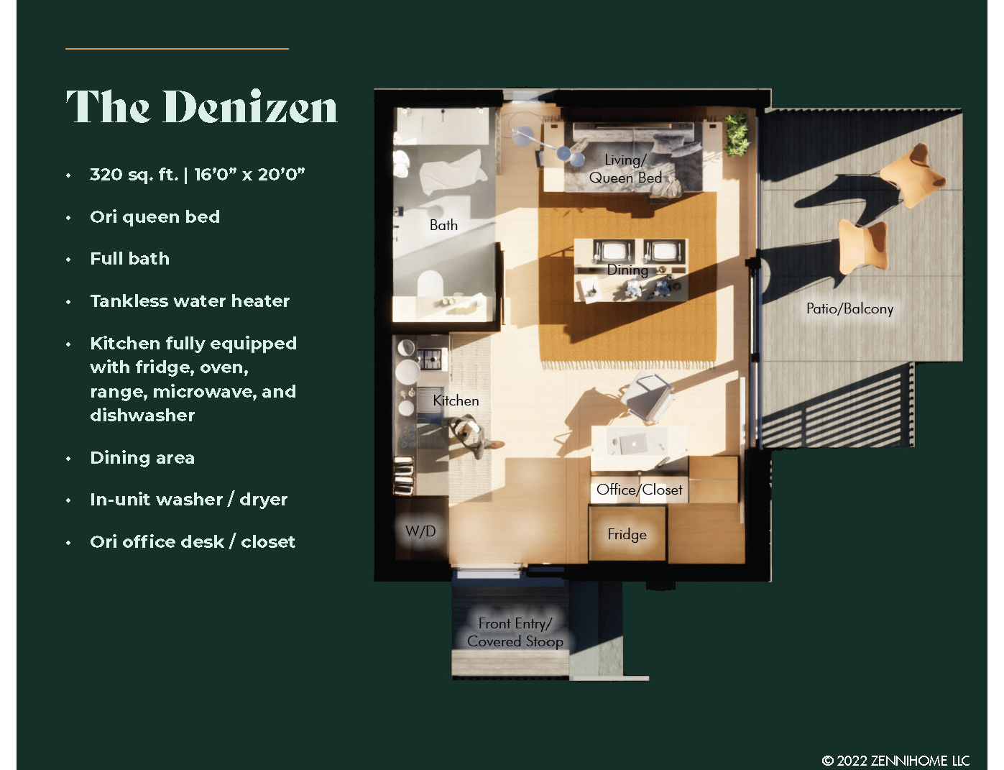
The Denizen
320 sq. ft. | 16’ x 20’
Ori queen bed
Full bath
Tankless Water Heater
Kitchen amenities: oven, range, microwave, fridge, and dishwasher
Dining area
In-unit washer/dryer
Ori office desk/closet
16’
20’

Slide 35
© ZenniHome Holdings, Inc.

Slide 36
© ZenniHome Holdings, Inc.

Slide 37
© ZenniHome Holdings, Inc.

Slide 38
170
170
36
36
© ZenniHome Holdings, Inc.

Slide 39
© ZenniHome Holdings, Inc.

Slide 40
15
© ZenniHome Holdings, Inc.

Slide 41
30/60
© ZenniHome Holdings, Inc.

Slide 42
© ZenniHome Holdings, Inc.

Slide 43
60
© ZenniHome Holdings, Inc.

Slide 44
© ZenniHome Holdings, Inc.

Slide 45
66/90
© ZenniHome Holdings, Inc.

Slide 46
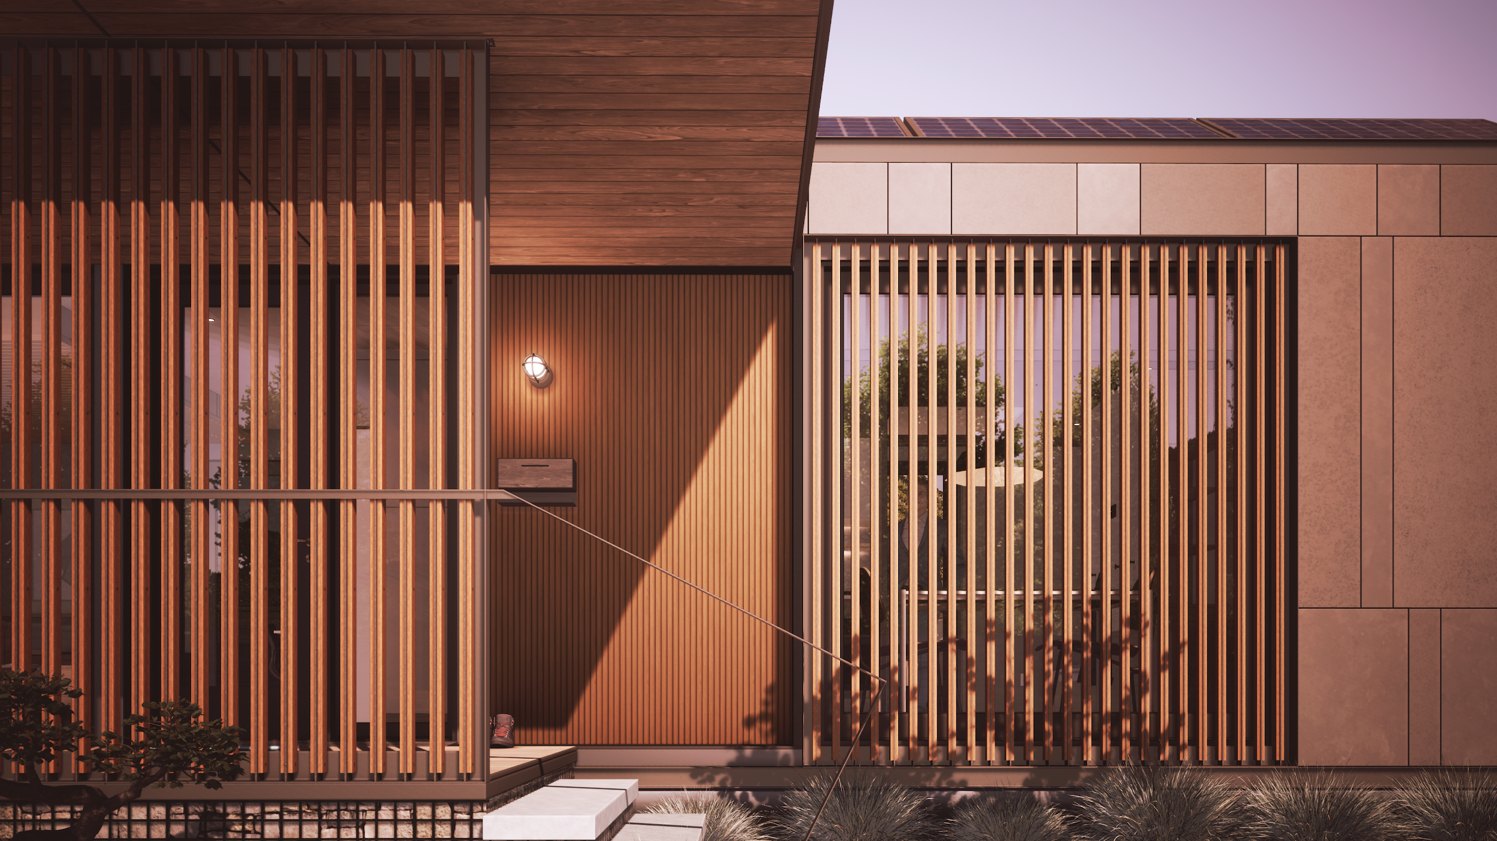
www.ZenniHome.com
© ZenniHome Holdings, Inc.

Slide 47
Notes:
This is where Michael gives an intro into ADOH’s role in approving and reviewing manufactured homes

Slide 48
https://housing.az.gov/
Notes:
Introduction to the ADOH website

Slide 49
https://housing.az.gov/
Manufactured Housing & Building Division
Notes:
Where to find the Manufactured Housing & Building Division

Slide 50
Manufactured Housing & Building Division

Slide 51
Notes:
Angelica talks about Mesa’s progressive approach to downtown redevelopment and form based zoning

Slide 52
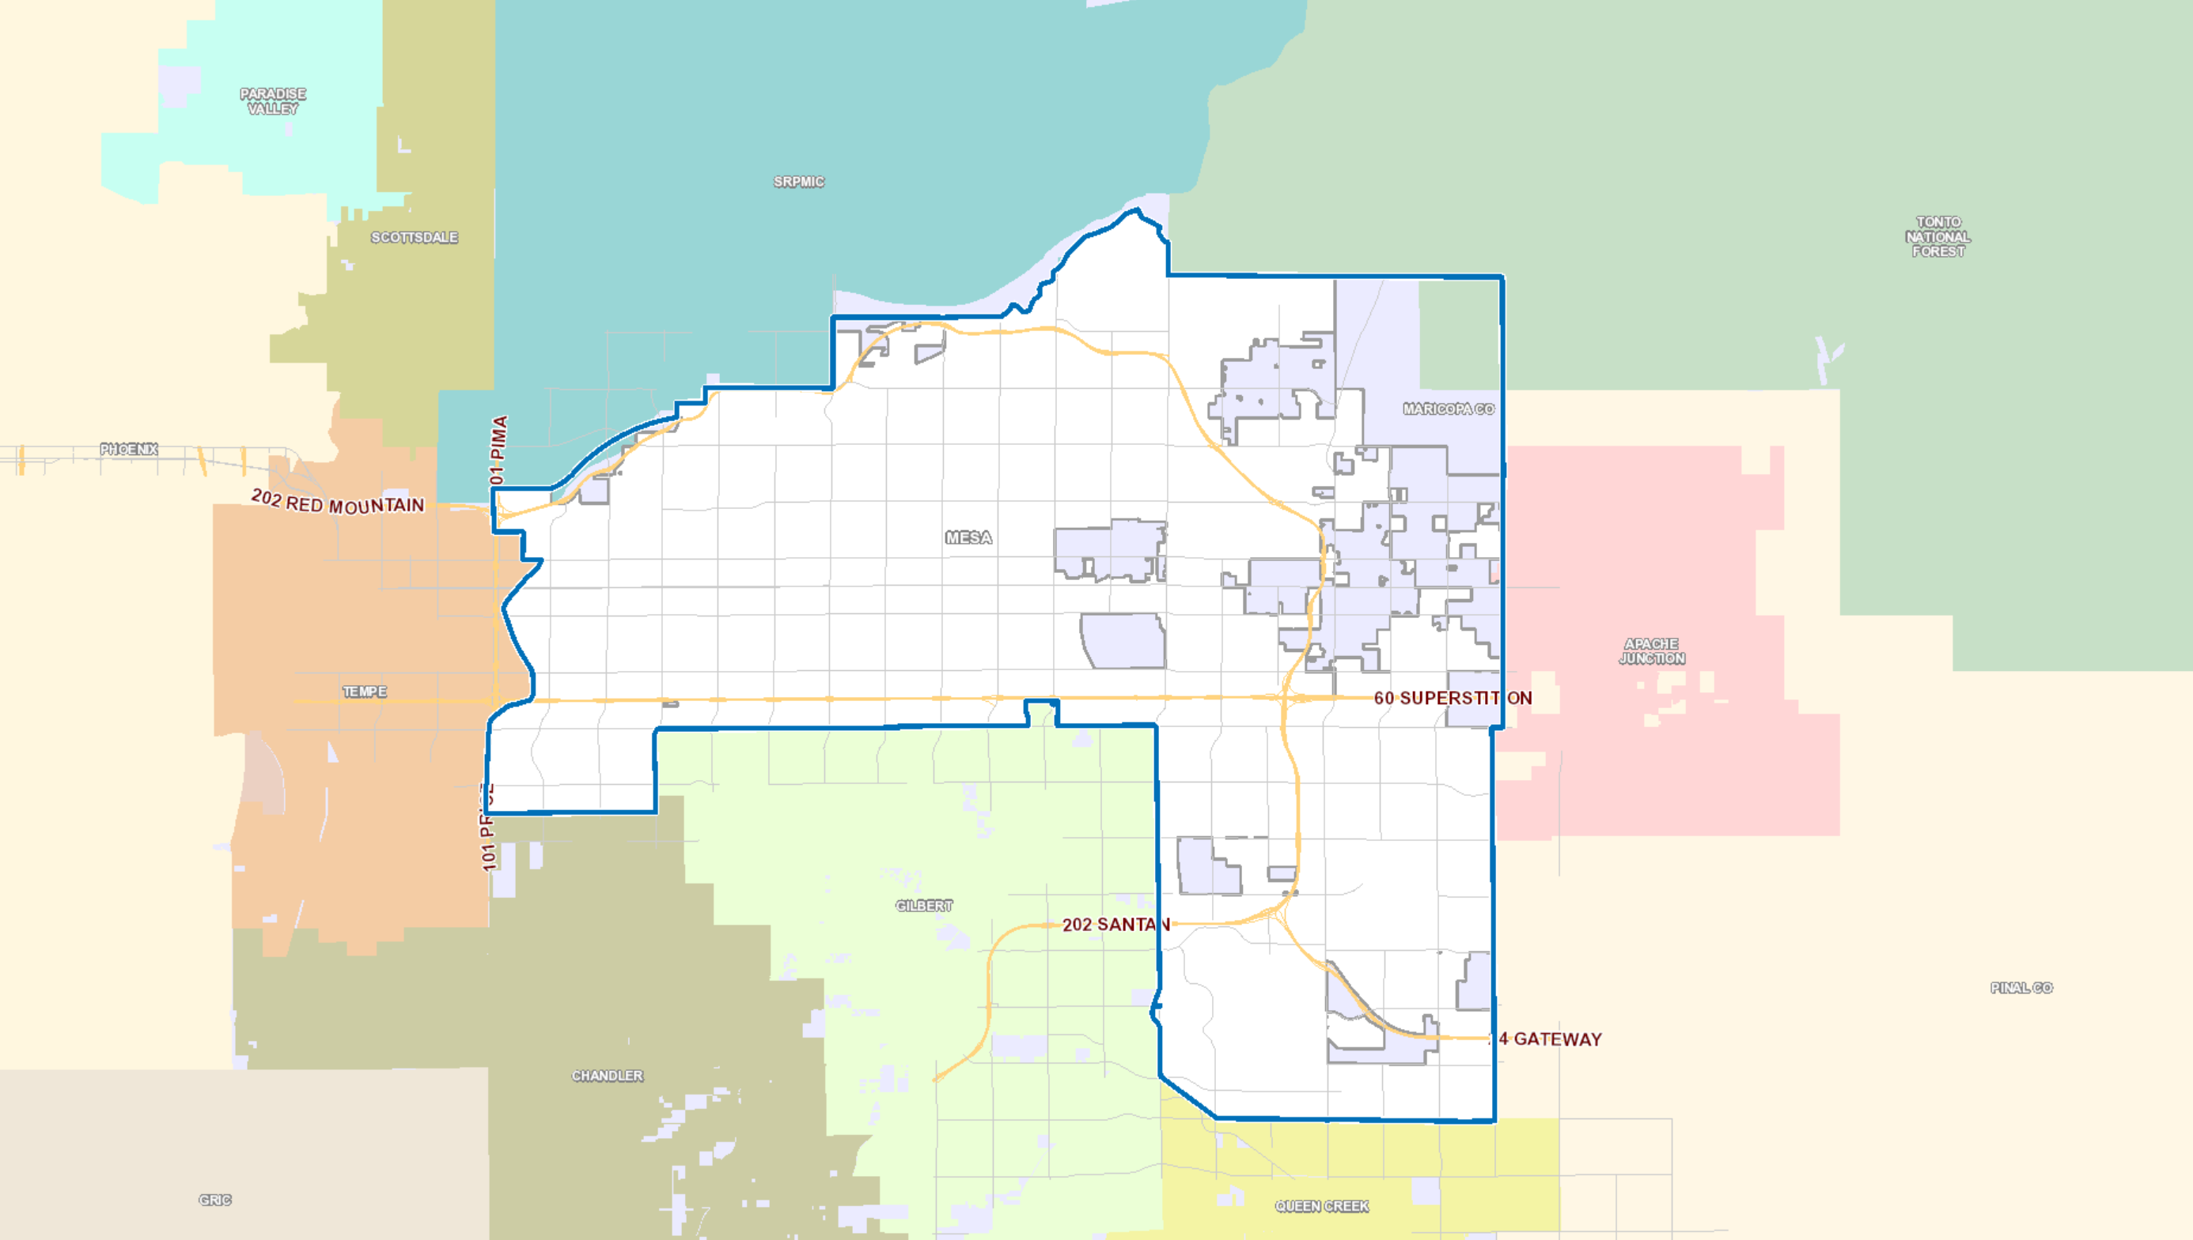

Slide 54
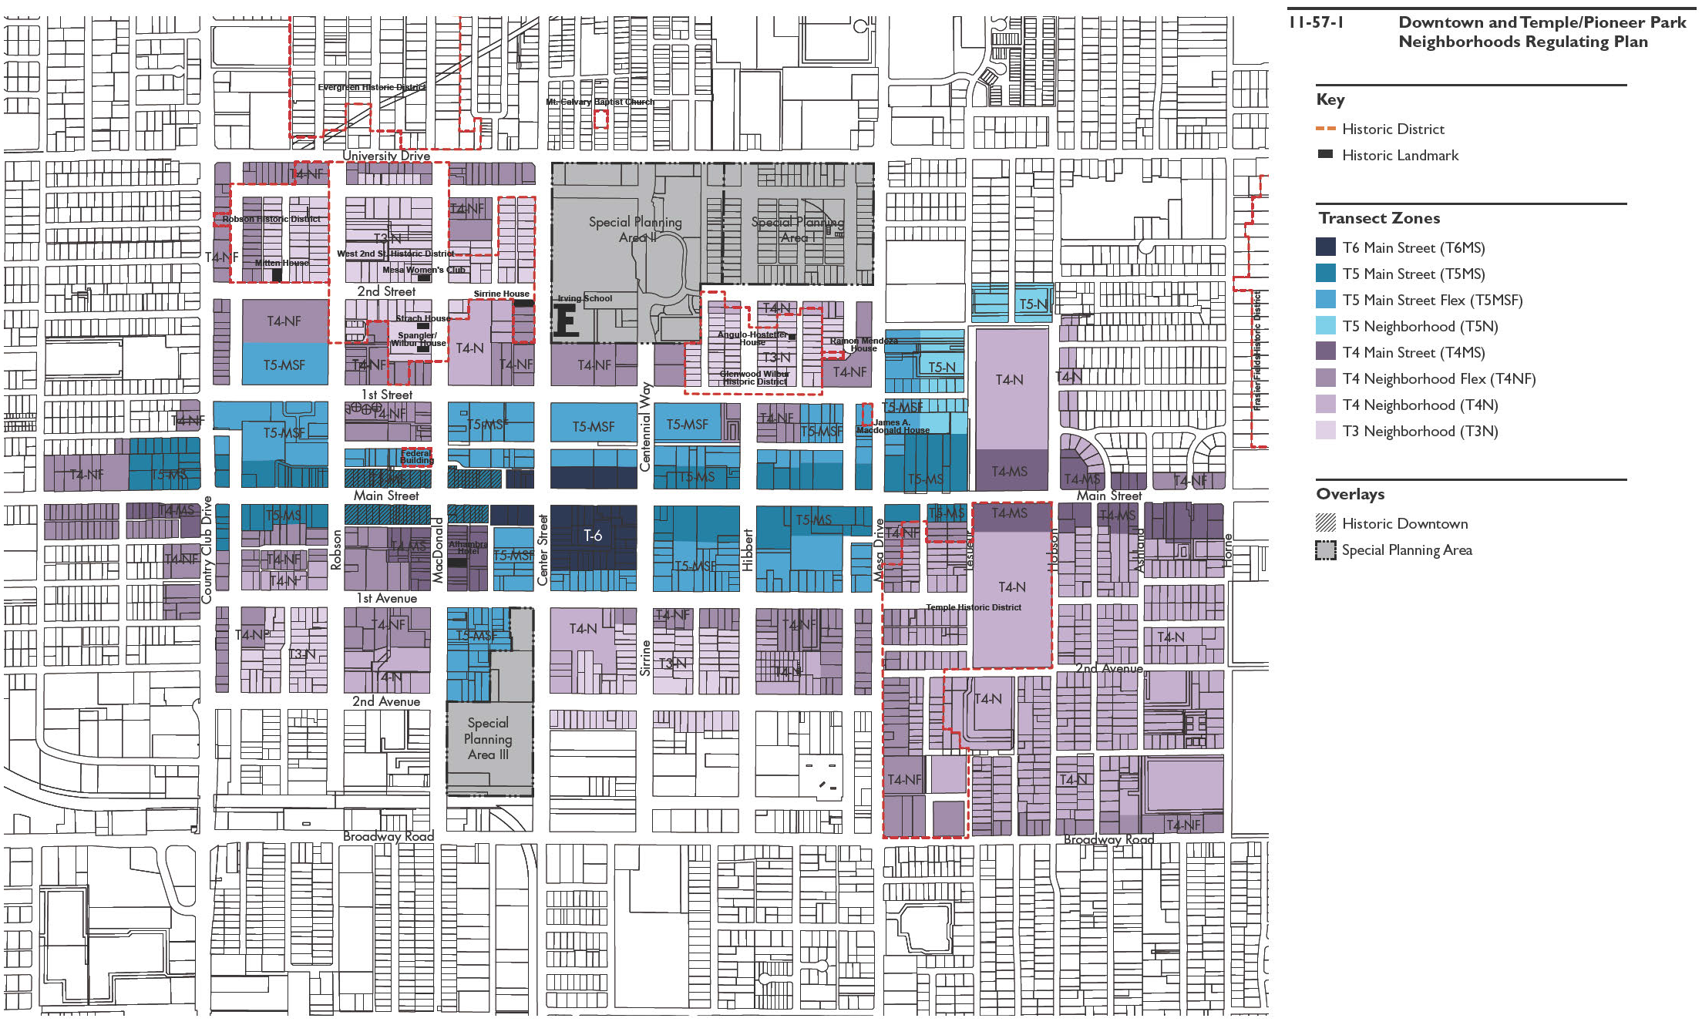
T6 Main Street Approval with Administrative Review
Central Main Street Plan Form-Based Zoning

Slide 55
Notes:
The project location on Central Main Street Plan Form-Based Zoning

Slide 56
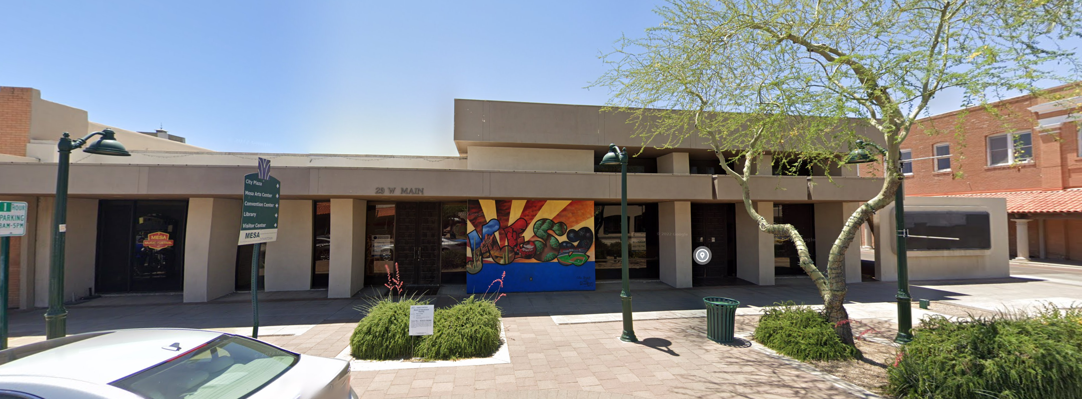
29 W Main Street - today

Slide 57
180
© ZenniHome Holdings, Inc.

Slide 58
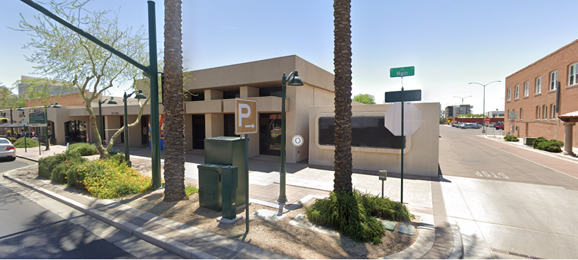
29 W Main Street - today

Slide 60
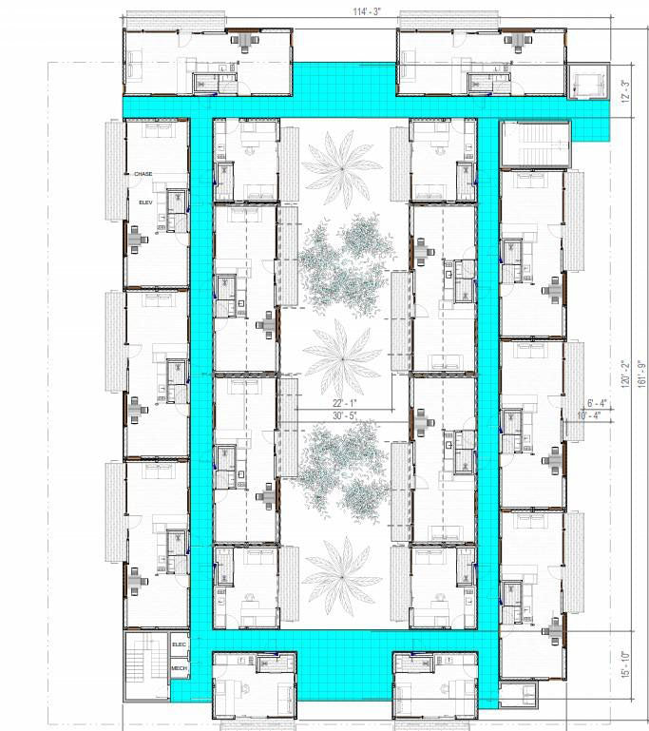
ZenCity
18 Homes per level
12 @ 640 sf = 66%
6 @ 320 sf = 34%
90 homes total
Circulation
4th & 6th Floors
Notes:
Diagram of residential floor plan

Slide 61
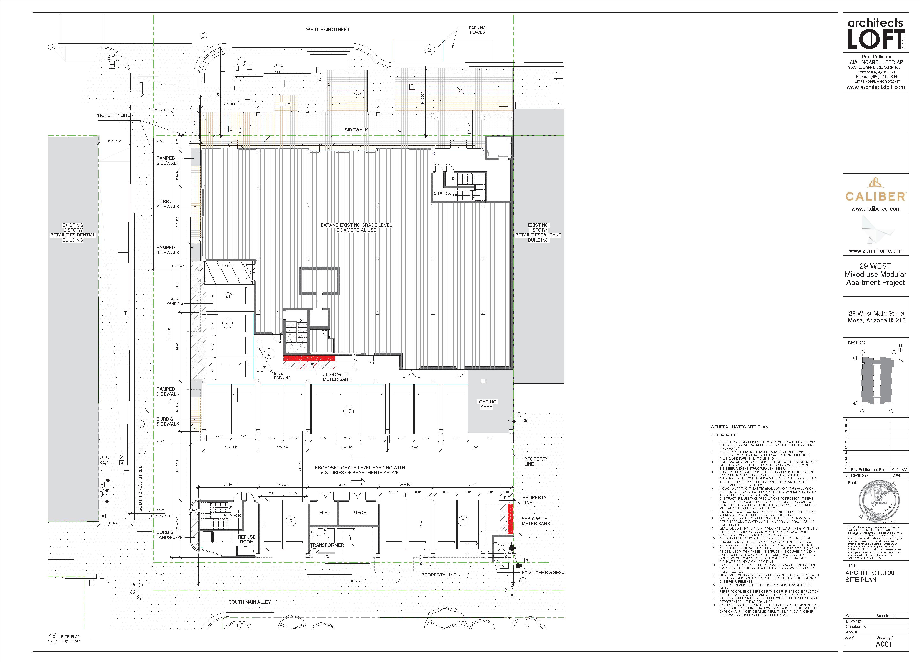
Ground Level
South Main Alley
Commercial
South Drew Street
Parking
South Main Alley

Slide 62
2nd Floor 3rd & 5th Floors

Slide 63
Section looking west

Slide 67
© ZenniHome Holdings, Inc.

