Slide 1
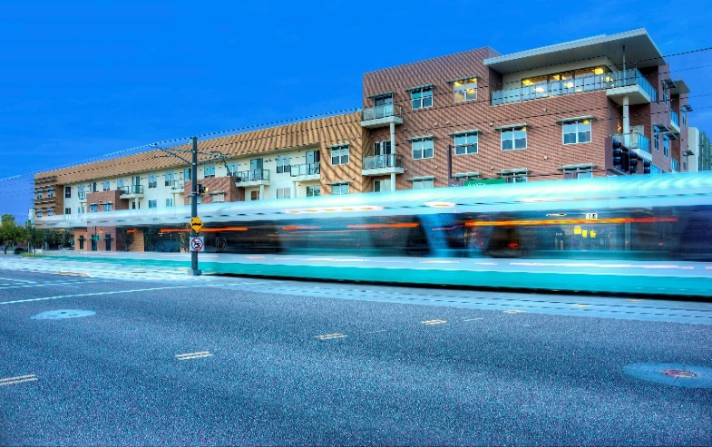
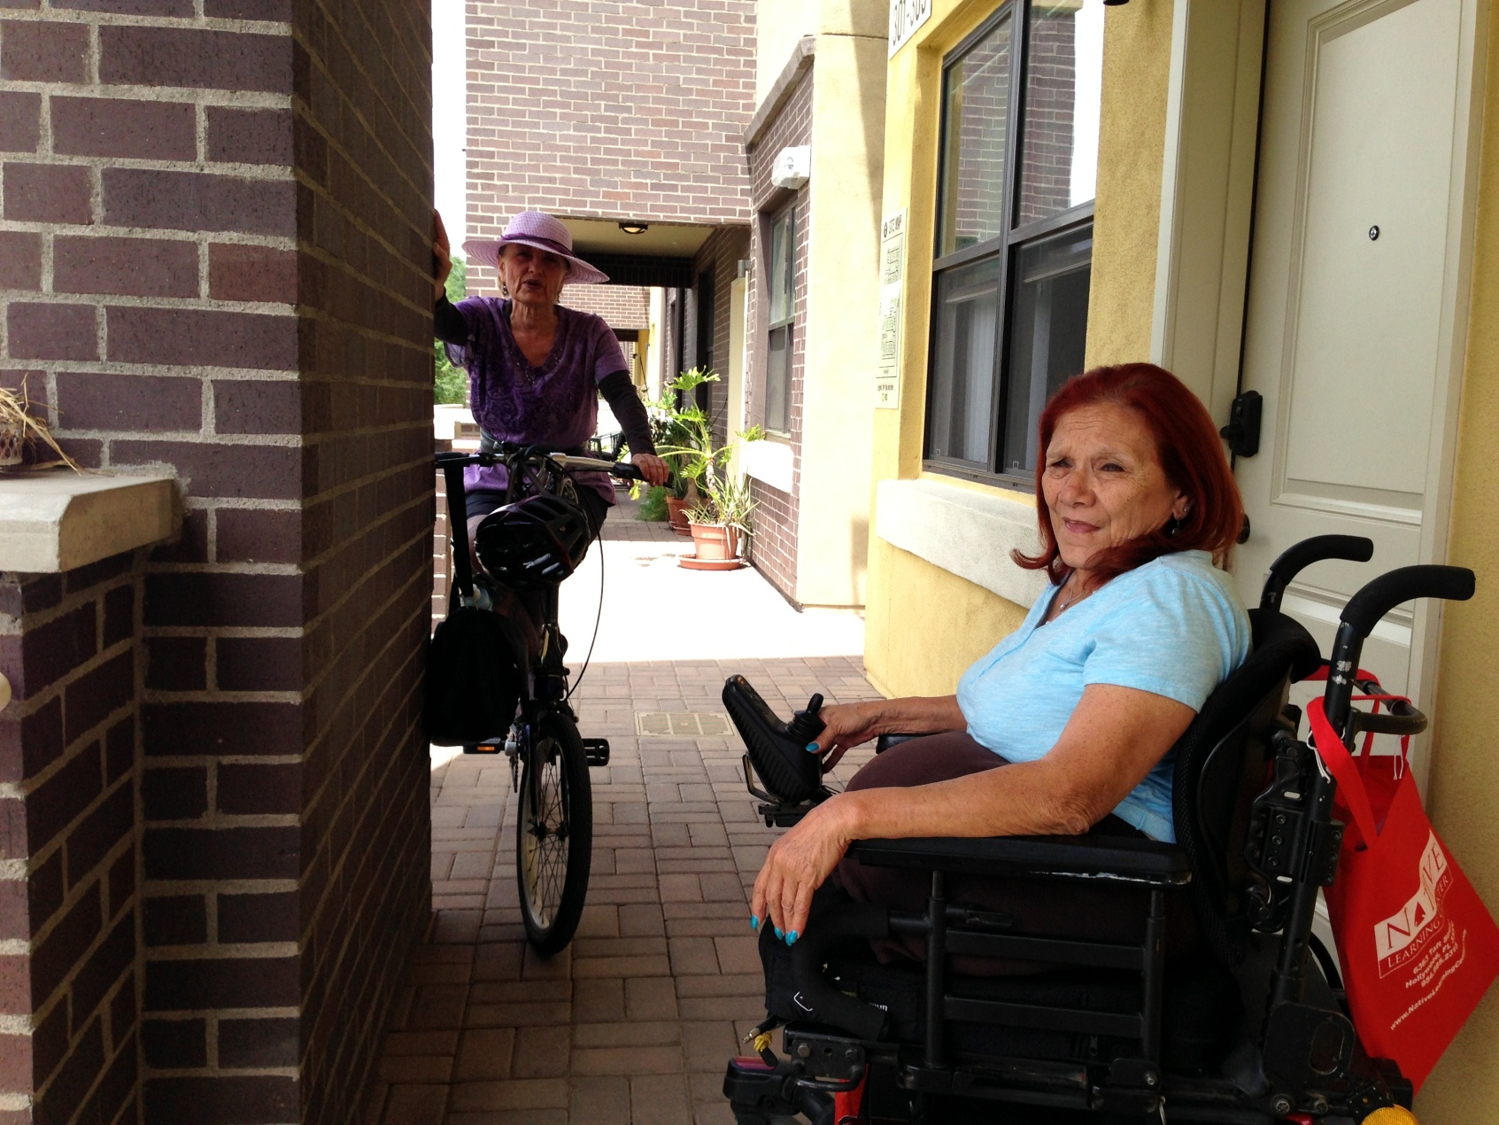


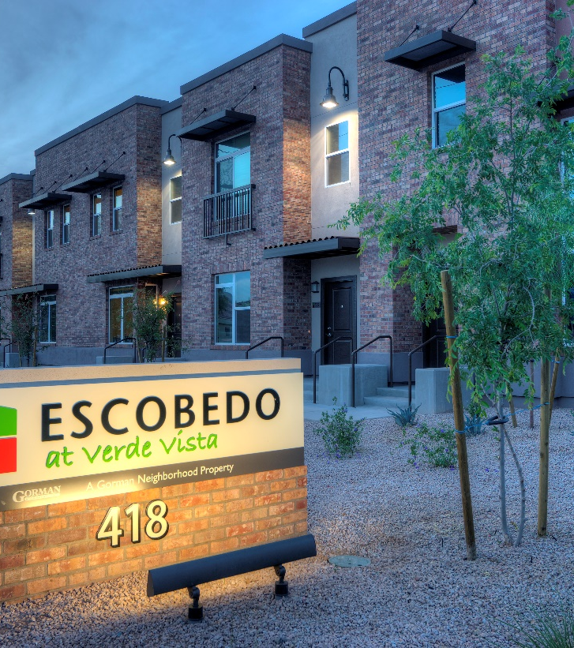
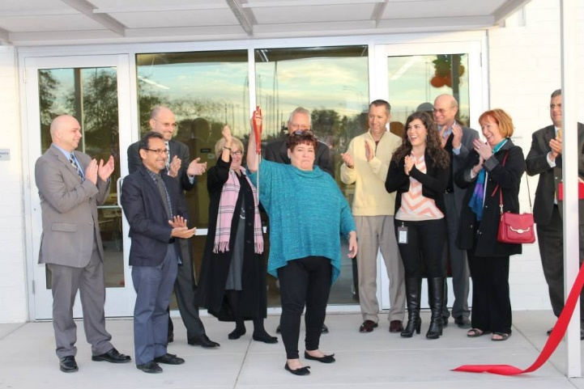
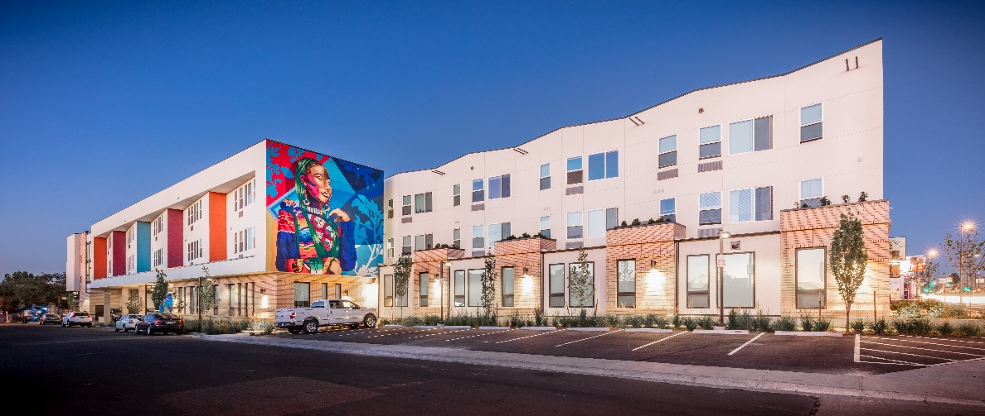
Accessibility and Housing:
What is YOUR Bottom Line?
Notes:
Intro to Gorman
3 LIHTC apps in first urban round. Only 4 in 2nd urban round. Need to get more interest/applications.
Goal is to help you understand the sweet spot in terms of scoring, how transactions work. We need more applications if we’re going to keep the program.

Slide 2


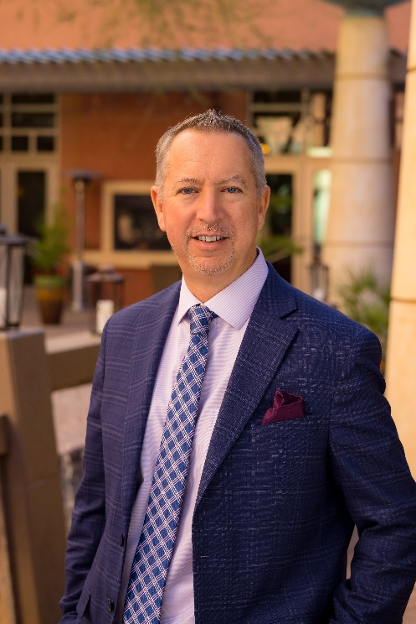



Darrel Christenson, VP Community Integration
5025 E. Washington Street #200, Phoenix, AZ
(602) 296-0530.direct
DarrelC@ability360.org
www.ability360.org
Brian Swanton, President & CEO
2030 E. Osborn Road, Phoenix, AZ
(602) 708-4889.text/cell
bswanton@gormanusa.com
www.gormanusa.com

Slide 3
About Ability 360
Empowering People with Disabilities for Over 30 Years 1981 – Present
Our Mission: to empower people with disabilities to take personal responsibility so that they may achieve or continue independent lifestyles within the community.
Ability360 Programs and Services:
Individual & Systems Advocacy
Information & Referral
Employment Services ADA Services and Counsel
Empowering Youth in Transition
Home Modifications
Social and Recreational Opportunities
Home Care Services
Sports, Fitness and Health & Wellness
Notes:
Ability 360 is a 501c3 that advocates personal responsibility – by, and for, people with disabilities – as a means to independence.
Ability360 continues a 35-year tradition offering and promoting programs to empower people with all disabilities to take personal responsibility so that they may achieve or continue independent lifestyles within the community. The independent living philosophy states that people with disabilities should have the same civil rights, options, and control over choices in their own lives as do people without disabilities.
Ability360 Programs and Services are designed to:
• Maximize independence
• Advocate personal responsibility as a means to independence
• Respond to direct consumer needs
• Encourage self-sufficiency
• Increase consumer control
• Achieve equal opportunity and full integration
• Remove barriers – architectural, communication and attitudinal
• Provide leadership through peer role models
Through its comprehensive programs, Ability360 touches the lives of individuals with disabilities and addresses the disability concerns of their family members, co-workers and employers.

Slide 4

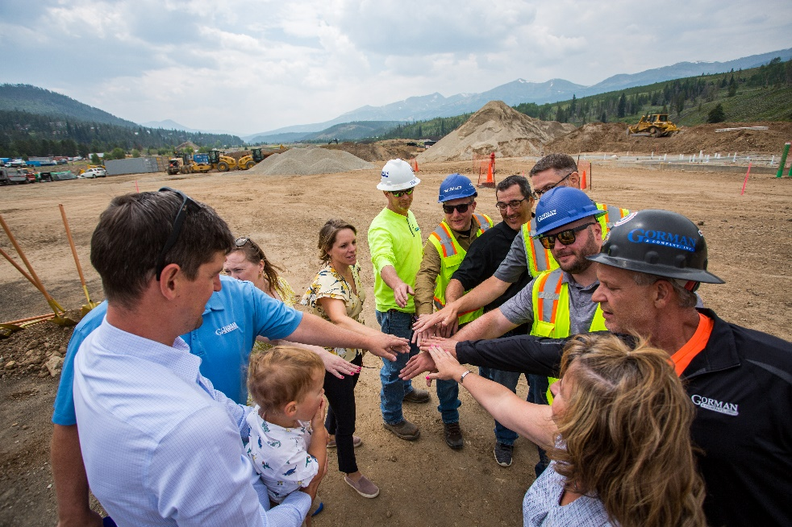
Mission-driven for-profit real estate developer
38 years and over $2 Billion of Affordable Housing and Community Development Experience.
550 team members in a vertically-integrated shop. Licensed Architecture, Construction, Asset/Property Management Operations
Top 20 Developer of Affordable Housing in the U.S.
Active in Arizona, Colorado, New Mexico, Oregon, Wisconsin, Illinois, Indiana, Ohio, Florida, Georgia, Arkansas, & Mississippi
www.gormanusa.com

Slide 5
Why is Accessibility Needed in our Communities?

Slide 6
The Need | Accessible Housing
In Arizona, thirteen percent (13%) of the population (or about 912,115 individuals) reported a disability.
There are rising disability levels among middle-age Americans (age 40 to 64) as well as increasing disability among those ages 55 to 64.
Seventeen percent (nearly 1,1 Million) of the population in Arizona is 65 years and older and this percentage is steadily increasing every year.
Roughly 10,000 baby boomers across the United States will turn 65 every day for the next 19 years. (i.e. the Silver Tsunami)
Notes:
Independent Living and Self-Determination Statement
Independent Living and Self-Determination are values that stress dignity, self-responsibility, choices and decision making. Independent living is the freedom to direct one’s own life. Each individual has the right to optimize his or her personal ability and fully integrate into the community. What does this mean? You get to be in charge of your own life. You might seek advice, but you make decisions for yourself. You know what is best for you. It does not mean doing everything all by yourself. You might need assistance around your home. You choose who assists you. You pursue your dreams. You explore your potential, talents and abilities. It means having the freedom to fail and learn from your failures as well as experience successes, just as those without disabilities do. The opportunity for independent living and self-determination is essential to the well being of people with disabilities.
What is Home Modification?
Ability360’s Home Modification program assists people with disabilities who need modifications to their residence to improve accessibility and safety. The program facilitates accessible modifications for Maricopa county residents made possible largely by Community Development Block Grants.

Slide 7
The Need | Accessible Housing
Over the past 10 years, the population age 65 and over increased from 37.2 million to 49.2 million (2006-2016). That is a 33% increase.
The age 85 and over population is projected to more than double from 6.4 million in 2016 to 14.6 million in 2040 (a 129% increase).
Rates of disability increase with age. For people ages 65 and older, 35.4% have a disability.
Approximately 22 million persons ages 65 and older reported having physical difficulties in 2006.

Slide 8
What is the solution?
VISITABILITY
A Visitability home is marked by these core architectural conditions:
  One zero-step entrance at the front, back, or side of the house depending on site conditions
  Doorways that provide thirty-two inches of clearance
  At least a half bath on the main floor.
  Lever door handles
  Reinforced walls in ground-floor bathrooms for future installation of grab bars.
  Electrical outlets and environmental controls in reachable location (switches less than 48” above the floor)
Including these features from the beginning creates a greater supply of accessible homes for a growing market and reduces the need for residents to spend large sums of money on modifications in the future.

Slide 9
Costs Associated with Visitablility
Features: Myths
Myth: Incorporating basic access features substantially increases total construction costs.
Facts:
Professional construction costs estimator hired by Pima Country, Arizona, estimated the cost at about $100 for new houses built on a concrete slab, which included $25 in overhead and profit for the builder.
Experiences in Georgia and Texas bear this estimate out. Executive director of the Home Builder Association of Georgia stated that when visibility features are planed in advance the added costs is very low for a new, single family detached home… Less that $100 for homes on concrete slabs, and $300-$600 for homes with craw spaces or basements.”

Slide 10
Costs Associated with Visitablility
Features: Myths
Facts:
With regard to door width, a study the surveyed five wholesale supplies across the U.S. found that 2’10” doors, when purchase in units of 100, not only were readily available but also costs on average only $2 more than 2’8” doors.
Wider doorways from the start: $50 vs. thousands of dollars in remodeling costs
Affordability is not compromised if the visitability features are incorporated early in the design process.

Slide 11
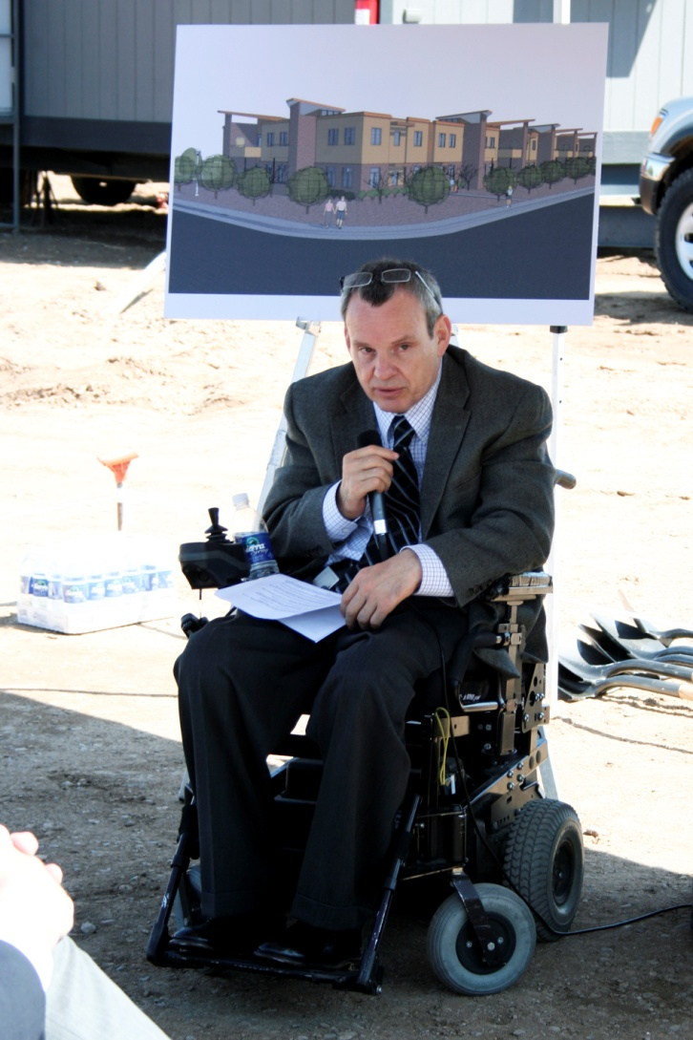
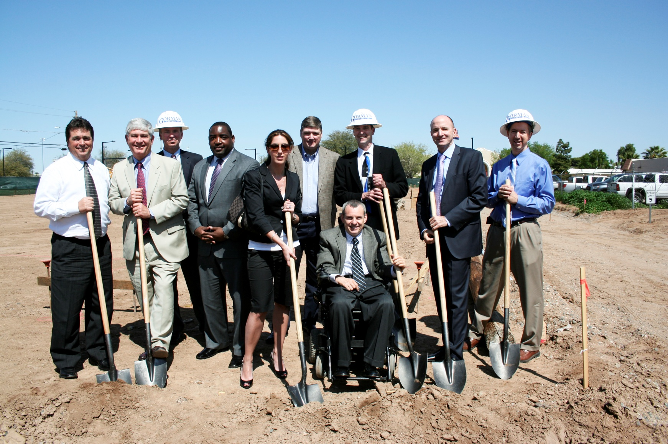
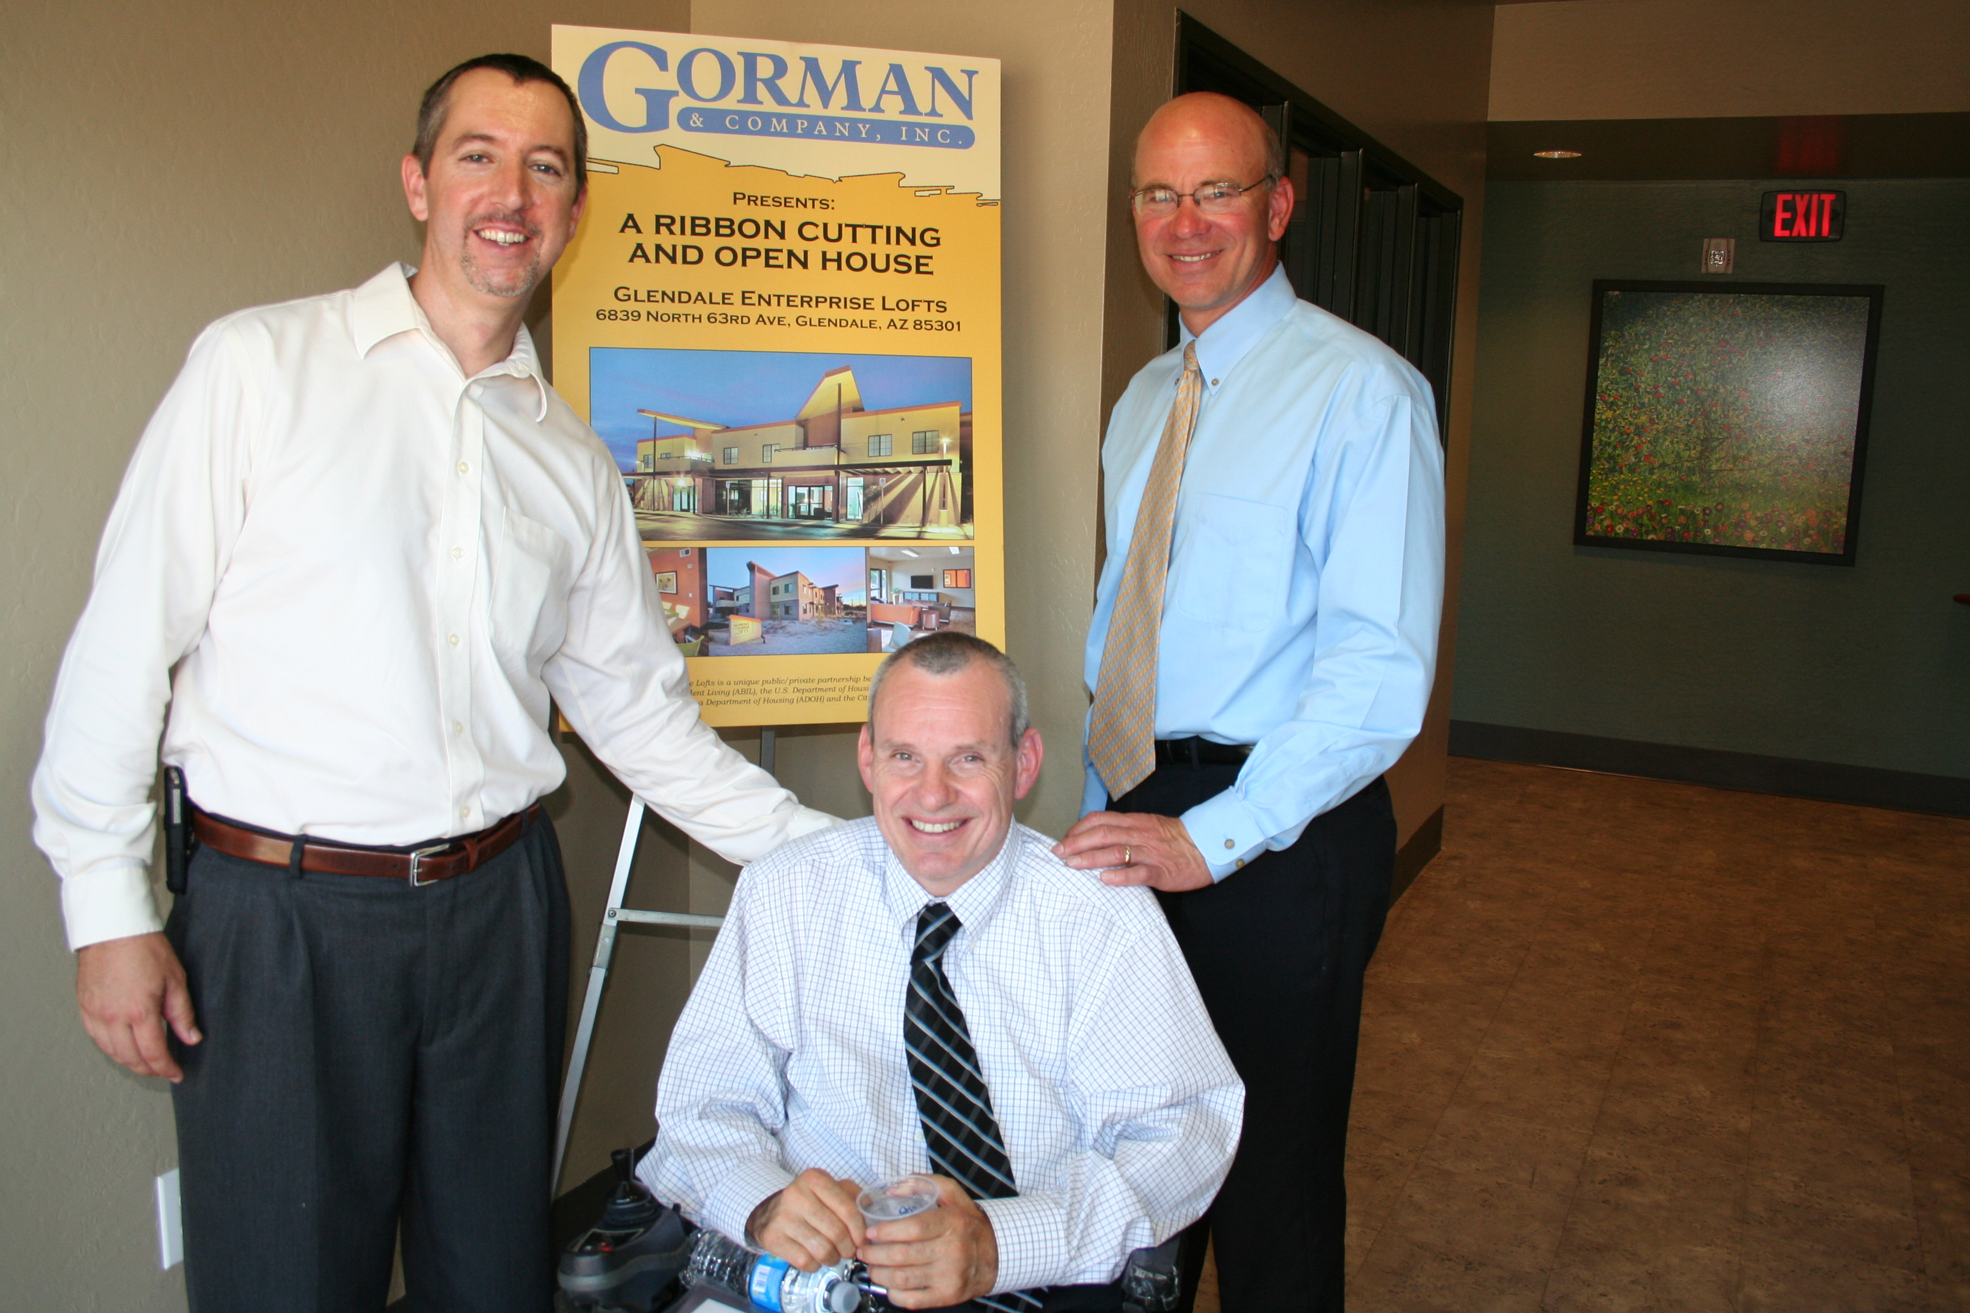
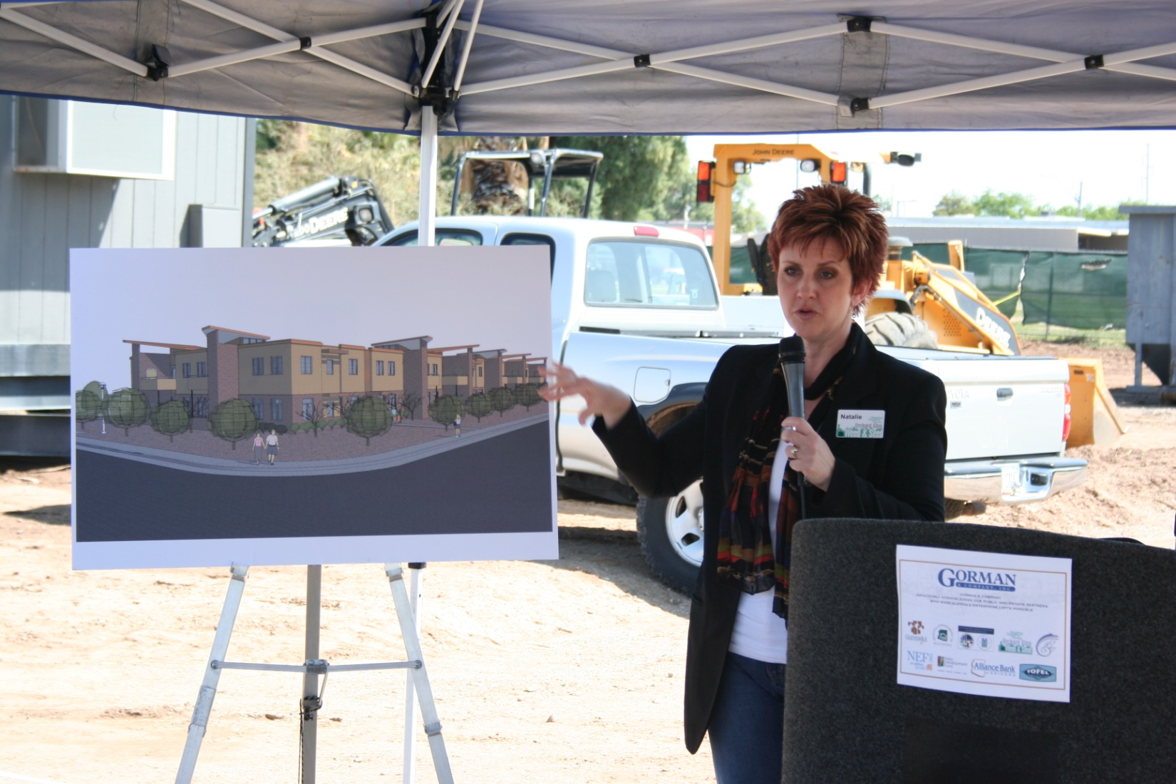
How it all started. Circa 2008:

Slide 12
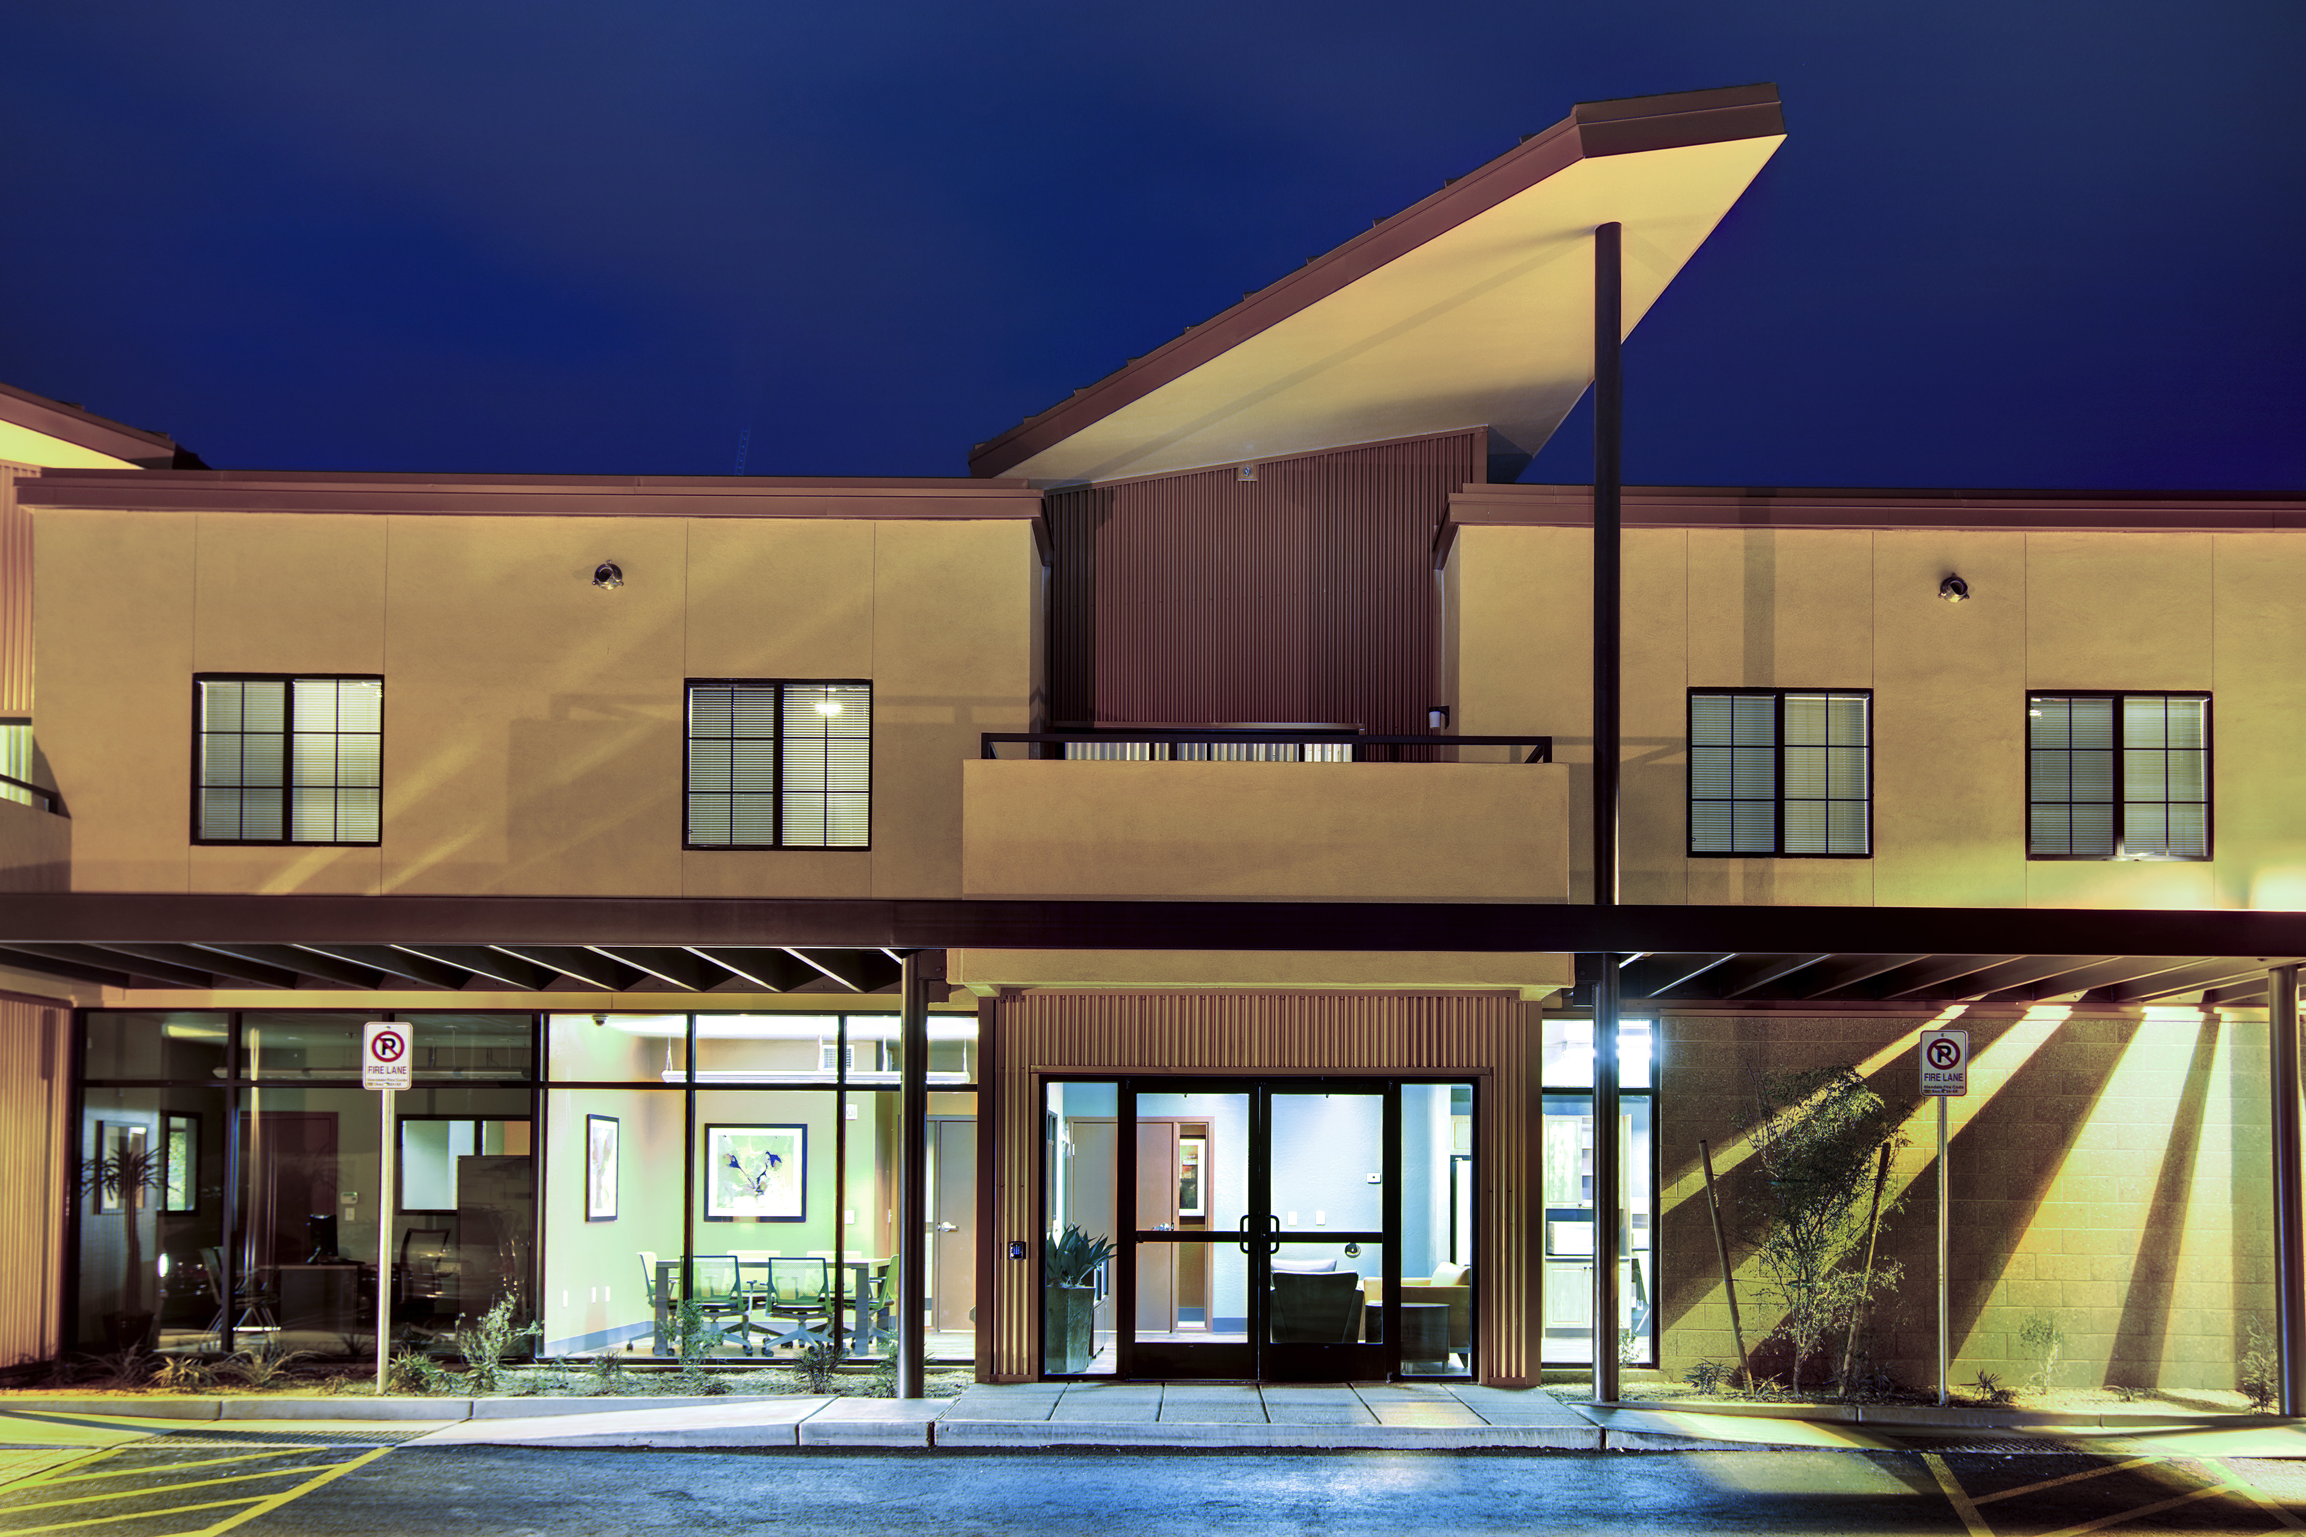

Slide 13
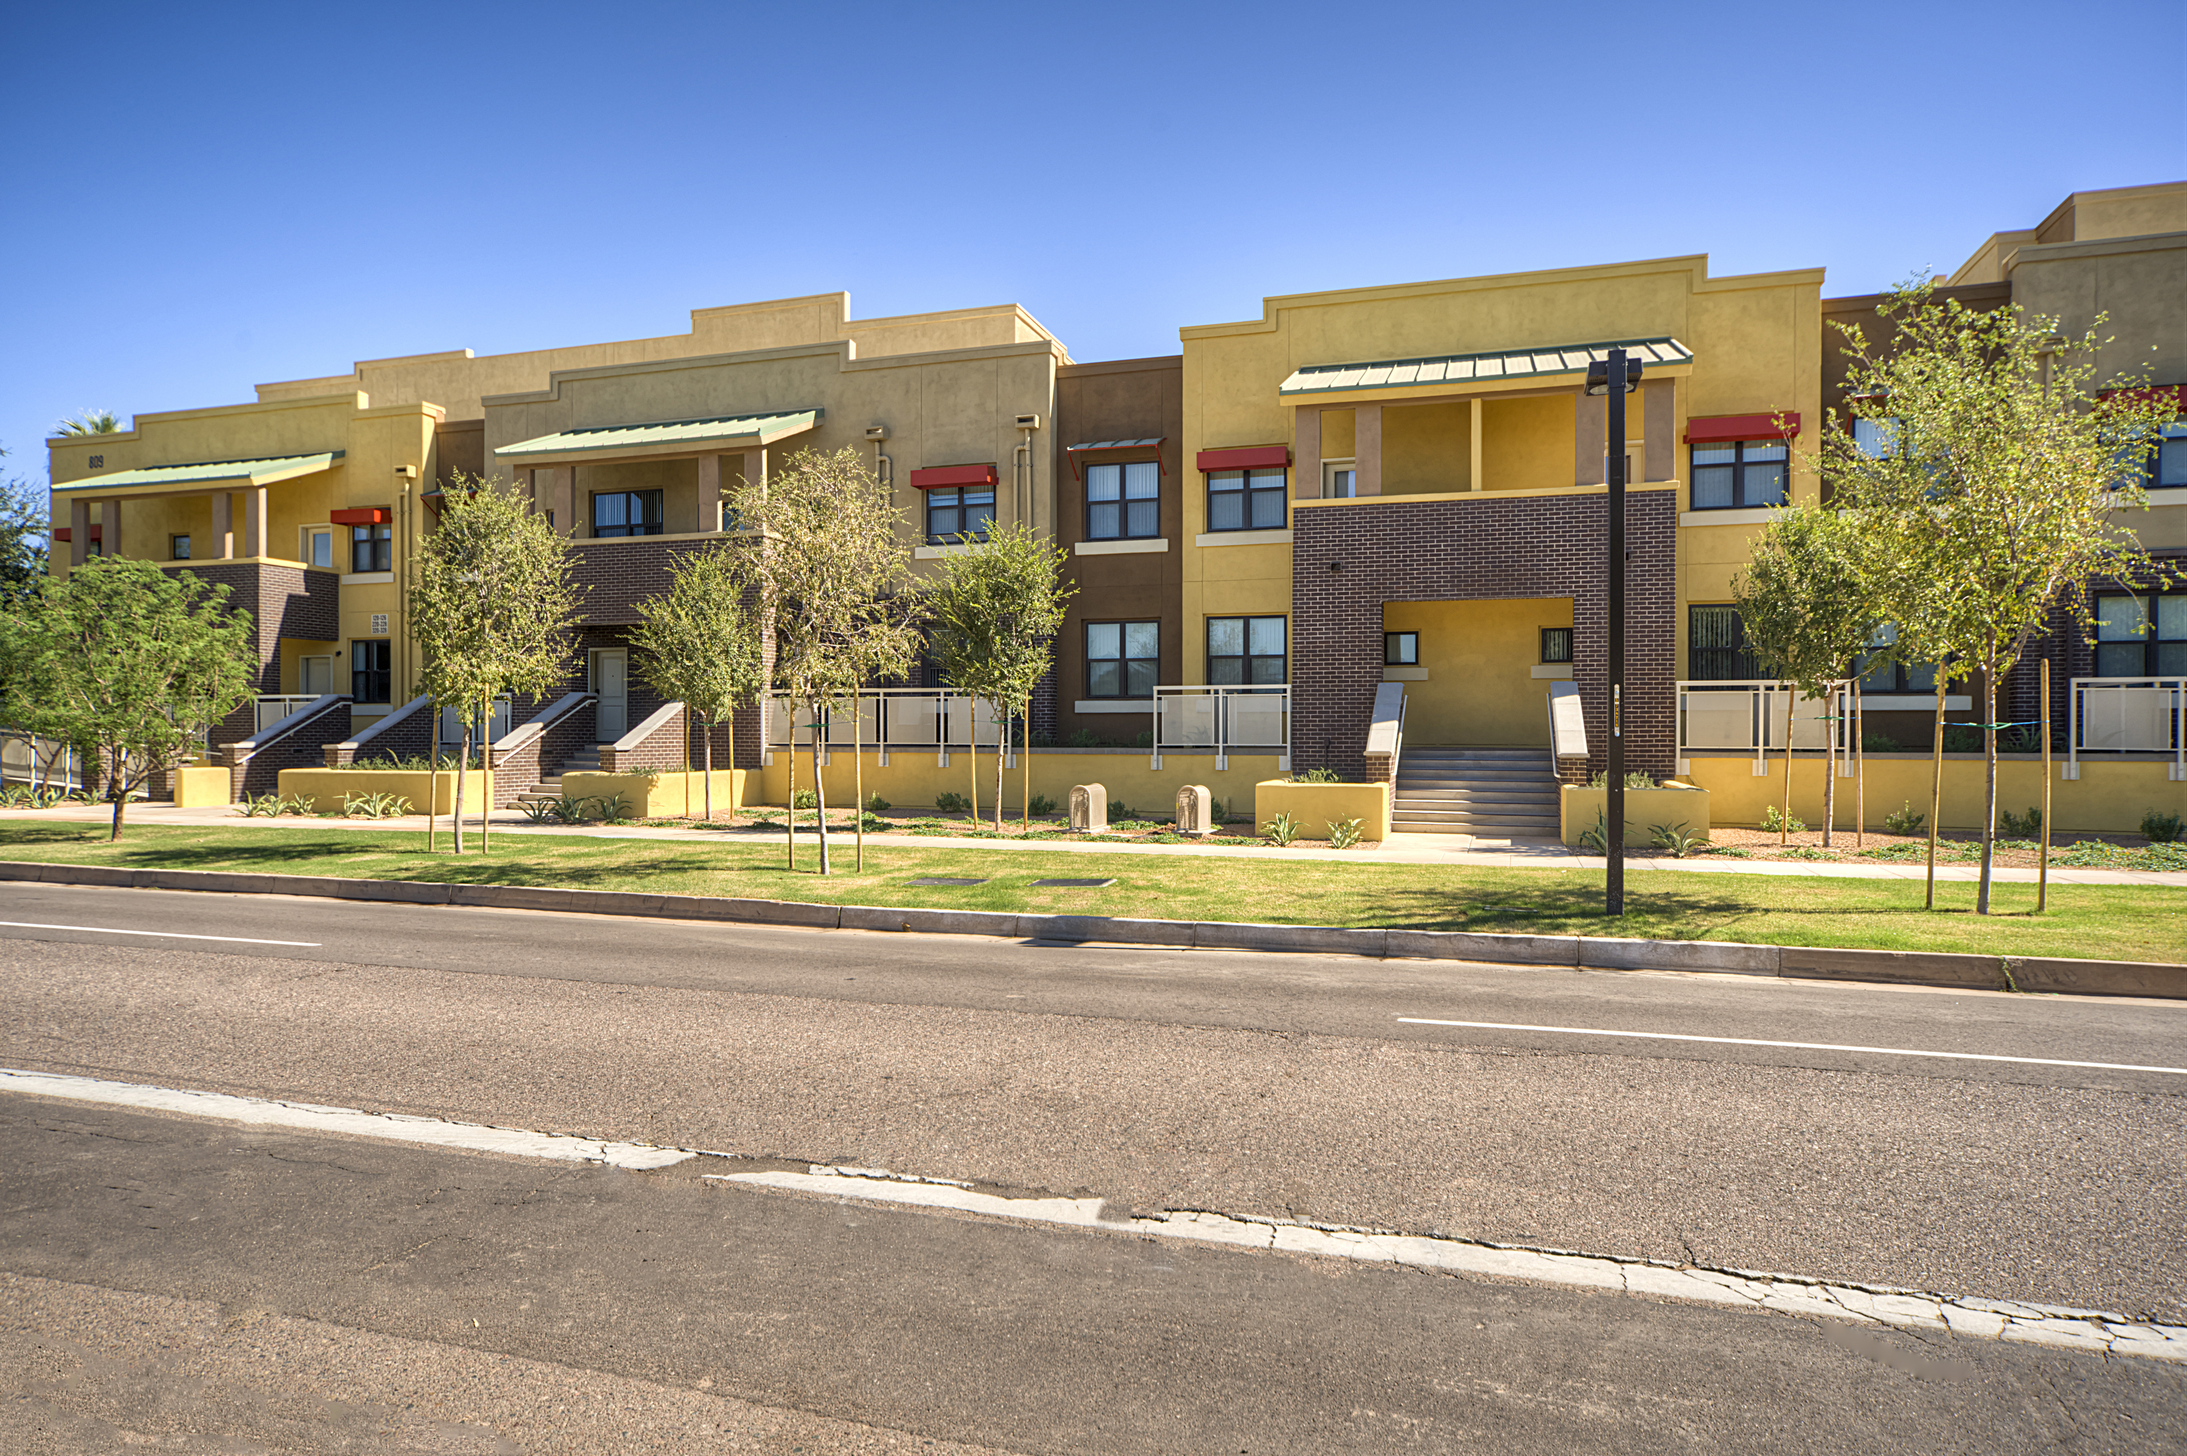
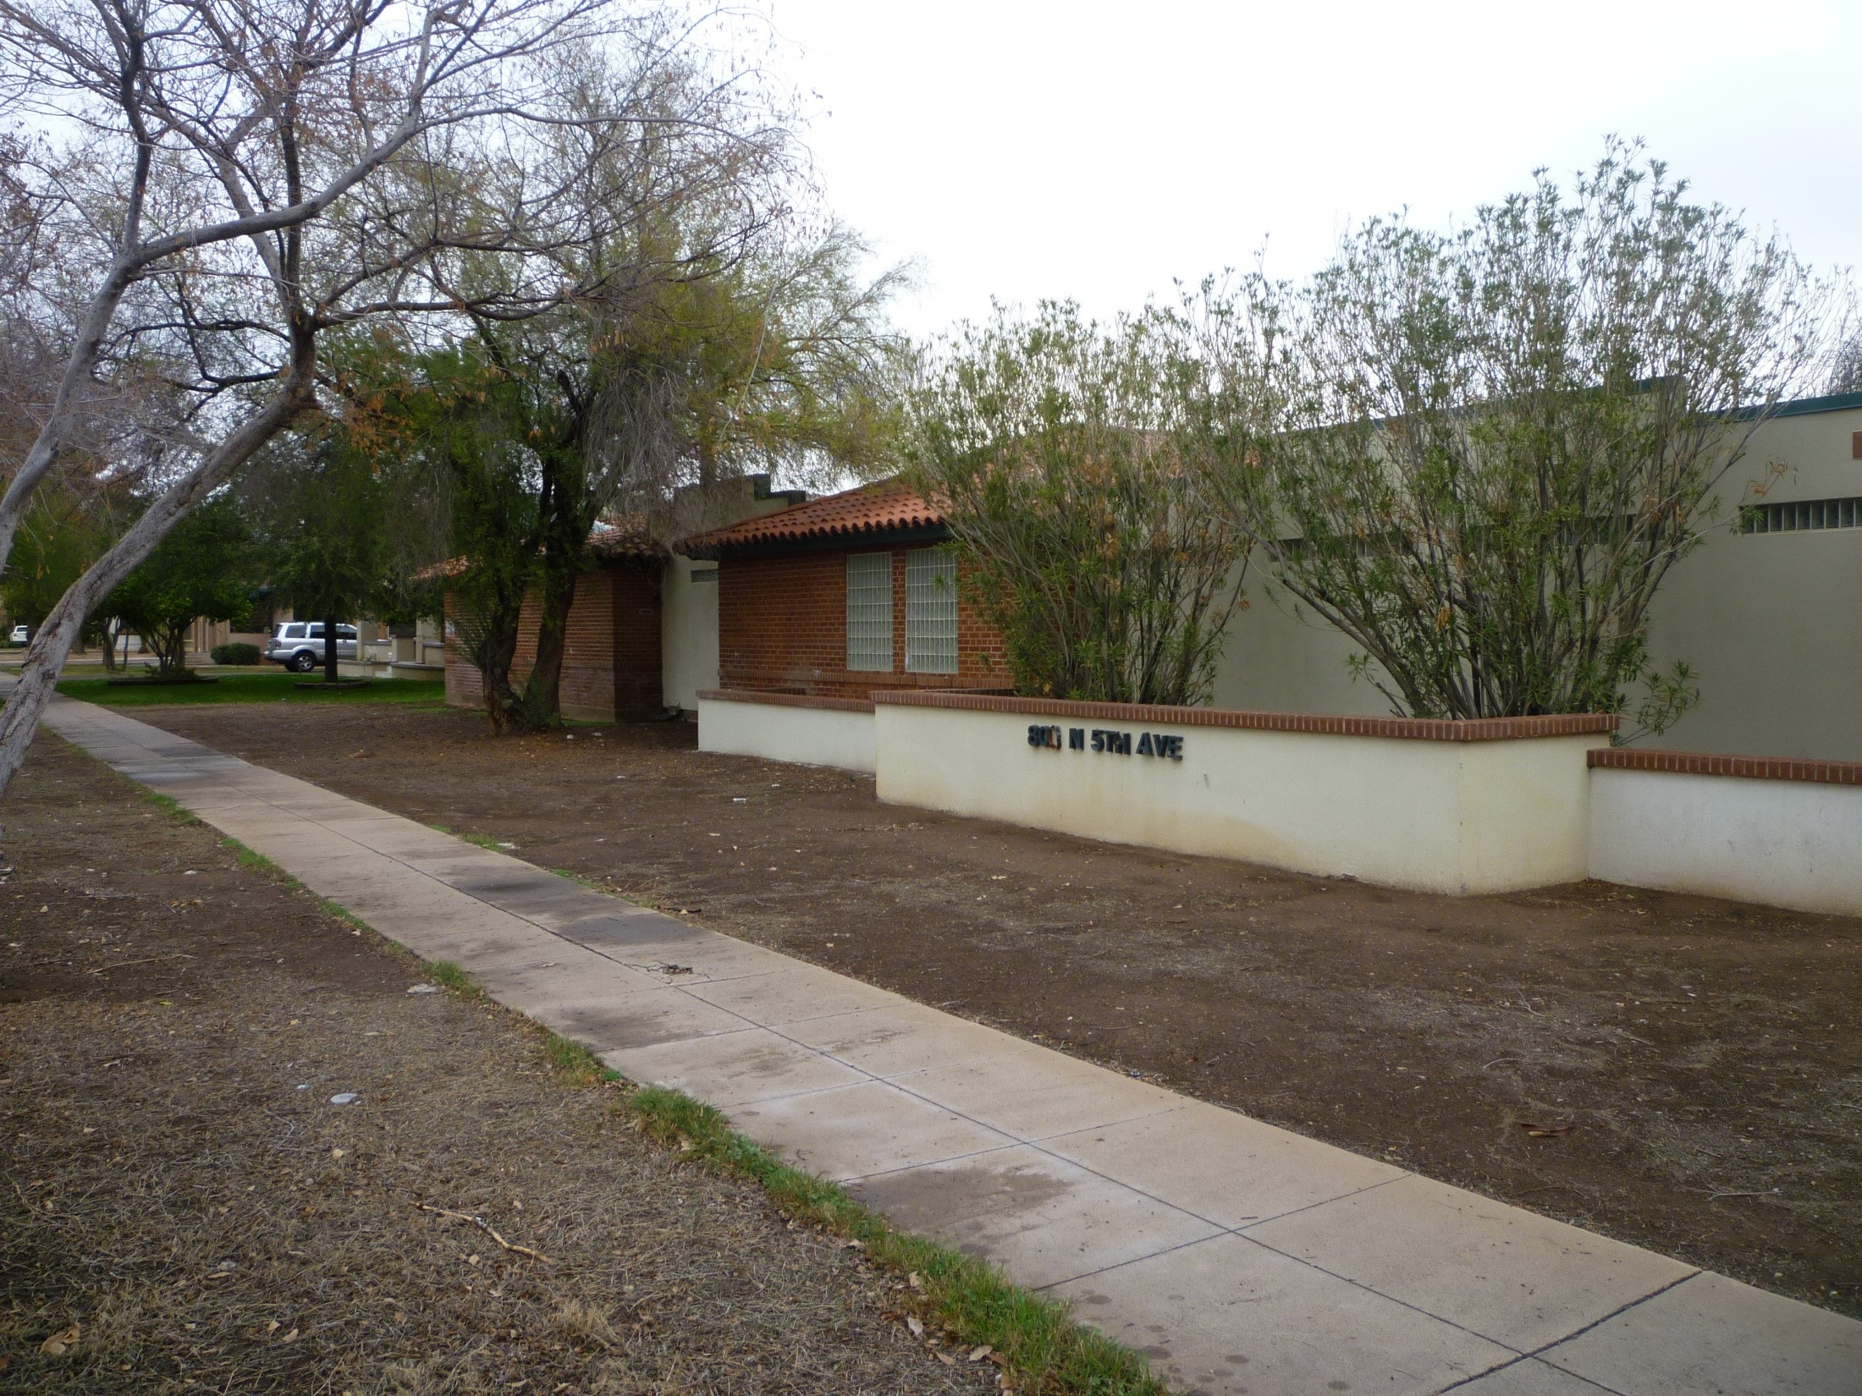
BEFORE
AFTER

Slide 14
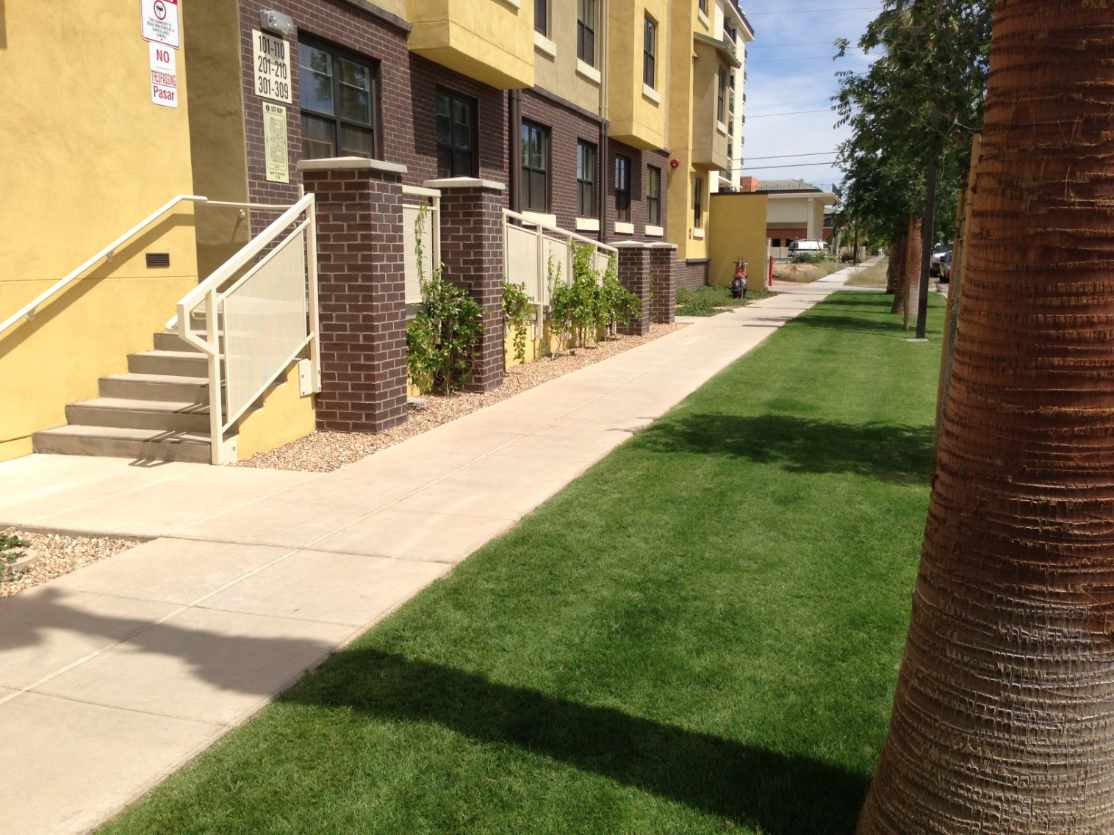

Slide 15
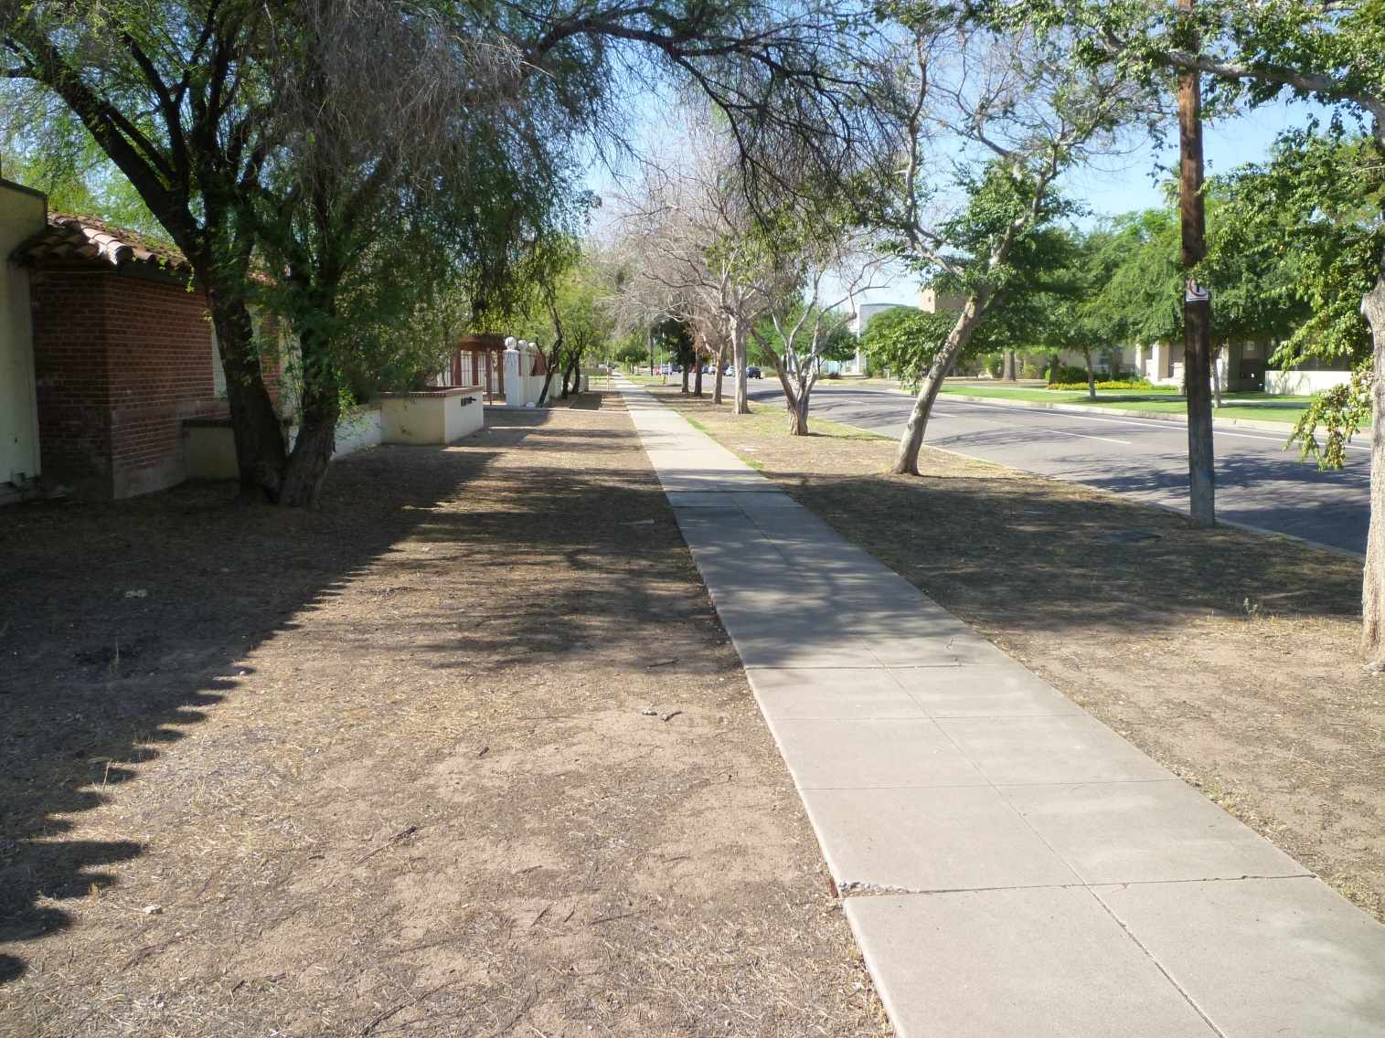
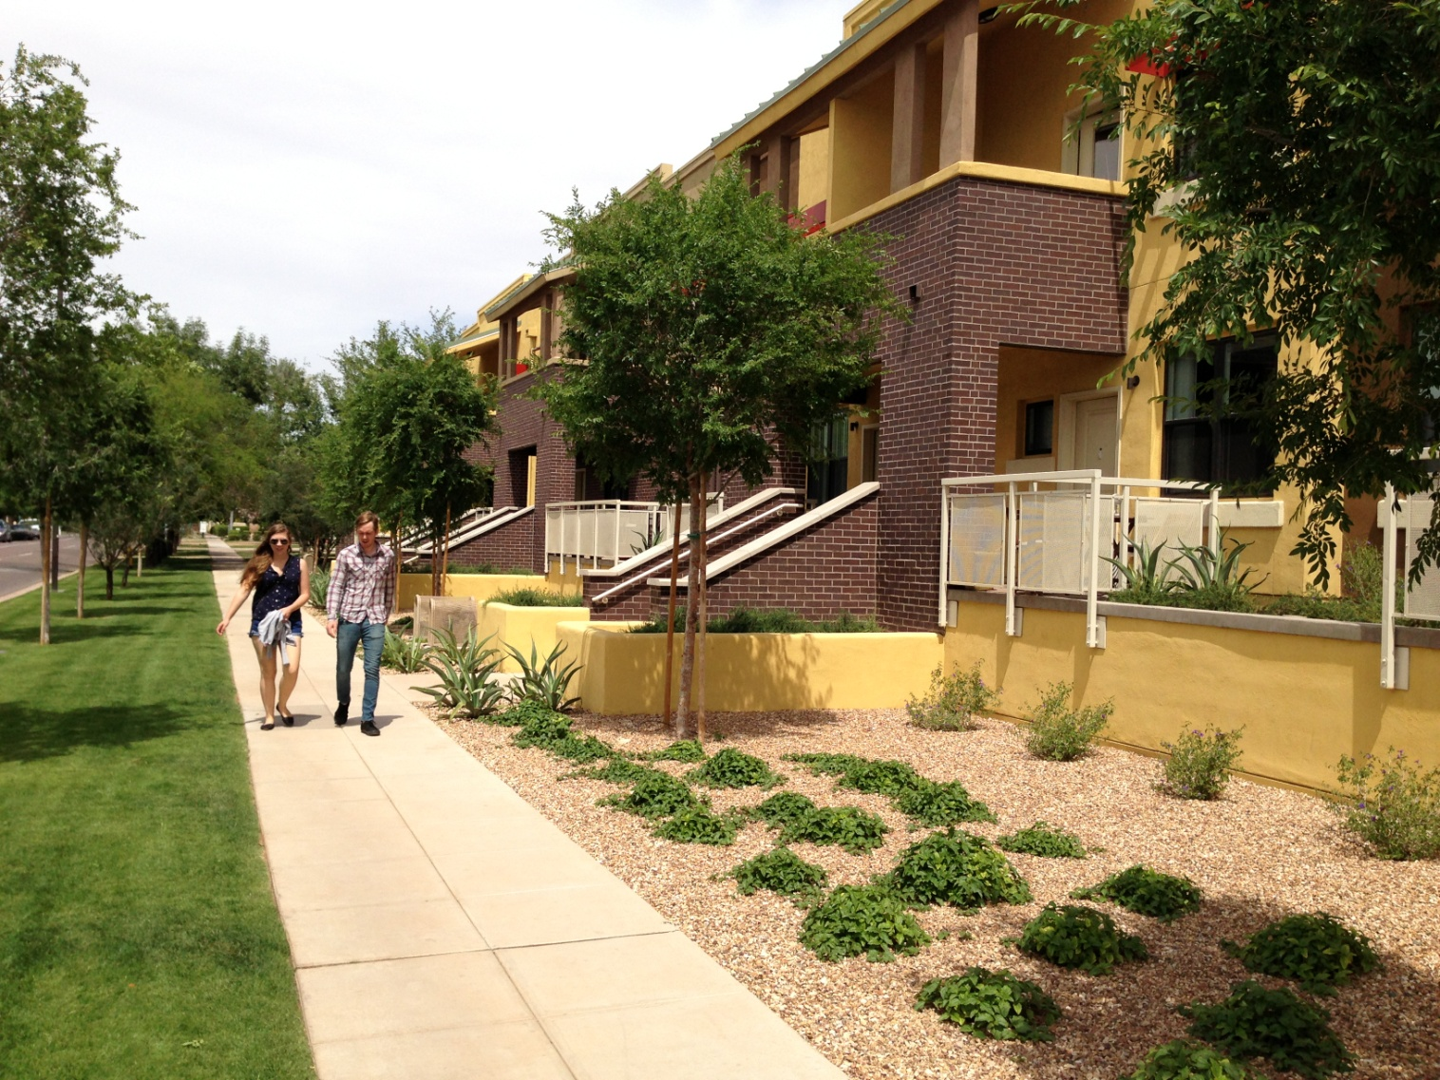
BEFORE
AFTER

Slide 16
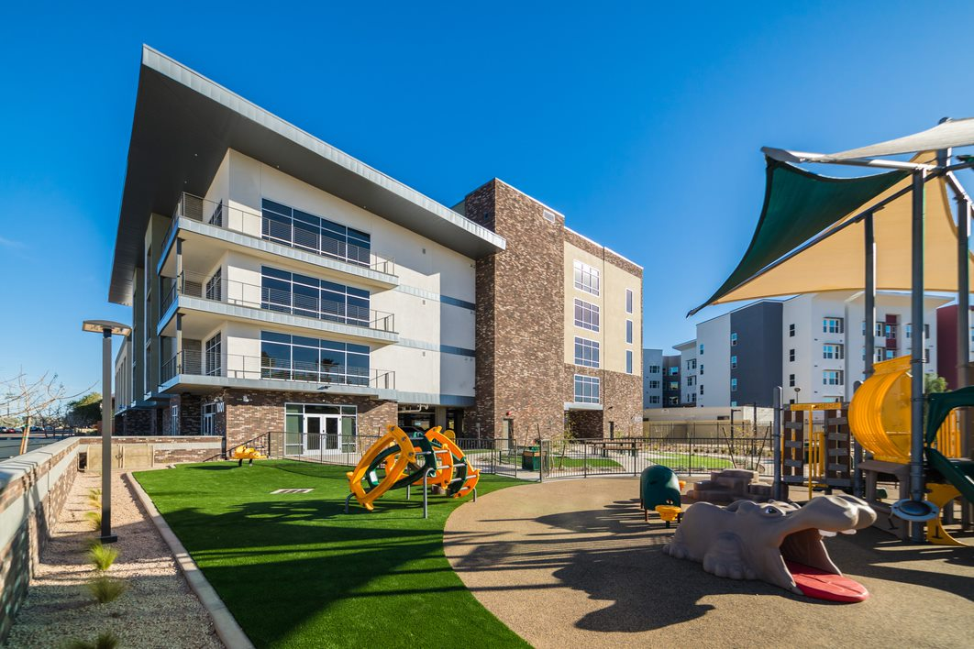
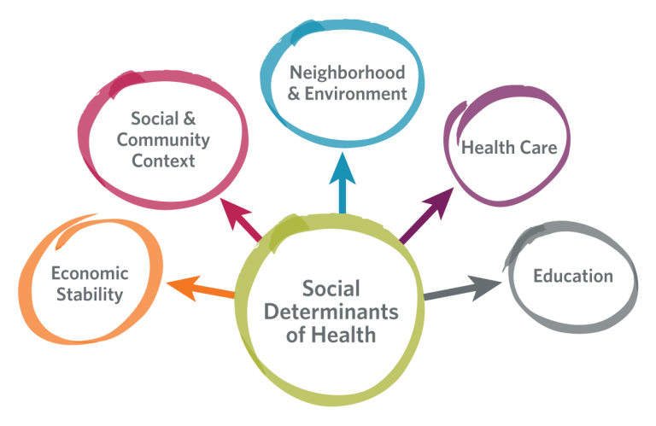
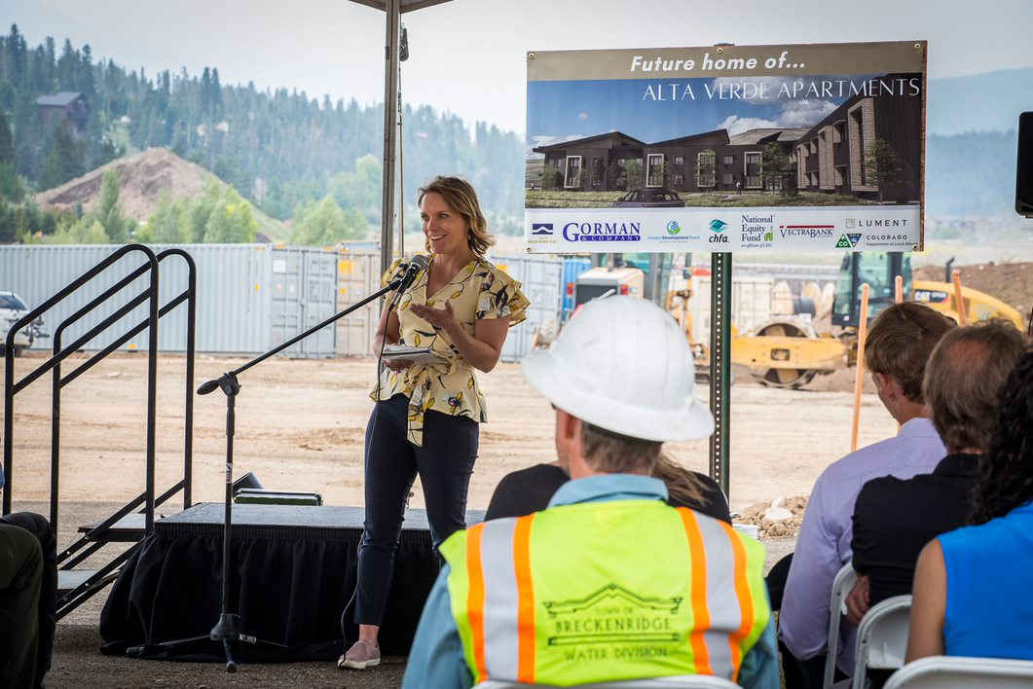
Why is Accessibility Important to Developers?

Slide 17
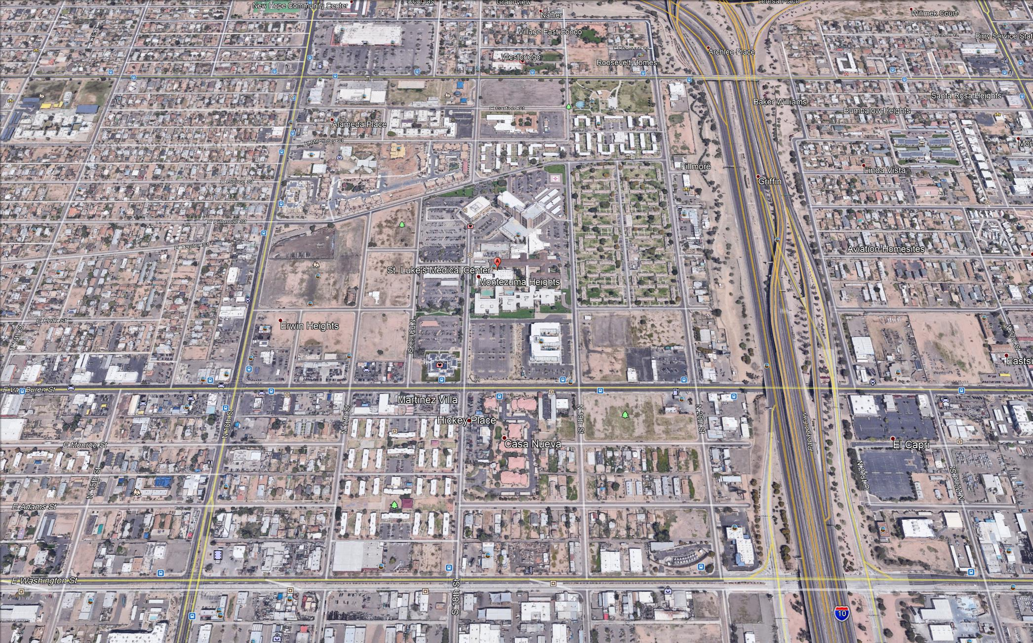




CHOICE NEIGHBORHOODS
Phoenix, AZ
202 Units
230 Units
145 Units

Slide 18
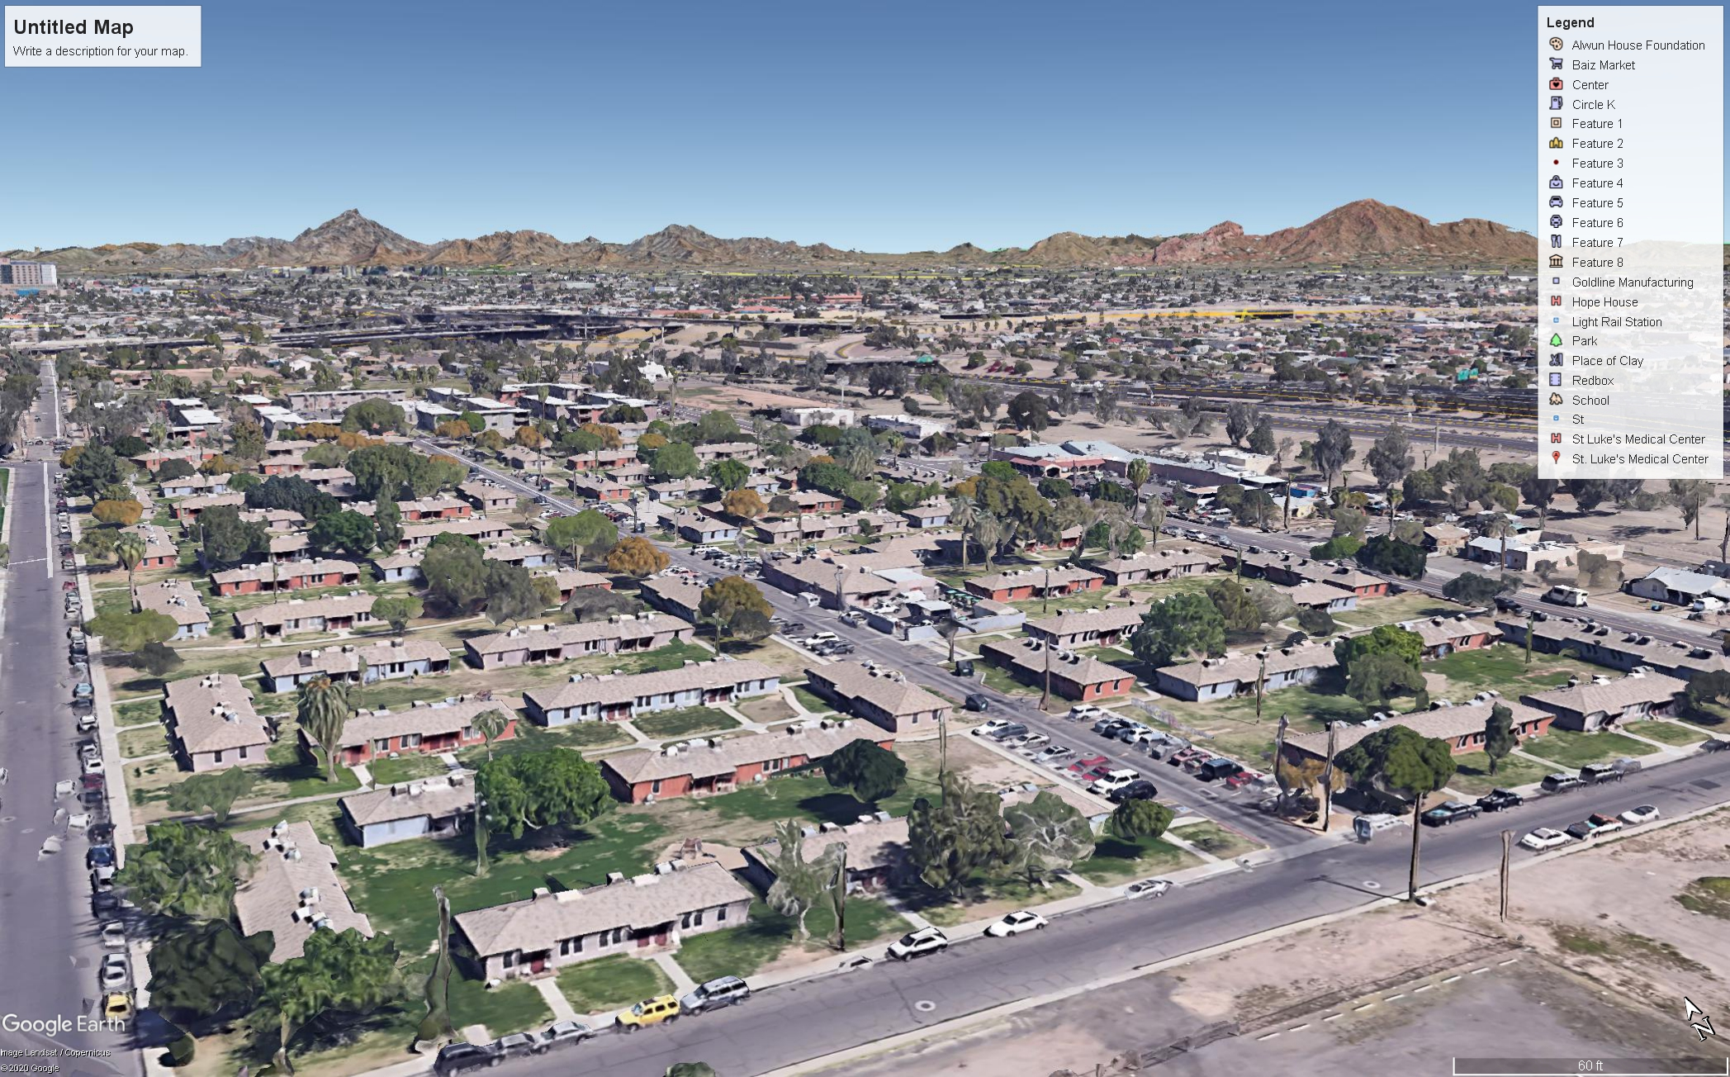

Slide 19
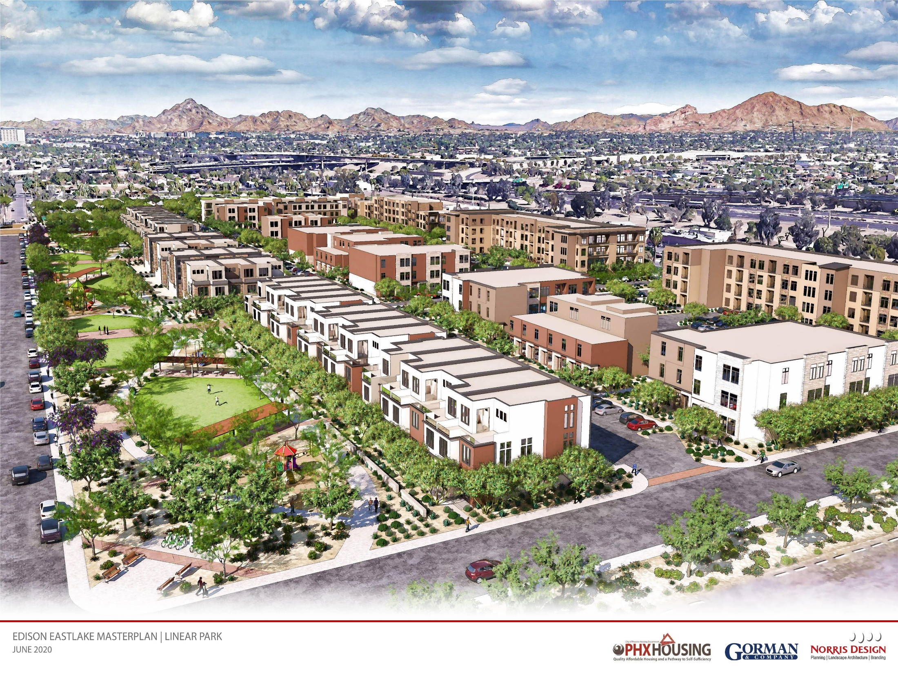


Slide 20
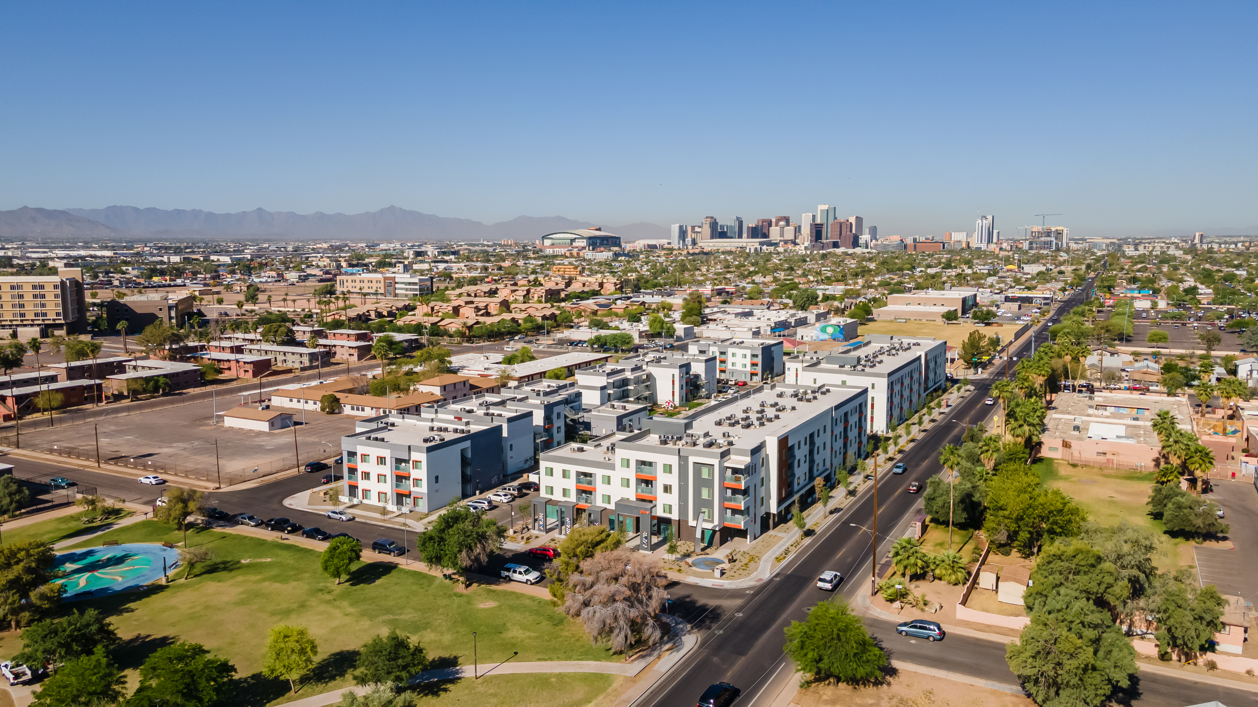

Slide 21
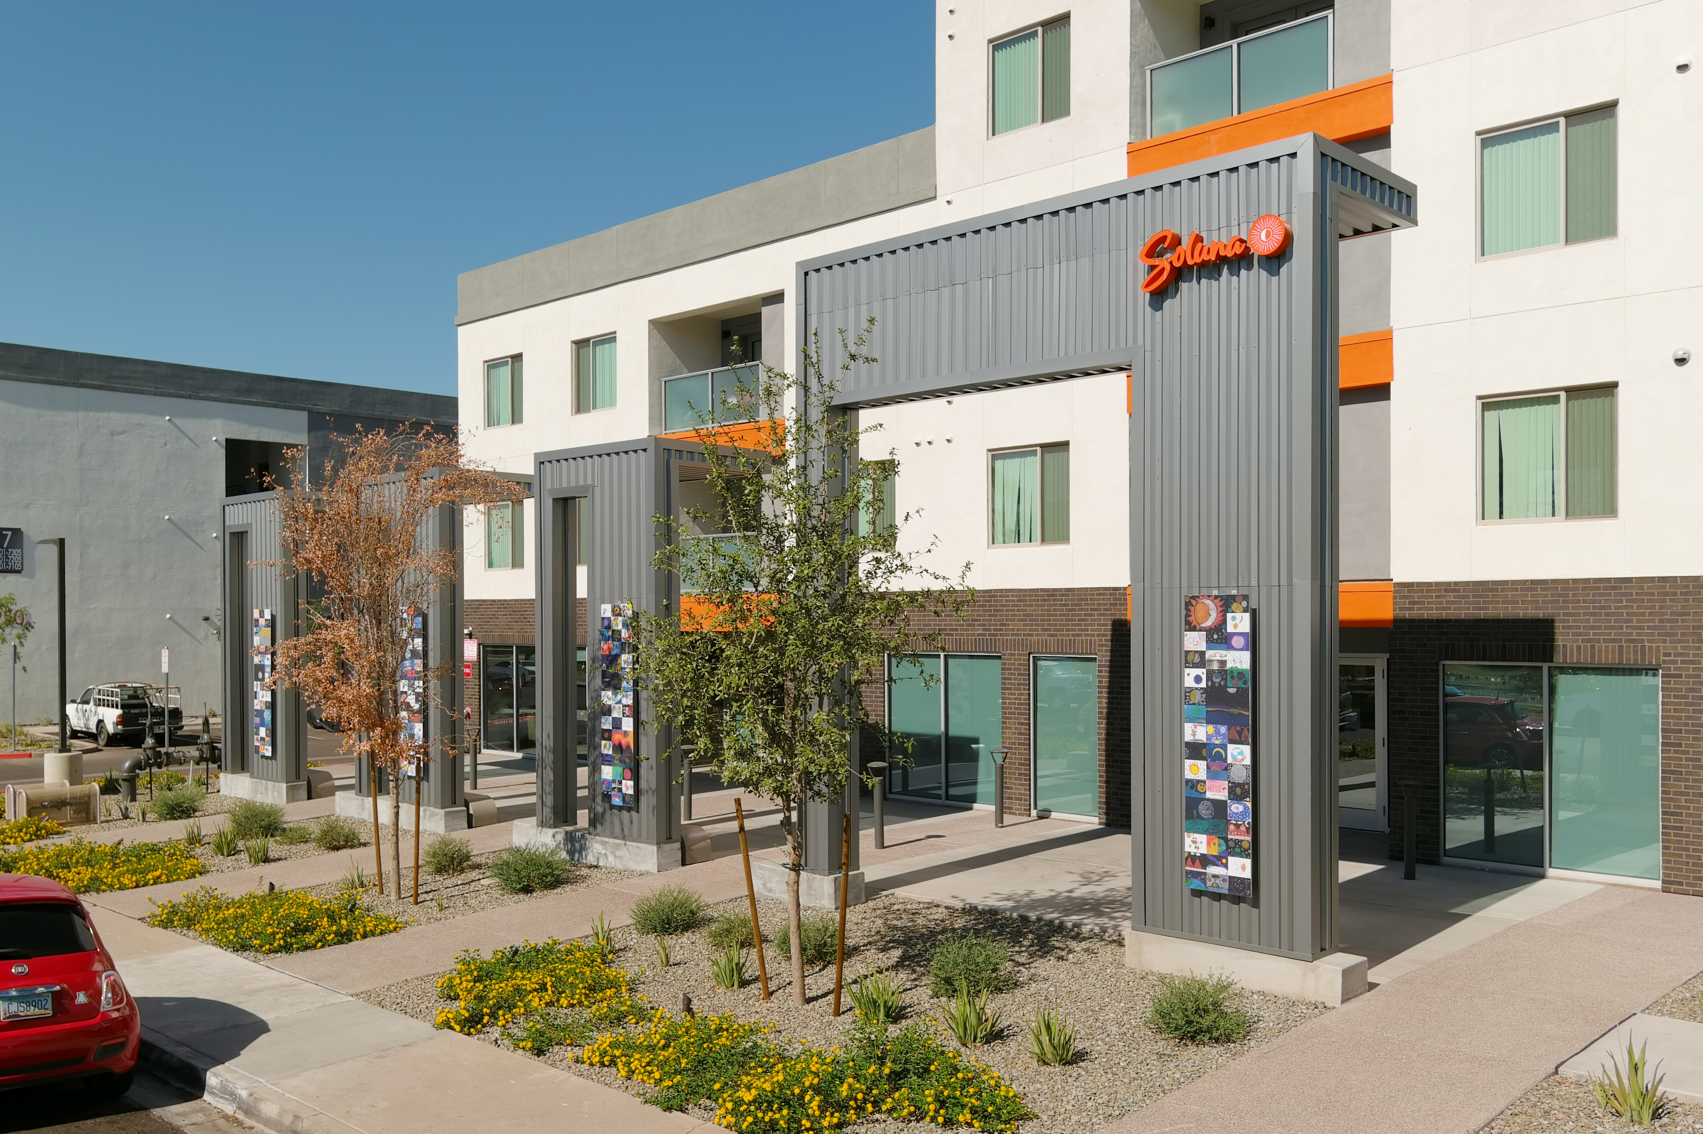

Slide 22
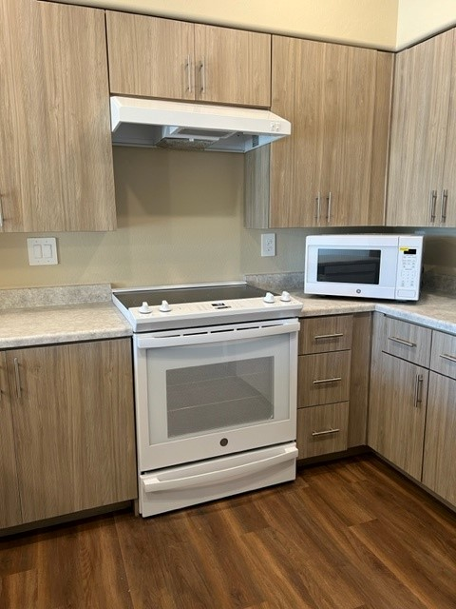
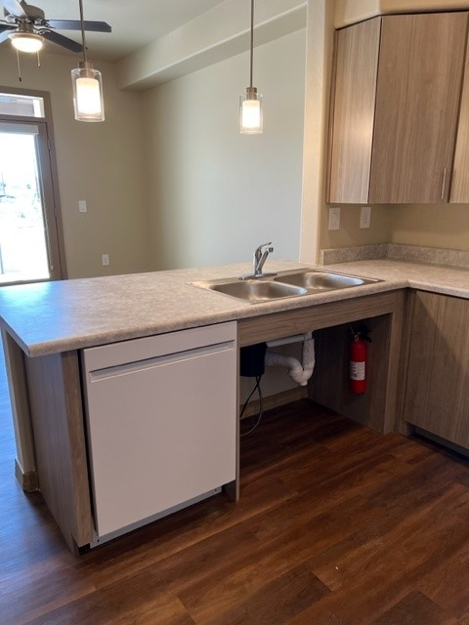

Slide 23
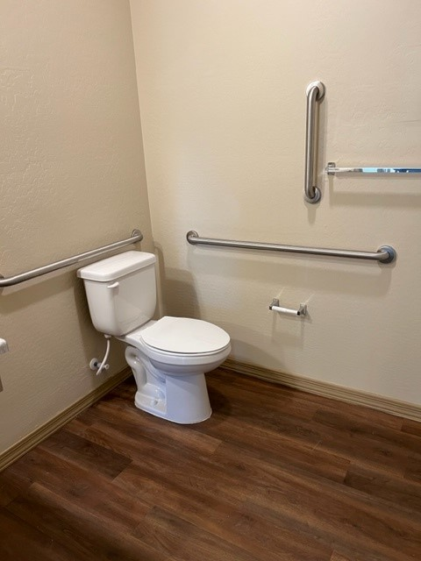
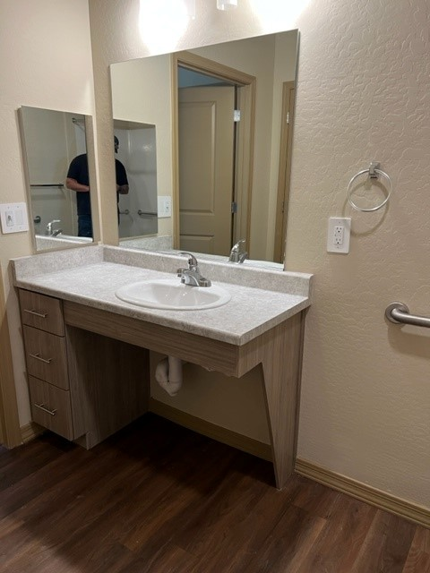
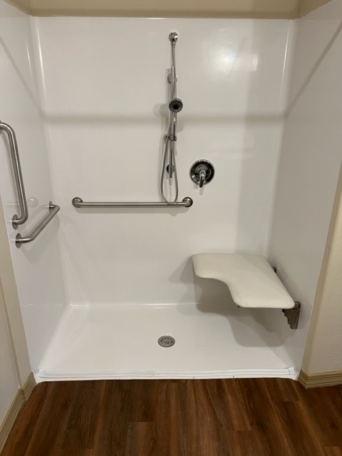

Slide 24
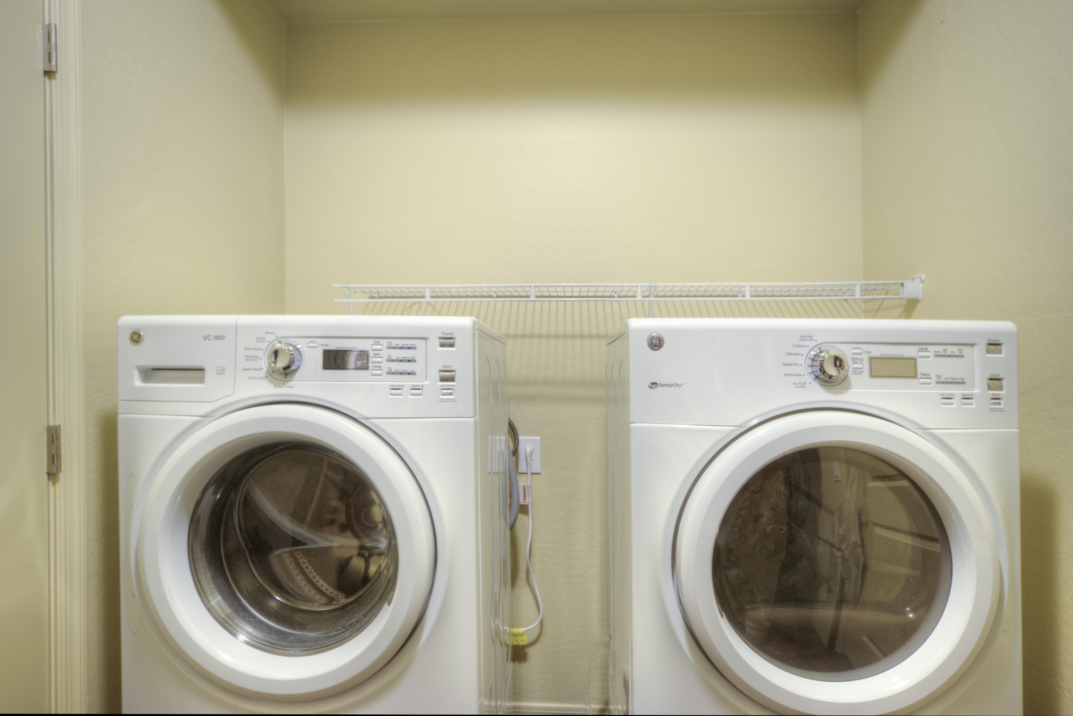

Slide 25
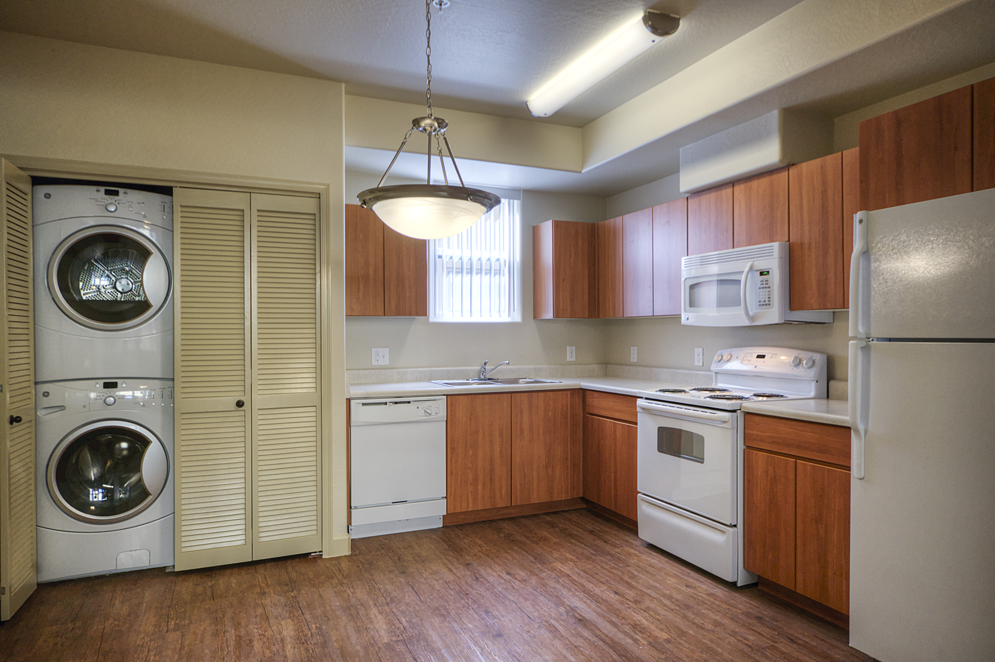

Slide 26
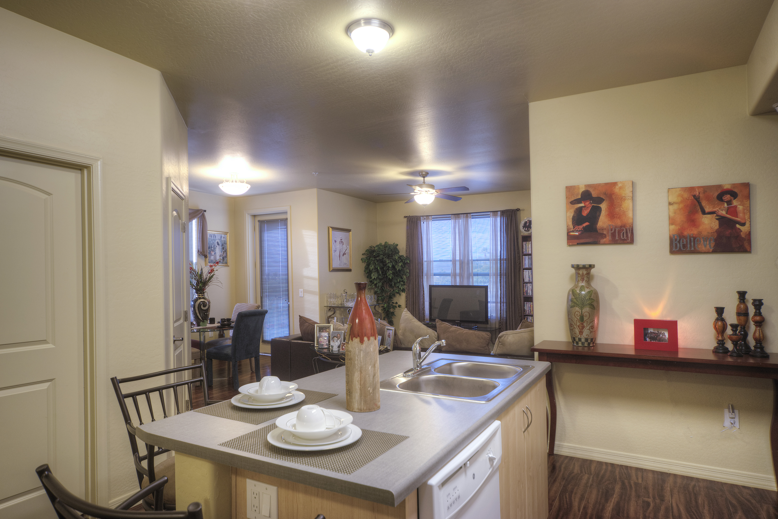

Slide 27
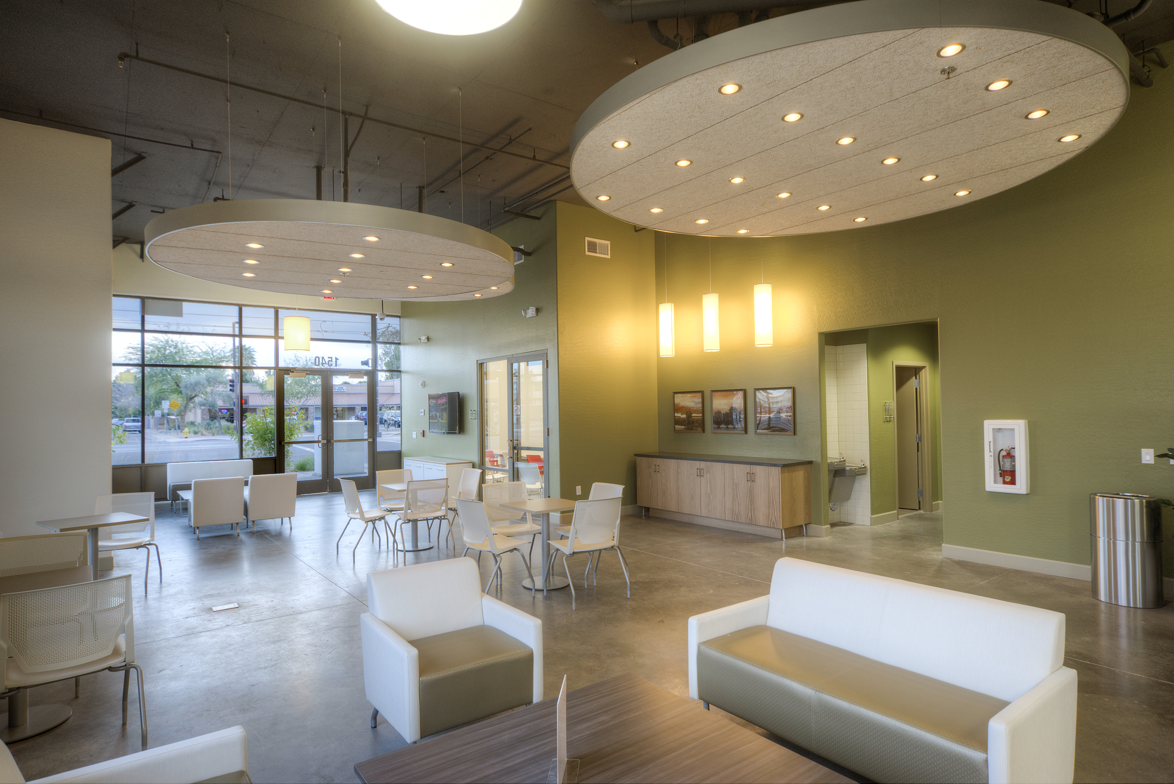

Slide 28
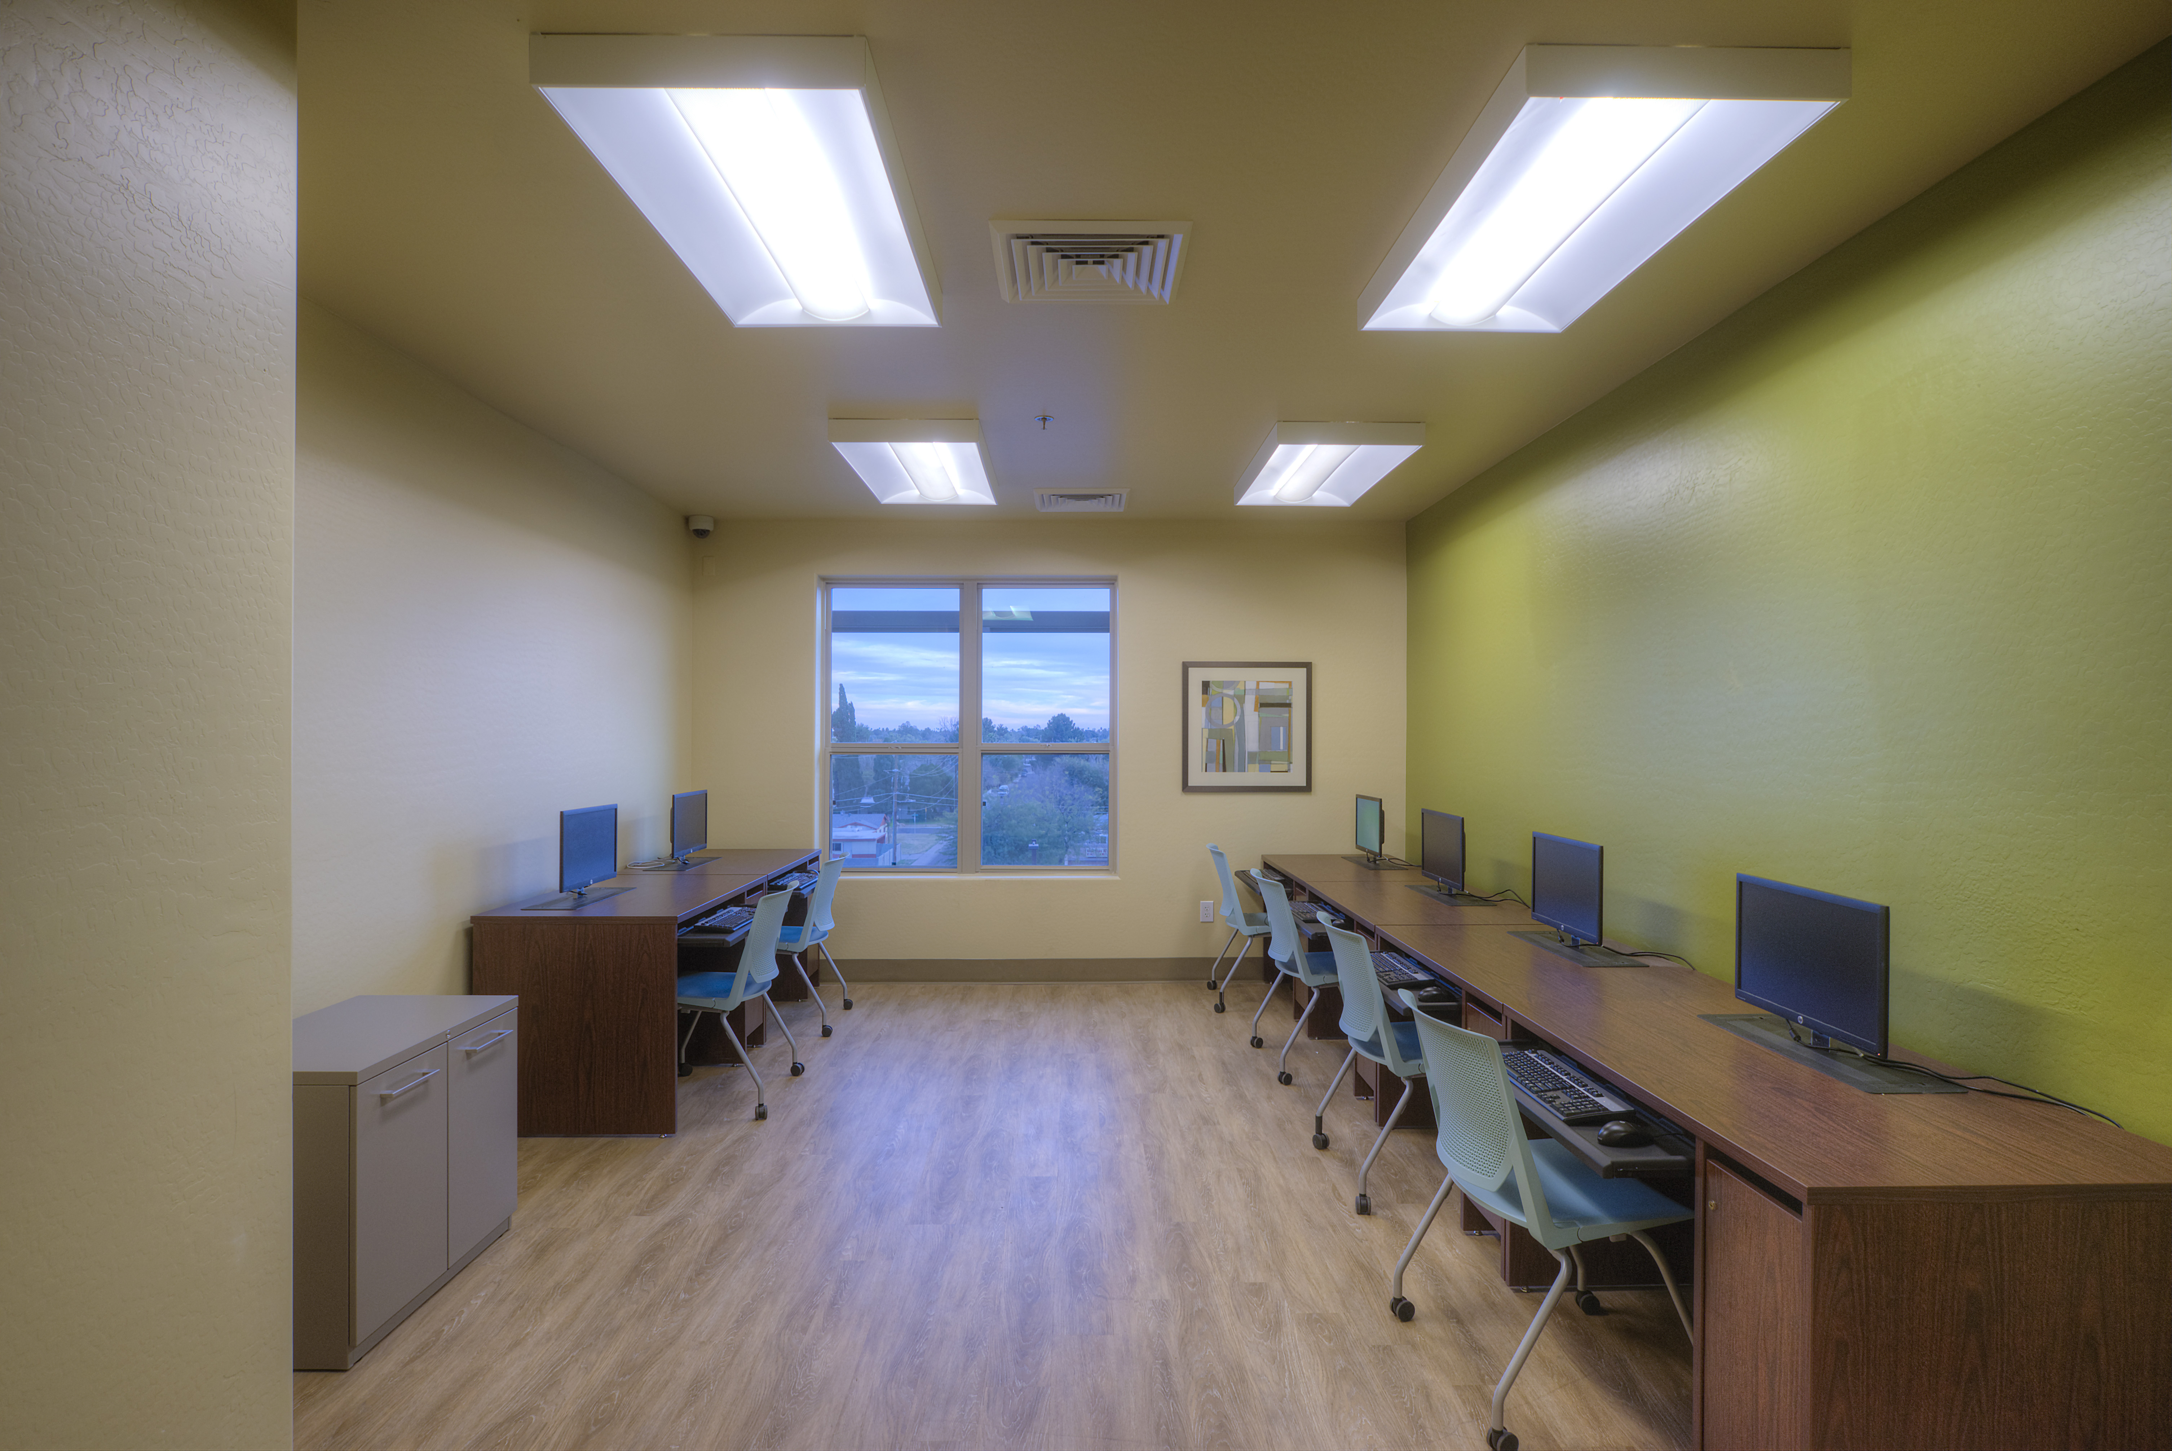

Slide 29
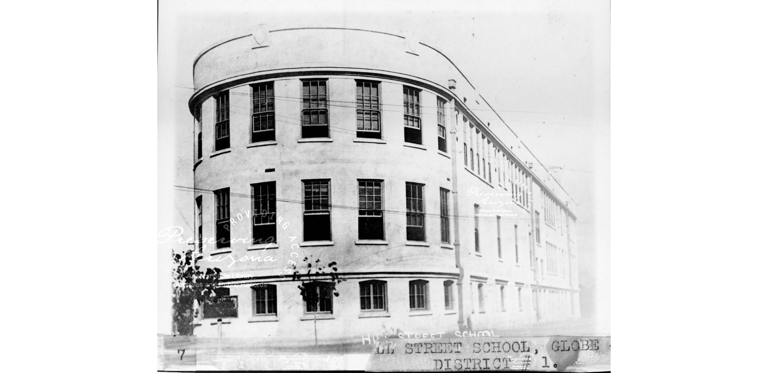
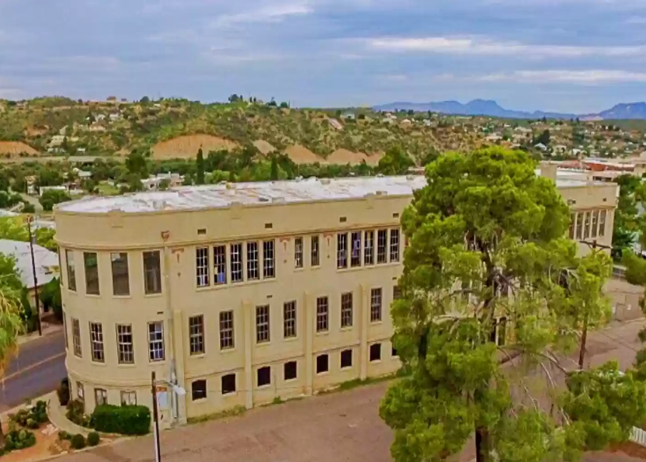
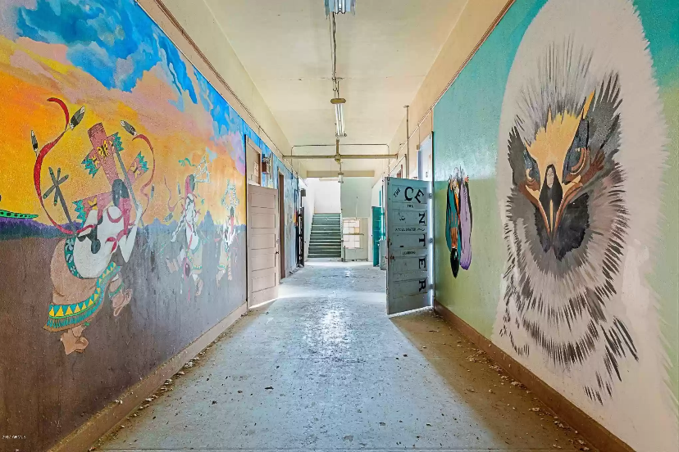
Hill Street School Senior Housing | Globe, Arizona
Notes:
Let’s shift now to Arizona.
“Globe” in Western Apache means “Place of Metal”
64 units of senior housing (80% of units at 55+). 8 market rate units. 26 units in the school. .7 acres. 91 units to the acre! In a DDA. 30% basis boost.
450 S. Hill Street in Globe (intersection of Hill Street & Ash (US 60). Gila County
Built in 1920. Over 100 years old. Closed after 85 years. Sold in 2005.
Sat vacant for 17 years.
Council re-zoned the site in 2 moths w/ unanimous approval. Also committed $400,000 in ARPA.
Downtown Historic Preservation Overlay District.
Not considering historic credits – would be small allocation of QRE’s and window cost would be astronomical.
AMI levels in Gila County are almost 30% lower than Maricopa County.

Slide 30
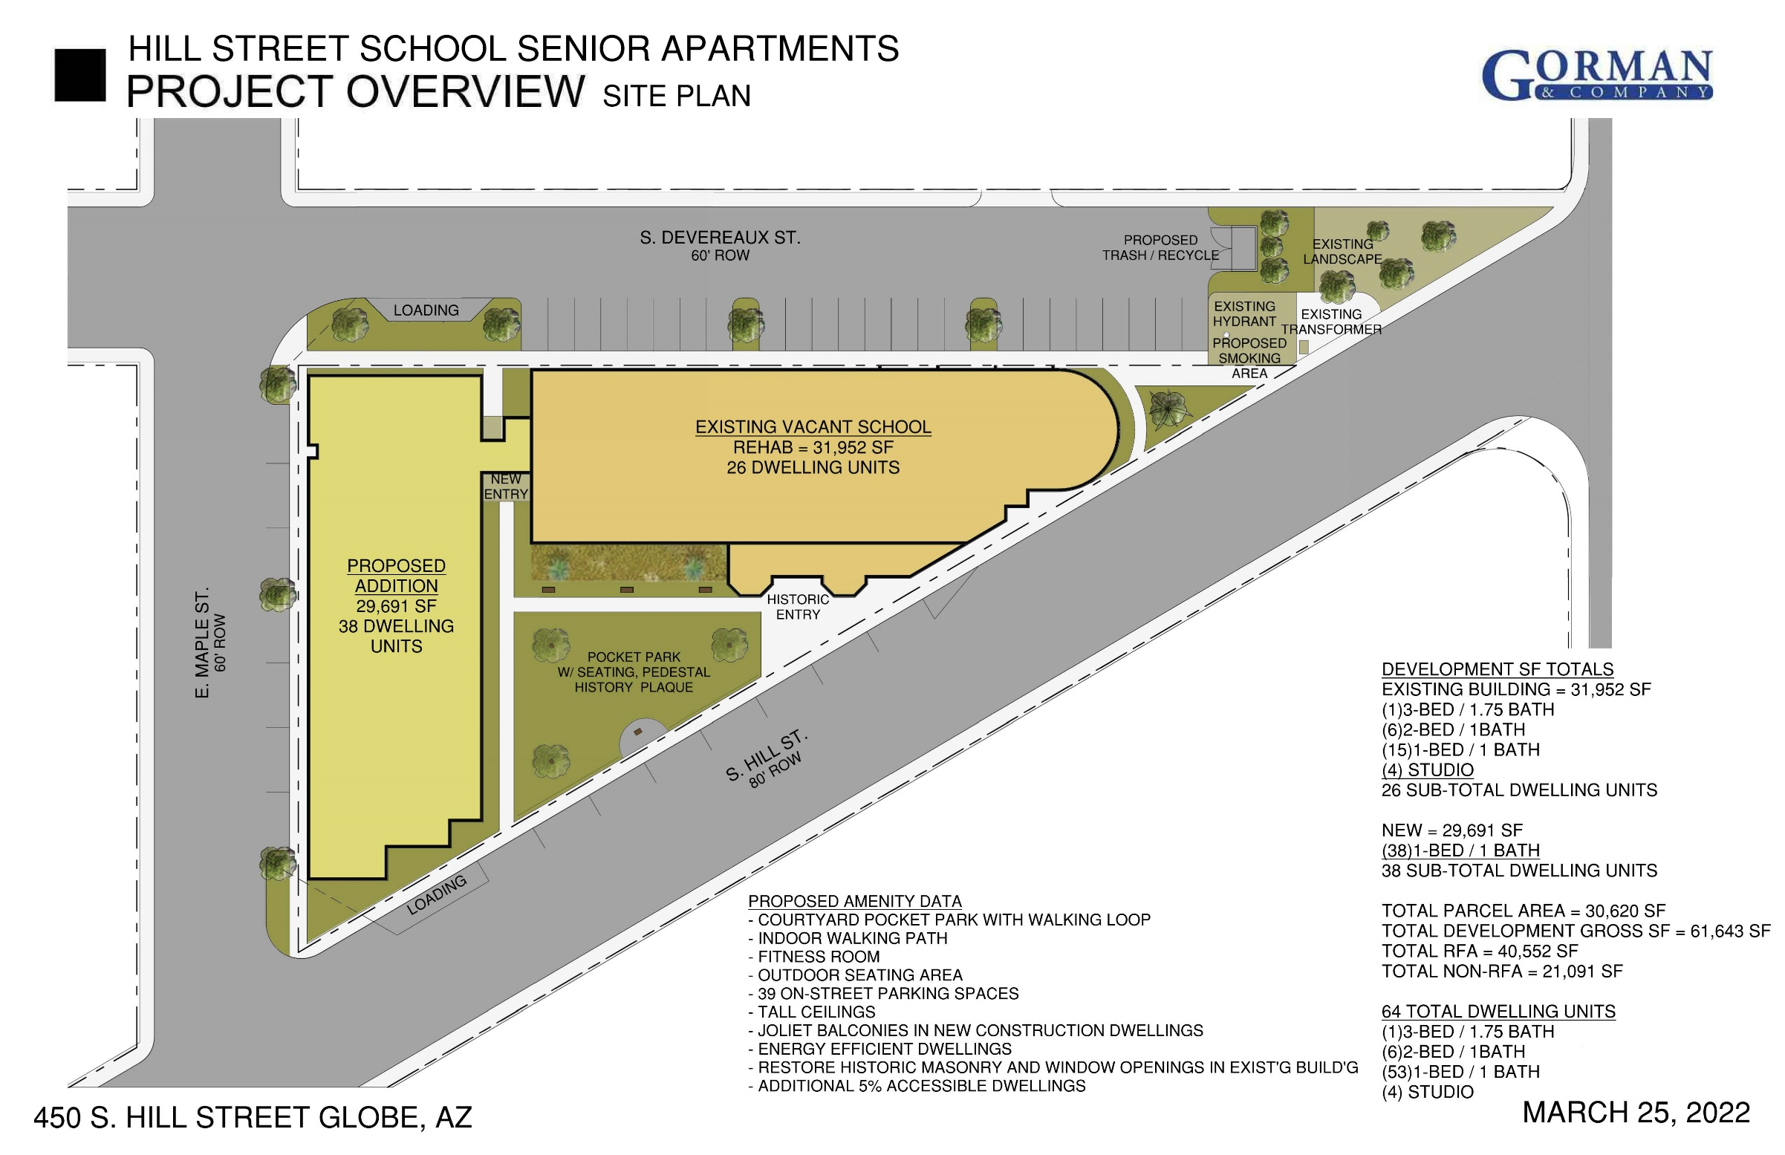

Slide 31
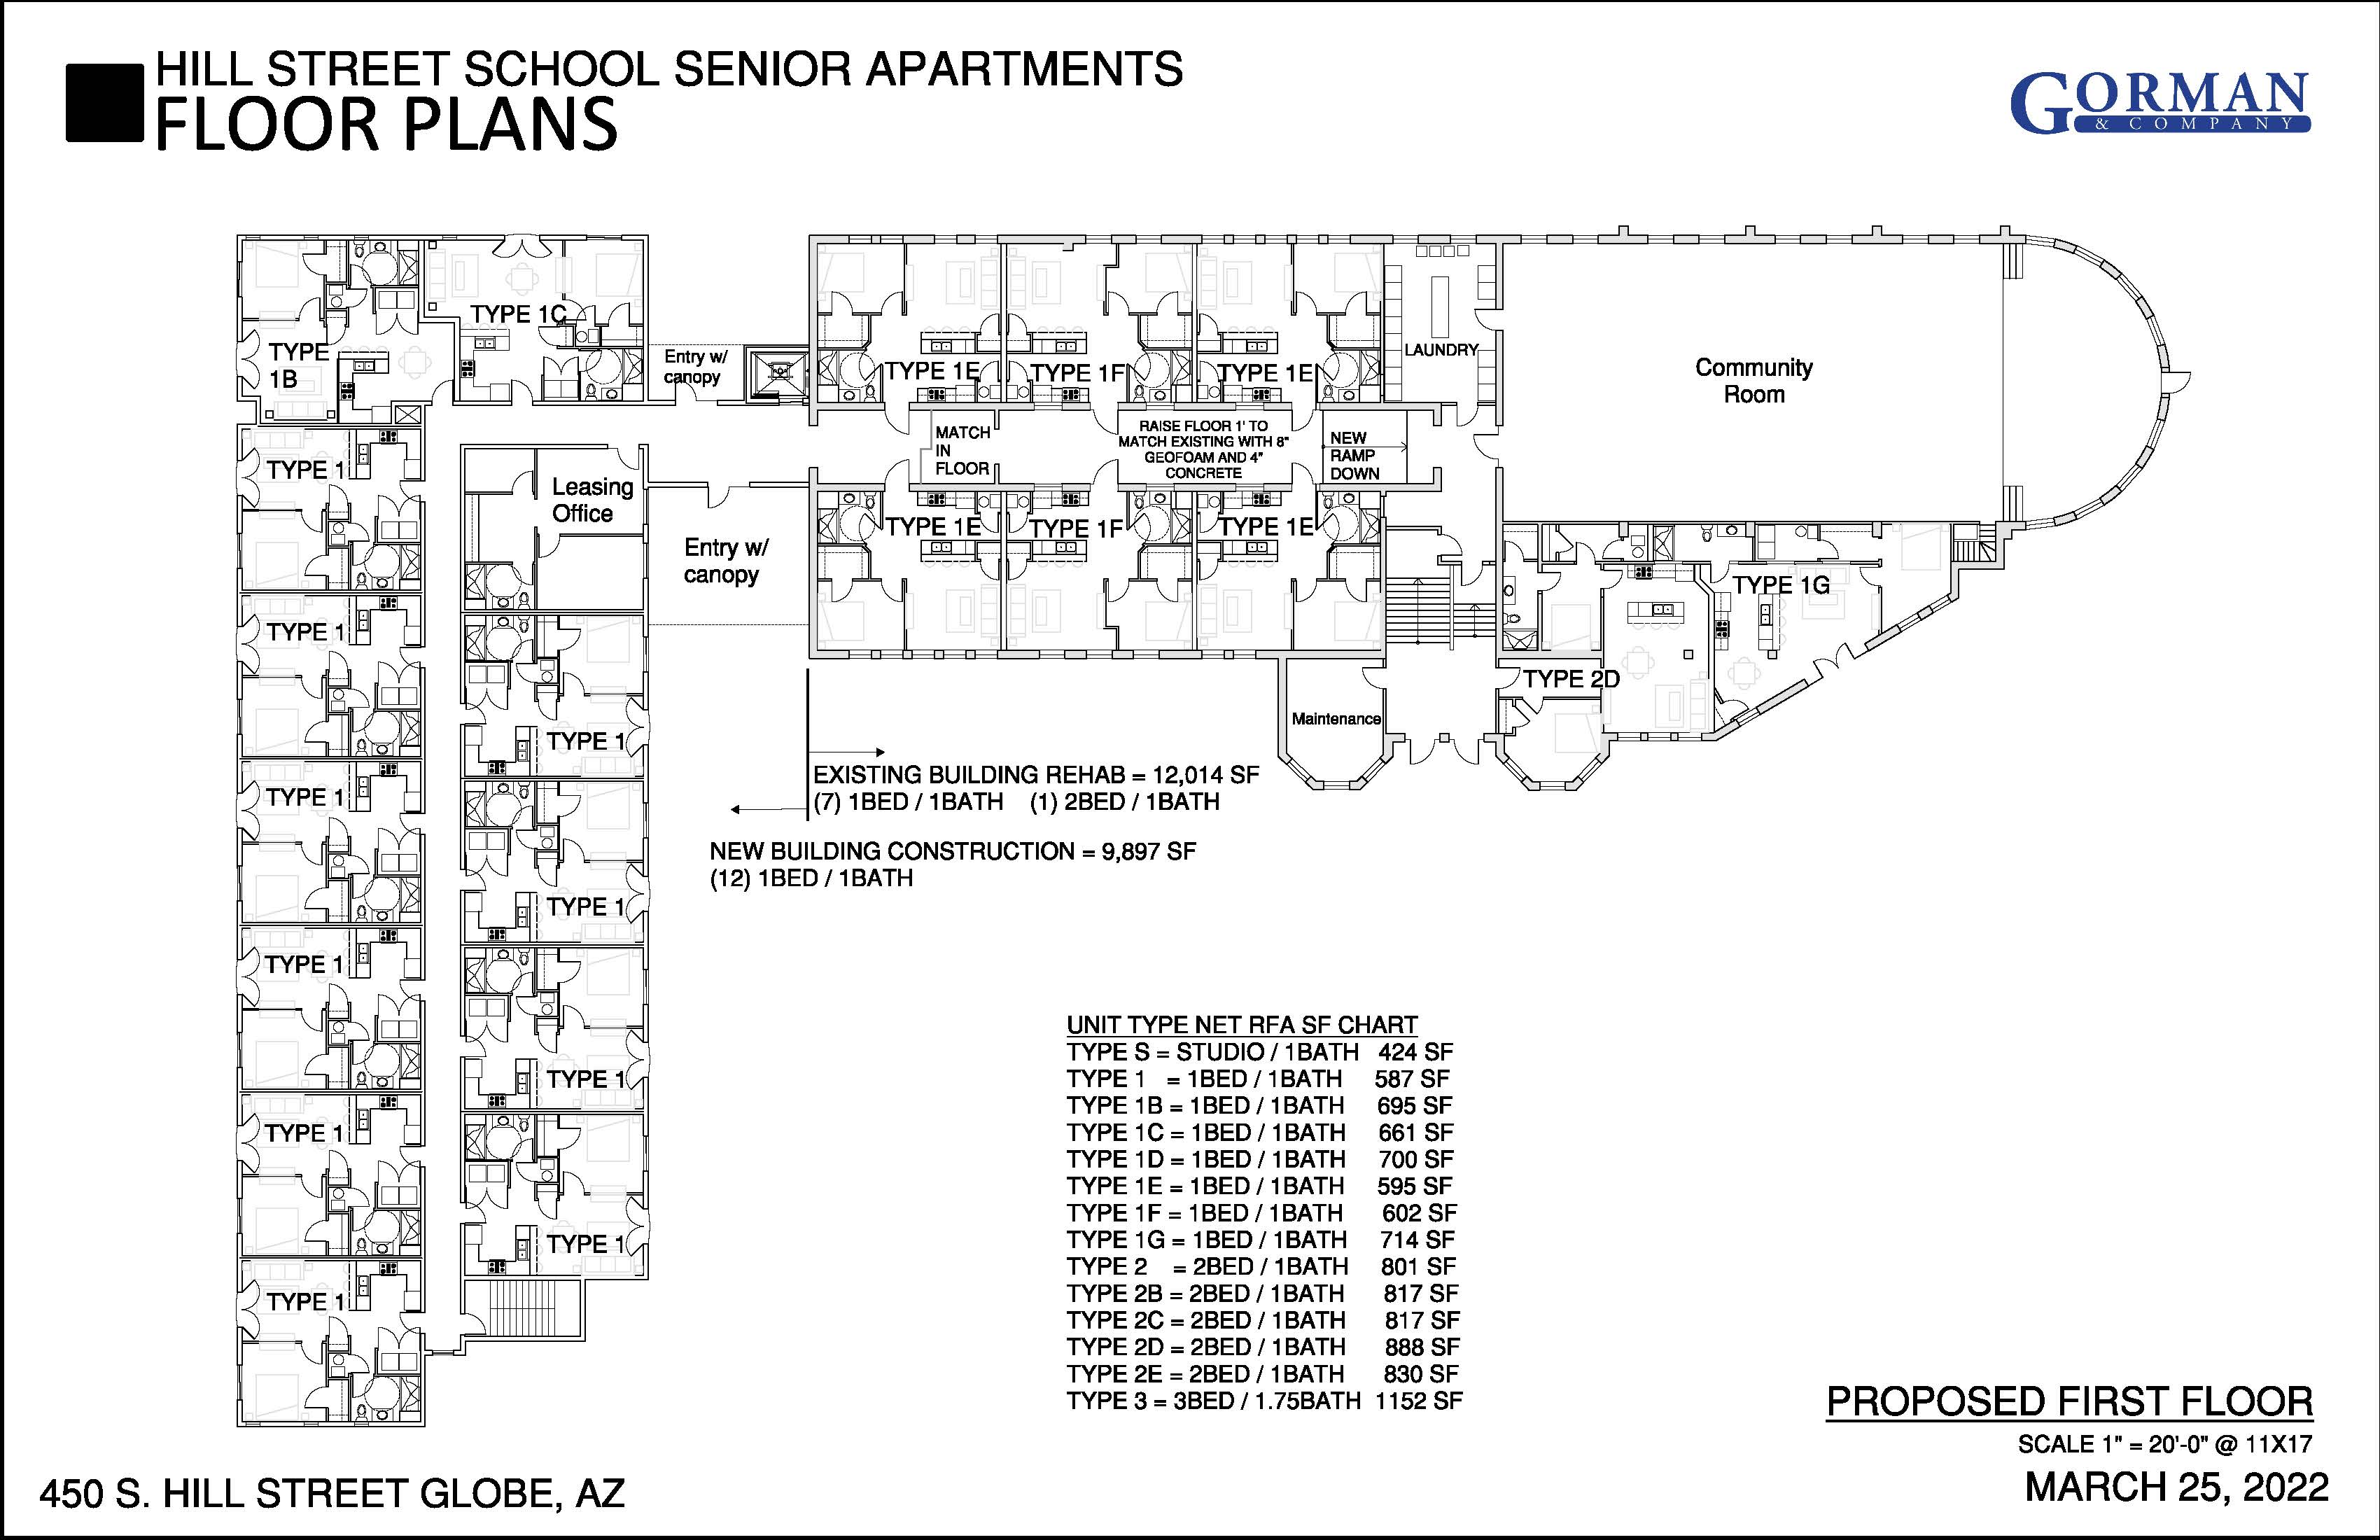

Slide 32
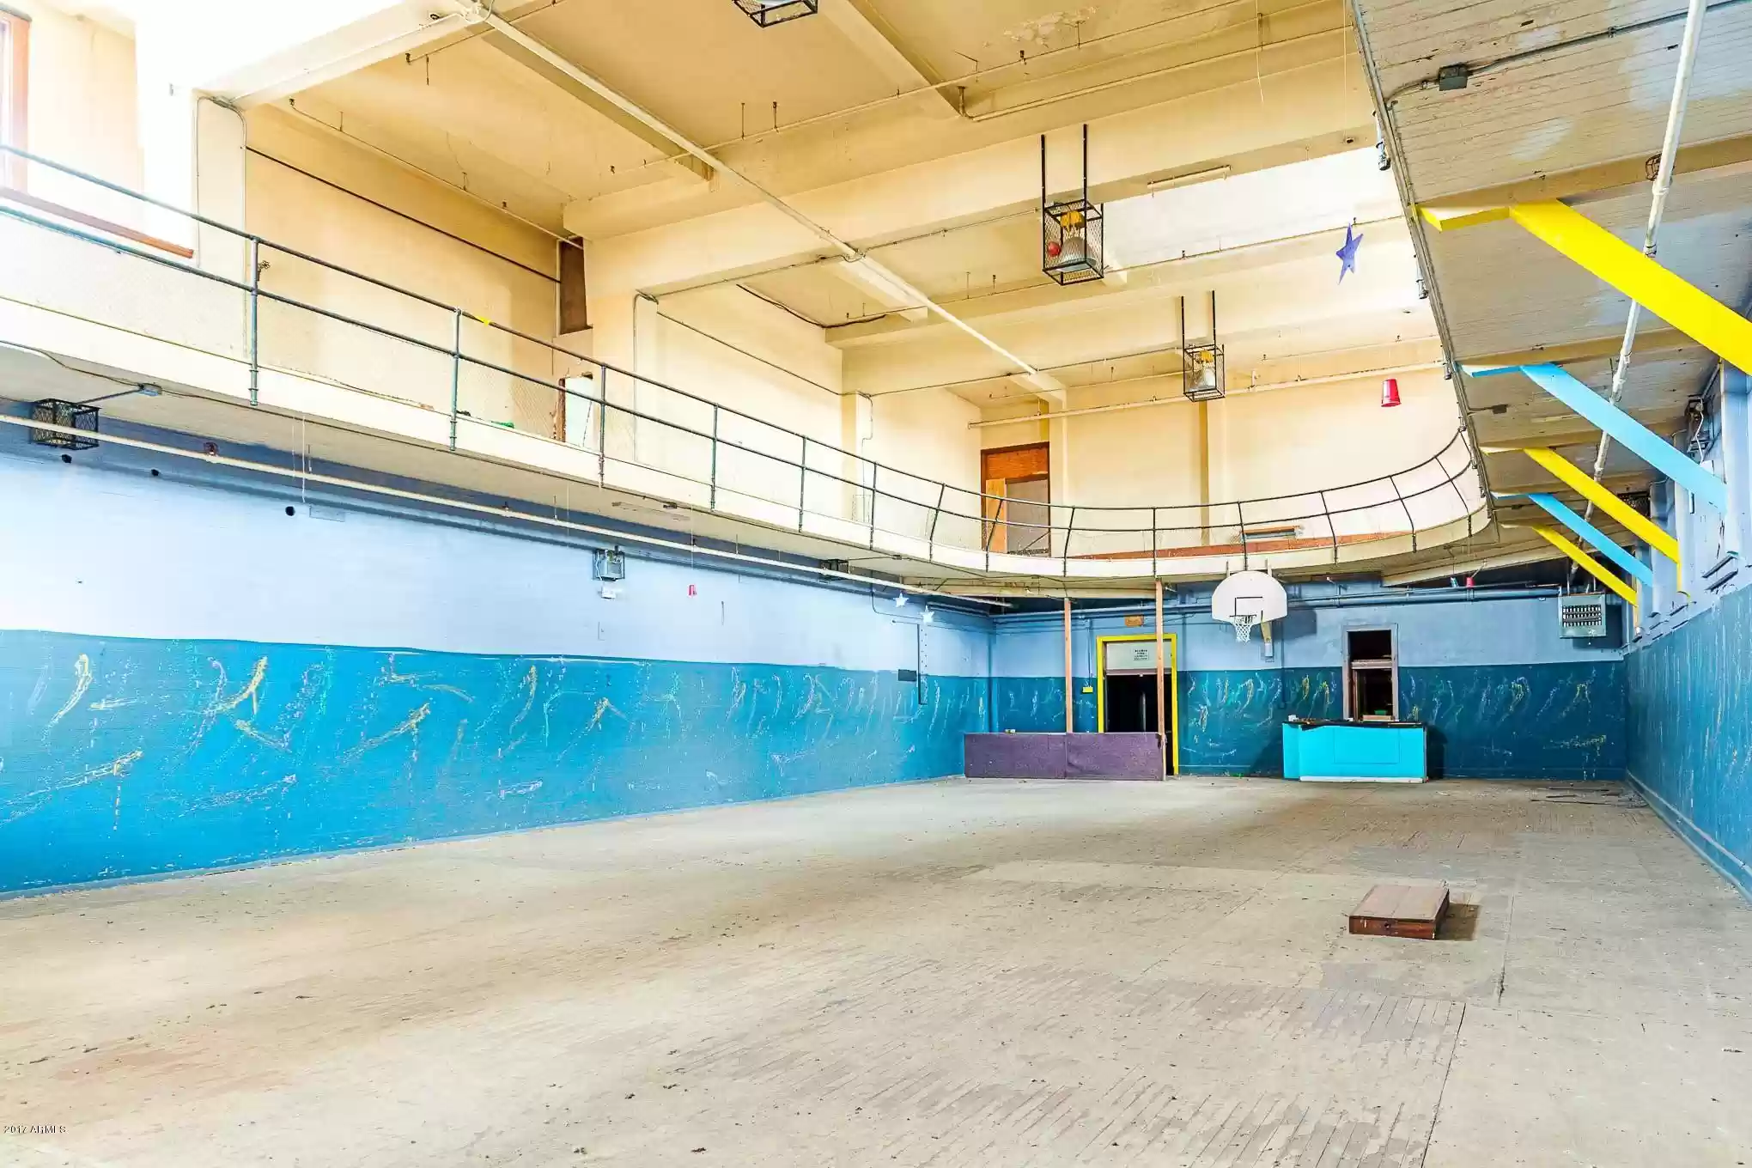

Slide 33
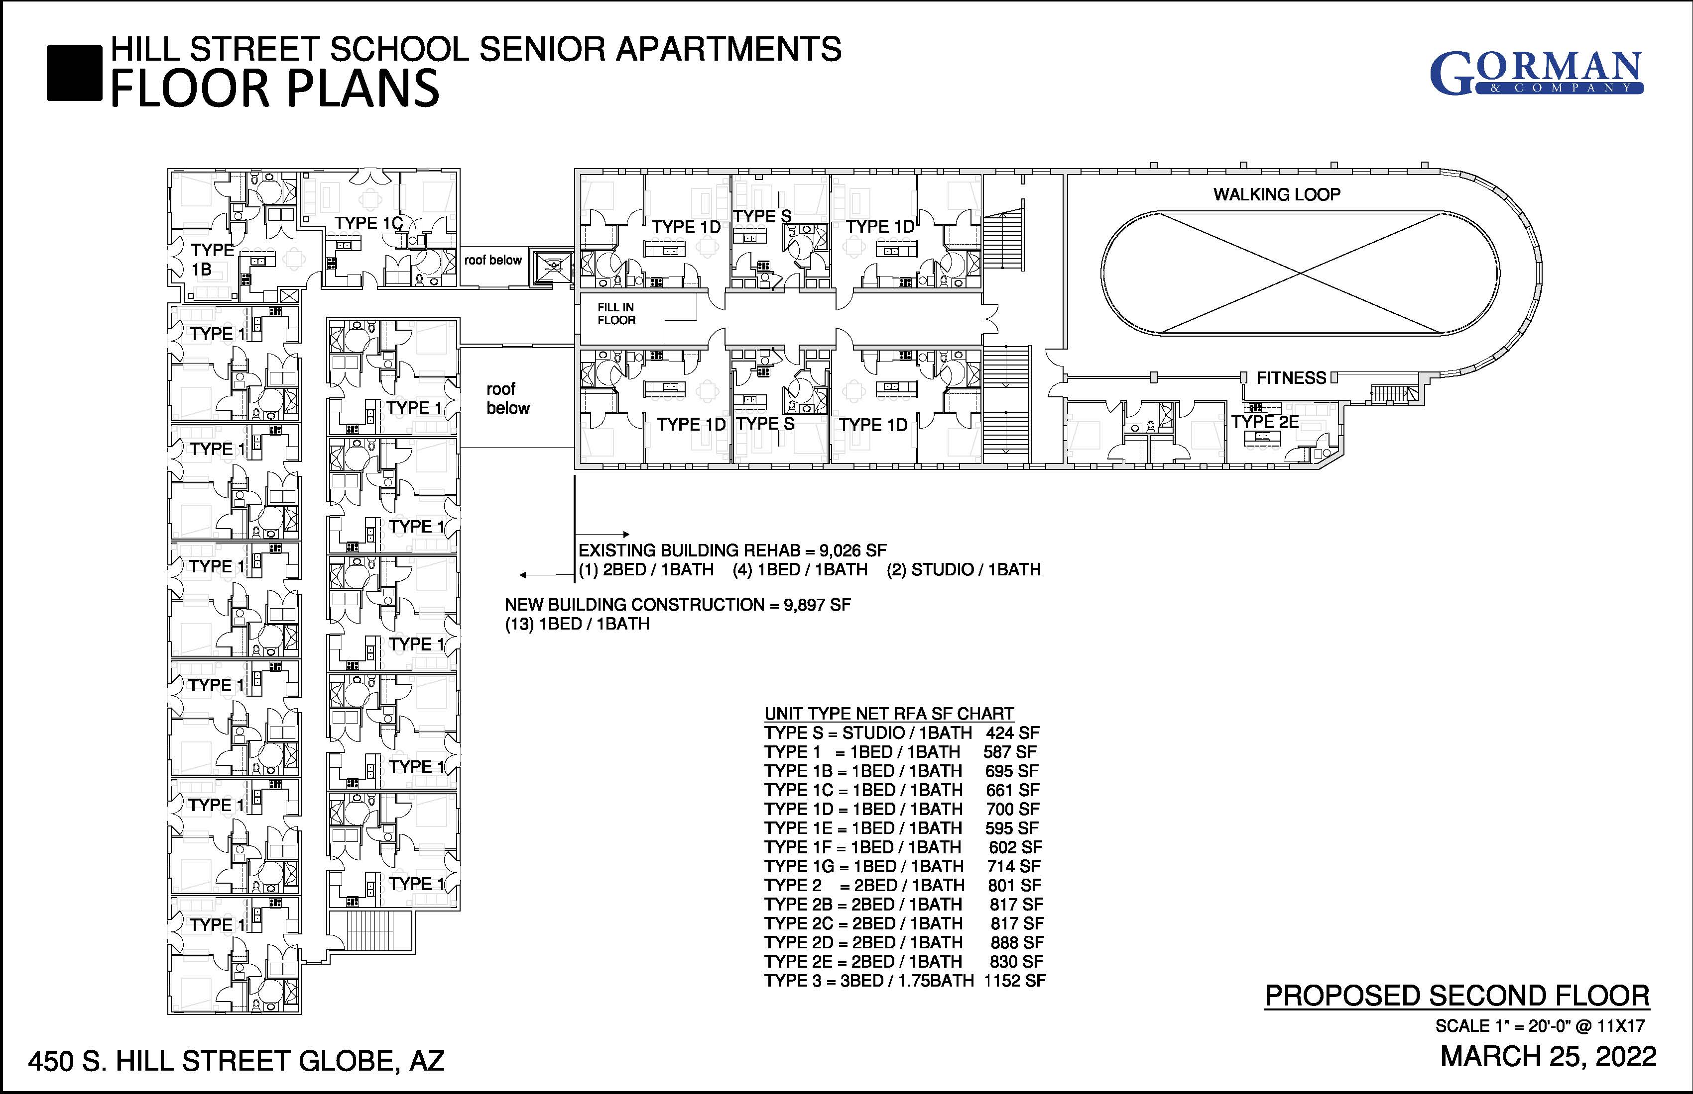

Slide 34
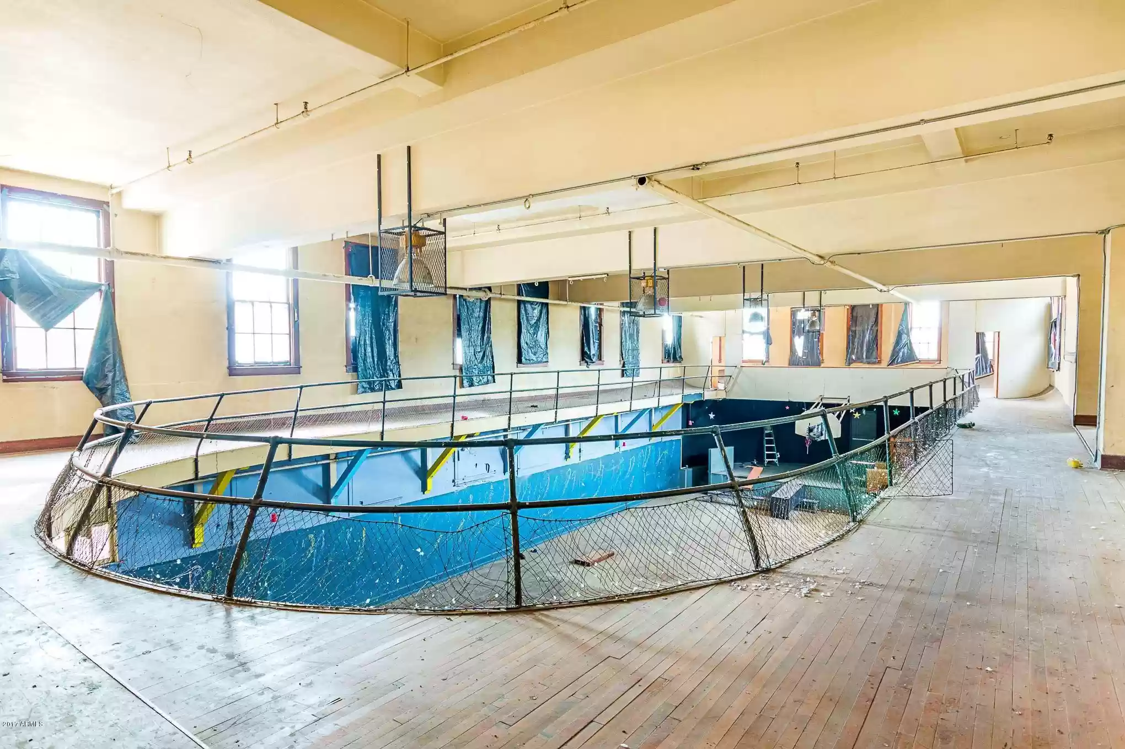

Slide 35
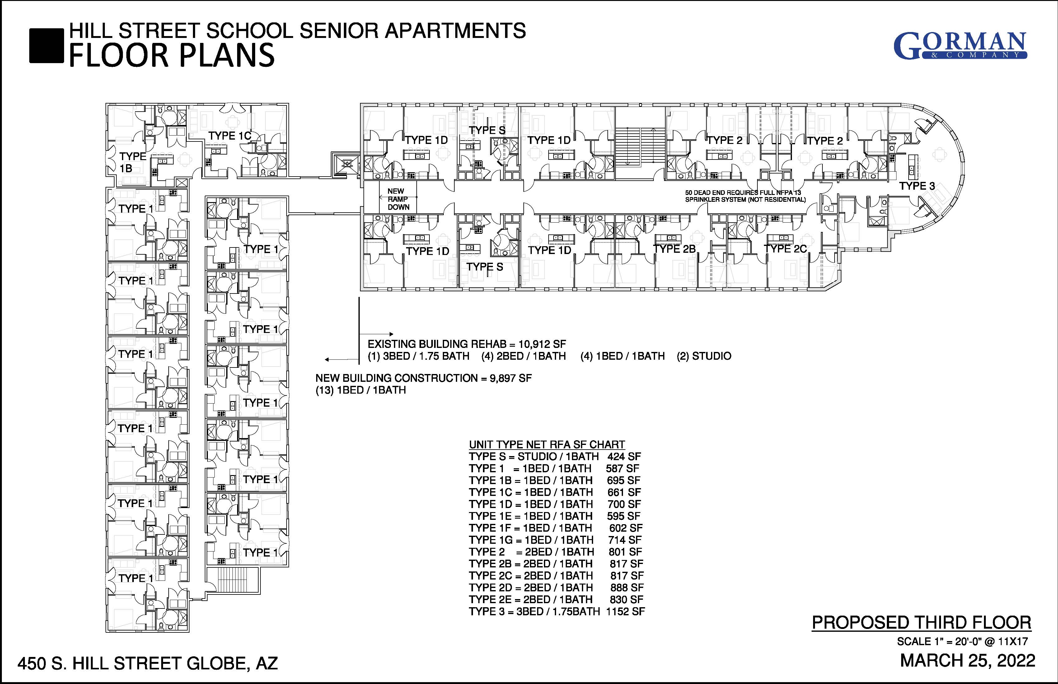

Slide 36
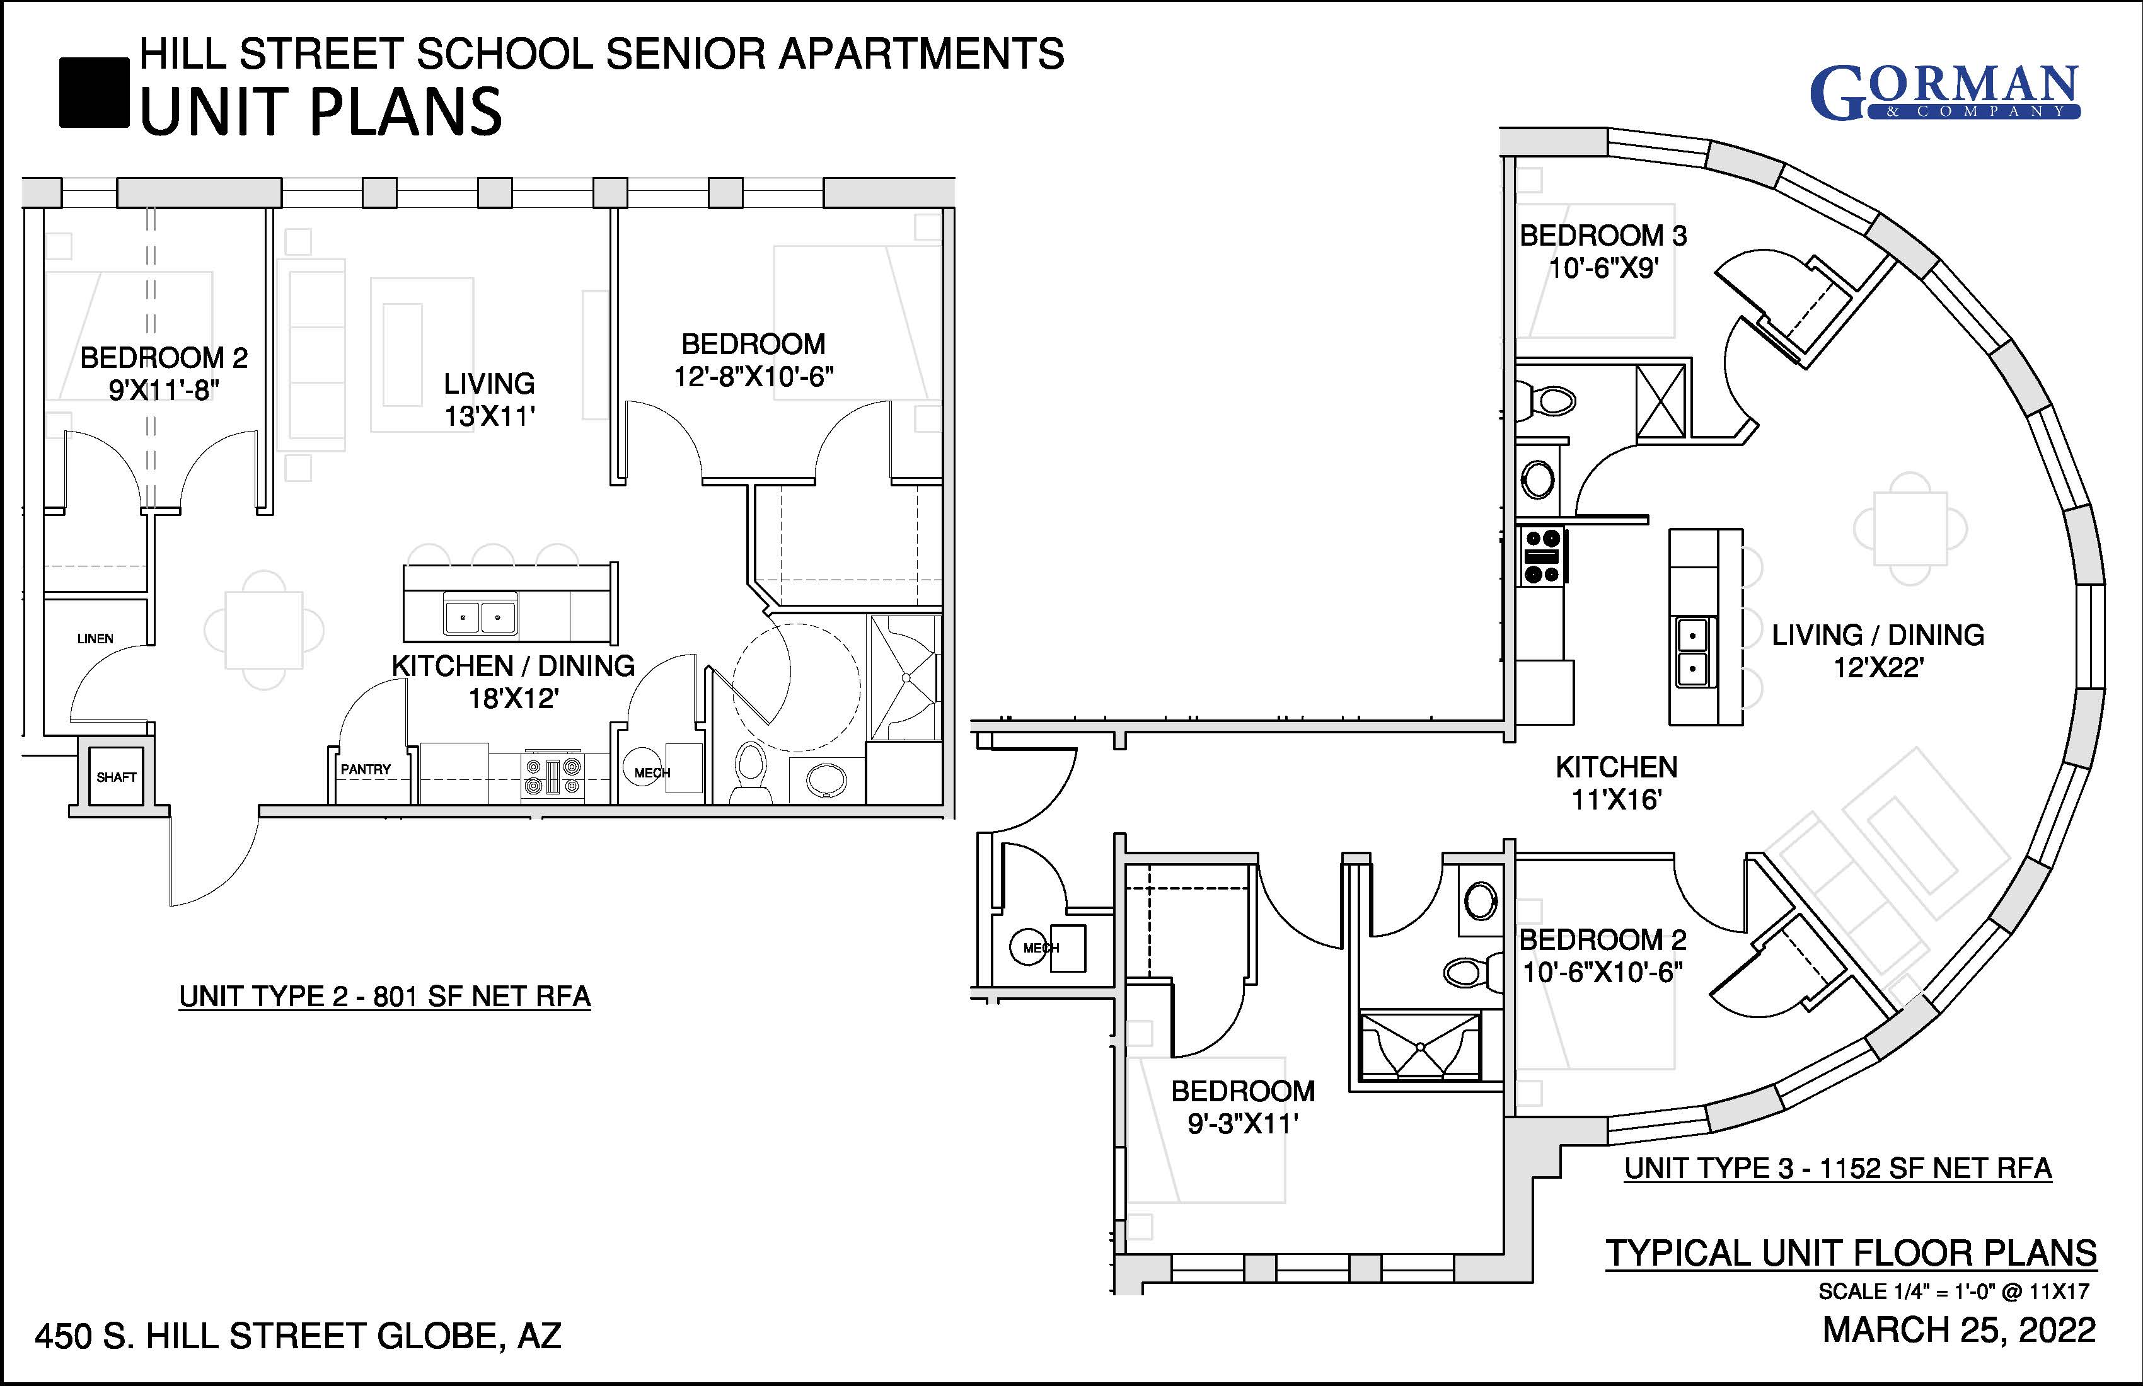

Slide 37
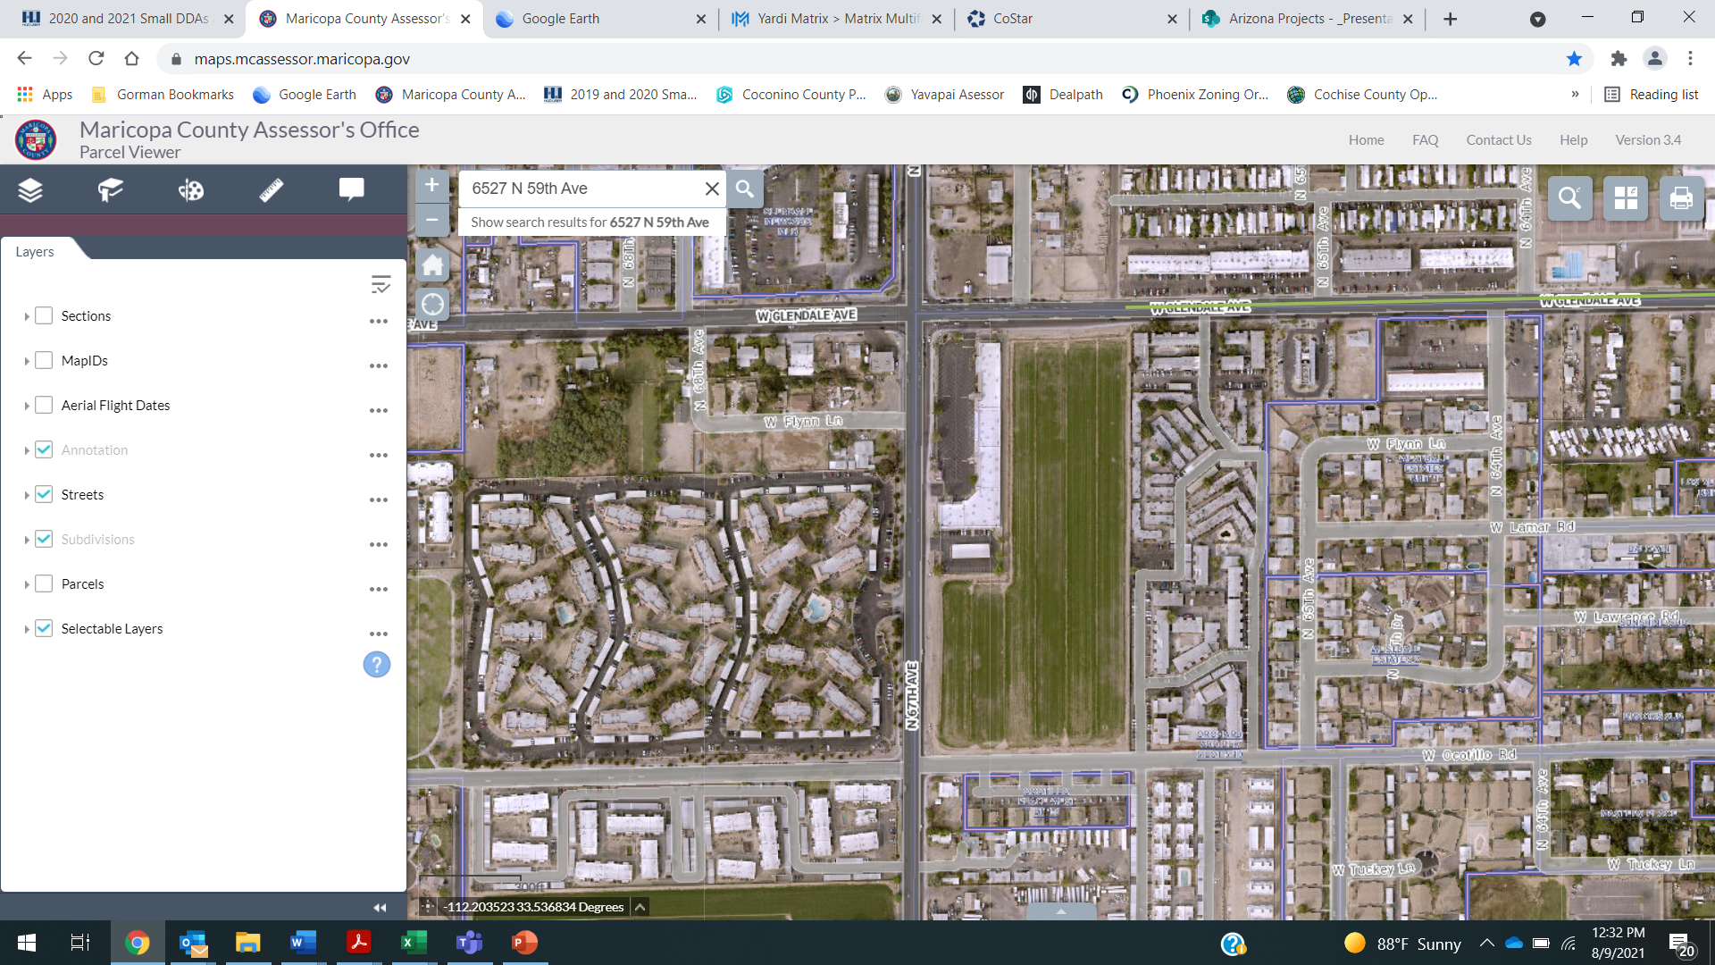
Centerline on Glendale I & II
13 acres hard zoned in the heart of Glendale.
In the Centerline Overlay District at Glendale Road and 67th Avenue
Located in a QCT
Major bus routes on both sides of the development
Retail, including grocery stores, nearby
Less than a mile from Downtown Glendale
Notes:
Points for Number of units (101-200 = 40 points. 201+ = 60 points. Low income targeting 20% at 30% AMI = max 60 points.

Slide 38
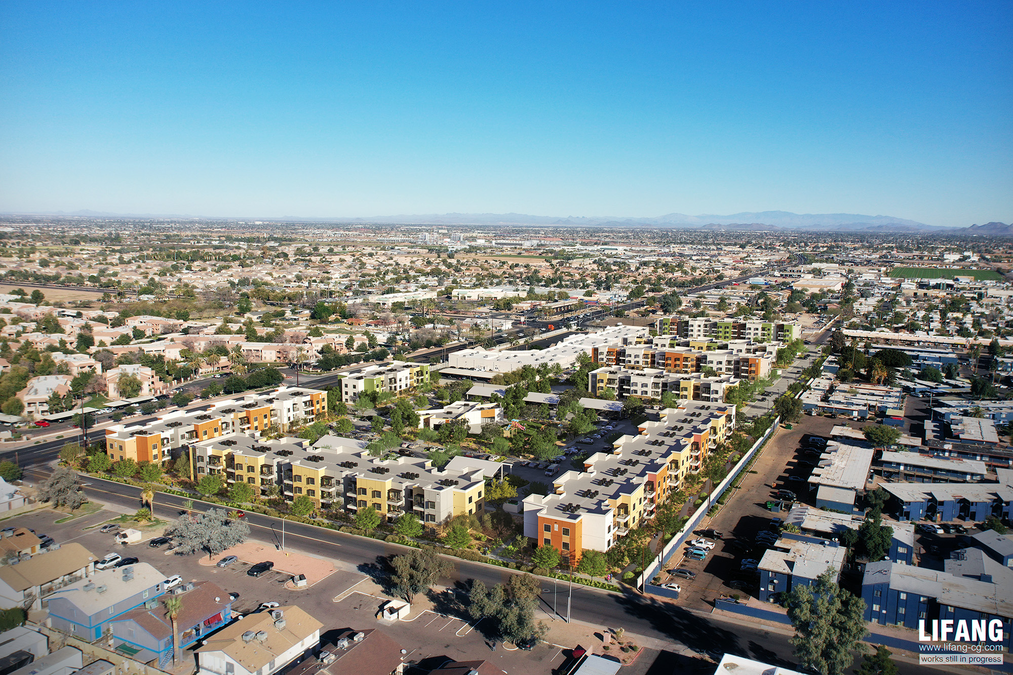
Centerline on Glendale I & II
Notes:
Urban round. 1st project ever awarded state LIHTC in Arizona.

Slide 39
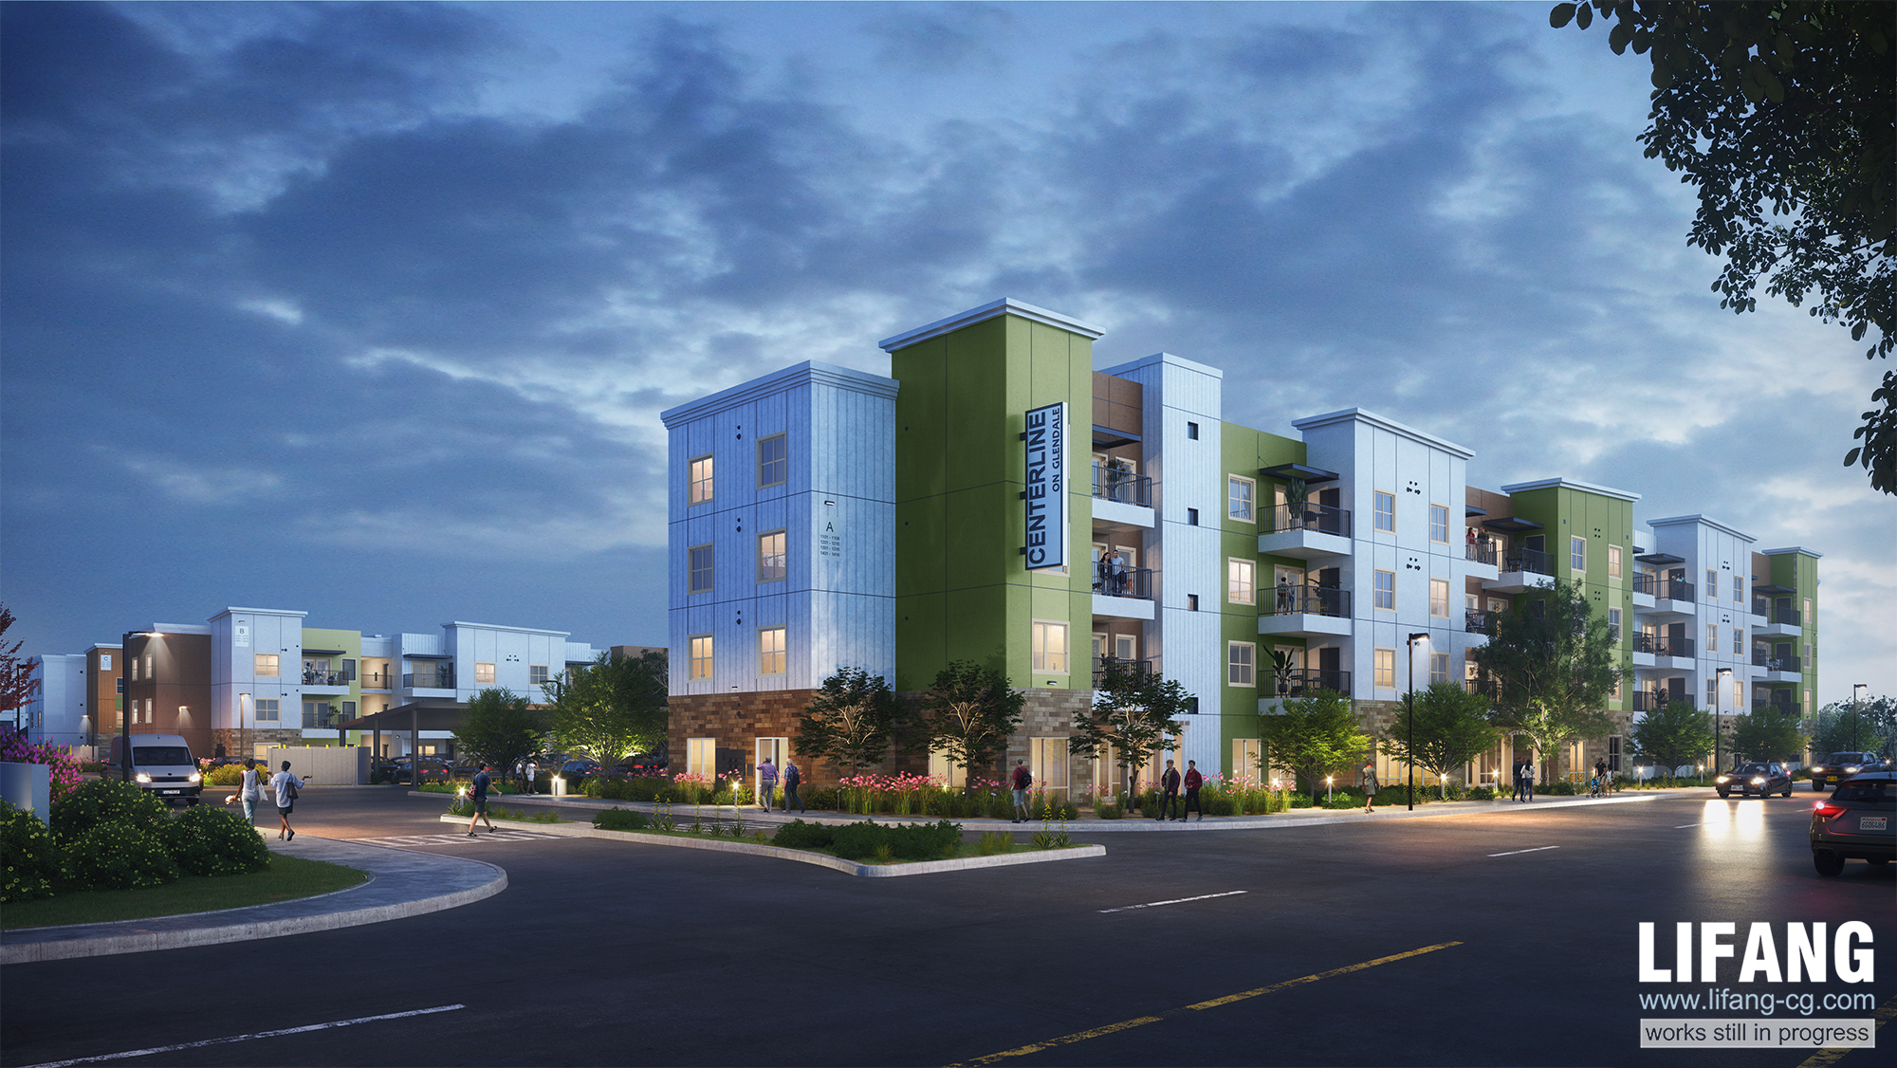
Centerline on Glendale I & II
Notes:
Urban round. 1st project ever awarded state LIHTC in Arizona.

Slide 40
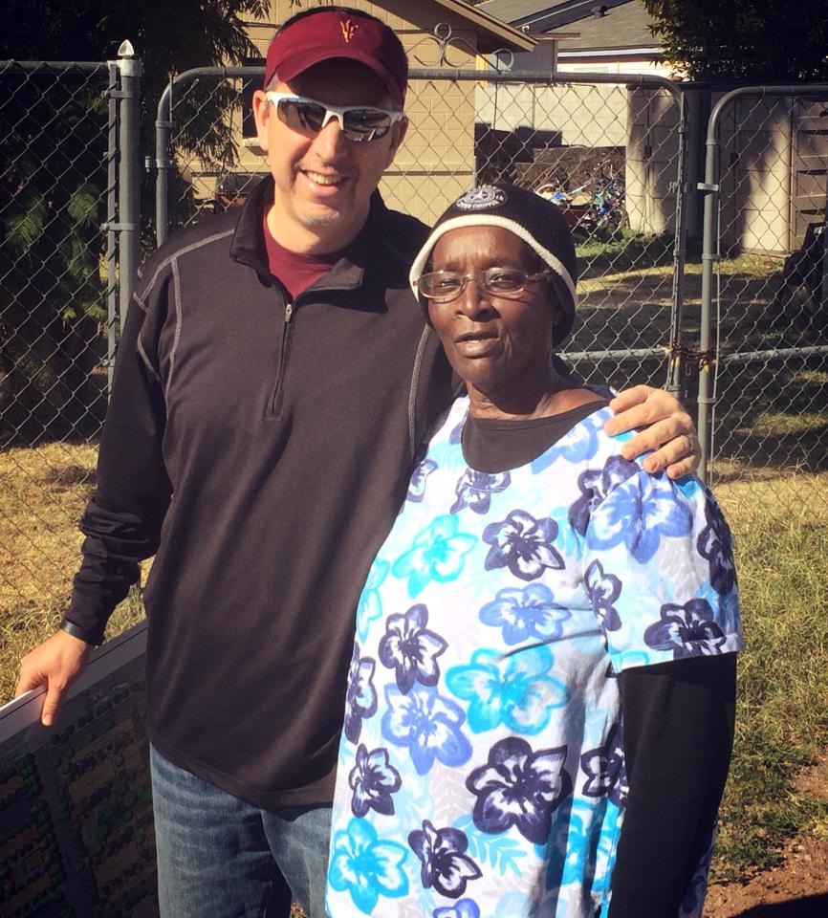
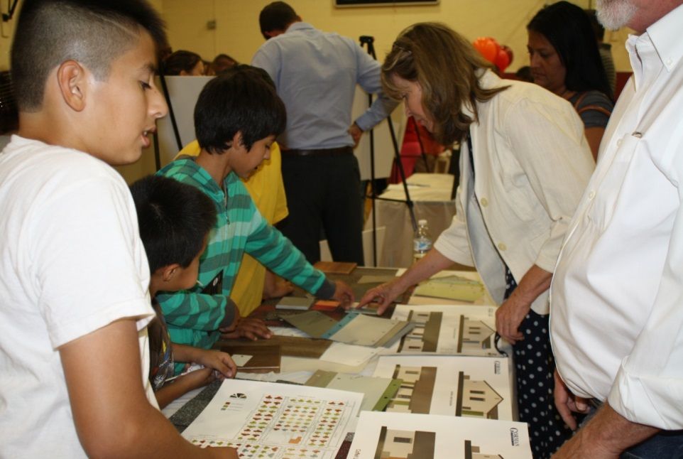


How we all can work together?

Slide 41
Darrel Christenson, VP Community Integration
5025 E. Washington Street #200, Phoenix, AZ
(602) 296-0530.direct
DarrelC@ability360.org
www.ability360.org
Brian Swanton, President & CEO
2030 E. Osborn Road, Phoenix, AZ
(602) 708-4889.text/cell
bswanton@gormanusa.com
www.gormanusa.com

