Slide 1
The Prosperity Initiative
An opportunity to be
architects of change for the
next generation

Slide 3
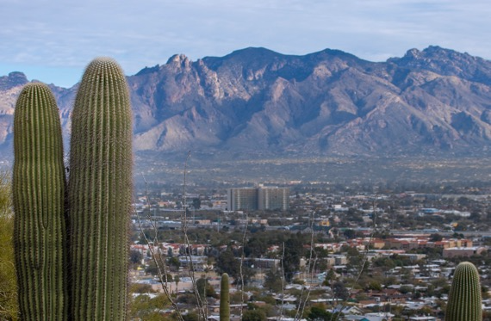
Pima County is a culturally vibrant and
resource rich community
We honor the tribal nations who have served as caretakers of this land from time immemorial and respectfully acknowledge the ancestral homelands of the Tohono O’odham Nation
and the multi-millennial presence of the Pascua Yaqui tribe within Pima County.

Slide 5
Pima County children and families are in crisis.
Childhood poverty rates are astounding, particularly those living on the Tohono O'odham Nation (54.8%), Pascua Yaqui Reservation (42.7%), and South Tucson (40.7%).
This is in comparison to the National Childhood Poverty
Rate of 16% .
Notes:
We know that many families in our region are in crisis.
Childhood poverty rates are over double the national average in certain geographic areas, specifically those living in Indigenous communities and areas with very high concentrations of Hispanic families. The opportunity to support the Tohono O'odham Nation and Pasqua Yaqui Reservation as well as South Tucson where each of the Childhood Poverty Rates are over 40% is glaring and something that needs critical and innovative action.
While we need to talk about the systemic "whys" of these inequities because they provide a critically important context, today we want to share a research-based, broadly adopted solution. One that has the potential to put Southern Arizona on the map for family-centered systems change that when implemented has been proven to reduce generational poverty and improve opportunity.

Slide 6
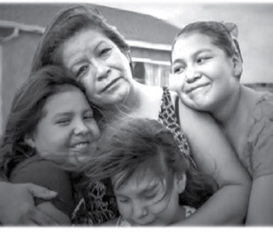
Low-income children, women, single parents and people of color are disproportionately impacted by poverty and by the pandemic

Slide 7
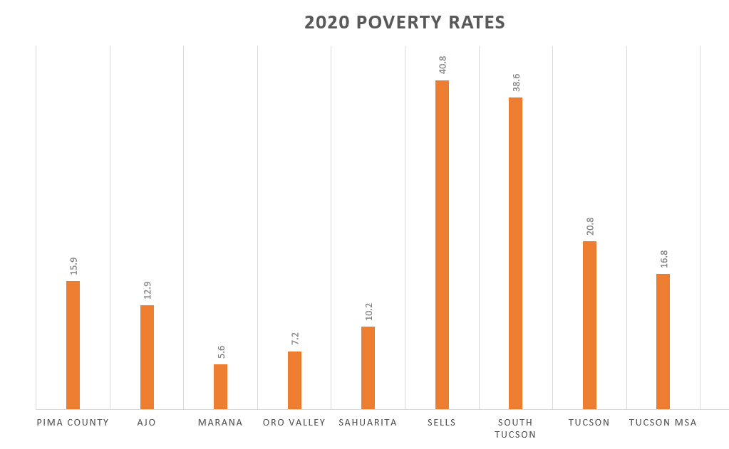
Pima County 15.9% = 62,195
The Tucson MSA has a total population of 1,010,025 as of the 2010 Census.
Notes:
https://www.census.gov/search-results.html?q=Tucson++AZ+poverty+&page=1&stateGeo=none&searchtype=web&cssp=SERP&_charset_=UTF-8

Slide 8
Poverty is expensive
$2.2 BILLION
It is a drain on community resources
It is a waste of human potential
It impacts the next generation
It impacts social capital and social cohesion
We can’t have a wealthier and more resilient community unless we address poverty in more effective ways.

Slide 9
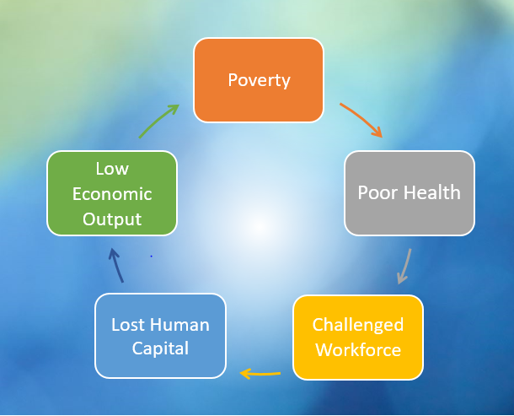
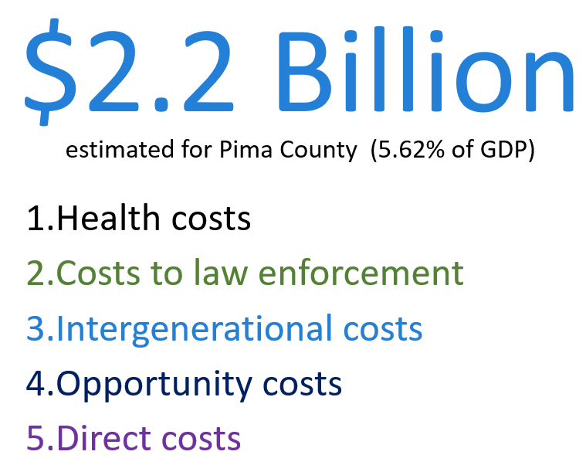
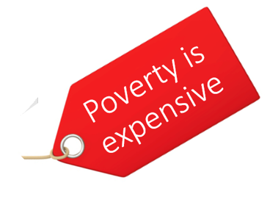
The community cost of poverty
Ending poverty is everybody’s business

Slide 10
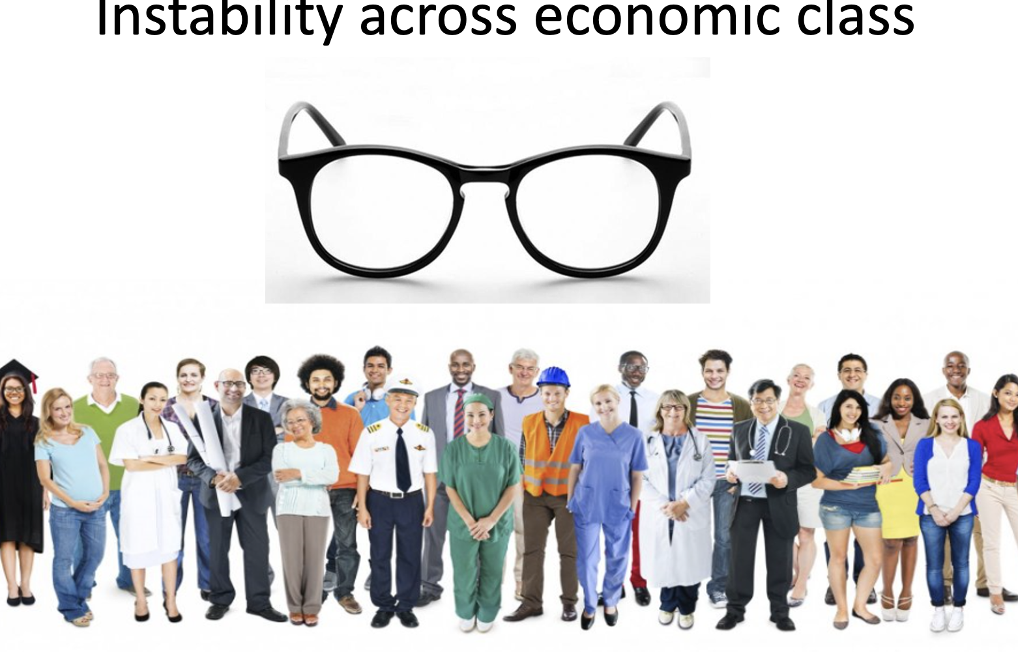
"There's plenty of poverty above the poverty line as a lived experience.“
Matthew Desmond, author of Evicted & Poverty, by America

Slide 11
ALICE: Asset Limited, Income Constrained, Employed
43% (51 million households) of Americans before the pandemic couldn’t afford the basics each month:
Housing
Utilities
Food
Child care
Health care
Transportation
Cell phone
And they don’t have $400 in savings or for emergencies
Working hard, but struggling
to survive
Notes:
https://www.unitedwayalice.org/

Slide 12
Four Approaches
Preventing poverty
Alleviating suffering
Aiding transition to economic stability
Addressing structures in a community
Hard Differentiators: Bridges Community of Practice Model

Slide 13
Parable of the River
There is a parable that tells the tale of two people walking by a river when they notice babies floating down the river.
One starts grabbing the babies out of the river, while the other runs upstream.
The first asks, "Where are you going?! We have to save these babies,"
And the other replies,
"I'm going to see who's throwing babies in the river!”

Slide 14
Policy can give us Cathedral Thinking
Cathedrals are started by people who know they will not live to see the end of their project,
but they start them nonetheless.
Notes:
“Whether you’re building a church, a business, or a mandate for social change, cathedral thinking presupposes that the vision you initiate must be handed over to others, that everyone involved will be laboring on faith at times, that people will share their most innovative ideas and tools, that the plans will change, that the blueprints may even be lost, and that the most important part of your job will be to inspire, to every neophyte who joins your team, reverence for a precept you will never see completed.”

Slide 15
The Prosperity Initiative’s mandate is to develop a set of policies that:
Are research and evidence-based
Guide long-term efforts to create community wealth by addressing generational poverty and improving opportunity
while also addressing the immediate needs of those currently experiencing poverty
for adoption or adaptation by local governments
The Prosperity Initiative is an opportunity to be architects of change for the next generation.
Pima County Supervisor Adelita Grijalva

Slide 16
So what is policy?
Instructions that define a recurring or long-term course of action to be followed by elected officials, administrators, and staff in making decisions and in their operations.
Decisions or actions that are relevant to future decisions and address important and/or controversial issues likely to recur.
Individual change
action
action
action
Organizational change
goal
goal
Systems change
Policy
Think of changes to systems or rules.

Slide 17
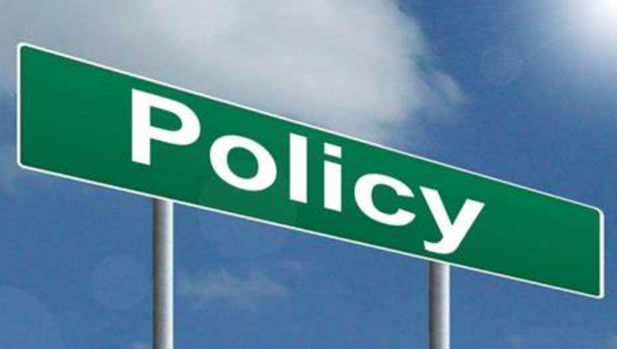
Years of antipoverty work have revealed two things:
community interventions achieve their greatest success when they are connected to policy, and
policy solutions are most effective when they draw from what is working in communities.
Angela Glover Blackwell

Slide 18
Right sizing the policy
Too little? Program Area
Too big? Advocacy Area
Just right? Policy for local government

Slide 20
University of Arizona Researchers
Brian Mayer, Professor School of Sociology
Keith Bentele, SIROW Associate Research Professor
Brian Mayer is a Professor of Sociology with the College of Social and Behavioral Sciences with expertise in the area of poverty as well as other areas. Dr. Mayer supported the Tucson Mayor's Poverty Commission from 2012-2014. He also developed the experiential learning Tucson Poverty Project class that incorporates community-based research approaches and has received recognition for his innovative work in teaching and community engagement.
His work in environmental sociology has examined the role of community activism and participation in the identification and management of potential environmental health risks.
Keith Bentele, PhD, is an Associate Research Professor with the Southwest Institute of Research on Women (SIROW) in the College of Social and Behavioral Sciences and holds a Ph.D. in Sociology. Dr. Bentele’s research has examined state-level poverty rates, inequality, homelessness, and the generosity and accessibility of various safety-net programs.
He is interested in policy-relevant research with the potential to reduce poverty and homelessness. His specific areas of methodological expertise are in the use of quantitative methods and statistics.

Slide 21
Consultative Process
Council Meetings
Other Presentations
Stakeholder Meetings
City of Tucson
County Supervisors
Marana Town Council
Sahuarita Town Council
Variety of Commissions
Better Together Sahuarita
Two Understanding Poverty Workshops
Policy input & development from local experts
160 meetings with ~ 450 stakeholders
Consultation with state and national experts
Input from people with lived experience

Slide 22
Guiding Principles
Is this reducing poverty and creating opportunity or alleviating suffering?
Is there a strategic and tactical element?
Is there credible evidence-based research behind it?
Is it applicable at the level of local government?
Is it supported by area experts, providers and those with lived experience?
Is there a potential return on investment?
Is it targeting the parts of our community with the highest rates of poverty?
Is it addressing and mitigating historic systemic inequities?
Does this impact urban and smaller/rural communities differently?
Can policies be grouped for greater impact?
Are there any unintended consequences?

Slide 23
Timeline: Two phases
Phase 1: Policy Development
December 2023
Phase 2: Operational Review
January 2024
Working Group meets monthly
Stakeholder Meetings & Listening Sessions
Develop five to ten policies for review and to be considered for adoption
Working Group reviews current programming and resource allocation to align with the adopted policies
Stakeholder Meetings and Listening Sessions for input on implementation ideas

Slide 24
What has the research shown us?
The highest returns target low-income children throughout childhood
early care and education
access to health insurance
college attainment
High returns also for policies and programs targeting adults that have children when there are spillover effects to the children
Support for better paying jobs/ career pathways
Access to housing in high opportunity neighborhoods.
Intergenerational Impact

Slide 25
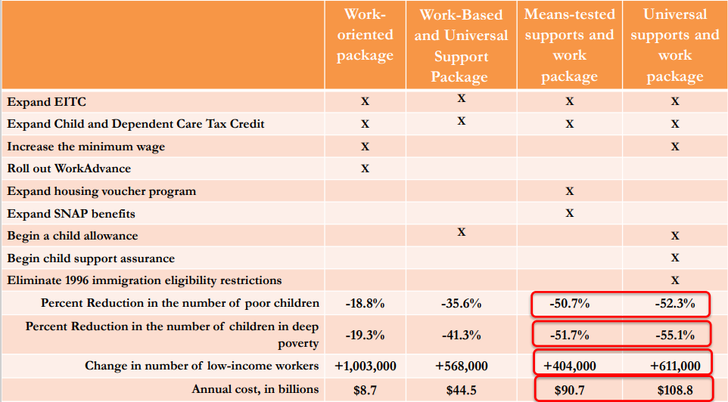
Bundling policies can have a greater effect

Slide 26
4 Policy Areas
Education
Critical Family Resources
Asset Building & Infrastructure Priorities
Cross Policy Strategies

Slide 27
Cross Policy Strategies
Climate Resilience & Environmental Justice
Crime Prevention & Reduction
2GEN Approach
Center family voice and participation in the development of policies, programs, and practices.
Build a more climate resilient community
Reduce potential harm to low income areas from
hazardous waste and contaminants,
air pollution,
environmental degradation,
resource extraction,
other land uses.
Prevent youth involvement in the criminal justice system
Assist low-income families in addressing legal issues
Build pathways for the integration of returning citizens.

Slide 28
Two Housing Policies
Housing Mobility
Increase the geographic diversity of affordable housing and improve opportunity.
Housing Stability
Improve housing stability among low-income renters and homeowners by preventing evictions and foreclosures, and increasing homeownership, especially for those in high poverty areas.

Slide 29
Housing Mobility
Affordable Housing to Reduce the Geographic Concentration of Poverty and Increase Mobility
Efforts to increase the supply of affordable housing should prioritize practices and investments that reduce the geographic concentration of poverty and increase the number of mixed-income neighborhoods.
In higher opportunity areas the availability of affordable housing should be increased and households with young children living in high poverty areas should be prioritized for access to these opportunities.

Slide 30
Why this policy is applicable to Pima County region?
Pima County exhibits a strong geographic concentration of poverty
within Tucson poverty levels vary dramatically from 3% to 56%
This spatial distribution of poverty is very similar to the pattern of racial segregation in Tucson
non-white Tucsonans constitute the majority of residents in these higher poverty areas.
Higher poverty areas in Pima County have been found to score
high on neighborhood vulnerability metrics
low on metrics attempting to measure opportunities
such as good schools, good jobs, access to healthcare, and adequate housing.

Slide 31
What the research shows
Improved educational outcomes for the children who relocated from high poverty neighborhoods
54% of the children who relocated to the suburbs enrolled in college relative to 21% of children whose families moved within the city
A 10-year randomized control trial involving 4,600 families with children showed prior to their move, participants lived in census tracts with an average poverty rate of 53%. One-year later the average poverty rate for participants who moved was 11%.
One evaluation of the MTO program found that 10 to 15 years after enrollment adult participants who moved to a low-poverty neighborhood had a significantly lower prevalence of diabetes, extreme obesity, physical limitations, and depression.
Younger children under 13 experienced substantial improvements in college attendance and lifetime earnings relative to children who remained in high poverty areas increased the child’s total lifetime earnings by about $302,000.

Slide 32
Anticipated outcomes
Tactical (or short term) element:
Strategic (or long term) element:
Households currently residing in high poverty areas who take advantage of affordable housing opportunities in low poverty areas may experience an immediate improvement in their quality of life, mental health, educational and employment opportunities, and their degree of safety.
Children participating in such housing mobility programs were found to have substantially higher lifetime earnings and college attendance rates, while adults experienced improvements in both physical and mental health.

Slide 33
Intergenerational Impact
“being poor in a very poor neighborhood subjects residents to costs and limitations above and beyond the burdens of individual poverty.”
“Housing mobility is also worthy of support because of high quality evidence demonstrating its effectiveness in breaking multigenerational cycles of poverty that persist in high-poverty neighborhoods, and for improving the lives of both children and their parents.”
Numerous longitudinal studies show improved educational outcomes for the children who relocated from high poverty neighborhoods.
In addition to reducing poverty for participating households at the time of relocation, the intergenerational persistence of these improvements is impressive.

Slide 34
Alignment with 3 key mandates
Pima County’s Regional Affordable Housing Commission
City of Tucson’s Housing Affordability Strategy (HAST)
HUD’s Affirmatively Furthering Fair Housing (AFFH) mandate (1968)
From HUD’s AFFH Mandate:
“proactively take meaningful actions to overcome patterns of segregation, promote fair housing choice, eliminate disparities in opportunities, and foster inclusive communities free from discrimination.”
“significant actions that are designed and can be reasonably expected to achieve a material positive change increasing fair housing choice or decreasing disparities in access to opportunity.”

Slide 35
Implementation ideas
Identification and regular review of high opportunity areas
Transportation planning and investments in high opportunity areas with affordable housing to address inadequate traffic capacity and/or the lack of reliable and affordable transit.
Zoning code changes to facilitate more housing in high opportunity areas
Bonus points on applications for funding of affordable housing development for proposals that would be built/preserved in high opportunity neighborhoods.
Prioritize and seek proposals to develop affordable housing on surplus government property in high opportunity neighborhoods
Prioritize housing vouchers to be used in high opportunity neighborhoods, coupled with counseling/navigation services
Identify and implement new funding sources to support affordable housing production
affordable housing impact fees, commercial impact fees, housing production trust funds, tax exemptions for non-profit affordable housing, and/or affordable housing bonds)
Homeownership assistance and similar supports can also support housing mobility and relocation to higher opportunity areas

Slide 36
Housing Stability
Improve housing stability among low-income renters and homeowners by preventing evictions and foreclosures, and increasing homeownership, especially for those in high poverty areas.
prevent evictions and foreclosures
mitigate negative consequences when forced moves occur
increase homeownership especially for those in high poverty areas
increase the stock of affordable housing

Slide 37
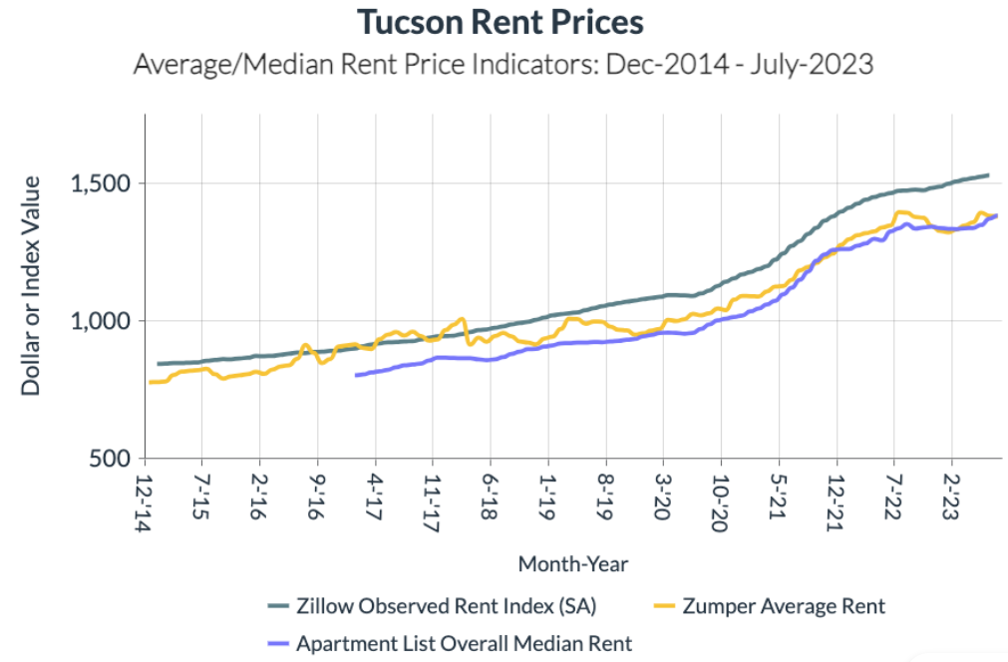

Slide 38
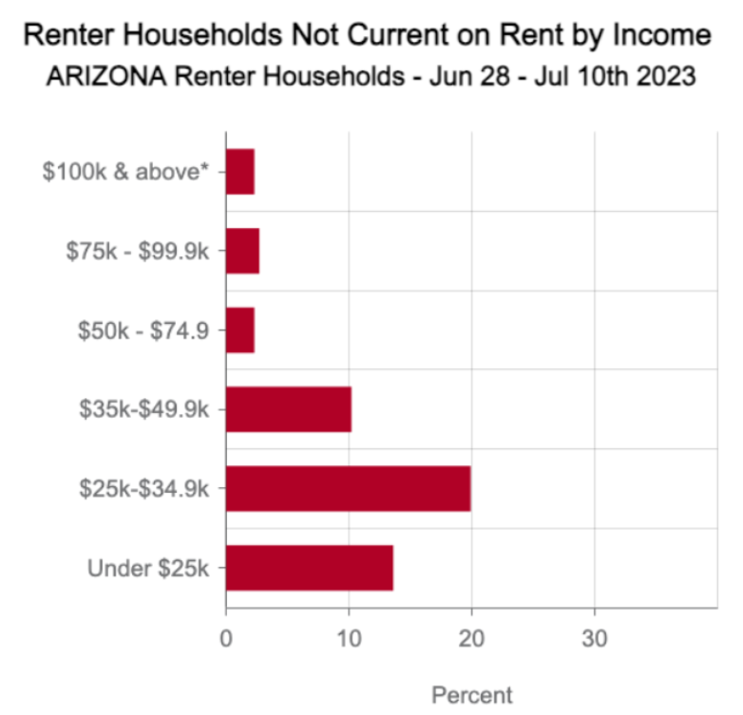
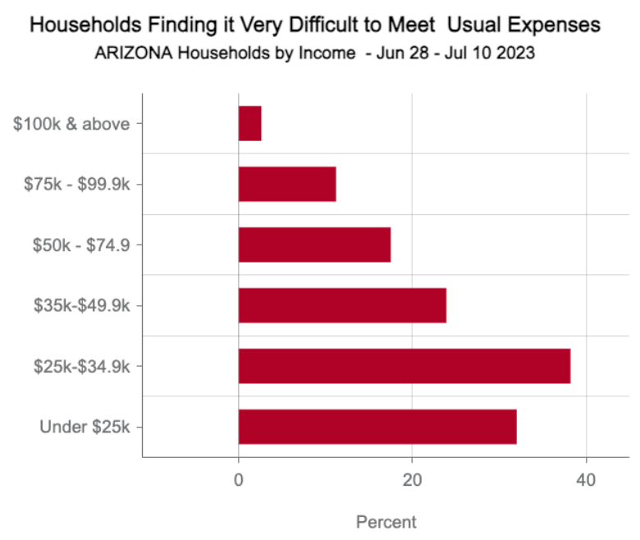
Source: Census Household Pulse Survey -Week 59

Slide 39
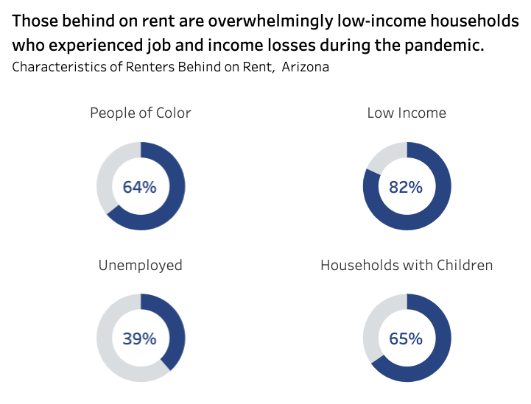
Source: National Equity Atlas – Estimates based on Wave 57 of the Census HPS (Apr 26 – May 8th 2023)

Slide 40
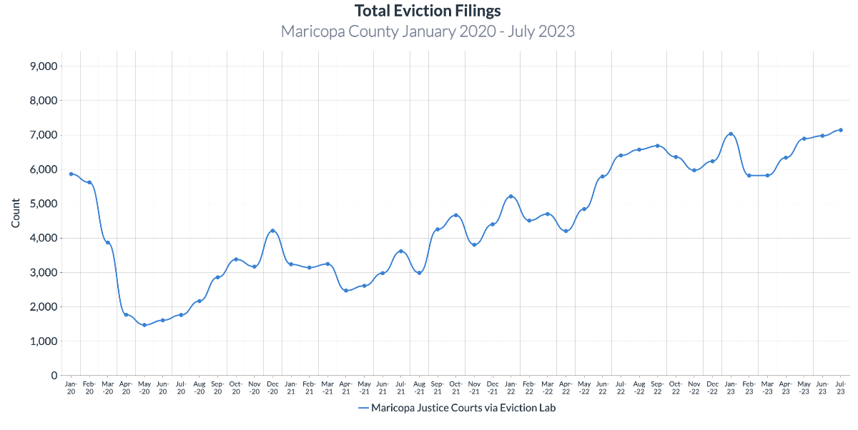

Slide 41
Source: HMIS AZ – Solari Crisis and Human Services https://public.tableau.com/app/profile/hmisaz/viz/MaricopaSystemFlowDashboard/Information
Persons Experiencing Homelessness and Enrolling in Maricopa’s HMIS (Homeless Management Information System)
8.5% increase Jan to Jun 2023
December 2022

Slide 42
Preventing foreclosures and evictions
Reduces
churn in the affordable housing market,
caseloads of caseworkers facilitating transitions to new housing arrangements
the likelihood of homelessness and impact on shelters
substantial negative impacts on the physical and mental health including increased depression, risk of suicide, overdose, and child maltreatment.
longer-terms costs and system burden of mitigated harms including physical health issues, SMI, SUD, homelessness
Loss of material possessions from displacement
Loss of wages or jobs related to housing instability

Slide 43
Preventing foreclosures and evictions
Increases and supports
the positive impacts of other safety-net programs
the health, well-being, and productivity of employees
For children the absence of the disruptions to their education and physical and mental health associated with eviction and foreclosure

Slide 44
Reducing the intensity and consequences of housing instability has the potential to substantially reduce harm. The benefits would then also be highly concentrated in impacted communities such as reduction in displacements via eviction prevention and the protection of assets through foreclosure prevention.
”

Slide 45
Strategic Element: The benefits of increased housing stability to individuals and communities includes reduced homelessness and the negative impacts and costs associated with homelessness improved incomes health and educational attainment prevention of loss of intergenerational and local wealth reduction in impacts to schools from child moves a more stable workforce. | Tactical Element: Families and individuals remain housed; jobs and schooling are not disrupted; and more income is available for other household needs. Homelessness is reduced, particularly for the most vulnerable households. Families and individuals are connected more quickly to key resources that build stability, reducing the need for future interventions and expenses. Lower-income homeowners are able to maintain their property and retain this critical asset.

Slide 46
Programs That Reduce the Negative Impacts of Housing Insecurity
Rental Assistance Programs
Less likely to be food insecure
More likely to afford medical care
Support the educational outcomes of children
Housing Vouchers
Families were 36% less likely to be homeless
40% less likelihood of moving over a five-year average
Legal Representation
Significantly less likely to receive an eviction judgment
Less likely to experience other related negative consequences of eviction records.
Navigator programs
Connects residents with needed services and benefits in real time
Provides valuable data on what are critical resources and barriers to getting them

Slide 47
Rent Assistance Update
Pima County and the City of Tucson partnered throughout the pandemic creating one portal and dashboard of ERAP funding.
Since March 2021
$59 million ERAP spent
$76 million for ALL funding sources
Funds distributed through a network of partners
More than 10,000 households impacted
Worked with more than 2,400 property owners

Slide 48
Pima County EELS Emergency Eviction Legal Services
Launched in August 2021
Second Right to Counsel program in Arizona
The first located in a social service agency
An innovative and holistic approach to prevent evictions and keep families in their homes

Slide 49
EELS PROCESS: A critical part of the homelessness prevention services continuum
Tenant calls the EELS Hotline
Navigator
Interviews caller & determines need
Referred to lawyer for advice &/or representation
if eligible & eligible
Referred for Job Services
if applicable
Expedited Rent Assistance
if needed
Emergency housing to prevent homelessness
if needed & eligible

Slide 50
Two-year outcomes: 4,260 clients served
Legal Services
Other Services
Over 250 new contacts each month
1,765 referred to free legal counsel
1,276 received brief legal advice
489 received full case representation.
Of these, 50% had a positive case outcome. (Dismissed, settled, judgment in defendant’s favor)
4,887 Tenants received assistance
2,286 directed to EELS expedited rent assistance
2,601 received rent assistance through CAA
724 referred to CWD job assistance
Over 200 rehousing cases

Slide 51
Emergency Housing program
EELS works closely with Constables and Justice Court
Identify early vulnerable tenant who may be evicted.
Seniors, families with children, people with disabilities
761 total individuals received emergency housing
260 households, more than half of which included children
Average length of stay ~70 days
85% exit to positive housing destination
Strong partnership with City of Tucson’s Housing Department

Slide 52
Home Ownership can break the intergenerational cycle of poverty
Families increase
Children are
housing stability
capacity to build wealth and provide opportunities for their children
more likely to go to college
less likely to receive public assistance
1.5 times more likely to own their own home.
“Programs that help families purchase affordable housing hold promise in helping ensure children reach their full potential and improving economic outcomes in future generations.”

Slide 53
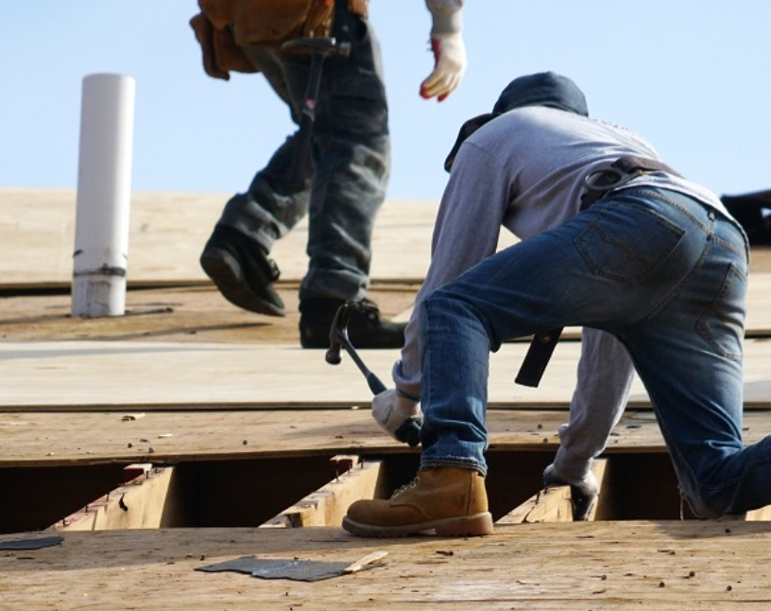
Home repairs & weatherization Low-income households carry a larger burden for energy costs, typically spending 14% vs. 3% of total annual income for other households.
Benefits:
Less impacted by climate related heat events
Lower utility bills
Lower medical bills and less missed work days
Every $1 invested in the program generates $4.50 in benefits:
$1.72 is in energy benefits
$2.78 in non-energy benefits

Slide 54
Implementation Strategies
Continue the County’s Emergency Evictions Legal Services program with the integration of Navigators to link tenants to legal counsel and critical resources like job and childcare assistance.
Develop an emergency rental assistance program that is less generous than the Federally funded ERAP program, but still provides much needed assistance.
Support partnerships with the Justice Courts to increase nonjudicial resolution of eviction disputes that create mutually satisfactory outcomes and avoid an eviction record.
Expand the program capacity of weatherization programs to serve more low-income homeowners through innovations like collaboration with local entrepreneur programs, underwriting the costs of certifications, etc.

Slide 55
Neighborhood Reinvestment Place matters for intergenerational mobility
Improve opportunities for low-income families in high poverty neighborhoods by improving neighborhood characteristics and through increased access to resources, benefits and services.

Slide 56
Place matters for intergenerational mobility
The differences we see in outcomes across neighborhoods are largely due to the causal effect of places, rather than differences in the characteristics of their residents.
Place-conscious policies to promote upward mobility should focus primarily on improving the local childhood environment rather than conditions in adulthood.
Neighborhoods have causal effects on children’s long-term outcomes.

Slide 58
You can use the mapping tool at Diversity Data Kids website

Slide 59
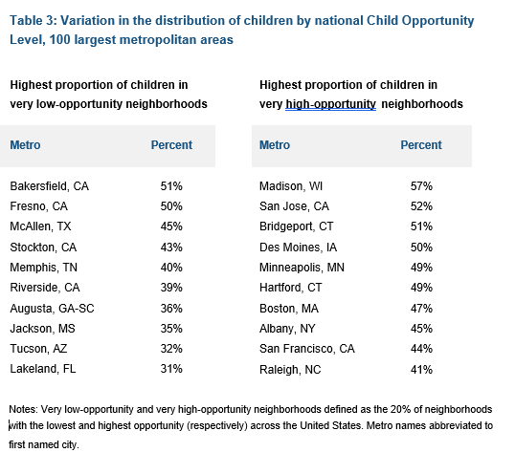
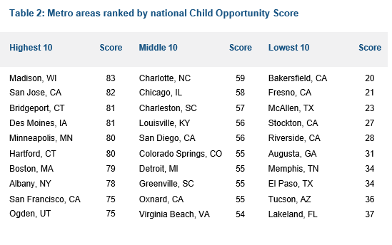
Lowest 10 Metro Areas
Highest proportion of children in very low opportunity neighborhoods

Slide 60
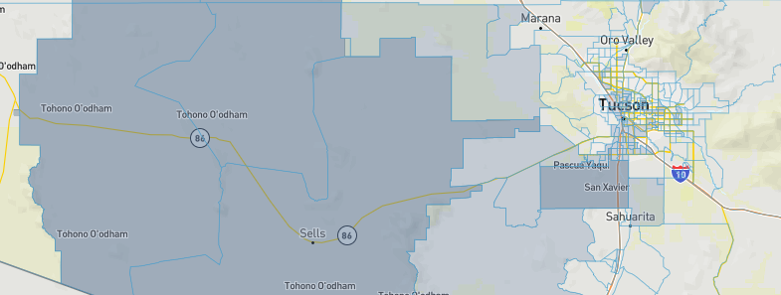
Climate Change
Clean Energy & Energy Efficiency
Clean Transit
Affordable & Sustainable Housing
Reduction & Remediation of Legacy Pollution
Critical Clean Water & Waste Infrastructure
Health Burdens
Training & Workforce Development
Being used by the Justice40 Initiative,
Uses 8 categories
Communities are identified as disadvantaged if they are located in census tracts that are at or above the thresholds in one or more of eight categories of criteria.

Slide 61
Access to Services
Services are important, but not enough.
Families also need
Knowledge (outreach and messaging)
Ease of access (centers/ hubs easily reached in person or on internet)
Support for navigating systems
Support for finding and building assets

Slide 62
Where we are now
Preventing displacement (protective policies ideally proceed investments)
Incentivize development and maintenance of housing units that are affordable for low income and long-term residents
Protections for renters such as relocation costs or right to return
Triggers to activate additional supports to preserve affordable housing stock (e.g. increased incentives for inclusionary zoning, or subsidies for affordable housing development) as needed in areas experiencing displacement as a result of investments
Infrastructure Investment
Weatherization and climate resiliency investments
Climate adapted environments
Pollution mitigation
More access to resources
Navigators to link people to what they need when they need it.
Financial Capability Centers to focus holistically on employment, financial coaching and access to services as a pathway to move ahead.
Limiting financial predators to reduce income and asset loss.
Place based investment using a common tool for selection and prioritizing investments
Child Opportunity Index
Climate and Economic Justice Screening Tool
Centralizing community voice
Participatory budgeting is one tool

Slide 63
Alison Miller Manager, Strategic Planning and Community Engagement (SPACE)
City of Tucson’s Housing and Community Development
Alison.miller@tucsonaz.gov
Bonnie Bazata
Ending Poverty Now Program Manager
(520) 724-3704 (office)
(520) 247-6011 (cell)
bonnie.bazata@pima.gov

Slide 64
EDUCATION
Early Childhood Education
Pathways to Post Secondary Education
Youth Programming & Career Development
Increase access to affordable high quality early childcare and education for children from low-income families, ages birth to five.
Increase college and other post-secondary educational and training opportunities by improving access to children’s college savings accounts for young children from low-income families.
Provide youth with positive activities to discover and develop their talents, prepare for academic success, explore career possibilities, and gain meaningful work experience through K-12 in-school, after-school, and summer youth employment opportunities, as well as targeted efforts to engage Opportunity Youth.

Slide 65
CRITICAL FAMILY RESOURCES
Digital Inclusion
Expand broadband services and address barriers so all Pima County residents have access, equipment, and skills for digital inclusion.
Housing Mobility
Increase the geographic diversity of affordable housing and improve opportunity.
Housing Stability
Improve housing stability among low-income renters and homeowners by preventing evictions and foreclosures, and increasing homeownership, especially for those in high poverty areas.
Health Coverage & Reducing Medical Debt
Provide healthcare insurance enrollment assistance to protect against medical debt.
Workforce Development
Prioritize workforce development for underserved populations with evidence-based case management practices that lead to jobs with self-sufficient wages and benefits.
Home Visitation & Family Planning Services
Support evidence-based practices in the areas of home visitation and family planning that improve health and increase the economic stability of low-income families.

Slide 66
ASSET BUILDING & INFRASTRUCTURE PRIORITIES
Neighborhood Reinvestment
Improve opportunities for children in low-opportunity neighborhoods by connecting families to resources and identifying, prioritizing, and tracking the impact of neighborhood investments using the Child Opportunity Index.
Economic Development
Support the growth of good jobs that provide sustaining wages, benefits, and longevity and that foster the economic growth and environmental sustainability of Pima County.
Community Financial Capability
Improve community financial capability for low-income families and small businesses to increase access to fair credit and to gain and protect wealth building assets.
Transportation
Expand safe, reliable and affordable transportation options to connect disadvantaged communities to jobs and resources.

