Slide 1

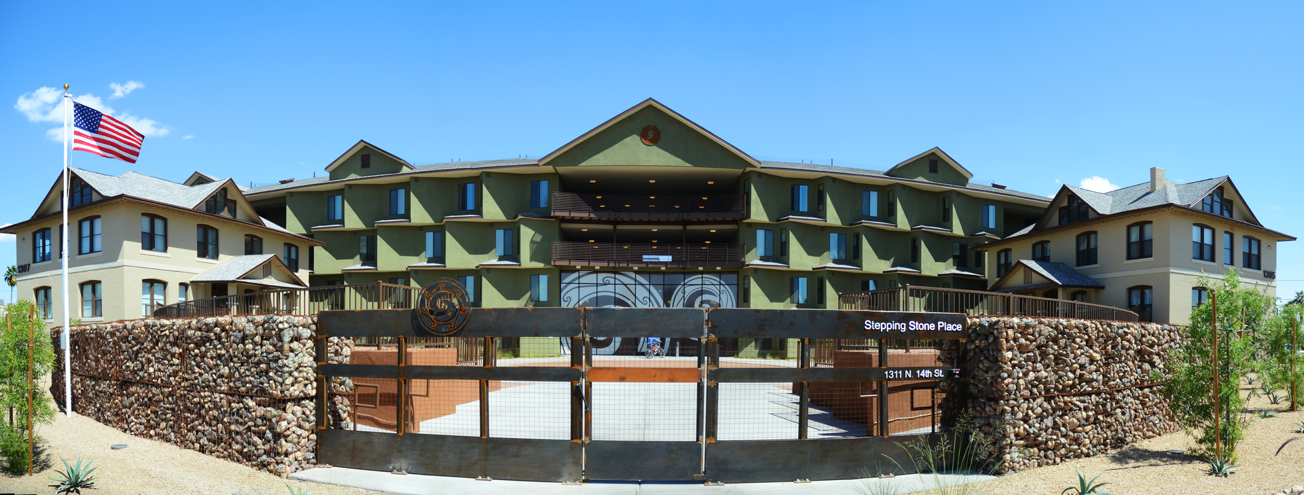
Partnerships & Financing of Affordable Housing
AZ Housing Forum / August 2023

Slide 2
About NAC
Since 1972, Native American Connections, Inc. (“NAC”) has been changing lives, strengthening families, and building healthy communities. We began as a small grassroots organization operating one program for Native American men in recovery from substance use disorder. Today, NAC owns and operates 25+ sites throughout Greater Phoenix offering a continuum of affordable housing, health, and community development services which touch and change the lives of over 10,000 individuals and families each year.
NAC works to integrate existing support systems in the community to leverage development capital and operating sources to provide these services to our clients and tenants.

Slide 3
Service Partners
St. Mary’s Food Bank – Kids Café
Terros Health
Wesley Community & Health Center
Farm Express Mobile
St. Joseph the Worker
Waste Not Arizona
Phoenix Indian Center
Circle the City
NAC’s Behavioral Health Services
Desert Financial Credit Union
Goodwill Arizona
Phoenix Kids.Com
Molina Health Care
Furniture Dignity
AARP
Hospice of the Valley
Amazon
Donation & Volunteer Services from lots of companies like Nationwide Insurance, The Howard Hughes Corporation, Hands on Greater Phoenix, Bank of America and many others!

Slide 4
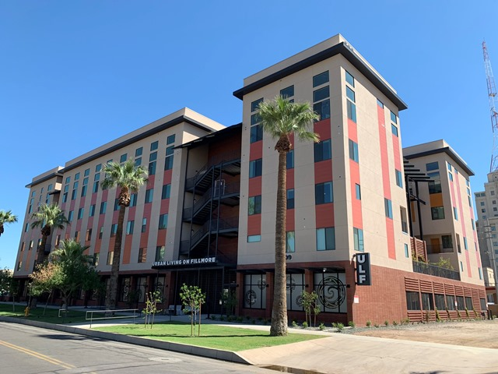
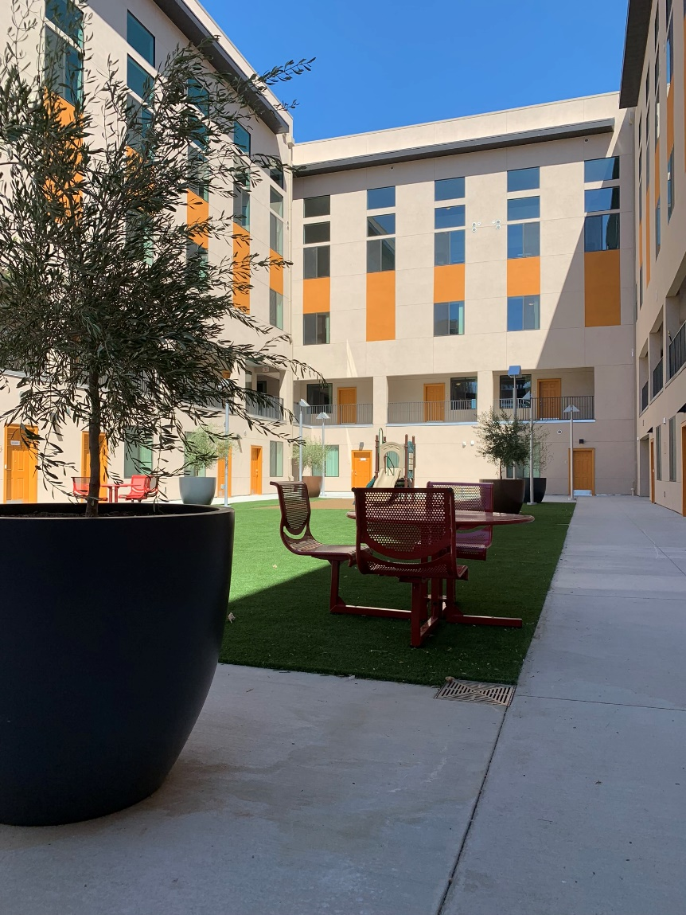
ULF
NAC completed ULF in 2019 to serve low-income families – specifically meeting a very large (and every-increasing) lack of affordable housing in downtown Phoenix.
Total Lot Area – 31,500 SF / 0.72 Acres → 63 Units
Overall ~ 88 DUA / 45 Parking Spaces
Zero parking spaces required due to downtown Phoenix planning overlays with “bonus” points associated with the project’s affordability & LEED Platinum certification. Tenants have excellent access to quality transit (light rail and bus options) as well as very walkable neighborhood amenities.
.

Slide 5
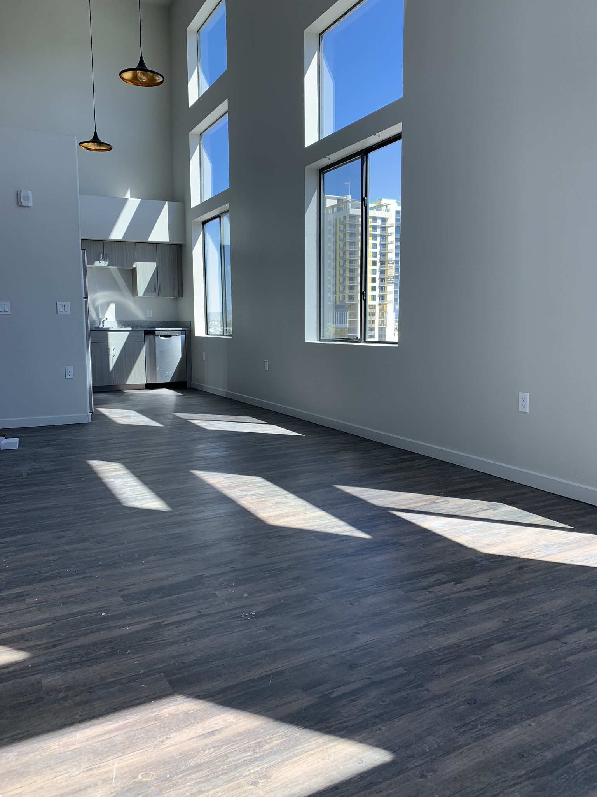
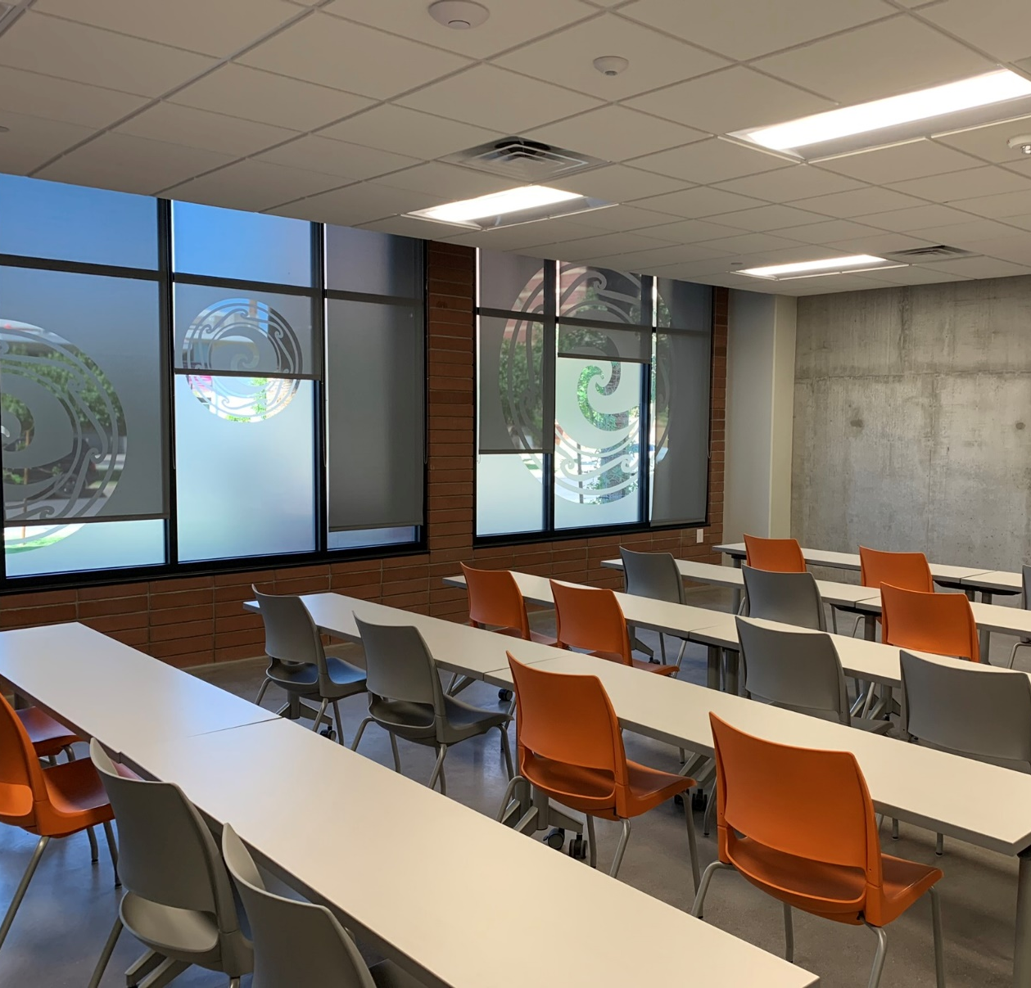
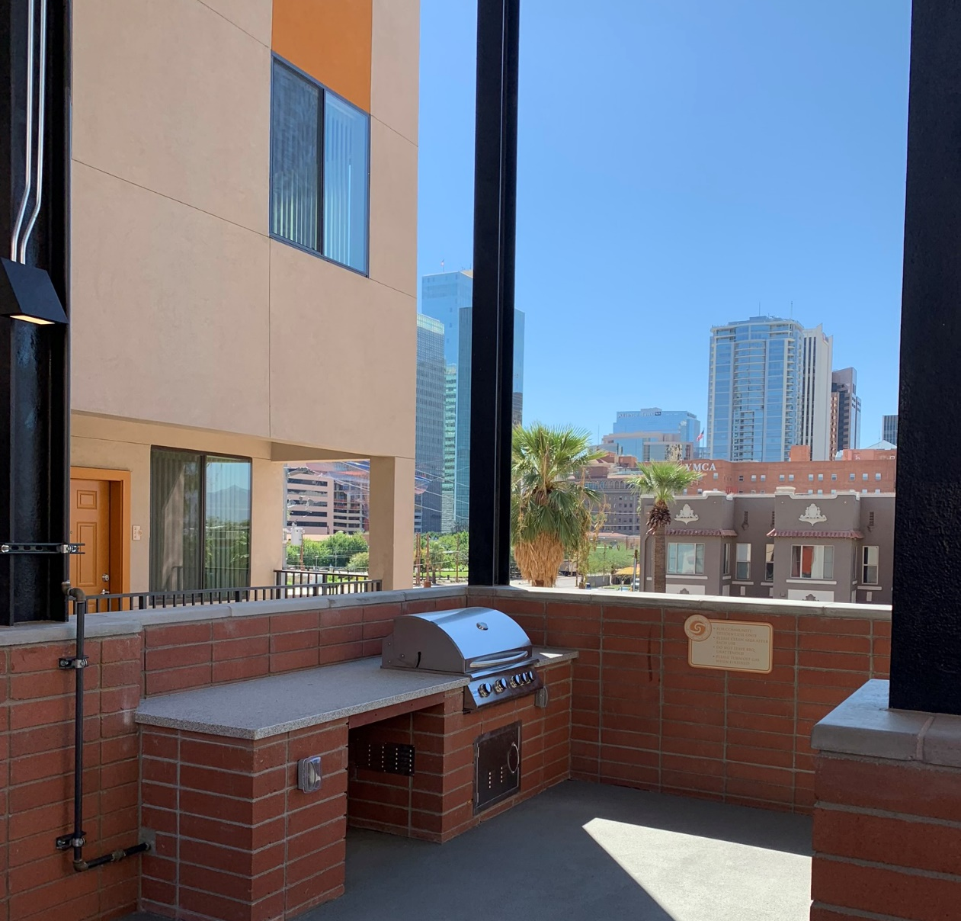

Slide 6
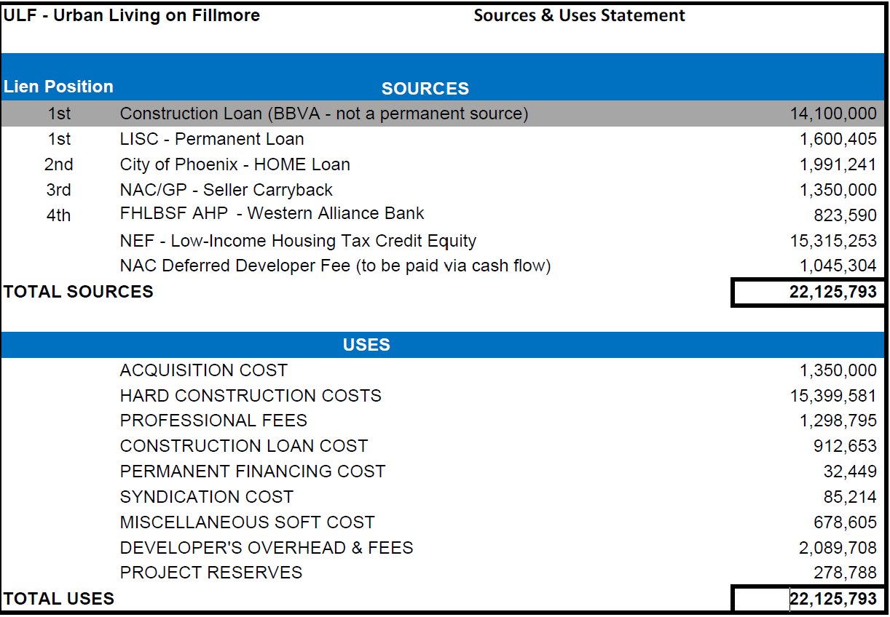
NAC leveraged 9% LIHTCs awarded by ADOH to anchor the capital stack for this affordable housing community serving families. Since NAC’s basis in the land was minimal, NAC was able to provide Seller Carryback financing to ensure financial viability.
Audios Co. | Brand Guide Fall 2020

Slide 7
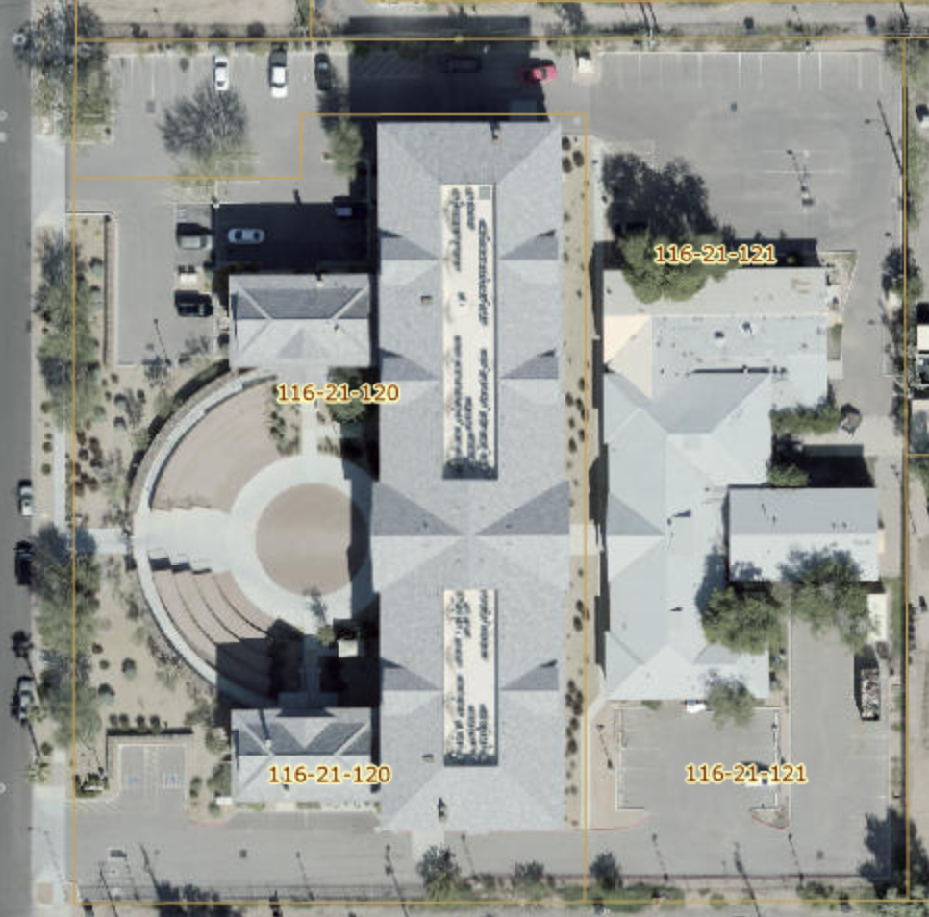
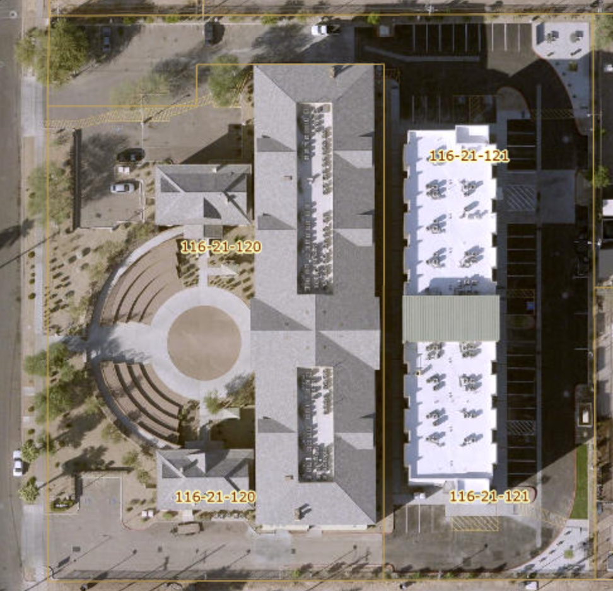
Stepping Stone III
NAC developed the Stepping Stone Campus to serve chronically homeless individuals – many applicants have $0 income at move-in. Phase III of the Stepping Stone Campus on “surplus” land that had no debt or use restrictions. In addition, the underlying zoning permitted additional multifamily units on the Campus.
Total Lot Area – 130,353 SF / 2.99 Acres
Phase II* - 70,629 SF / 1.62 acres → 83 Units
Phase III – 59,724 SF / 1.37 acres → 42 Units
Overall ~ 42 DUA / 93 Parking Spaces (with approved Parking Use Permit → 139 required)
* Phase I was originally developed by NAC and Mercy Housing 1997 and was an acquisition/rehab of 1920’s & 1950’s buildings. NAC redeveloped Phase II in 2011 as buildings were in disrepair.

Slide 8
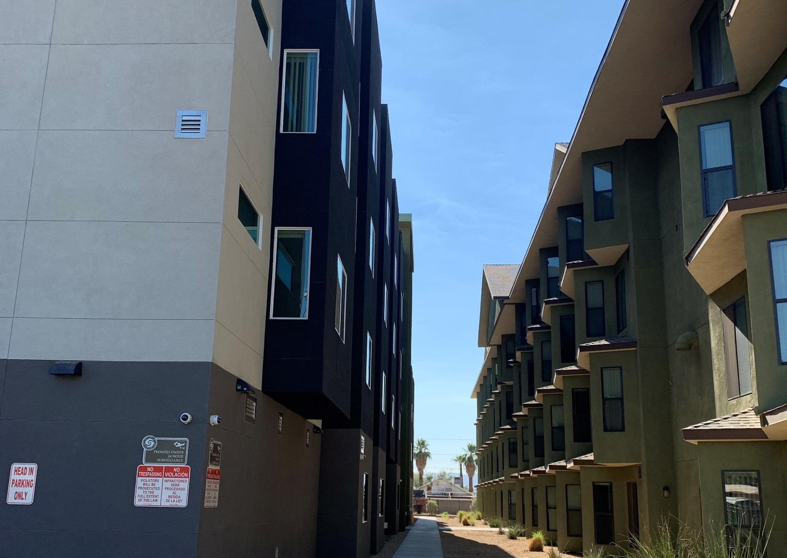
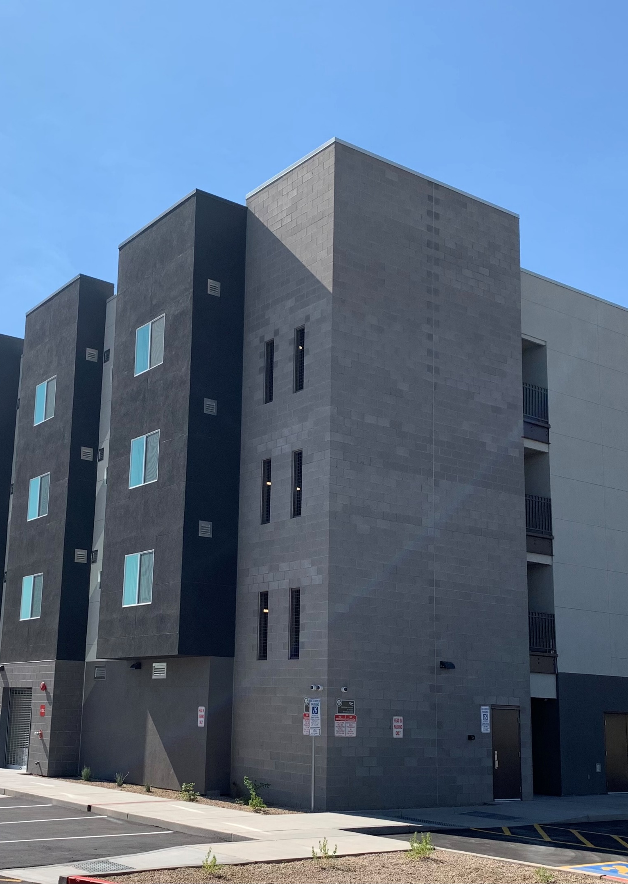
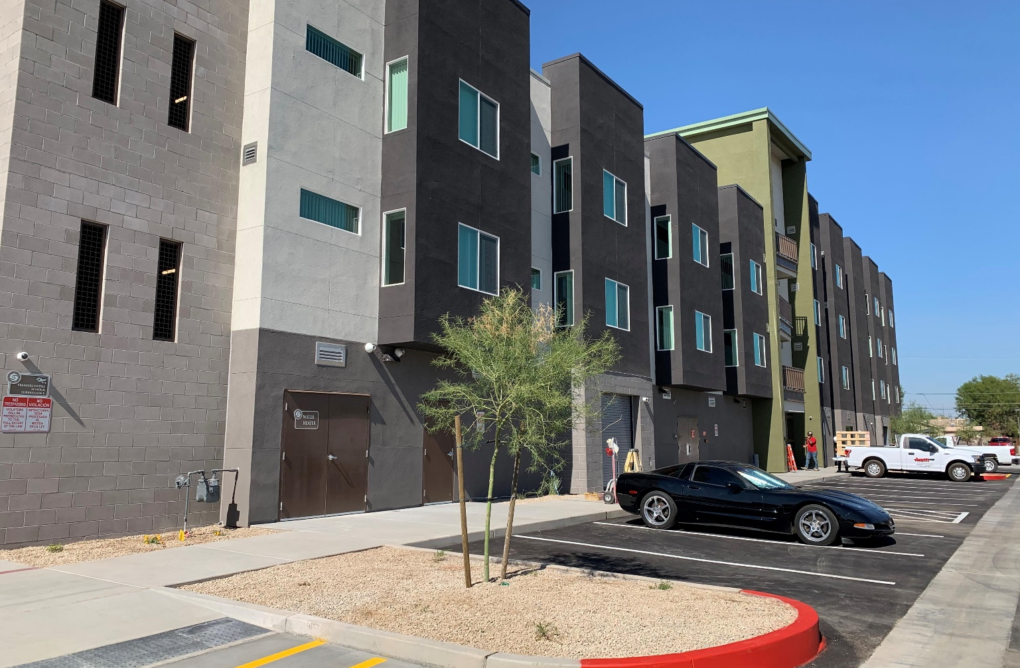

Slide 9
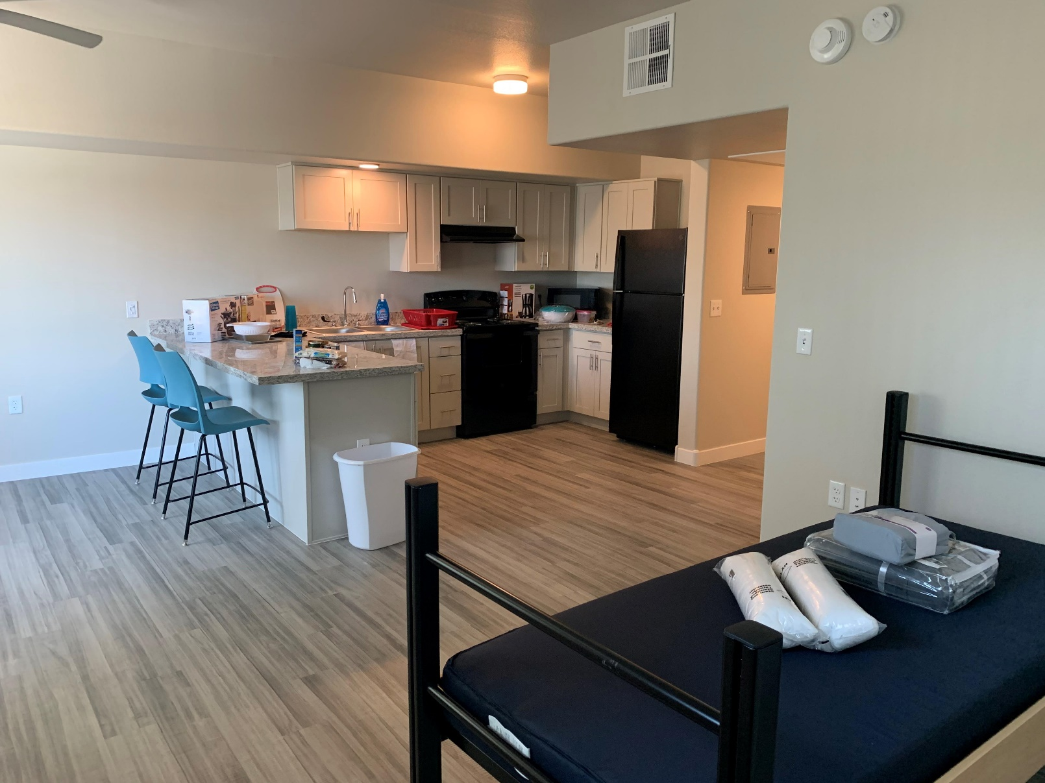
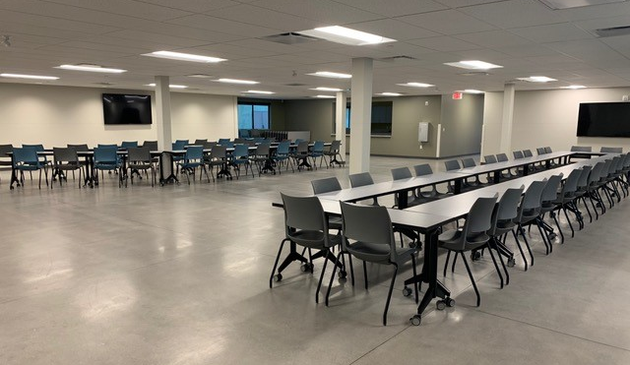
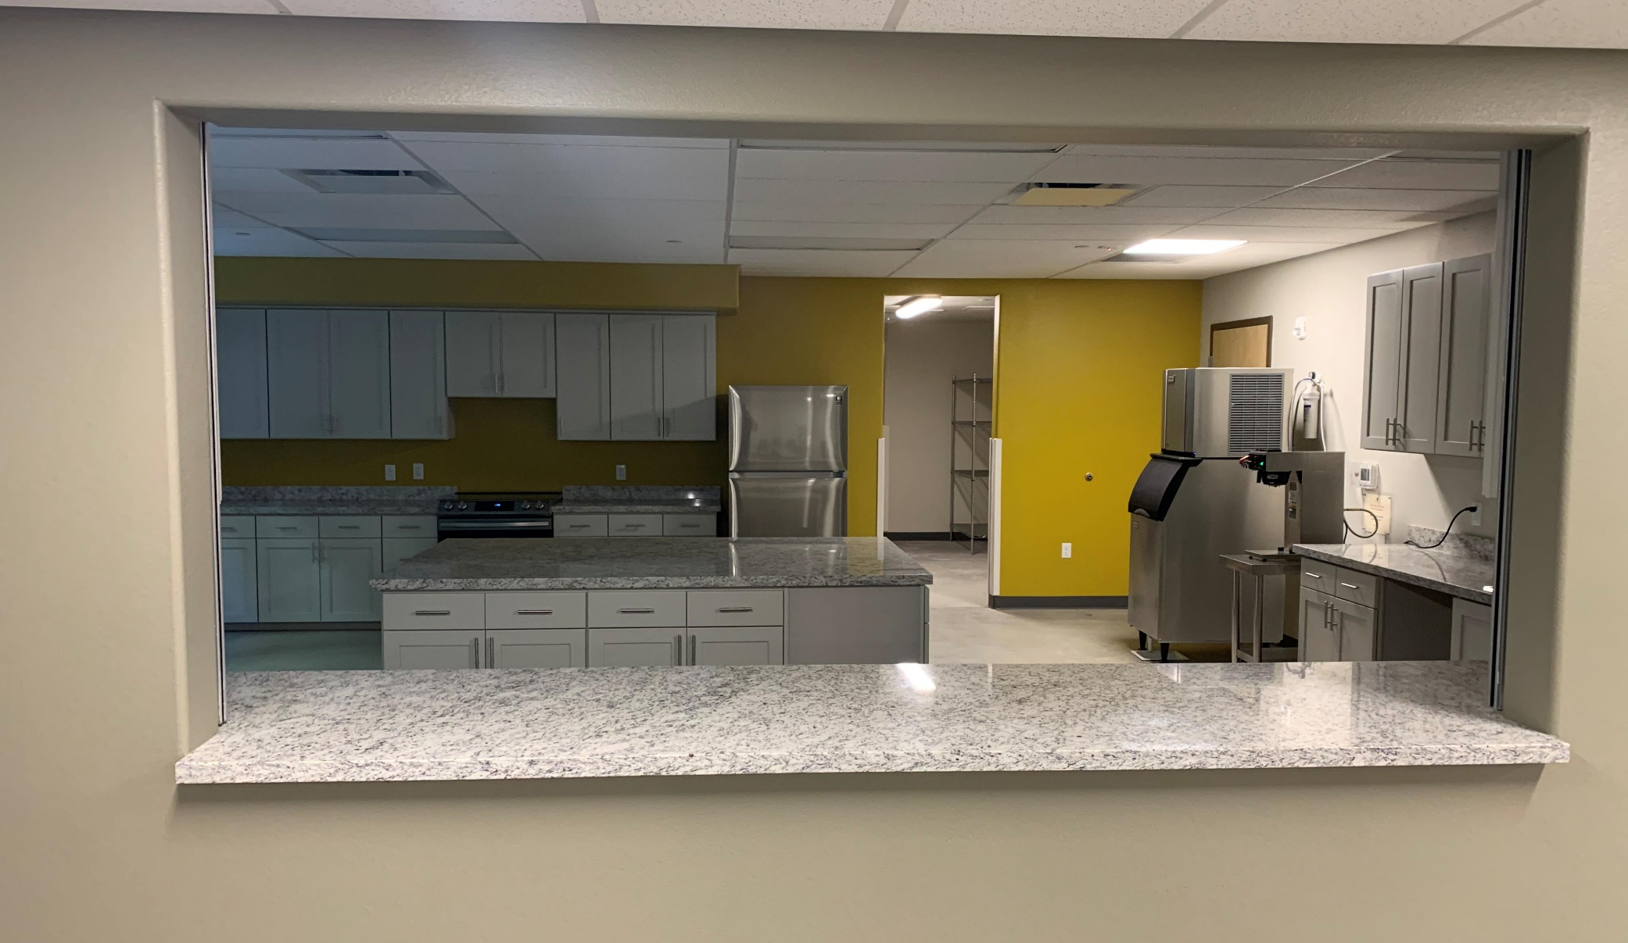
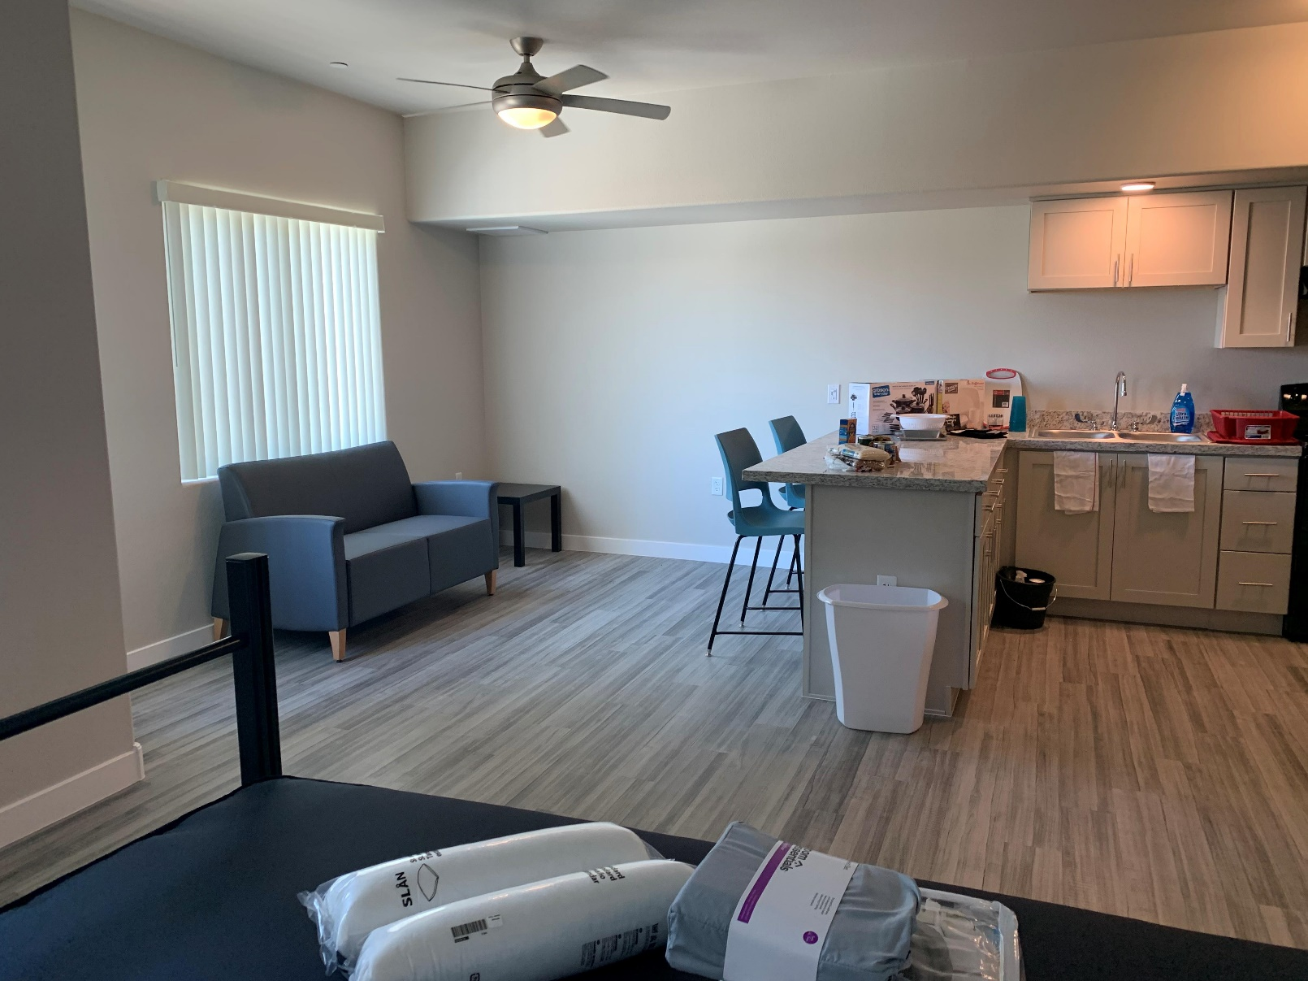

Slide 10
Stepping Stone III
NAC utilized 9 different capital sources to develop Stepping Stone III. Originally planned as a 9% LIHTC project, competitiveness in the Arizona 9% LIHTC program required NAC to switch to a 4% LIHTC Tax-Exempt Bond financing structure.
This property utilizes a combination of TBRA’s and HUD CoC for operational support to serve chronically homeless individuals.
Audios Co. | Brand Guide Fall 2020

Slide 11
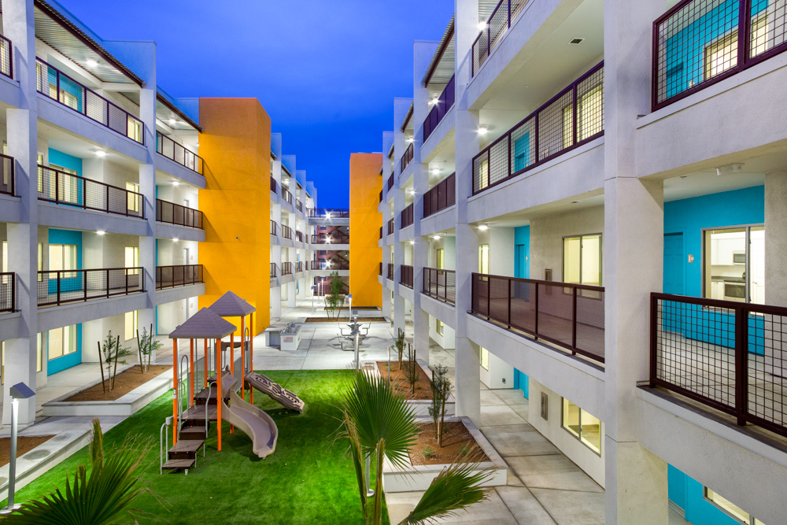
Cedar Crossing
Cedar Crossing was completed in 2015 and serves low-income families with a mix of studio, one, two and three bedroom apartment homes. The community is in midtown Phoenix with a Walk Score of 71 (i.e. Very Walkable).
Total Lot Area – 99,487 SF / 2.28 Acres → 74 Units
Overall ~ 32 DUA / 125 Parking Spaces (w/ shared parking easement to adjacent NAC property)
* Cedar Crossing is part of the Virginia Campus that includes Patina Wellness Center, a 70-bed residential treatment center. The Campus was developed in partnership with ASU’s Herberger Institute for Design and the Arts.

Slide 12
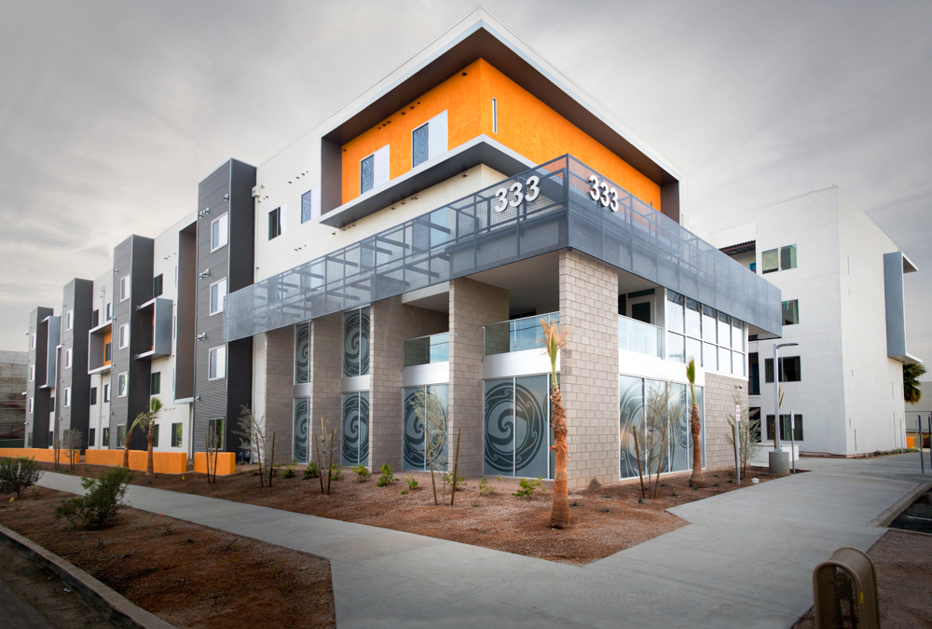
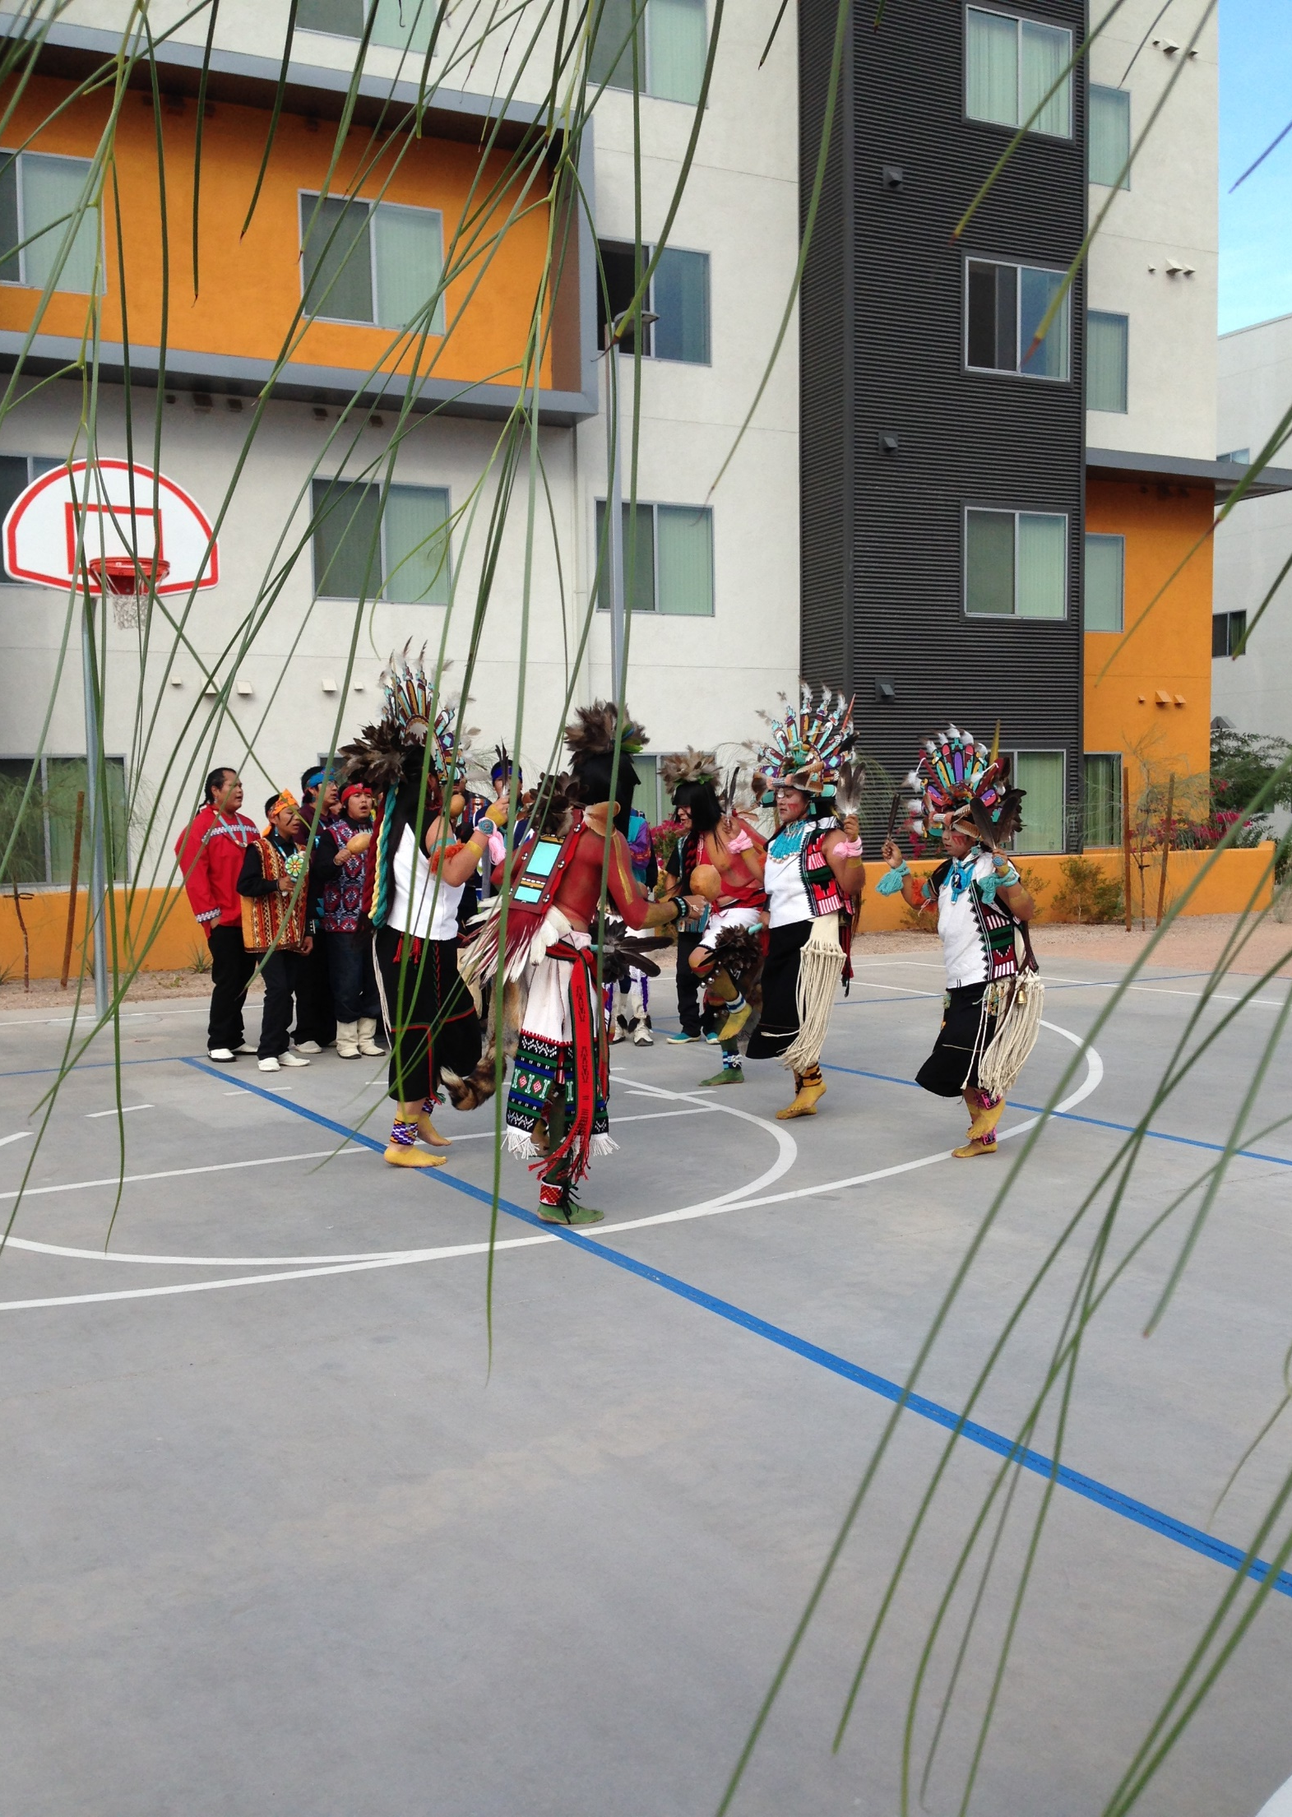
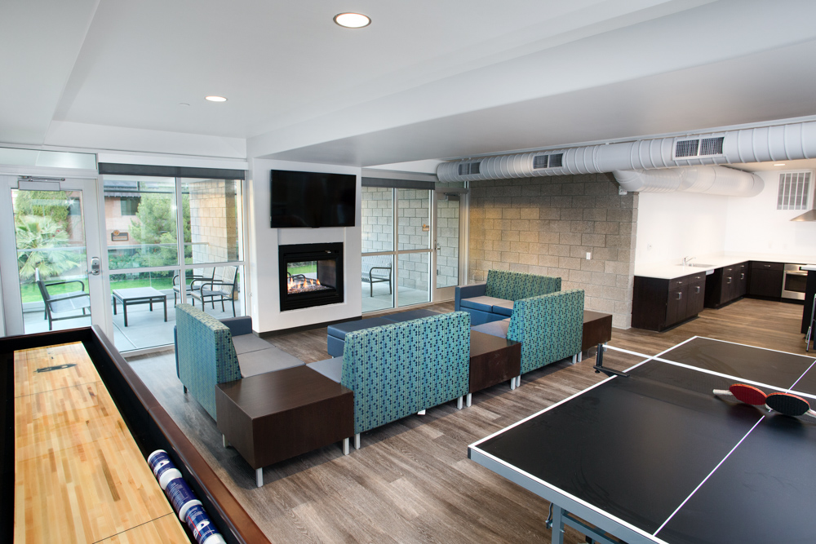

Slide 13
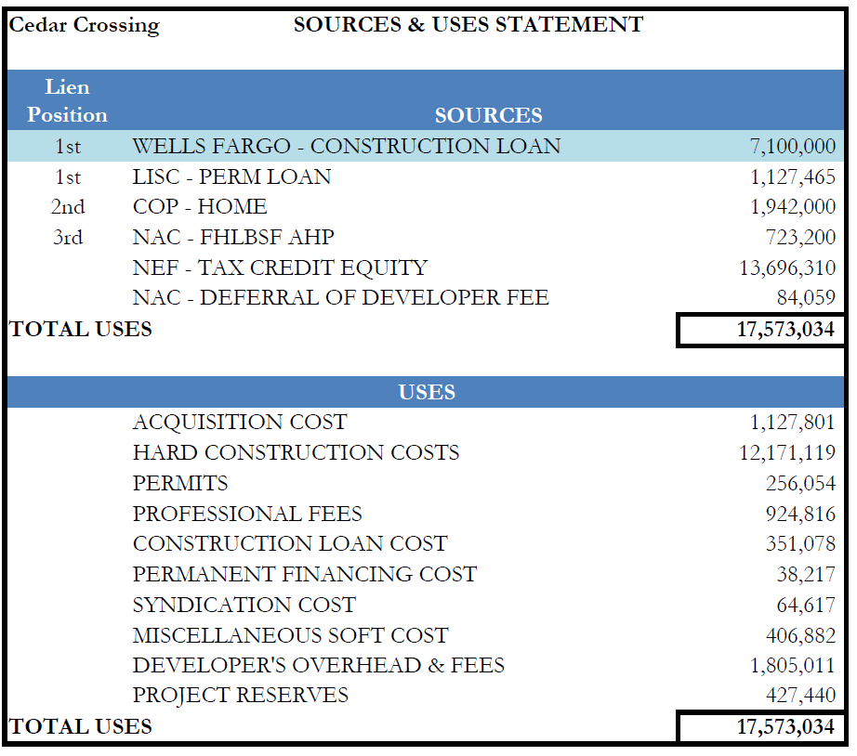
Cedar Crossing
NAC leveraged 9% LIHTCs awarded by ADOH to anchor the capital stack for this affordable housing community.
Stable construction costs at the time of this development permitted minimal deferred developer fee by NAC.
Audios Co. | Brand Guide Fall 2020

Slide 14
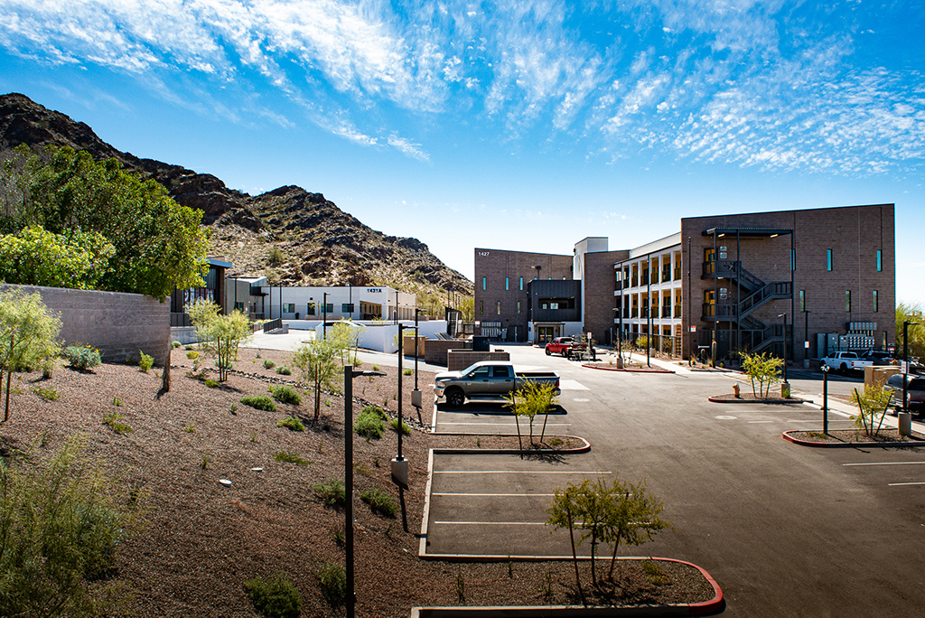
Dunlap Pointe & Patina Mountain Preserve

Slide 15
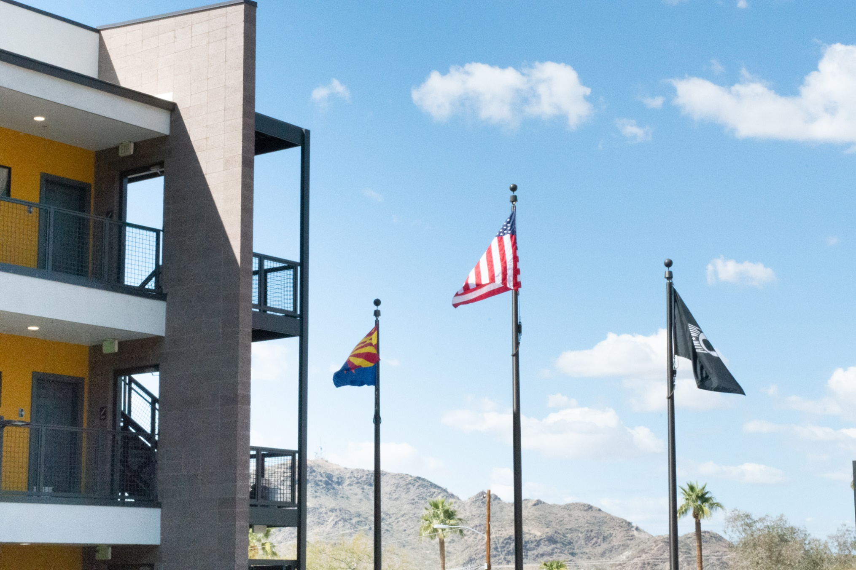
Dunlap Pointe
NAC developed Dunlap Pointe in 2021 as part of Dunlap Campus that includes Patina Wellness Center, a 55-bed residential treatment center. Dunlap Pointe serves chronically homeless individuals, with a special focus on serving homeless veterans.
Total Lot Area – 73,617 SF / 1.69 Acres → 55 Units
Overall ~ 32 DUA / 55 Parking Spaces

Slide 16

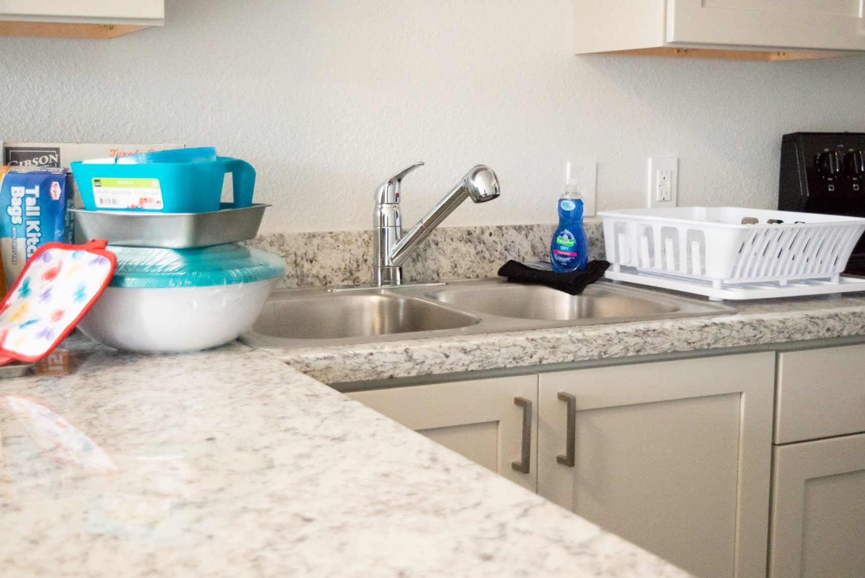
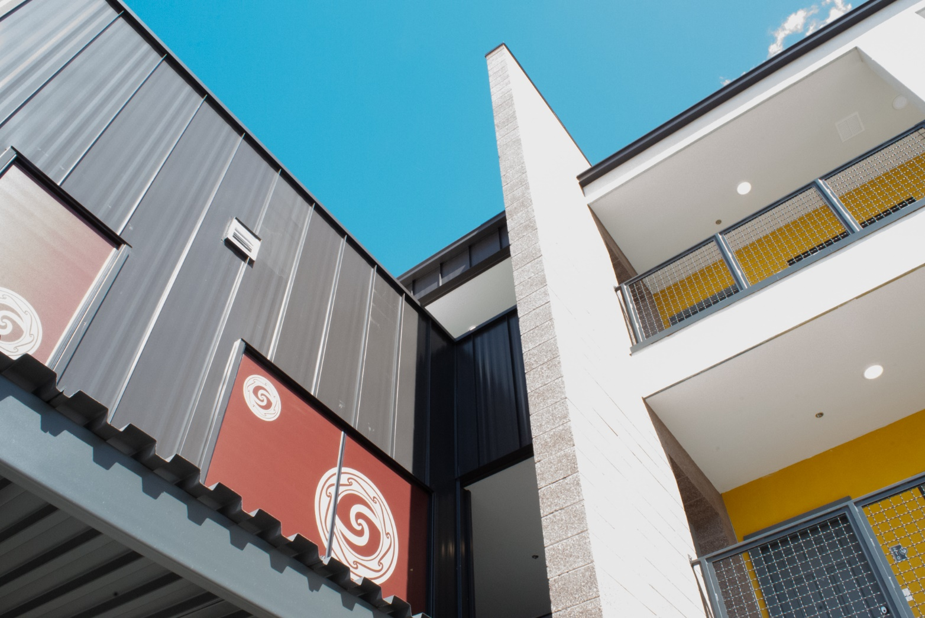

Slide 17
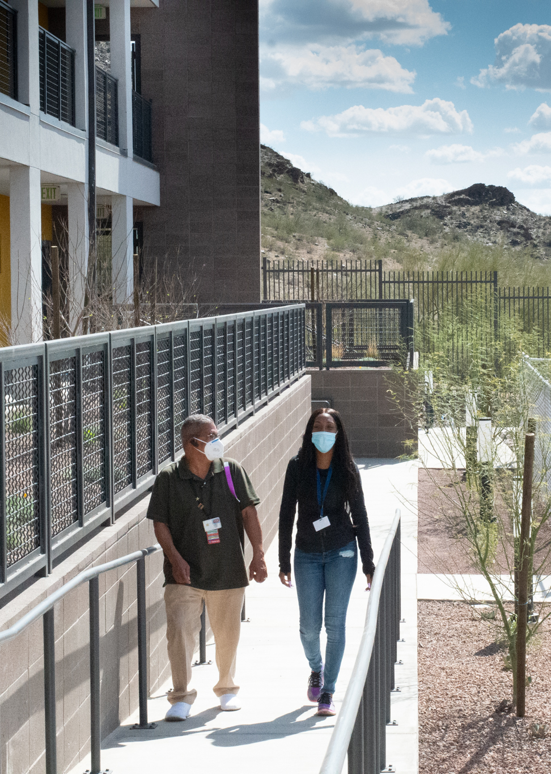
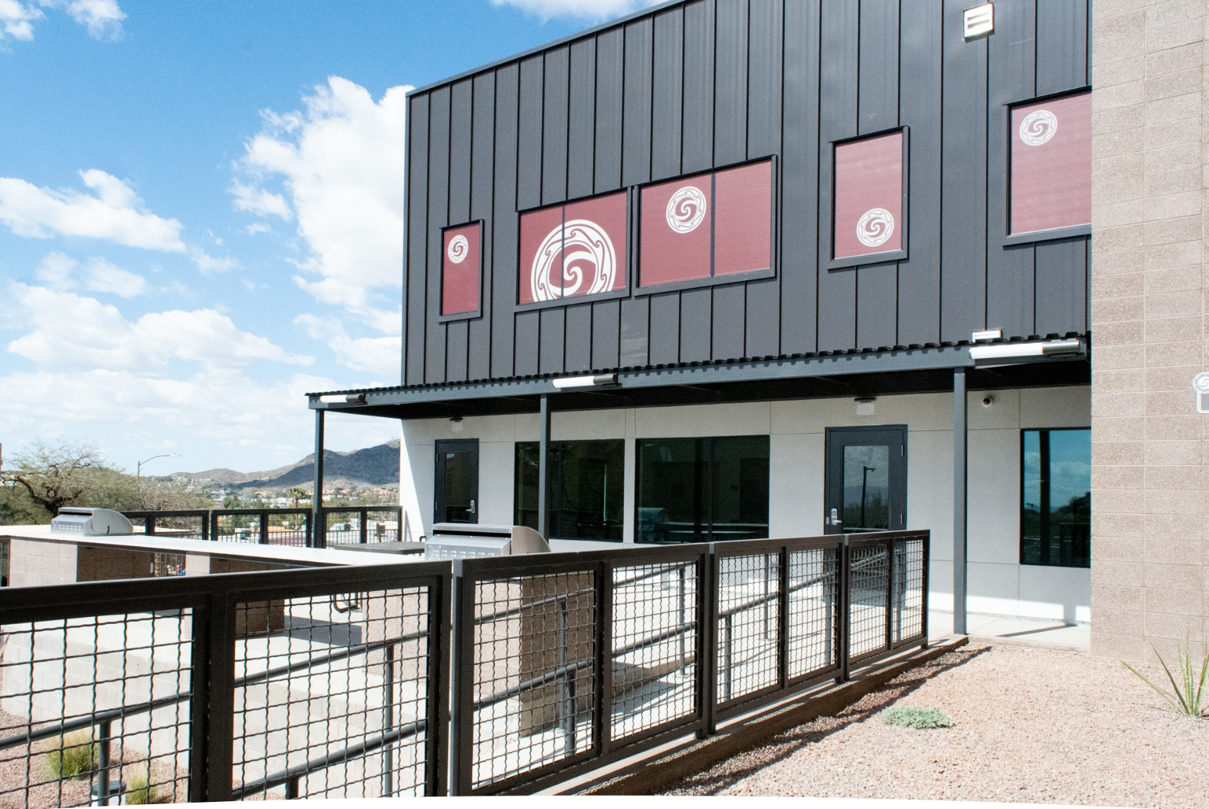


Slide 18
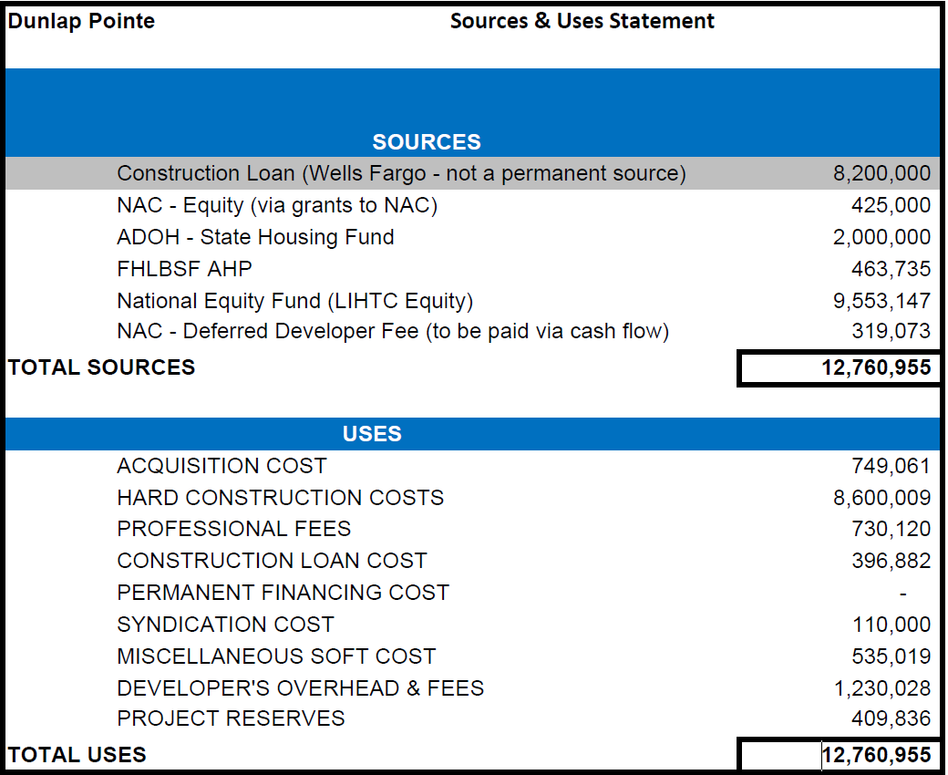
Dunlap Pointe
NAC was able to leverage planning grants with local & national foundations to begin feasibility studies of the Dunlap Campus.
ADOH provided the only “hard” loan payment financing for the Project due to the service population and required supportive services provided by NAC and other agencies.
Audios Co. | Brand Guide Fall 2020

Slide 19
Insights & Tips
Patience – Understanding that your funding & development partners have more than your project to manage. In addition, supportive service partners might not understand the “compliance” associated with tax credits.
Creativity & Flexibility – capital markets can change quickly, as can the construction/labor/supply markets so look to alternate solutions. Time is the most expensive “line-item” in your budget.
Leverage – combining different rental assistance sources may create increased permanent loan sizing but understand the long-term implications.
AZ Housing Forum / August 2023

