Slide 1
Rethinking Frameworks: Considerations for Developing Specialized Programs and Policy
Richard Southee

Slide 2
Agenda
Defining the Problem
How is this a Problem?
Where did the Problem Come From?
Who Does the Problem Affect?
What Does the Problem Look Like at a System Level?
How Can We Solve the Problem?

Slide 3
So… What’s The Problem?

Slide 4
“Chronic Homeless”
While the problem is not limited to ‘Chronically homeless’ it is the perfect embodiment of what the problem is, so we’re going to focus a bit on this.

Slide 5
“Chronic Homeless”
As defined by HUD is an individual with a disability as defined by the McKinney-Vento Assistance Act who has been homeless for at least 12 months or on at least 4 separation occasions in the last 3 years totaling at least 12 months.
Notes:
So let me ask: How many of you have at your organization, programs or positions specifically targeted towards a vulnerable population? Chronic, Senior, Youth, Disabled, Veterans, etc?
[get people to share]

Slide 6
What’s the Problem with “Chronic”?
Well, what do you do when someone is chronically homeless?
Is there special chronic homeless therapy?
Is there a chronic homeless hotline?
A chronic homeless case plan to follow?
Notes:
You might have a case plan – but my guess is that its really just a bunch of questions to help determine why someone is homeless. And this is the problem – many of the labels that we use and assign our clients don’t tell us much of anything. They don’t give you any insight into how to resolve the problem. Senior, Youth, Disabled, Veteran, SMI, none of these tell you what the client needs to resolve their homelessness.

Slide 7
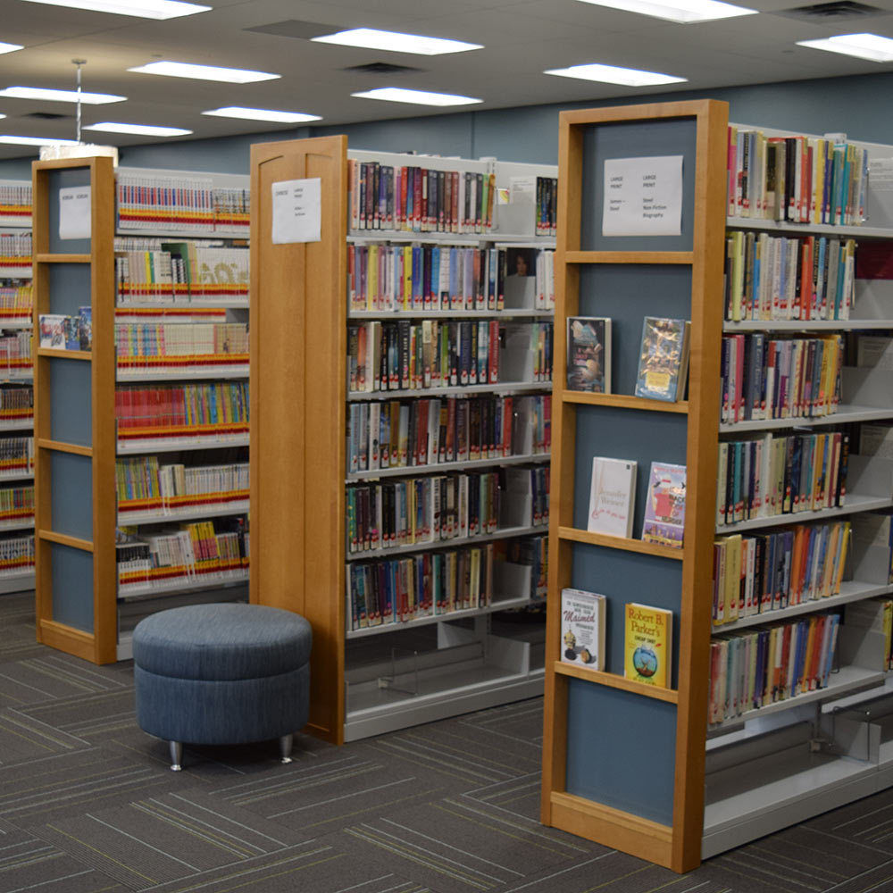
Youth
Senior
Veteran
Chronic
Disabled
SMI

Slide 8
Senior
Youth
Chronic
Veteran
Disabled
SMI
Notes:
Dewey Decimal System of programs. Envision a program meant to serve a specialized population and think about the services it provides. Now change that label to another program. Does it still work? If so, how is it specialized?

Slide 9
How is this a Problem?

Slide 10
What good are these labels?
These populations are identified based off their vulnerability, which does not necessarily inform how you resolve their homelessness.
Vulnerability is about how being in this group makes them vulnerability to the long-term effects of homelessness, not that being in this group makes them vulnerable to being homeless.

Slide 11
So… Where Did This Come From??

Slide 12
Enter: Kuhn & Culhane
Two researchers who researched homelessness in it’s various forms
Typological groups had been used such as:
Recently Dislocated, Vulnerable, Outsiders, Prolonged
Hostile/Psychotic, Depressed, Best-functioning, Substance Using
Alcoholic, Psychiatrically impaired, best-functioning, multi-problem
Chronic, Episodic, Transitional
Published work in 1998 applying a cluster analysis to temporal type typologies
Was highly popularized due to findings around the cluster analysis.
“Kuhn and Culhane theorized that assistance could be targeted to individuals based on the nature of their homelessness. While short-term assistance such as income supports may be sufficient for someone who is transitionally homeless, a person experiencing chronic homelessness may need long-term housing subsidies and ongoing supportive services.”
In 2000, the NAEH prioritized addressing Chronic Homelessness, and in 2003 under the guidance of George W. Bush it became a part of HUD’s 10-year plan to end homelessness.

Slide 13
Shelter Utilization Patterns
Kuhn & Culhane utilized 3 major clusters that virtually every client they included could fall into, then identified constituent characteristics most common among these populations
Chronic User
“These are people who are likely to be entrenched in the shelter system, and for whom shelters are more like long-term housing than an emergency arrangement”
Episodic User
“The episodically homeless population comprise those who frequently shuttle in and out of homelessness, or the mediating institutions that house them”
Transitional User
“[This population] consists of those who generally enter the shelter system for only one stay and for a short period.”
Among these groups, what they identified were that most barriers or vulnerabilities (age, substance use, mental illness, medical issues) increased from transitional to episodic, then from episodic to chronic. What they called “a gradient”.

Slide 14
Two Things About That…
Shelter Utilization Patterns are not the same as Time(s) Homeless
A person considered transitional could easily be chronic or episodic
A person considered episodic could easily be chronic
A person then considered chronic could be reclassified as episodic
“…future research should also explore the extent to which these typologies would be affected by the inclusion of homelessness experiences outside of public shelter”
Their focus was on housing interventions.
Their recommendations were about what type of housing intervention to provide for the clients who fell into each group and why this housing recommendation would work for provision of further services when necessary.
Less residential emphasis for transitional groups
Residential treatment programs for episodic
Supportive housing, SROs and community housing programs for Chronic.
Notes:
Very simply – the more barriers, the more interventions you need. IF you aren’t serving the higher populations, don’t bother with higher interventions.
Kuhn and Culhane’s work opened the gates to vulnerable populations are who we need to prioritize.

Slide 15
General Population of Clients
Homeless Prevention Services
Transitional Clients
Economic Barriers
Residential Treatment Programs
Episodic Clients
Substance Use Barriers
Chronic Clients
Alternative Housing Interventions
Substance, Medical, Mental Health, Social Barriers
Notes:
Very simply – the more barriers, the more interventions you need. IF you aren’t serving the higher populations, don’t bother with higher interventions.
Kuhn and Culhane’s work opened the gates to vulnerable populations are who we need to prioritize.

Slide 16
General Population of Clients
Homeless Prevention Services
Economic Barriers
Transitional Clients
Residential Treatment Programs
Episodic Clients
Substance Use Barriers
Alternative Housing Interventions
Substance, Medical, Mental Health, Social Barriers
Chronic Clients
Notes:
Very simply – the more barriers, the more interventions you need. IF you aren’t serving the higher populations, don’t bother with higher interventions.
Kuhn and Culhane’s work opened the gates to vulnerable populations are who we need to prioritize.

Slide 17
General Population of Clients
Homeless Prevention Services
Economic Barriers
Transitional Clients
Residential Treatment Programs
Episodic Clients
Substance Use Barriers
Alternative Housing Interventions
Substance, Medical, Mental Health, Social Barriers
Chronic Clients
Notes:
Very simply – the more barriers, the more interventions you need. IF you aren’t serving the higher populations, don’t bother with higher interventions.
Kuhn and Culhane’s work opened the gates to vulnerable populations are who we need to prioritize.

Slide 18
General Population of Clients
Homeless Prevention Services
Economic Barriers
Transitional Clients
Residential Treatment Programs
Episodic Clients
Substance Use Barriers
Alternative Housing Interventions
Chronic Clients
Substance, Medical, Mental Health, Social Barriers
Notes:
Very simply – the more barriers, the more interventions you need. IF you aren’t serving the higher populations, don’t bother with higher interventions.
Kuhn and Culhane’s work opened the gates to vulnerable populations are who we need to prioritize.

Slide 19
General Population of Clients
Homeless Prevention Services
Transitional Clients
Economic Barriers
Residential Treatment Programs
Episodic Clients
Substance Use Barriers
Chronic Clients
Alternative Housing Interventions
Substance, Medical, Mental Health, Social Barriers
Notes:
Very simply – the more barriers, the more interventions you need. IF you aren’t serving the higher populations, don’t bother with higher interventions.
Kuhn and Culhane’s work opened the gates to vulnerable populations are who we need to prioritize.

Slide 20
Who does this affect?
The reality is, these labels actually have tangible effects on the clients we serve. Just as the example earlier of a person willing to provide a job to a person experiencing homelessness, in our day-to-day work labeling clients this way can limit the way they receive services or have no affect on the services they’d receive at all.
Meet Marge & Homer

Slide 21
Marge!
Marge is…
A 58-year-old, Hispanic woman
She has been in-and-out of homelessness over the past 14 years.
She has received a Rapid Rehousing Voucher 3x times but has never maintained housing in this 14-year period for more than 9 months.
She has a serious mental illness designation for bipolar disorder.
Most recent period of homelessness the result of fleeing an abusive relationship.

Slide 22
Homer!
Homer is…
A 68-year-old white man
He has been homeless for a year and a half since being released from prison for drug trafficking.
He was dishonorably discharged from the military in his early 20s.
Following an injury while in prison, Homer walks with a cane and struggles to stand for long periods of time.
Receives $914 in SSI monthly
Had a son he was distant from

Slide 23
Labels for Marge & Homer
Marge
Chronic
Senior
SMI
Domestic Violence Survivor
VI-SPDAT score of 9
Homer
Chronic
Senior
Veteran
Felon
Disabled
VI-SPDAT score of 8
Both these clients went a senior program, were identified for Rapid-Rehousing vouchers, and went through the process of finding a home based off the provisions of their voucher.

Slide 24
Labels for Marge & Homer
Marge & Homer are – for all intents – opposites. They overlap only on two of the labels we assign them in our system. Many of their points on the VI-SPDAT came from different causes; Yet they were placed in the same program, with the same resources, under the same case manager because of these two overlapping labels. Curiously, the labels that they overlap on, and that we prioritize, are the two labels that tell us the least about their needed interventions.
Homer’s resolution could have been facilitated knowing nothing except for the fact that he was seeking employment and needed a felony friendly job.
Marge’s resolution could have been facilitated knowing nothing except for the fact that she was a domestic violence survivor and seriously mentally ill.

Slide 25
At a Systems Level
When talking about this for a system’s level, two major issues arise:
It becomes obvious very quickly that many programs that are “specialized” are offering the same services to different populations. Perhaps there is heavier emphasis on one particular barrier over another, but the division of clients ultimately requires the duplication of services, which increases the economic burden of the organization to address these barriers or decentralizes the clients case management which is often viewed as impersonal or jarring.
We find that the distribution of barriers does not radically shift based on the specialized population you’re looking at. In fact, self-reported barriers are distributed rather consistently across the various labels we use to identify vulnerability.

Slide 26
Reason for Homelessness
Reason For Homelessness | Seniors | Youth | Veteran | Disabled | Mental Illness | Substance | Chronic
Aged Out of Foster Care | 0 | 24 | 0 | 22 | 2 | 2 | 21
Client doesn't know | 2 | 0 | 0 | 5 | 1 | 0 | 5
Client NOT Homeless | 48 | 7 | 3 | 77 | 14 | 14 | 14
Client Refused | 0 | 0 | 0 | 1 | 0 | 0 | 1
COVID-19/Coronavirus | 72 | 3 | 19 | 195 | 24 | 60 | 135
Criminal Activity | 5 | 0 | 0 | 17 | 2 | 4 | 16
Economic | 196 | 11 | 18 | 392 | 58 | 72 | 343
Evicted | 117 | 5 | 5 | 234 | 23 | 58 | 209
Exploitation/Human Trafficking | 9 | 0 | 0 | 20 | 2 | 0 | 18
Family Dispute/Overcrowding/Kicked-Out | 642 | 243 | 52 | 1583 | 222 | 346 | 1261
Lacking Financial Resources | 11 | 0 | 8 | 11 | 0 | 0 | 1
Loss of Employment | 196 | 38 | 51 | 588 | 77 | 97 | 495
Loss of Job (Unemployment) | 2 | 0 | 0 | 1 | 0 | 0 | 1
Loss of Non-Employment Income or No Financial Resources | 258 | 39 | 43 | 527 | 100 | 118 | 370
Medical Problems | 187 | 1 | 18 | 397 | 33 | 79 | 352
Mental Health Concerns | 185 | 4 | 41 | 705 | 146 | 167 | 624
Moved to Seek Work | 24 | 4 | 3 | 50 | 4 | 14 | 41
Natural Disaster/Fire | 44 | 0 | 1 | 56 | 9 | 5 | 49
New to Area | 220 | 65 | 57 | 482 | 89 | 75 | 352
Other | 183 | 28 | 39 | 398 | 65 | 81 | 305
Release from Jail/Prison/Juvenile Hall | 171 | 14 | 17 | 494 | 53 | 120 | 400
Substance Use/Alcohol Dependency Concerns | 125 | 10 | 24 | 435 | 51 | 145 | 382
Transient/Choice | 10 | 11 | 5 | 37 | 1 | 2 | 34
Unable to Find Affordable Housing | 386 | 39 | 50 | 614 | 125 | 105 | 518
Unsafe Living Environment - Not Violence Related | 57 | 3 | 7 | 96 | 13 | 17 | 82
Unsafe Living Environment - Violence/Domestic Abuse | 53 | 13 | 4 | 200 | 39 | 40 | 163
Total Responses | 3081 | 528 | 443 | 7337 | 1112 | 1545 | 6016
Total Individuals | 1450 | 280 | 262 | 3321 | 490 | 660 | 2599

Slide 27
Reason for Homelessness
Reason For Homelessness | Seniors | Youth | Veteran | Disabled | Mental Illness | Substance | Chronic
Aged out of Foster Care | 0.0% | 5.0% | 0.0% | 0.3% | 0.2% | 0.1% | 0.4%
COVID-19/Coronavirus | 2.5% | 0.6% | 4.8% | 2.9% | 2.3% | 4.1% | 2.4%
Criminal Activity | 6.2% | 2.9% | 4.3% | 7.5% | 5.3% | 8.6% | 7.4%
Economic | 41.5% | 28.2% | 42.9% | 35.3% | 37.5% | 32.0% | 34.9%
Exploitation/Human Trafficking | 0.3% | 0.0% | 0.0% | 0.3% | 0.2% | 0.0% | 0.3%
Family Dispute/Overcrowding/Kicked-Out | 26.5% | 53.7% | 15.9% | 27.6% | 26.6% | 27.8% | 26.6%
Medical Problems | 6.6% | 0.2% | 4.5% | 5.8% | 3.2% | 5.5% | 6.2%
Mental Health Concerns | 6.5% | 0.8% | 10.4% | 10.3% | 14.2% | 11.5% | 11.0%
Natural Disaster/Fire | 1.6% | 0.0% | 0.3% | 0.8% | 0.9% | 0.3% | 0.9%
New to Area | 7.8% | 13.5% | 14.4% | 7.1% | 8.6% | 5.2% | 6.2%
Substance Use/Alcohol Dependency Concerns | 4.4% | 2.1% | 6.1% | 6.4% | 4.9% | 10.0% | 6.8%

Slide 28
Reason for Homelessness
Reason For Homelessness | Seniors | Youth | Veteran | Disabled | Mental Illness | Substance | Chronic
Economic | 1 | 2 | 1 | 1 | 1 | 1 | 1
Family Dispute/Overcrowding/Kicked-Out | 2 | 1 | 2 | 2 | 2 | 2 | 2
Mental Health Concerns | 5 | 7 | 4 | 3 | 3 | 3 | 3
New to Area | 3 | 3 | 3 | 5 | 4 | 7 | 6
Criminal Activity | 6 | 5 | 7 | 4 | 5 | 5 | 4
Substance Use/Alcohol Dependency Concerns | 7 | 6 | 5 | 6 | 6 | 4 | 5
Medical Problems | 4 | 10 | 6 | 7 | 7 | 6 | 6
Aged out of Foster Care | x | 4 | x | 10 | 10 | 10 | 10

Slide 29
Considering Alternatives: Service Specialization
Our current form of service prioritization and specialization is built around an expectation that people in similar categories will have similar needs, yet we see time and time again a wide array of needs being displayed by people across these categories. Specialization in vulnerability is not the same as specialization in barriers. Delivery of services must take into consideration that clients need to have a stake in the services they receive and be able to identify what their barriers are and how to navigate them. Time and time again best-practice models teach us this:
Harm Reduction
Housing First
Trauma-Informed Care

Slide 30
Considering Alternatives: Trauma-Informed Care
Through the use of Trauma-Informed Care, we can also take into consideration how trauma influences service utilization. A thorough examination on how trauma-influences service utilization patterns could help us better understand how client’s histories impact their service utilization and generate service models that are specialized in overcoming barriers that manifest in response to trauma. Our services are often designed to overcome explicit barriers to homelessness, but what if instead out programs were designed to be therapeutic in nature, initiating a cycle of healing in our clients that empowers them to overcome their barriers independent of the nature of the barrier, and allowing them to generate their own stabilization through healing of trauma.
If our programs were specialized in trauma-informed care, identifying barriers in advanced may no be necessary as trauma-informed care should independently empower the clients to act.

Slide 31
Conclusion: Reframe & Refocus:
What we should consider is that currently, we deliver and prioritize services based off of vulnerability – rightfully because these are the people most as risk for the consequences of homelessness. But organizing clients this way results in duplication of services, fundamentally different clients going into the same programs based off of this vulnerability, and a deficit of information of what the client needs until the client is in front of you.
I ask that we reframe our approach to be built around barriers, not vulnerabilities. Chronic clients can be prioritized, but they do not need to be treated as a group. Consider the labels we assign our clients and how it informs the work you do with them – if it does not, should it be a consideration for how you deliver services?
Notes:
I’m not saying these programs are bad especially if they’re helping someone navigate homelessness. Organizations like, Justa-Center for example aren’t doing it “wrong” because they’re targeting seniors, in –fact targeting seniors to help them navigate and survive homelessness is definitely needed because seniors have shared experiences during homelessness. The issue arises from attempting to resolve homelessness based on this label as well.

Slide 32
Thank you for your time!
Questions?
Richard Southee
rsouthee@cassaz.org
rsouthee@asu.edu

