Slide 5
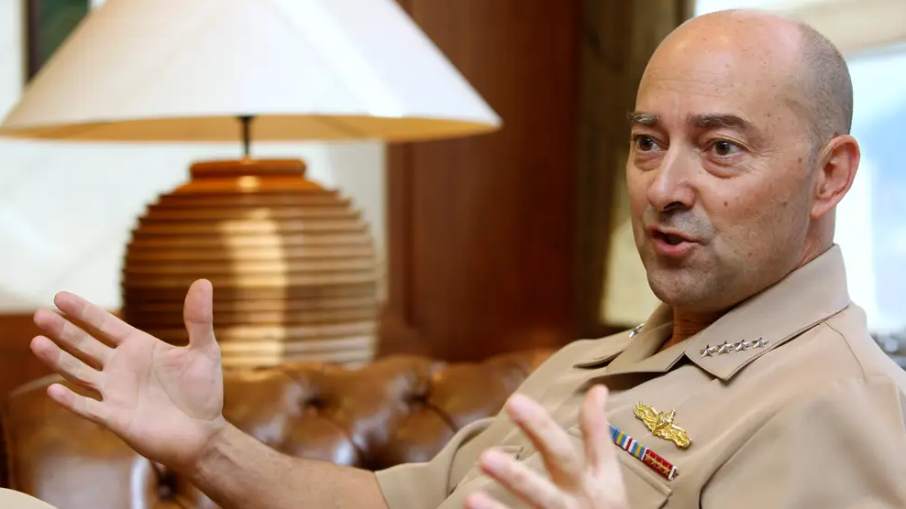

Slide 6
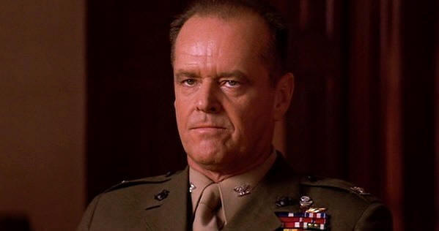

Slide 8
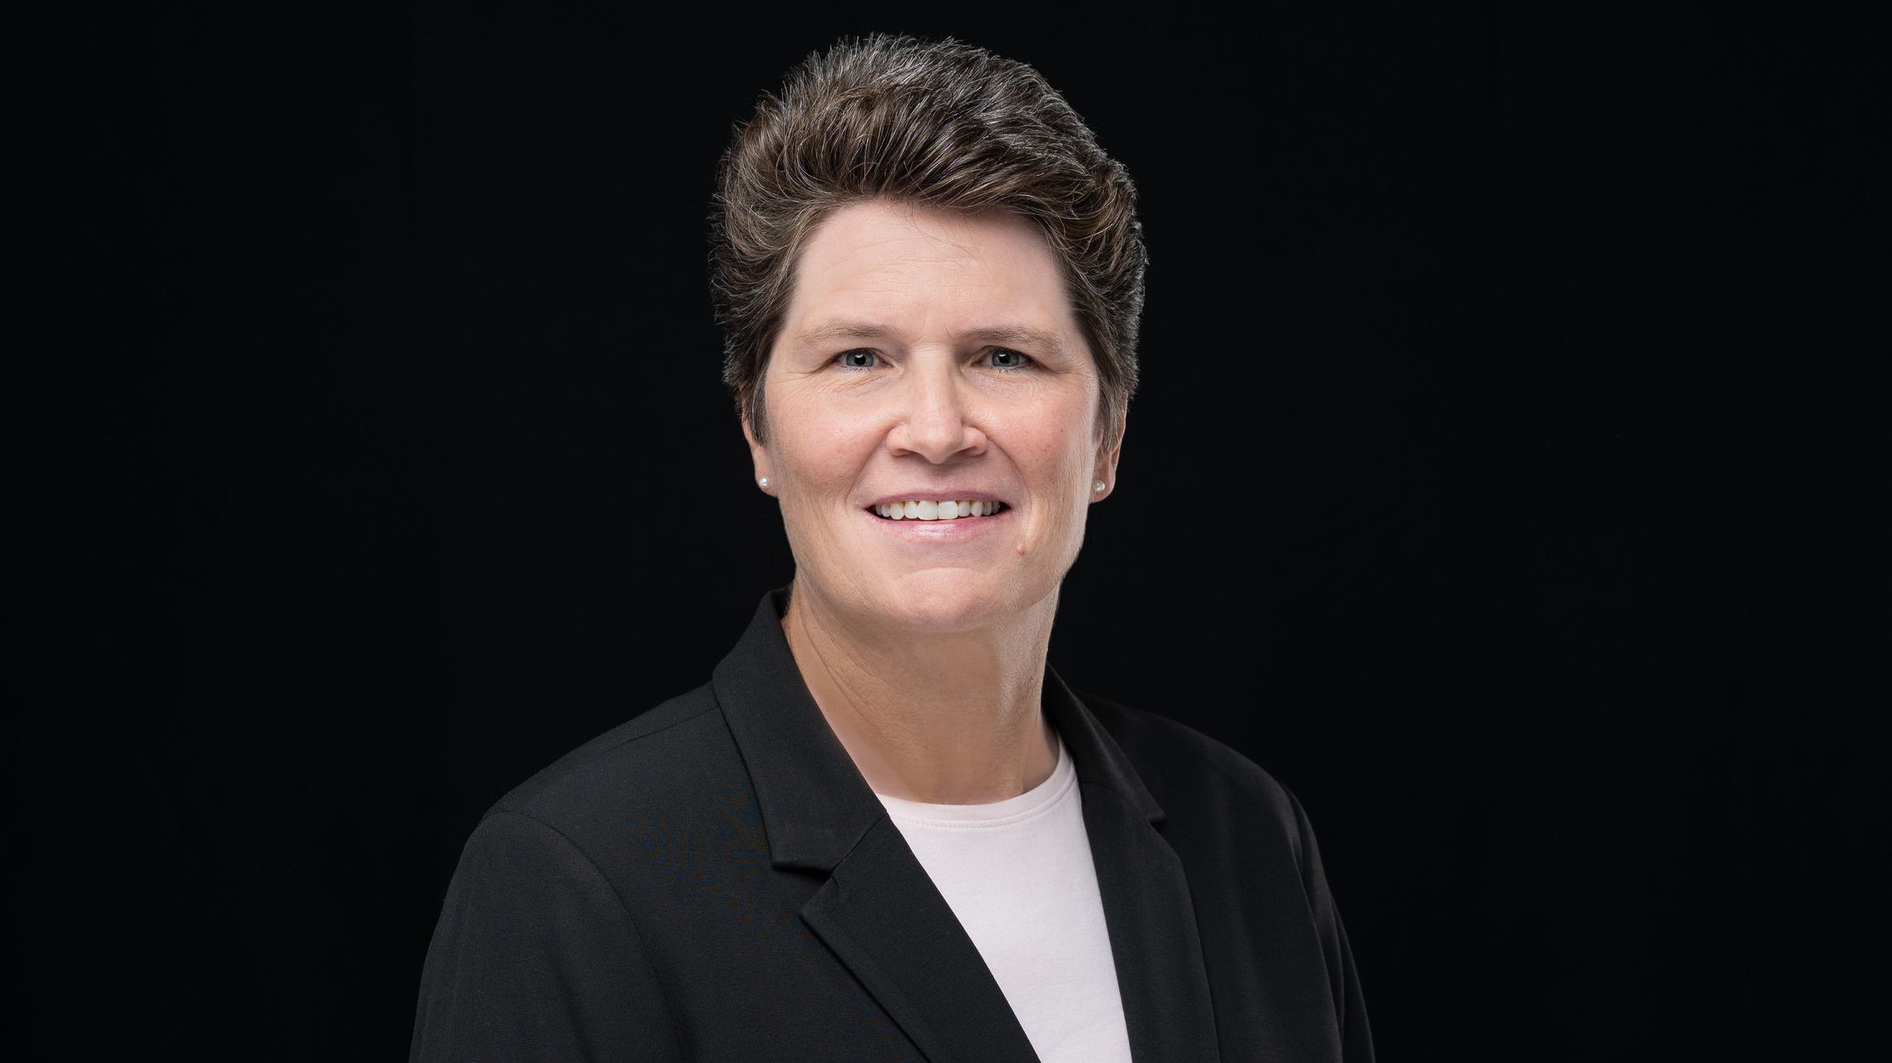

Slide 10
Vision
Flexibility
Self-Confidence
Self-Awareness
Empathy
Morality
Love of People

Slide 18
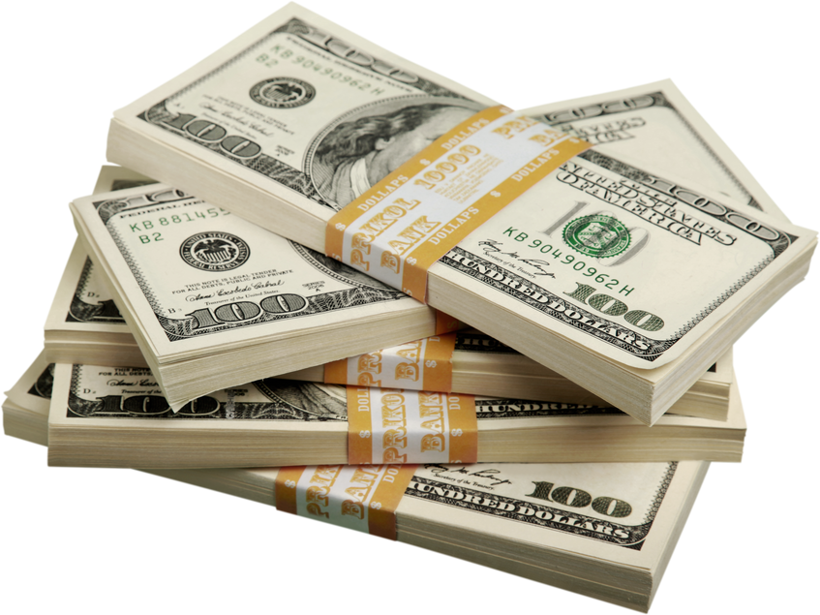

Slide 21
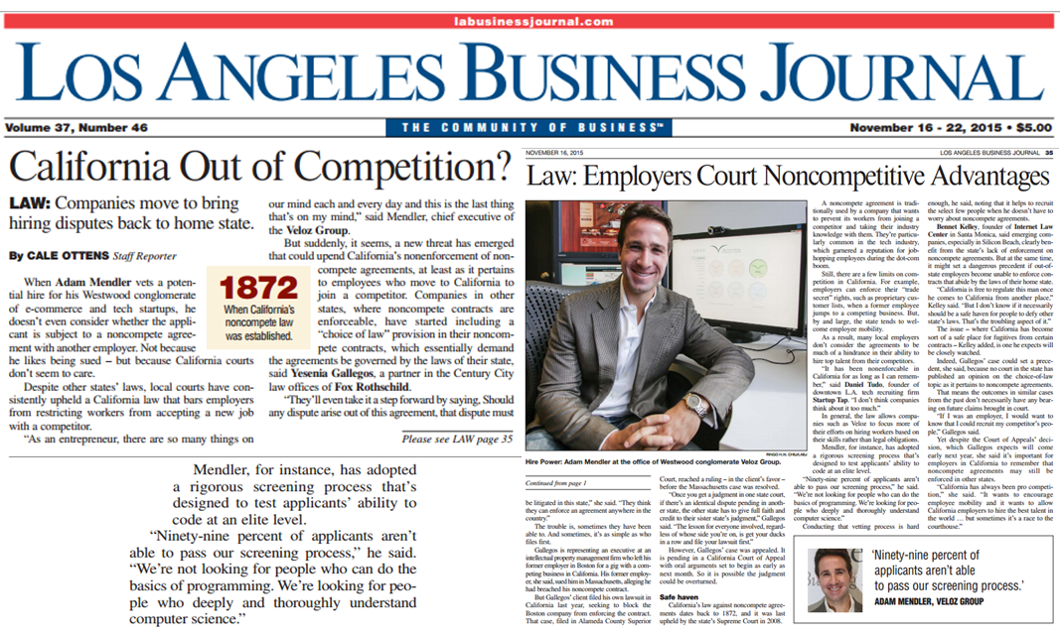

Slide 23
SKILL
SUPERPOWER

Slide 24
SKILL
WHAT YOU DO

Slide 25
SUPERPOWER
YOUR GIFT
THAT ALLOWS YOU TO
EXCEL AT WHAT YOU DO

Slide 26
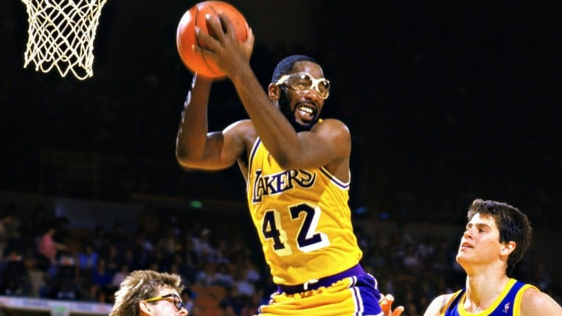

Slide 29
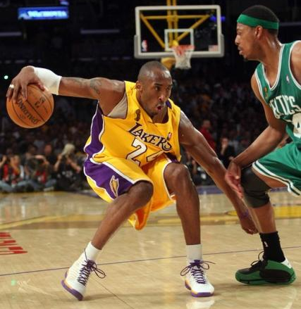

Slide 30
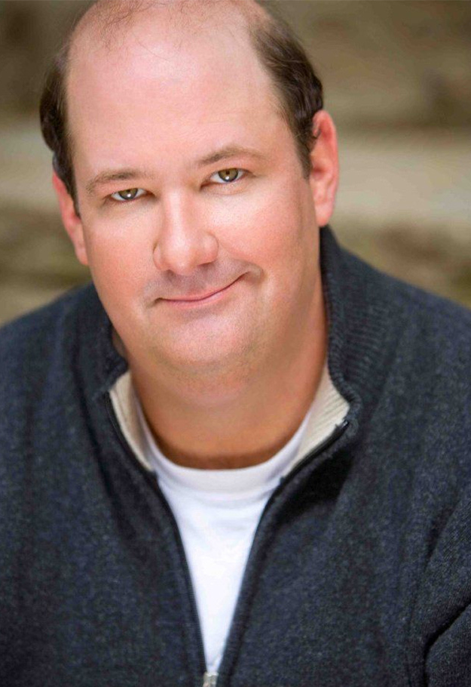

Slide 31
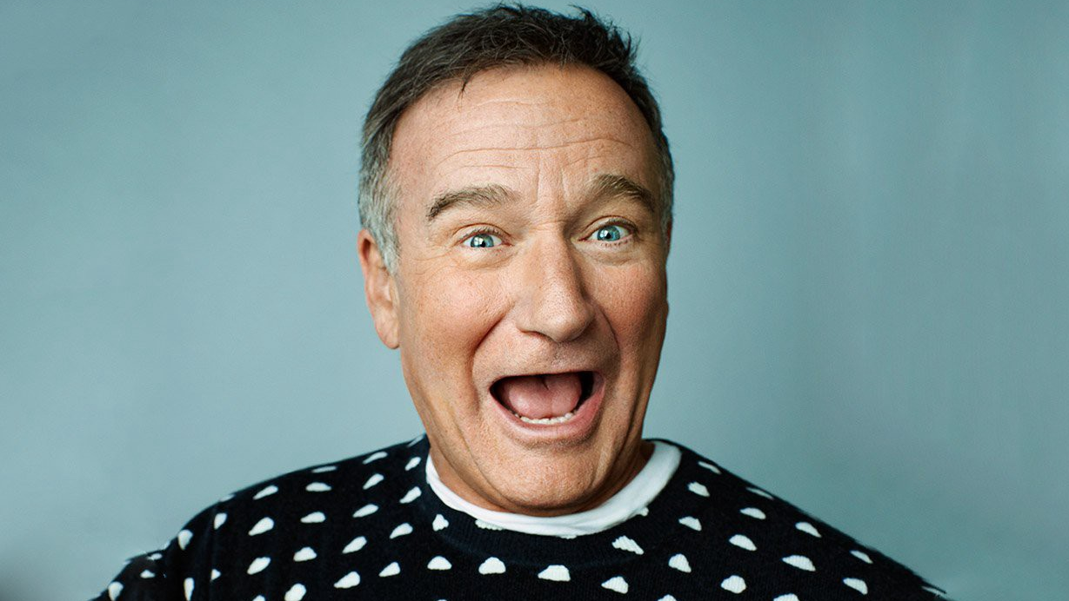

Slide 32
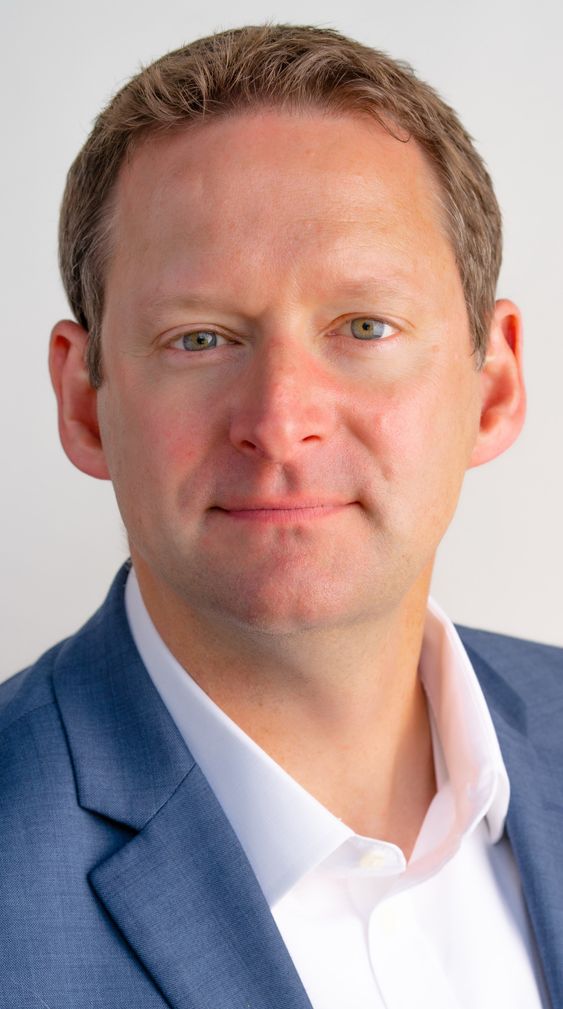
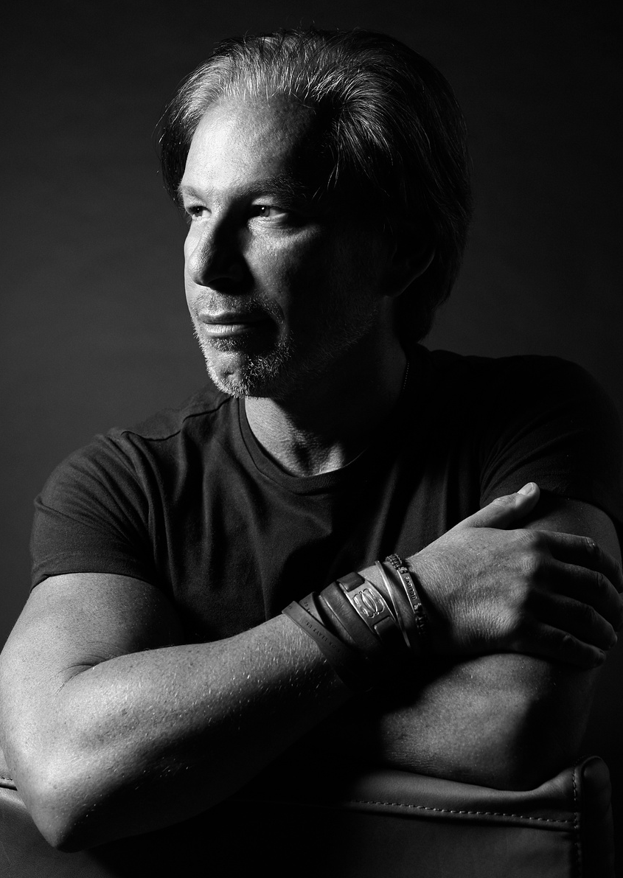

Slide 34
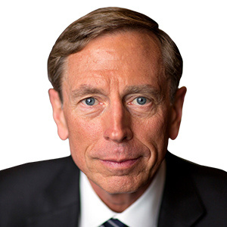

Slide 35
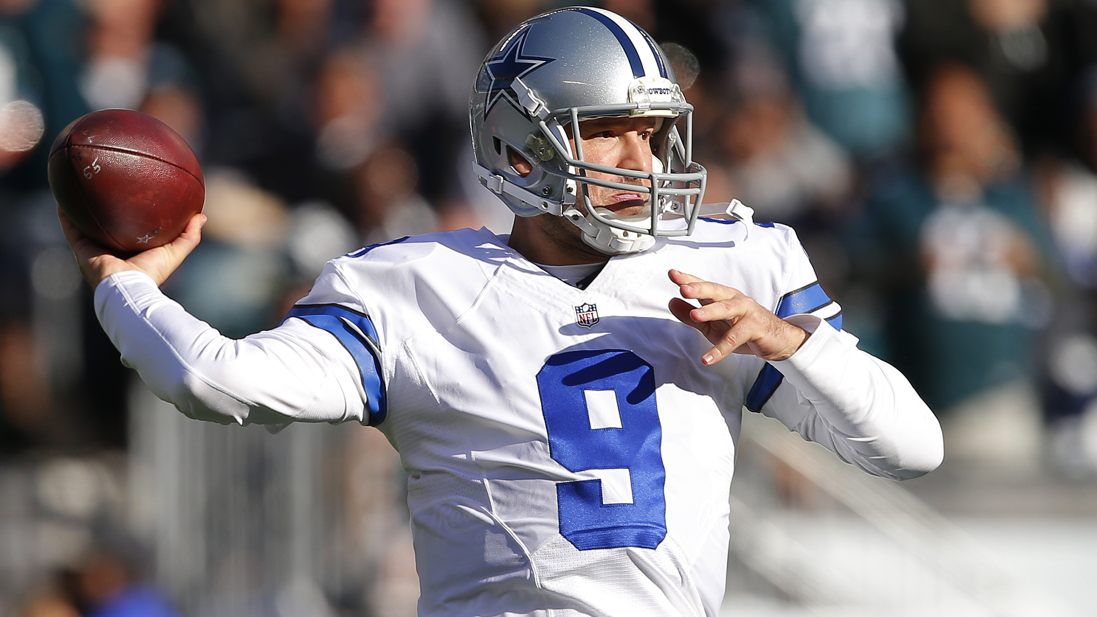

Slide 37
DISCOVER
DEVELOP
DEPLOY

Slide 38
DISCOVER

Slide 41
What do you enjoy doing?

Slide 42
What comes easily to you?

Slide 43
What can you do all day
without getting bored?

Slide 44
What energizes you?

Slide 45
What do others appreciate in you?

Slide 46
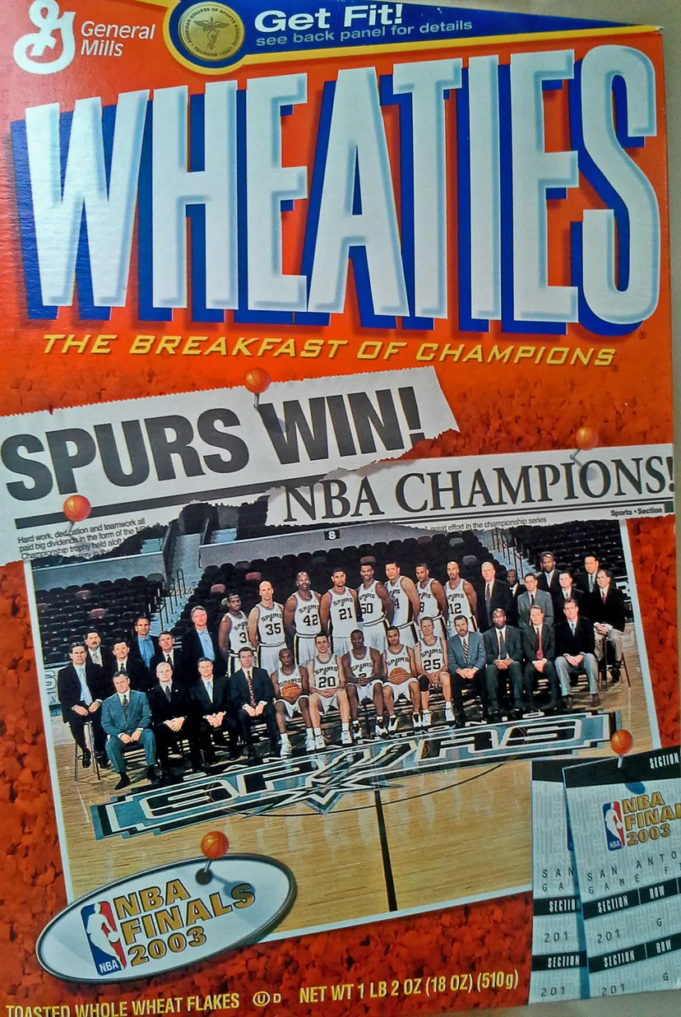

Slide 47
DEVELOP

Slide 49
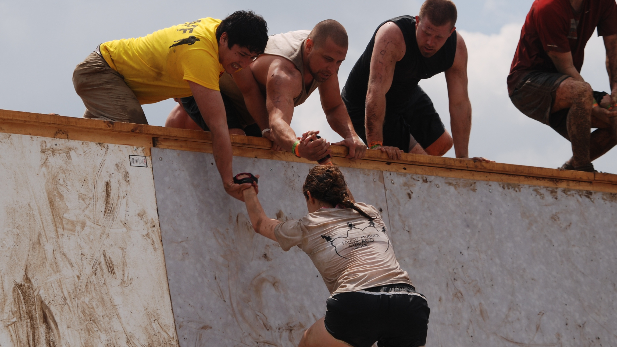

Slide 55
DEPLOY

Slide 56
Am I doing something that I love?
Am I doing something I am great at?
Am I making a positive impact?

Slide 57
SKILL
SUPERPOWER

Slide 58
Identify three people.
What is each person's skill?
What is each person's superpower?
How does their superpower fuel their success?

Slide 59
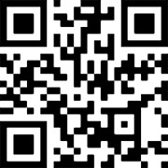
Mentorship Guide +
Feedback & Thoughts
Scan this QR code
2. Enter this code on the screen
MENTOR
Stay in touch!
adam@adammendler.com
@adammendler
or go to talk.ac/adam
adammendler

