Slide 1
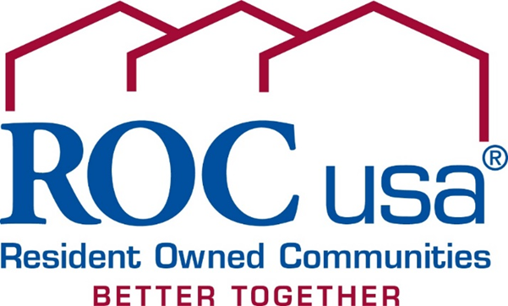
Angela Romeo, VP Acquisitions

Slide 2
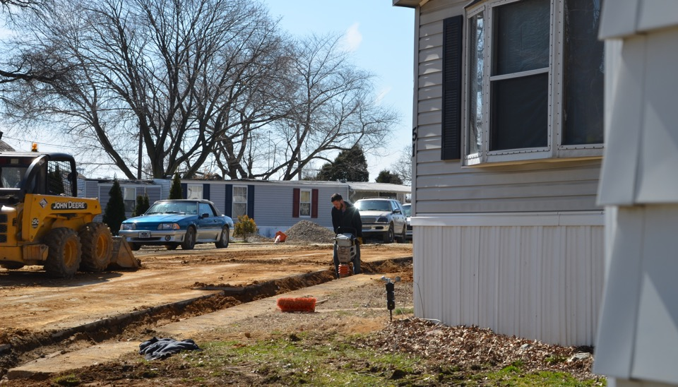
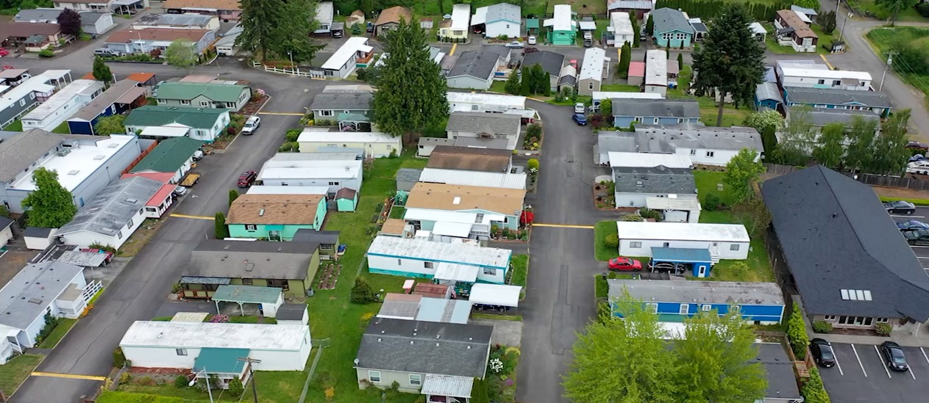
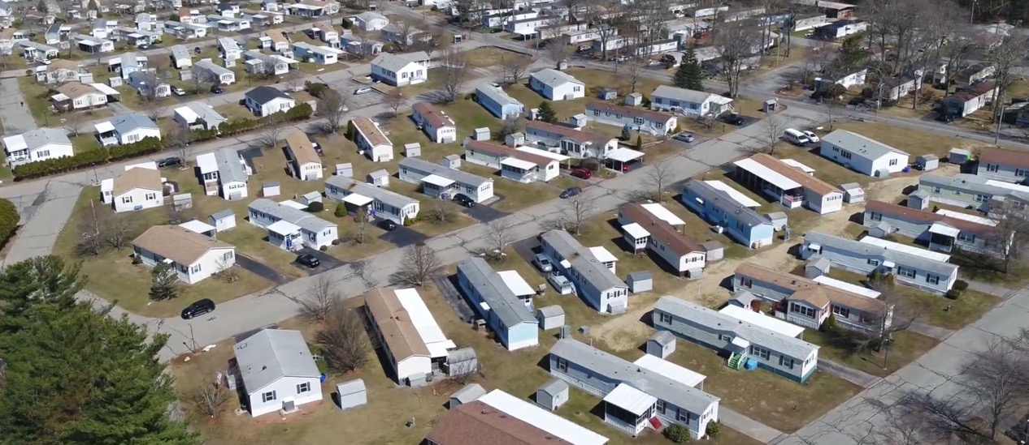
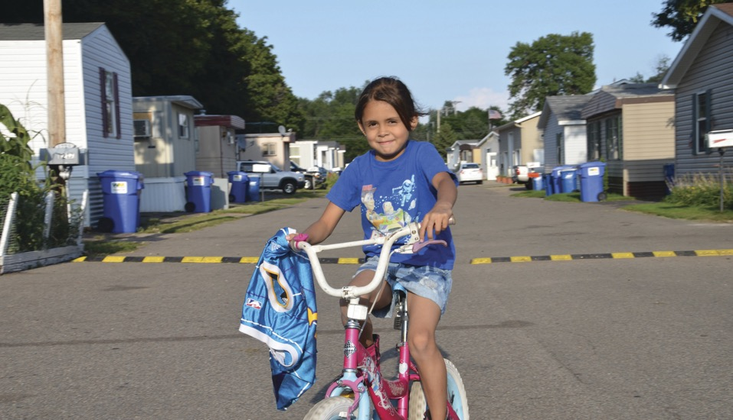

Slide 3
“This is one of our nation’s largest sources of deeply affordable housing, and it’s deeply affordable without any federal subsidy.” Esther Sullivan, Associate Professor of Sociology, University of Colorado Denver and author of Manufactured Insecurity: Mobile Home Parks and Americans’ Tenuous Right to Place
45,600 communities nationwide
3M homeowners and renters
Median incomes half of national median
Detached, modest size factory-built homes in dense neighborhoods

Slide 4
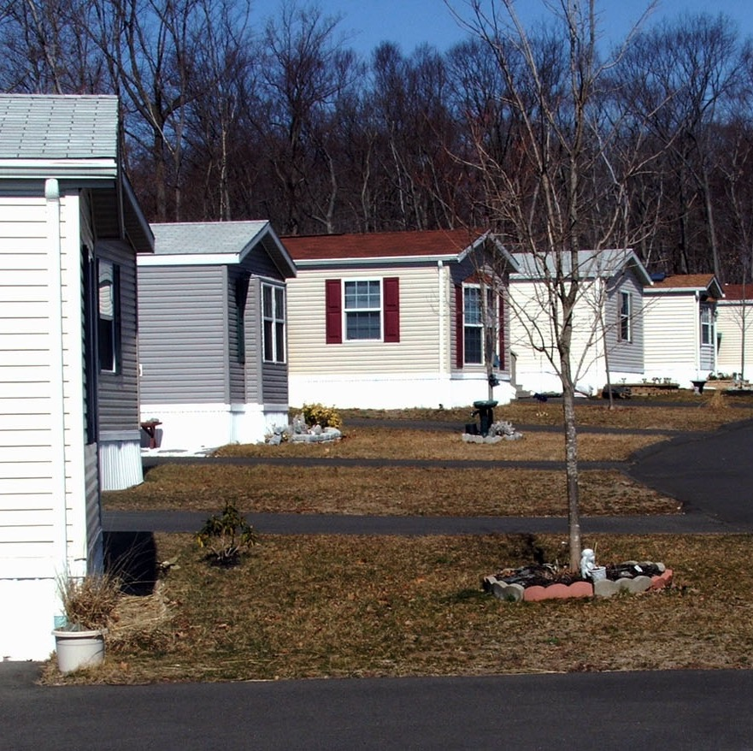
Owning a home on rented land …………
Lack of secure land tenure makes homeowners vulnerable to:
No control over owner’s rent increases
Threats to quality of life / health and safety if community infrastructure poor or failing
No certainty land will remain a mobile home park
Limited and expensive financing options

Slide 5
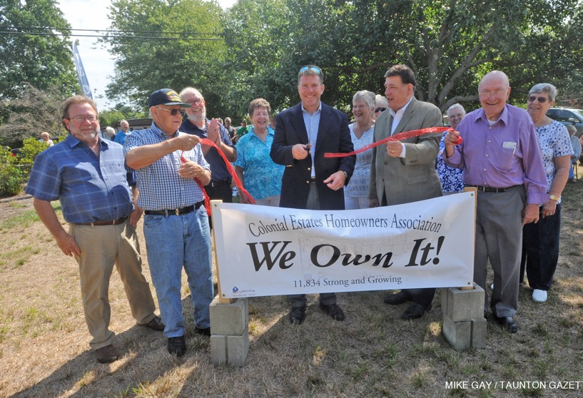
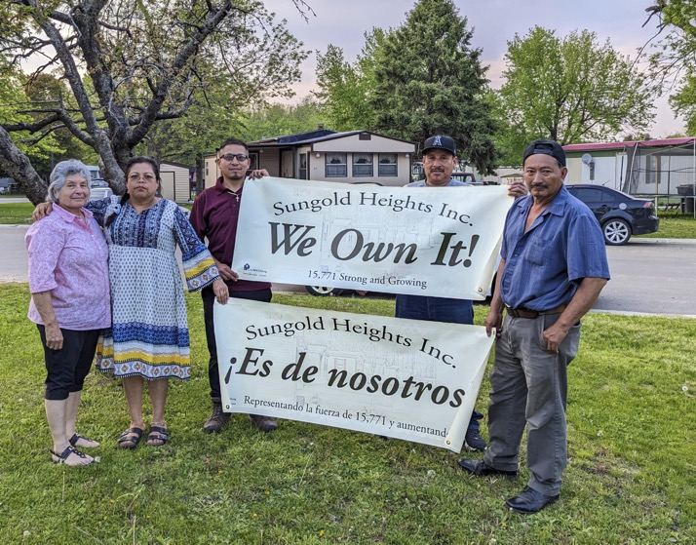
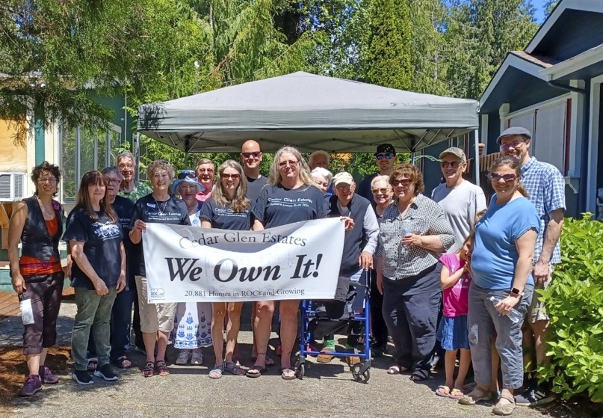
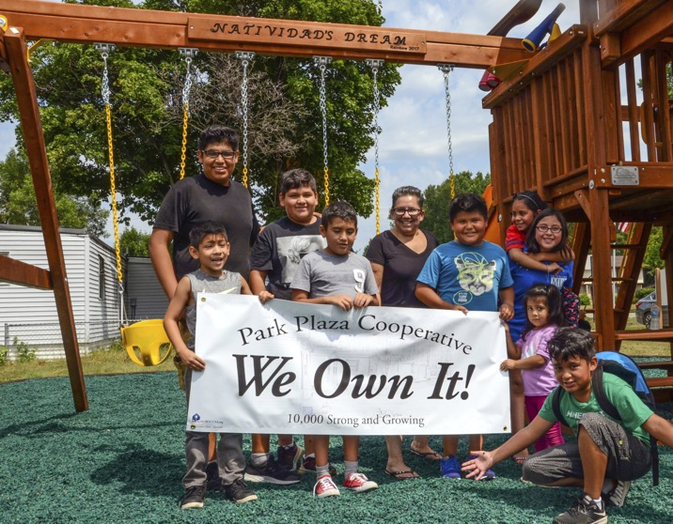
Resident Owned Communities - 312 ROCs - 21 states - 22,000 homes preserved - Limited equity co-op model

Slide 6
The Co-op corporation is the is the owner/operator, the borrower, holds title to the property
The corporation is governed by an elected Board of Directors
The property is professionally managed by hired PM
Site rents are revenue to support expenses and capital improvements
Property is valued based on cashflow
Homeowners’ homes appreciate not Member shares

Slide 7
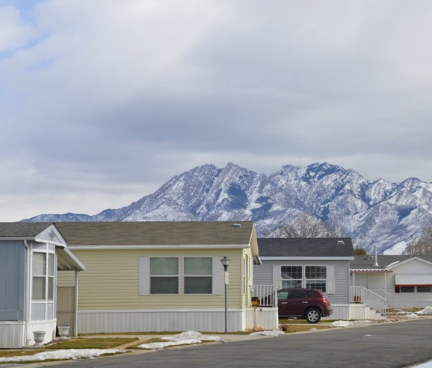
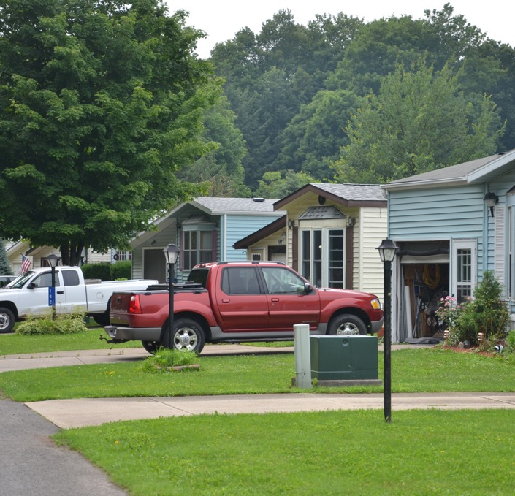
Market Conditions:
Surge in profit-oriented institutional
investing in MHCs
high and sustained prices for MHCs, and rapidly increasing site-rents.
Gentrification / economic development in neighborhoods
change of use and displacement
Continued consolidation of the MHC “business”
Infrastructure (and home) deficiencies accumulating
Challenges financing homes (private property) or communities (land & infrastructure)

Slide 8
Market Conditions:
Surge in interest from entities committed to alleviating housing crisis:
Government
National
State
Local
Philanthropy
Social determinants of health
Equity and inclusion
Business
Banks
Healthcare
Tech
Other employers

Slide 9
“Manufactured housing is no longer about mobility . . . but about affordability. These homes look pretty much like your typical ranch house but, depending on where you live, they might cost half the price.” Financial Times, Feb. 7, 2020 “Why big investors are buying up American trailer parks”

Slide 10
Implementing the Resident Owned Communities solution …
Major Steps:
Agreement on shared equity model – long-term preservation and wealth-building.
High-priced markets require dedicated source of low-cost, customized and nimble financing – a mix of equity grant and low-cost debt (acquisition and infrastructure / home repair).
Support for residents and their elected boards
Market development – either Opportunity to Purchase (OTP) or extensive marketing to owners.

Slide 11
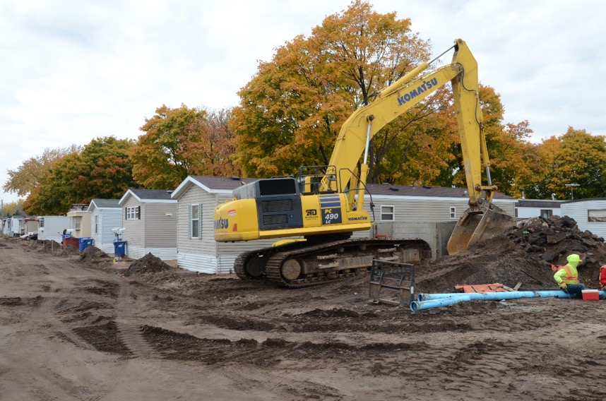
Policy Priorities
Infrastructure Resources- 2023 PRICE Initiative
Access to affordable housing resources
Equal access to commercial financing
Single Family financing

Slide 12
Opportunity to Purchase Laws
Which states have them?
What is working / what isn’t?
Several new states/regions looking at this in a new light.
Recent states adopting OTP.

Slide 13
Angela Romeo, VP Acquisitions aromeo@rocusa.org 603.545.1704 www.ROCUSA.org

