Slide 1

Evictions in Arizona -
An Opportunity for Change
Maxine Becker – Attorney Advocate - Wildfire: Igniting Community Action to End Poverty in Arizona
Chris Groninger - Chief Legal Strategist- Arizona State Bar Foundation
Pam Bridge, Director of Litigation and Advocacy, Community Legal Services

Slide 2

Evictions - What is Happening NOW?
Notes:
While evictions are always chaotic, an accelerated legal process, and a true life emergency for tenants, the last two years of the pandemic, moratorium, and rent assistance have added another layer to that chaos.
Now - I’m sure you’ve heard that evictions are almost back at pre-pandemic levels, which is true.
This presentation explores the pre- and post pandemic landscape, and what we can do, what advocates across the state are doing, and we should do about making the eviction process more just, creating policy that promotes housing stability.

Slide 3
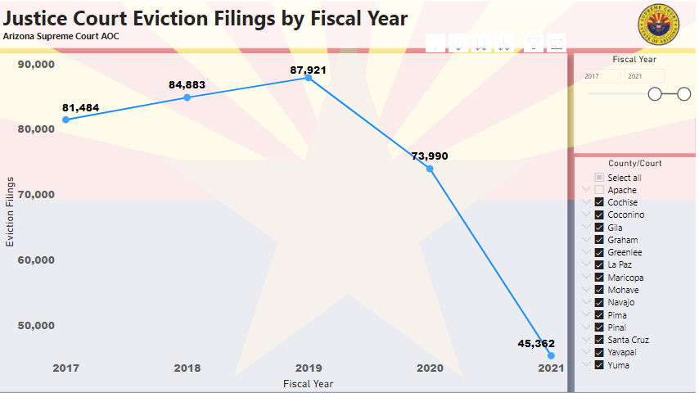
Arizona Evictions - 2017 to 2021
Notes:
Justice Court Evictions (azcourts.gov)
This slide takes a look at eviction filings statewide 2017 through 2021.
Data provided by Arizona Supreme Court Administrative Office of the Courts.
Between 2017 and 2019, Arizona evictions were on a skyrocketing trajectory - increasing by 3,000 eviction filings every year.
Statewide Moratorium on evictions went into effect in July 2020 - followed by the CDC federal moratorium which went into effect in September 2020.

Slide 4
Housing in Maricopa County 2010-2018-
Elusive at Best
Notes:
This slide provides economic and housing context for the rise in evictions prior to the pandemic.
Wages simply did not keep up with rental and home prices.
Holmes, Courtney. “As Arizona Housing Prices Rise, Wages are not Keeping Up.” ABC 15 Arizona, March 2, 2021. https://www.abc15.com/news/state/as-arizona-housing-prices-rise-wages-are-not-keeping-up.City of Phoenix used throughout presentation because had the most complete data picture. Data throughout 2020 and 2021 was inconsistent and not updated. Presentation reflects the most up-to-date data available.

Slide 5
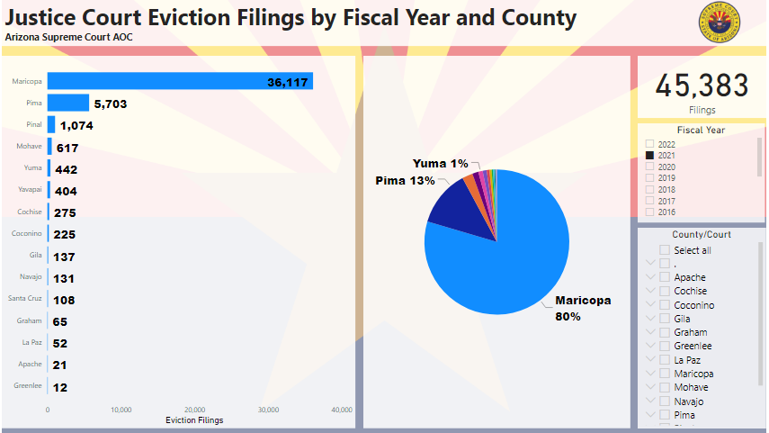
Evictions by Arizona County
Notes:
This slide provides perspective on the eviction filings across the state.
Maricopa County makes up 80% of the filings = Pima and Pinal follows much farther behind.

Slide 6
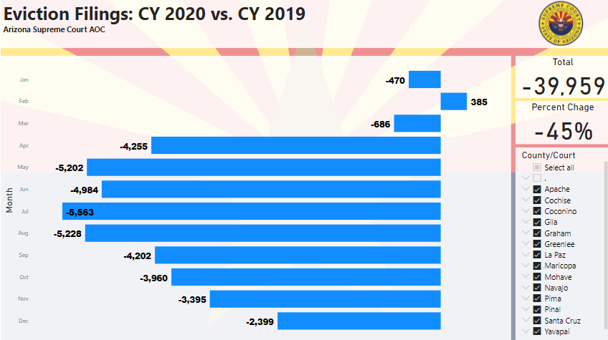
Notes:
Another way to visualize the data on eviction filings pre and the dramatic drop post pandemic.

Slide 7
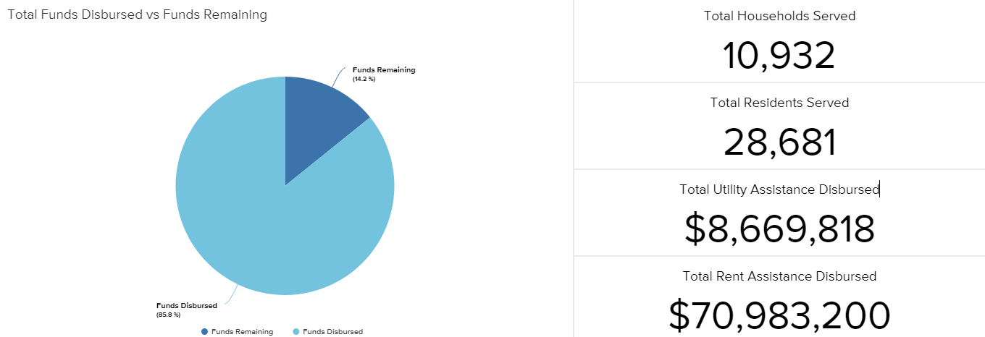
City of Phoenix ERAP 1.0 & 2.0
Notes:
Next series of slides shows the amount of ERAP (Emergency Rental Assistance Program) funds provided to our communities across the state since March of 2020.
Prior to March 2020 - CARES Act provided a one time $3300 in emergency assistance for tenants.
CARES Act $90M statewide
ERAP 1.0 $464 Statewide
ERAP 2.0 $____ statewide

Slide 8
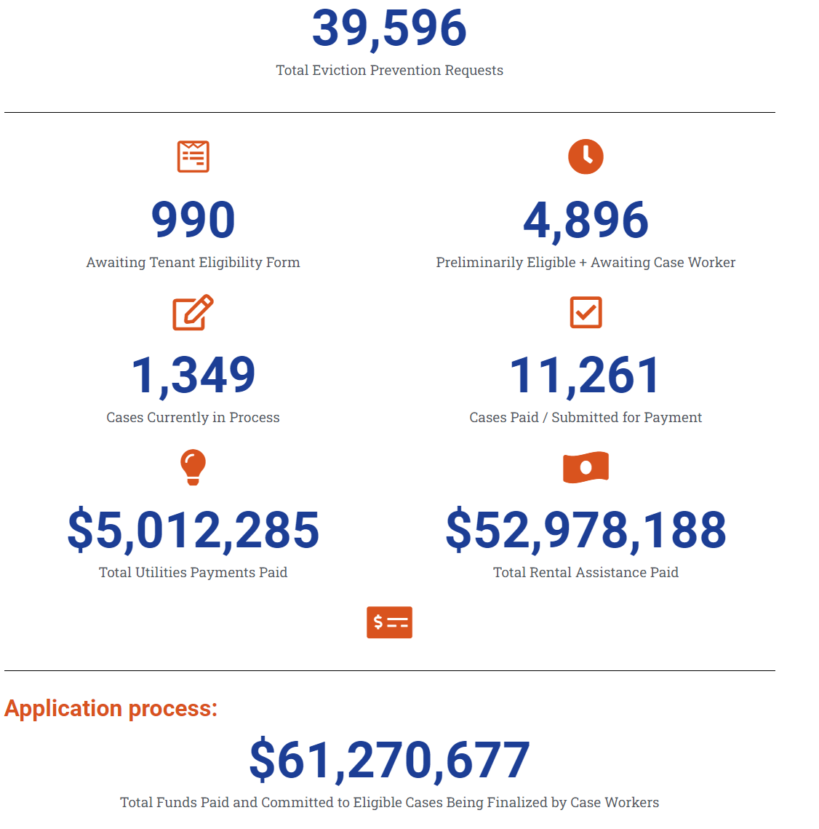
Pima County ERAP Dashboard

Slide 9
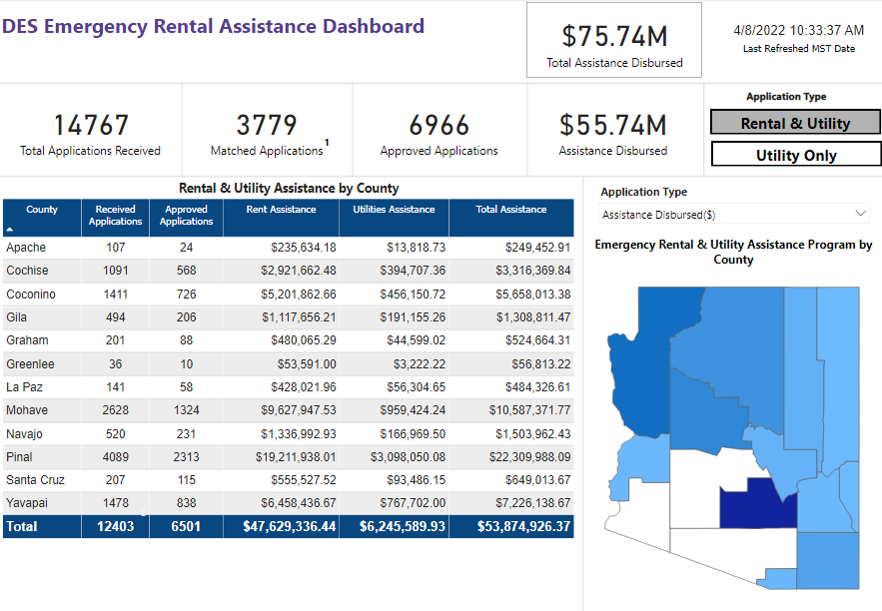

Slide 10
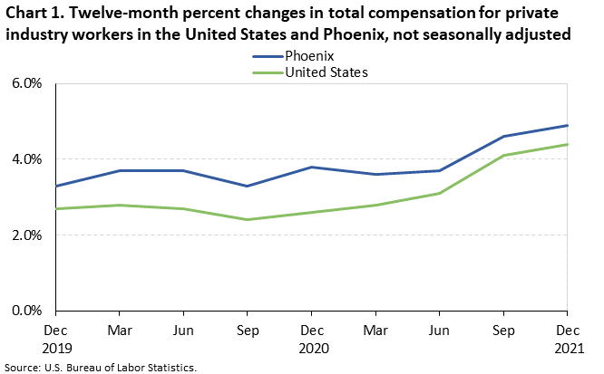
Phoenix Wages & Compensation Rise 5.1%
Between 2021 & 2022
Notes:
Bureau of Labor Statistics - January 2022

Slide 11
Phoenix Rent Rises 37.2% Since 2019
60.8% Rise in Rent Since 2015
Notes:
$1477 – as of October 2021
$1547 - as of February 2022 (rentcafe) - Up 4.7% since October.

Slide 12

Too Big of a Burden
275,000 cost-burdened households in Maricopa County
100,000 cost-burdened households in Phoenix
Source: US Census Bureau, “Tenure by Housing Costs,” 2019.
Notes:
Presentation Definition: Affordable housing: housing that costs 30% or less of household income.
Cost Burden: Households that spend more than 30% of their income toward housing costs are cost-burdened.

Slide 13


Slide 14
As of September 2021 – 97.1% of rental units in
Maricopa County were occupied.
Low vacancy = Consequences for cost-burdened renters.
    Landlords can terminate leases and charge more rent.
    Landlords can be “choosier” about applicants
    Tenants have no where to move as costs go up. As tenants stay, and become increasingly cost-burdened just to stay housed and teeter closer to possible eviction.
Notes:
Ruffner, Brent. “Metro Phoenix Rental Occupancy Hits Highest Mark in 40 Years.” Daily Independent, September 9, 2021. https://yourvalley.net/stories/metro-phoenix-rental-occupancy-hits-highest-mark-in-40-years,257699.
Thomas Brophy, national research director at Colliers in Phoenix: occupancy rate is 97.1% — the highest since that number topped out at 96.8% in 1978, just before a construction boom in the early 1980s.

Slide 15
Arizona Supply and Demand – Rental Homes - Part 1
Notes:
113,000 extremely low income renter households v. 23,000 affordable and available rental homes. Aurand, Andrew, Dan Emmanuel, Ellen Errico, Dina Pinsky, and Diane Yentel. “The Gap: A Shortage of Affordable Homes.” National Low Income Housing Coalition, 2019, https://nlihc.org/housing-needs-by-state/arizona

Slide 16
Arizona Supply & Demand Rental Units – Part 2
Notes:
Another way to look at the issue: 21 affordable and available units for every 100 households that need it. Aurand, Andrew, Dan Emmanuel, Ellen Errico, Dina Pinsky, and Diane Yentel. “The Gap: A Shortage of Affordable Homes.” National Low Income Housing Coalition, 2019, https://nlihc.org/housing-needs-by-state/arizona

Slide 17
MARICOPA COUNTY EVICTION CASES FILED
Notes:
Numbers in January/February close to pre-pandemic levels.

Slide 18
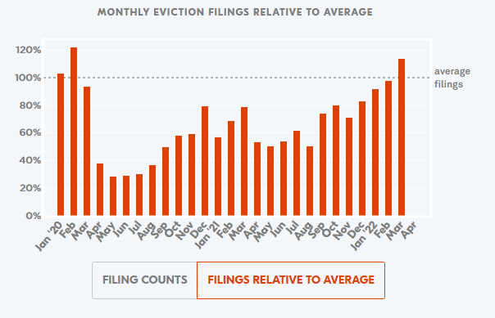
Data from Eviction Lab –evictionlab.org
Eviction filings in Phoenix were near or above historical averages in January, February, and March of 2020.¹ New filings dropped dramatically in April and have remained below historical averages.
Notes:
Most recent data compiled by Eviction Lab out of Princeton (Matthew Desmond’s group - Pulitzer Prize winning “Evicted”)
March - 4,676 eviction filings
Average eviction filings (2015-2019) 4,131
Why? We know landlords were waiting to file evictions - perhaps hoping rent assistance came through. We may have seen the end of that patience in March.
Rent judgment amounts were also double or triple the average pre-pandemic amounts, which also points to landlords waiting to file or perhaps having a judgment and waiting to execute on the Writ of Restitution to see if rental assistance would come through.
Wait to see what happens in April to determine where we are for housing stability.

Slide 19
Calendar Year 2022 Percent of Eviction Filings v. CY 2019
County | Percent Change | Jan –Feb 2022 Eviction Filings | Jan –Feb 2019 Eviction Filings
Apache County | 100% | 2 | 0
Cochise County | 130% | 71 | 59
Coconino County | 50% | 10 | 12
Gila County | 120% | 12 | 10
Graham County | 146% | 19 | 13
Greenlee County | 100% | 3 | 0
La Paz | 121% | 17 | 14
Mohave | 88% | 163 | 188
Navajo | 77% | 20 | 36
Pima | 87% | 1920 | 2202
Pinal County | 65% | 222 | 342
Yavapai | 90% | 88 | 98
Yuma | 102% | 110 | 109
Notes:
About 50% of rural counties above a 100% change in eviction filings pre-pandemic. (7 out of 13)
AOC website

Slide 20





Eviction Process
Eviction Process Overview
Landlord provides NOTICE to the tenant about the lease or rental agreement not being followed.
Tenant has the opportunity to correct the issue (except in immediate or irreparable violations of the lease).
If not corrected, the landlord can file a COMPLAINT with the court to evict the tenant.
The tenant is issued a SUMMONS by the court for a hearing about the Complaint.
Notes:
Take a break to discuss the eviction process.
Can go through this process quickly, but am happy to answer any questions you have about the court process, landlord/tenant rights, or the post judgment process.

Slide 21



Eviction Process
Eviction Process Overview
The landlord and tenant have a HEARING with a Judge about the Complaint.
The Judge decides whether the landlord has a legal right to evict the tenant and any money owed. The Judge issues a JUDGMENT. The judgment will state whether the tenant must leave the property.
If the Judge determines the tenant is evicted, the landlord can request a WRIT OF RESTITUTION to remove the tenant from the property and change the locks.

Slide 22

OPPORTUNITIES FOR CHANGE

Slide 23

TENANT EVICTION ASSISTANCE PROJECT
TEAP
COMMUNITY LEGAL SERVICES

Slide 24




Slide 25
Background
CLS has a unit of five attorneys to assist tenants in Maricopa County
Other states are developing Right to Counsel/Tenant Assistance housed at Court initiatives
January 31, 2020: Letter to Mayor Requesting Right to Counsel Eviction Pilot Project
  Detailed successful programs in New York, Michigan, Los Angeles, Minnesota, Denver, Philadelphia, Newark, DC, Seattle, Wisconsin

Slide 26
Timeline
May–June 2020
CLS has discussions with City of Phoenix Council and Human Services Department
July 2020
CLS signs contract with City of Phoenix through December 2020
July 2020
CLS Hires Director to supervise TEAP
August 2020
TEAP hires six attorneys, one paralegal
Oct. 2020
CLS signs MOU with Wildfire as a referring partner
Jan. 2021
City of Phoenix extends TEAP contract through September 2021
Feb. 2022
City of Phoenix renews TEAP contract through September 2022

Slide 27
Logistics
Tenants residing in the City of Phoenix under 200% of Federal Poverty Level (FPL) facing eviction receive a referral or call CLS directly for services.
Paralegals conduct intakes to determine eligibility and forward cases to attorneys or make additional referrals.
CITY OF PHOENIX TEAP
Attorney contact tenant within 24 hours
(or less in emergencies).
Attorney’s provide aid ranging from brief advice, negotiations to representation.

Slide 28
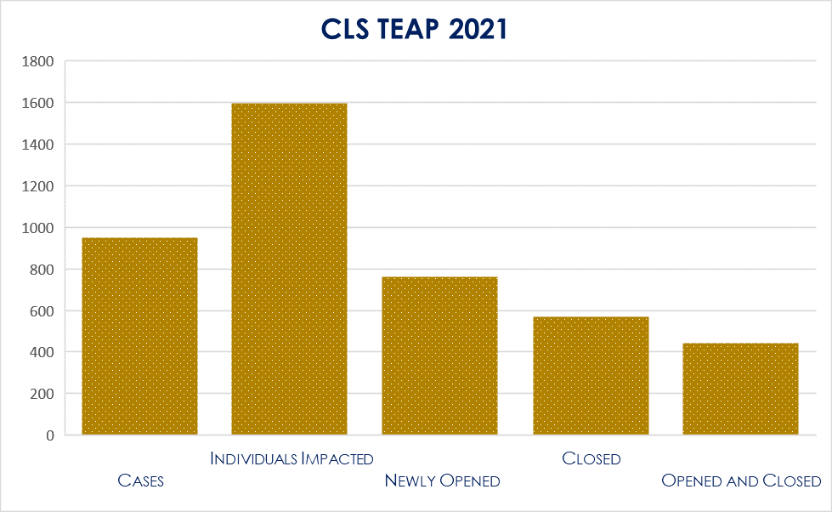
DATA
Funded for 12 attorneys, 6 paralegals
In 2021, TEAP assisted with 949 cases, 1597 individuals
During the moratorium, TEAP has stopped 95% of all evictions with CDC Declaration
During the moratorium, TEAP won 90% of challenges against the CDC Declaration
CLS TEAP Attorneys have appeared in all Justice Courts within the City of Phoenix

Slide 29
2,897
543
12
CLS TEAP number of cases in 2021
Times that CLS TEAP Attorneys appeared in Phoenix courts in 2021
Times that CLS TEAP Staff lost the case

Slide 30
Pilot Eviction Mediation Programs -
Pima County and Maricopa County
Pima County –
  Voluntary Program
  *Court Program- Cannot Go to Mediation unless an Eviction is Filed*
  49 Settlement Conferences
  66% Success Rate
  Requested Improvement:
    “Create an immediate post-filing “offramp” = Landlord can immediately elect into the program and the court would not schedule an initial appearance. Instead, the tenant would be notified and given an opportunity to opt-in, and if they do the case could directly be set for settlement conference (or if the only issue is ERA $, directly assigned to a caseworker), and then only go to initial appearance if the settlement conference fails.

Slide 31
DES Housing Stability Court Navigators
Assist litigants with obtaining available federal and local resources to avoid unnecessary evictions while at the same time safeguarding landlord rights.
Address housing stability in vulnerable populations in treatment and specialty courts, individuals on other forms of probation, as well as those in the dependency system.
Will use available Emergency Rental Assistance Program (ERAP) funds from DES for at least the next 3 years.
At this time, five counties are participating in the Navigator program:
Yavapai
Mohave
Coconino
Pinal
Yuma

Slide 32
AZEVICTIONHELP.ORG
AZEvictionHelp.org was launched January, 2021
Since launch, more than 185,000 individuals have accessed the legal information on the site.
More than 41,000 referrals made to rent/utility assistance, legal help, and other resources.
Live Chat feature on AZEvictionHelp.org (staffed by Foundation staff and volunteer experts) has helped more than 250 individuals with direct assistance.
Notes:
Launched in January 2021 - funded through the Bar Foundation, philanthropy (Virginia Piper, Vitalyst) – statewide collaborative effort.
True success story of tenant advocacy during and post pandemic.

Slide 33
Emergency Rental Assistance is
STILL AVAILABLE STATEWIDE!
  Utility Funding
    The Arizona Low IncomeHome Energy Assistance Program (LIHEAP) assists low-income Arizona families and households pay heating, cooling, and appliance repair costs. Funding for the program is supported by utility providers, private donations, and abandoned utility deposits.
  Water Funding
    The Low Income Household Water Assistance Program (LIHWAP) provides eligible households up to $1,800 in water assistance.
  Broadband Assistance –
    “Affordable Connectivity Program” $30 in assistance per month ($75 per month for households on tribal lands) to help pay for internet service. Eligible households can also receive a one-time $100 benefit for devices such as laptops and tablets.

Slide 34
Wildfire’s Policy Goals for 2021-2022:
Lessen the Consequences of Eviction
  Remove Requirement to Pay Filing Fees/File Motion for Fee Deferral or Waiver
  Record Sealing
  Rule Change Petition

Slide 35
HB 2484
Removes all Fees and Requirement to File Motions for Fee Deferral or Waivers
Sponsored Representatives Wilmeth and Weninger
Signed by Governor Ducey on March 30!

Slide 36
HB 2485
Seal case files for eviction cases that were dismissed prior to judgment or where judgment is entered in favor or tenant.
Worked through a stakeholder process with AMA
Sponsored by Rep. Wilmeth, Rep. Weninger, and Rep. Blackman
Passed House; Passed Senate Committee

Slide 37
Arizona Supreme Court Rule Petition
Requesting Two Rules of Eviction Procedure Be Amended
Co-Sponsored by
  Community Legal Services
  Southern Arizona Legal Aid
  DNA People’s Legal Services
  Southwest Fair Housing Council
Comment In Support Filed from the Access to Justice Commission

Slide 38

More Eviction Numbers
  An average of 64,000 evictions filed each year in Maricopa County.
  25% to 30% of judgments are satisfied each year (16,000 to 19,200 cases).
  Average of 4% (approximately 2,560 cases) of judgments are vacated each year. Vacated Judgments render the judgment legally void- as if it never happened.
  *Pre-Pandemic statistics. Reflects data from 2015 through 2019.

Slide 39
Objectives for Rule Petition
1. Rules for eviction judgments should be consistent with rules, statutes, and administrative orders that govern other Arizona civil judgments.
2. Provides a way for tenants who pay their eviction judgments to rehabilitate their credit and rental history, which benefits their housing opportunities.
3. Promotes the repayment of eviction debts, benefitting landlords.

Slide 41
What else can we do?
File a Comment in Support of the Rule Petition !
  www.azcourts.gov/Rules-Forum
Tenants Bill of Rights
Gap Funding for most vulnerable (seniors and disabled).
Income Discrimination
So much more work to do!

Slide 42

Thank you for attending!

