Slide 1
Building a Homeownership Path for Tribal Members
The Pascua Yaqui Development Corporation
February 28, 2024
PYDC
V

Slide 2
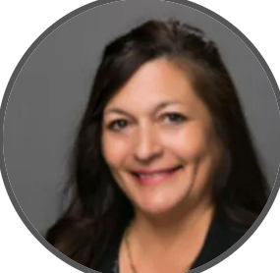
SPC: Pascua Yaqui Tribal Member Raymundo Baltazar is the General Manager of SPC.
PYDC Ventures LLC: Pascua Yaqui Tribal Member Veronica Escobar is the managing member of PYDC Ventures LLC.
PYDC: Pascua Yaqui Tribal Member Daune Cardenas-Daily is the CEO of the Pascua Yaqui Development Corporation.
Notes:
Pascua Yaqui Tribal Member Raymundo Baltazar is now the General Manager of SPC and has passed the Arizona Registrar of Contractors KB-1 test for large commercial contracts with unlimited contract amounts. Mr. Baltazar is committed to serving his community and has been working for the Tribe, Casino, PYDC, and now SPC for most of his life.
Pascua Yaqui Tribal Member Veronica Escobar is the managing member of PYDC Ventures LLC. A licensed realtor in the State of Arizona, and has established a partnership with real estate broker Robert Underwood to meet all the company’s broker needs. Mr. Underwood has committed to mentoring Ms. Escobar, and by year two, Ms. Escobar is expected to become a broker. She worked for the Pascua Yaqui Tribal Prosecutor’s office for several years and is committed to seeing PYDC Ventures become very successful.
Pascua Yaqui Tribal Member Daune Cardenas-Daily is the CEO of the Pascua Yaqui Development Corporation. Mrs. Cardenas-Daily has her Juris Doctor from the University of Arizona James E. Rogers College of Law and has earned her Bachelor of Business Administration from NAU. She is admitted to practice law in the Pascua Yaqui Tribal Courts and in the State of New Mexico. She worked for the Pascua Yaqui Office of the Attorney General and helped form the Pascua Yaqui Development Corporation, Sonoran Pueblo Contracting, and PYDC Ventures.

Slide 3
Training
&
Education
Good Real Estate Agent
Good
Financing
Good Jobs
Recipe For A
Tribal Homeowner:
Training and Education
Good Jobs
Good Real Estate Agent
Good Financing

Slide 4
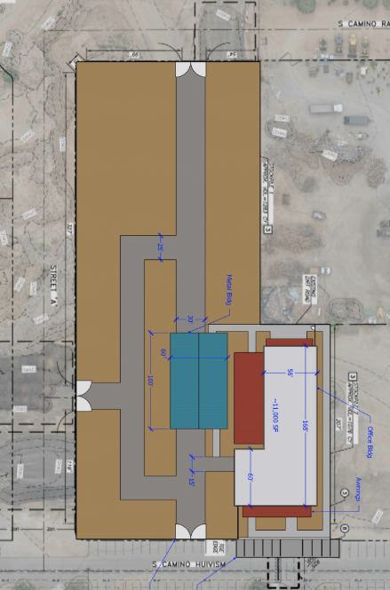
Investing in Meaningful Jobs
PYDC is developing leaders and professionals in new industries.
SPC has started training SPC and Tribal employees in project management.
PYDC Ventures is working with PYT WIOA to hire its clients once they have become licensed real estate agents.
PYDC is working on a plan with WIOA to collaborate in developing a strong trades training program.
PYDC has been awarded the USDA RBDG Grant and ARPA grant funding to develop a trades training center in New Pascua, focusing on heavy equipment that will be purchased with the USDA Grant (see Master Plan Concept to Right).
Notes:
SPC has started training SPC and Tribal employees in project management. The first cohort had eight SPC employees, a PYDC employee, and a Tribal employee. To continue developing project managers for the federal market, interested trainees will be attending the Constriction Manager Certification Institute (CMCI), which national leaders in the industry teach.
PYDC Ventures is looking to work with PYT WIOA to hire its clients once they have become licensed real estate agents.
PYDC is working on a plan to collaborate with WIOA to develop a strong trades training program.
PYDC has been awarded the USDA RBDG Grant and utilized ARPA grant funding to develop a trades training center in New Pascua (see Master Plan Concept to Right). The center has a ramada and fencing to house the heavy equipment that will be purchased for hands-on heavy equipment operator training. The training will be provided in partnership with training providers.

Slide 5
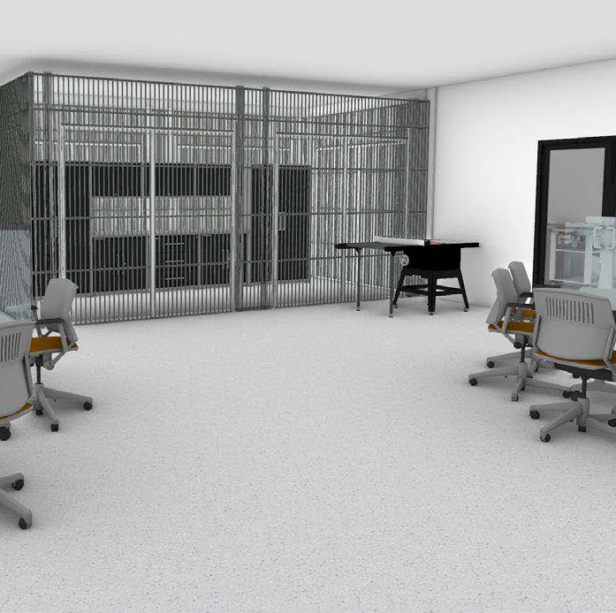
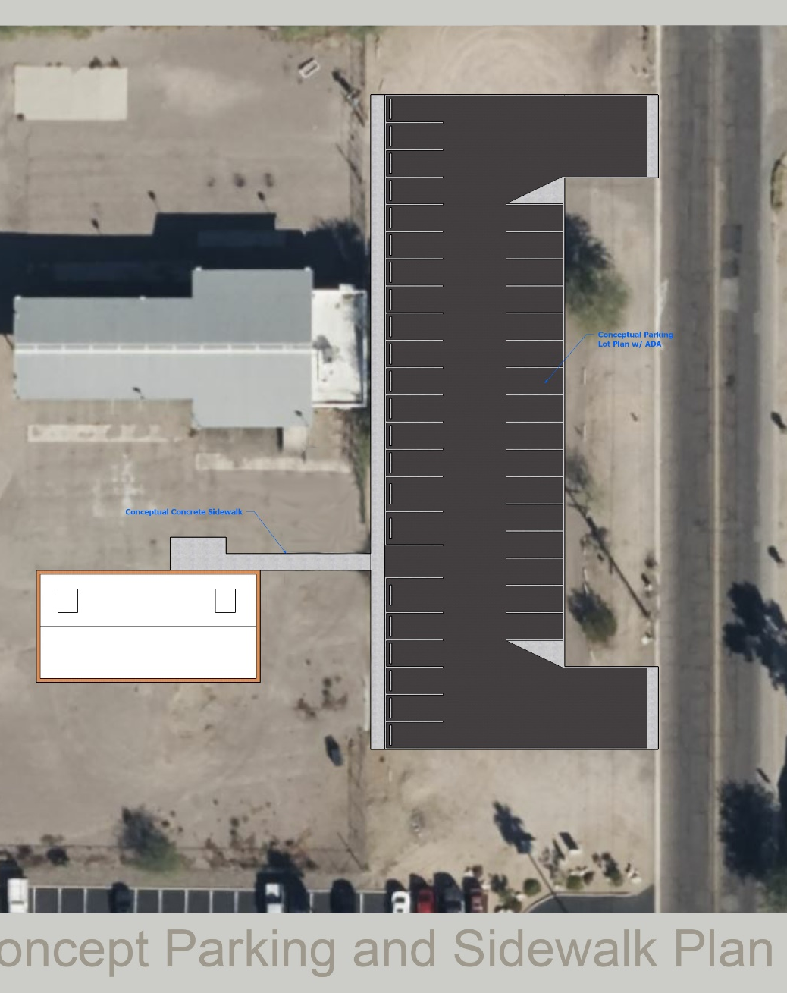
Investing in Meaningful Jobs
The Pascua Yaqui Development Corporation is in the final stages of being awarded grant funding by the Department of Commerce Economic Development Administration to build a state-of-the-art trades training center near Grant Road and Fairview Ave in Tucson, near Old Pascua.
The funding also includes the purchase of heavy equipment, furniture, fixtures, and equipment.
Notes:
The Pascua Yaqui Development Corporation is requesting $3,992,613.29 in Department of Commerce, Economic Development Administration funding for design, construction, heavy equipment simulator, heavy equipment, permit & inspection fees, admin & management expense, and contingencies to build a state-of-the art construction trades training center near Grant Road and Fairview Ave in Tucson, near Old Pascua.
The final application has been submitted, and it looks very favorable that PYDC will receive the award funding within the next sixty to ninety days.

Slide 6
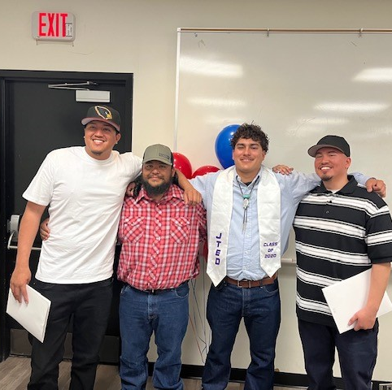
Investing in Meaningful Jobs
The Workforce Training Academy USA is a new training partner with the Pascua Yaqui Tribe.
They are also in partnership with Empire Caterpillar
On February 21, 2024, they graduated eight students, and 4 of those were Pascua Yaqui with certifications as Heavy Equipment Operators
Notes:
SPC has started training SPC and Tribal employees in project management. The first cohort had eight SPC employees, a PYDC employee, and a Tribal employee. To continue developing project managers for the federal market, interested trainees will be attending the Constriction Manager Certification Institute (CMCI), which national leaders in the industry teach.
PYDC Ventures is looking to work with PYT WIOA to hire its clients once they have become licensed real estate agents.
PYDC is working on a plan to collaborate with WIOA to develop a strong trades training program.
PYDC has been awarded the USDA RBDG Grant and utilized ARPA grant funding to develop a trades training center in New Pascua (see Master Plan Concept to Right). The center has a ramada and fencing to house the heavy equipment that will be purchased for hands-on heavy equipment operator training. The training will be provided in partnership with training providers.

Slide 7
Sonoran Pueblo Contracting: Skill Building & Career Building

Slide 8
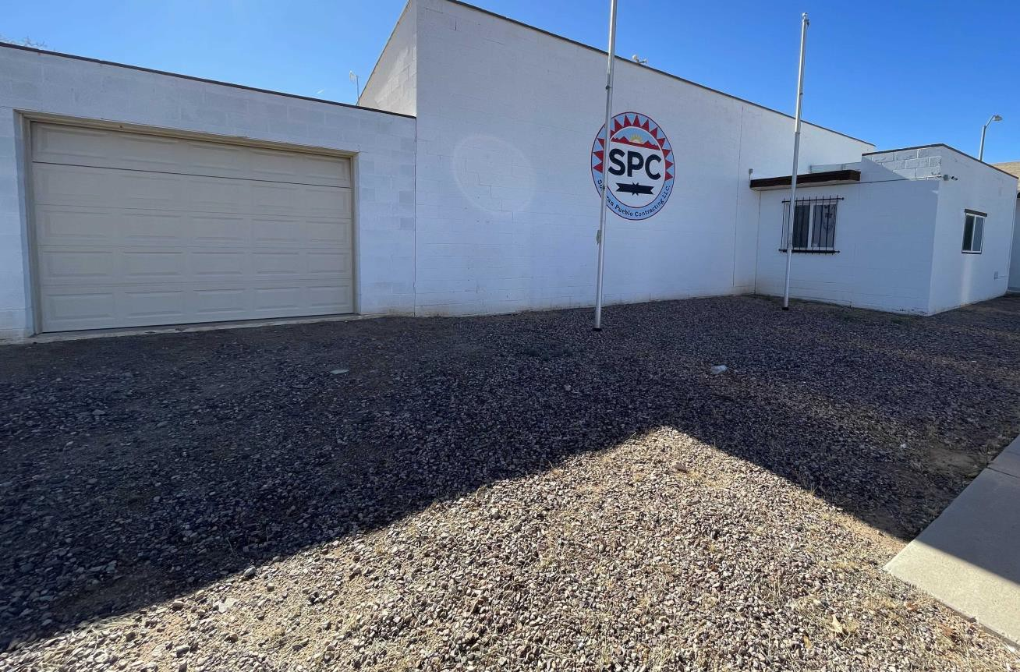
Sonoran Pueblo Contracting, LLC
YourTrusted Builder

Slide 9
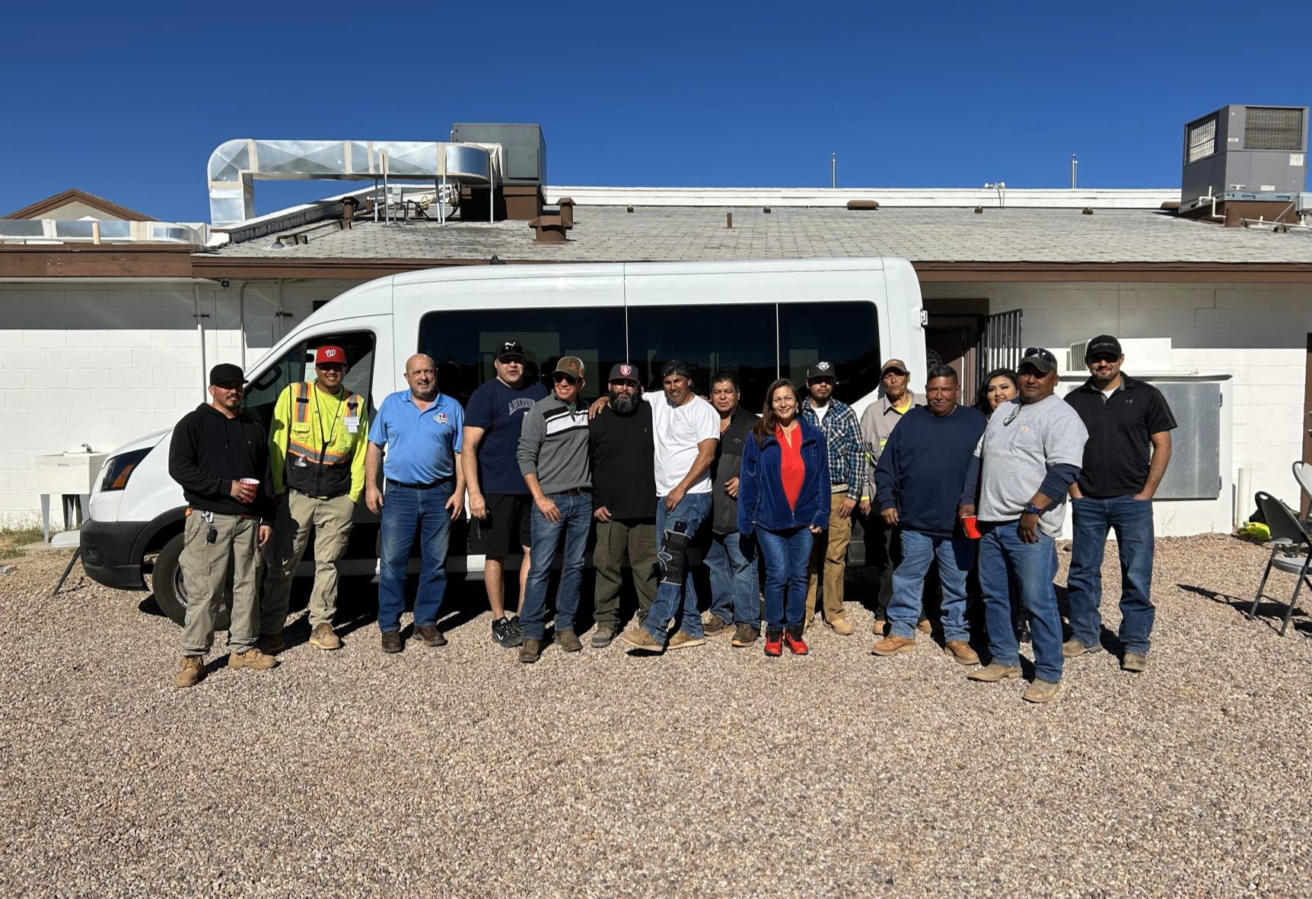
VISION
Sonoran Pueblo Contracting, LLC is the premier Federal and Tribal contracting partner across Indian Country.
MISSION
SPC focuses on Federal and Tribal construction projects that generate economic and career opportunities for our employees and our community.

Slide 10
SPC proudly has a tribal member employment rate of 66%.
THE SPC TEAM
3 Administrative Team
24 Full time Employees
Preconstruction Team
2 Estimators/PM
16 Tribal Members
Construction Team
Project Managers,
Superintendents,
14 Field Workers
1 PT Civil Engineer Intern (PYT)

Slide 11
SPC'S BRIEF TIMELINE
2019—Started off as a KB2-Small commercial &
residential which has a $2 million cap per project.
2020—SPC changed to KB1 –Large commercial and residential with no cap.
2022—SPC achieved SBA 8a status
Only Tribe in Arizona with an 8(a) Construction Company.
2023—Updating and Redefining Strategic Plan Analysis & Marketing Plan.

Slide 12
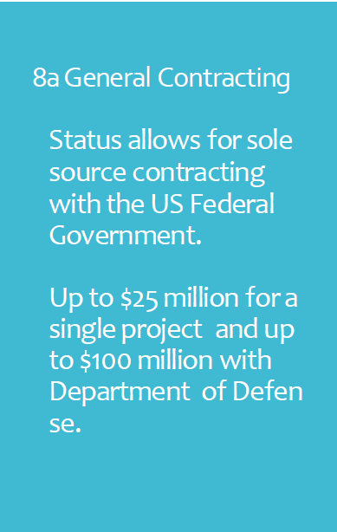
SPC has succesfully completed 4 8(a) sole cource projects.
8a General Contracting
Status allows for sole source contracting with the US Federal Government.
SPC maintains a “good” CPAR Rating (Contractor
Performance Assessment Report).
Up to $25 million for a single project and up to $100 million with Department of Defen se.
SPC was encouraged to submit a bid on a 5 year, $25 million MATOC award at Davis Monthan Air Force Base which will be awarded in April ‘24.
Looking into the SBA mentor protege process to address our bonding challenge.

Slide 13
SPC PROJECTS
Washington
Yakama Nation
Completion of Legends Casino Spa
Bidding on BOH Project
Arizona
Pascua Yaqui Tribe
Site work for residential projects.
Road Projects
Renovation Projects
HVAC Conversion Project
Cowlitz Indian Tribe
Tohono O’odham Nation
Site Work-Home Development Projects
Erosion Control
Commercial Renovation
Commercial and Residential Demo
Utility Installs
Working on an Annual General Service Agreement (TOC).
*SPC has a business office address in Gig Harbor, WA.
*SPC is in the process of getting a Washington State
Business License.

Slide 14
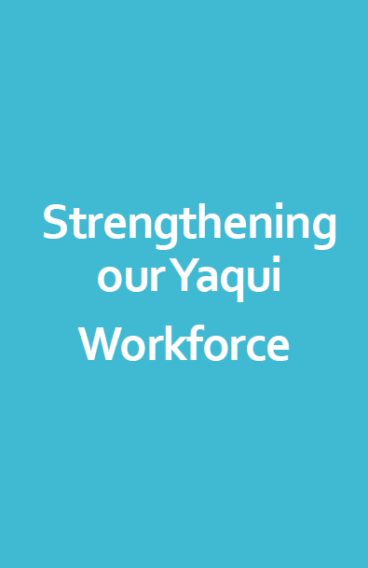
2 tribal members working on NCCER certification heavy equipment operator, blueprint reading, a grade checking.
1 PY tribal member intern will graduate next year as a civil engineer. Currently helps with take-offs.
4 PY tribal members went through the NCCER Project Management Course.
In March, there is going to be a 2-day session in grade checking and grade stake reading.
Jesus Corella is a direct lineal descendant of an enrolled tribal member (Steve Salvador) has been elevated to Superintendent in small projects and is currently enrolled in a Project Management Certificate Course at UofA.
Strengthening ourYaqui
Workforce

Slide 15
Project Manager – 90-100K per year. Higher in federal projects.
Project Engineer -75-80k per year
Industry Career Path Opportunities
Construction Superintendent -80-90K per year. Higher in federal projects.
Heavy Equipment Operator -55-60k per year
Estimator – 90K per year

Slide 16
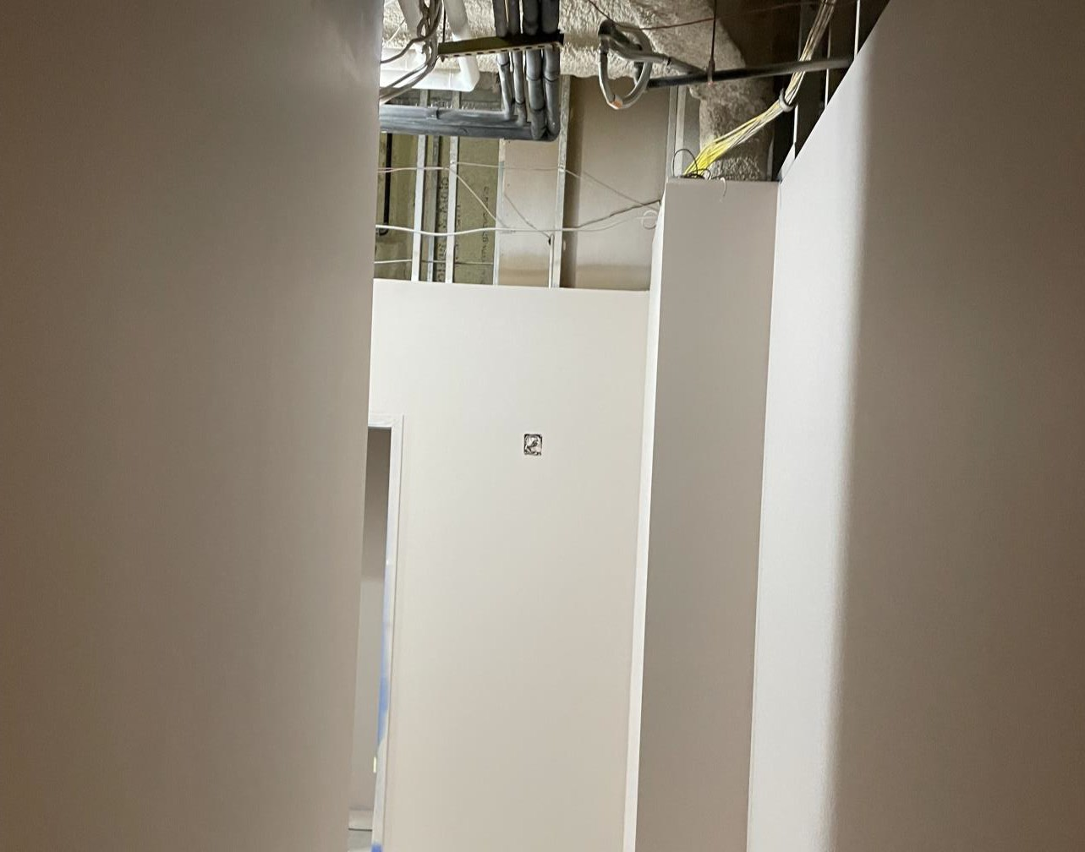
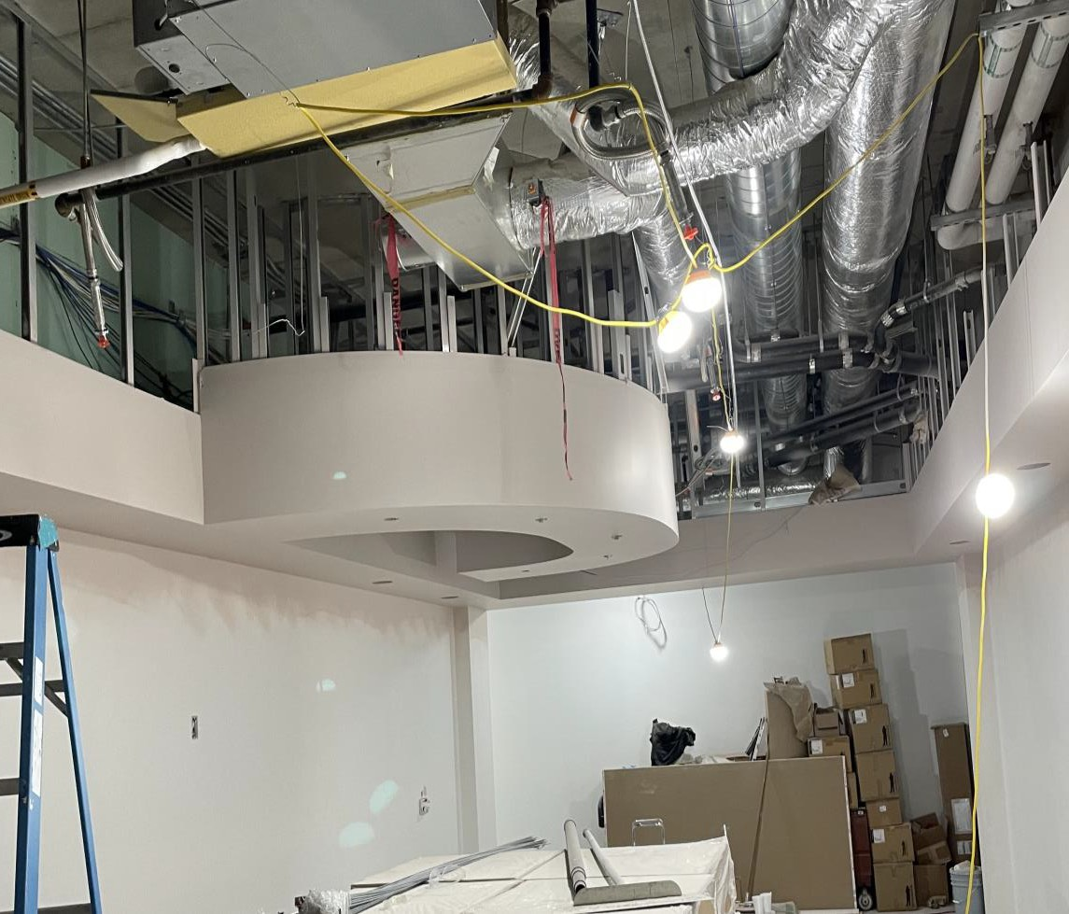
Yakama LegendsSpa Project Yakama,Washington

Slide 17
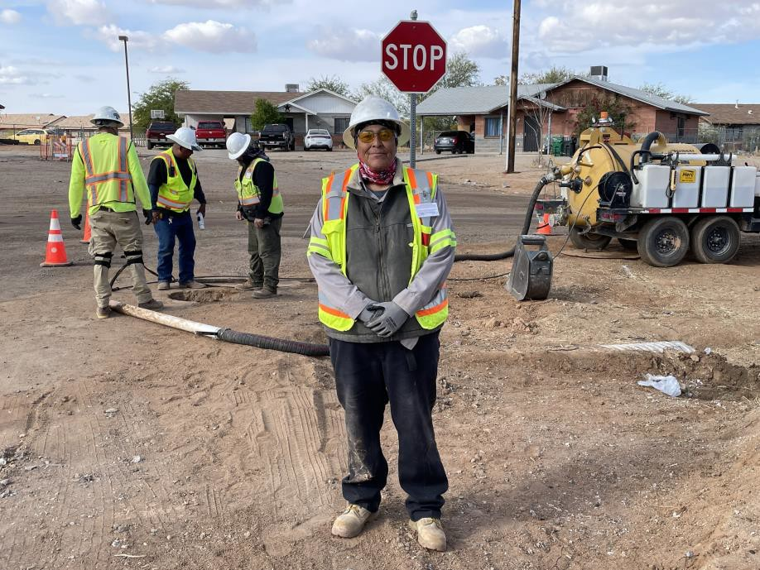
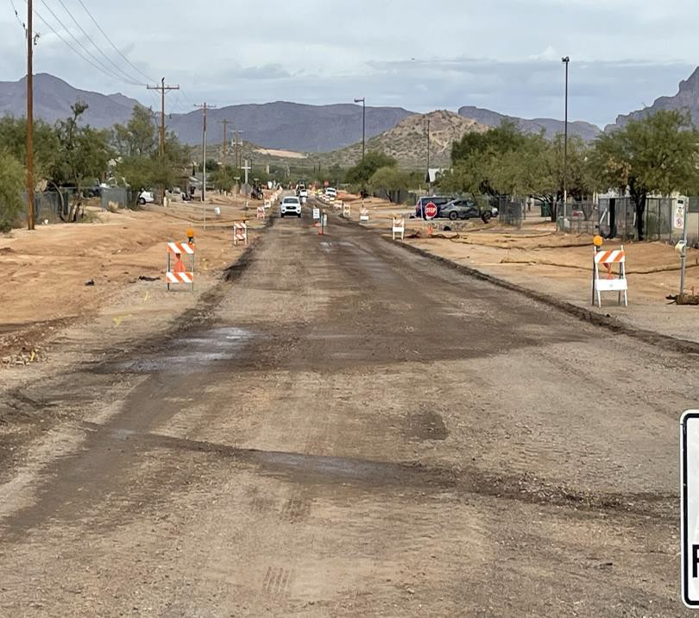
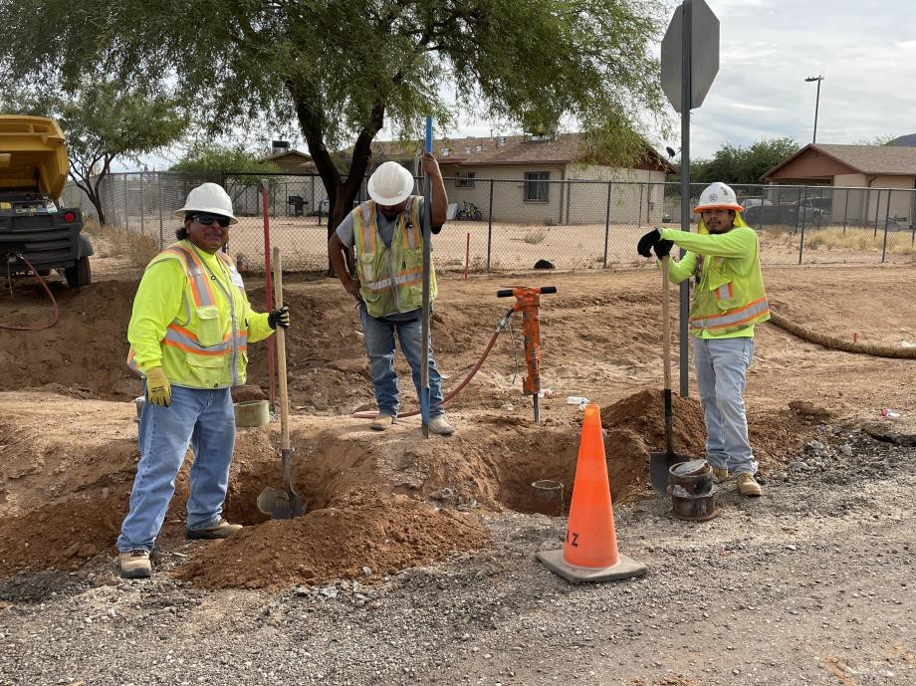
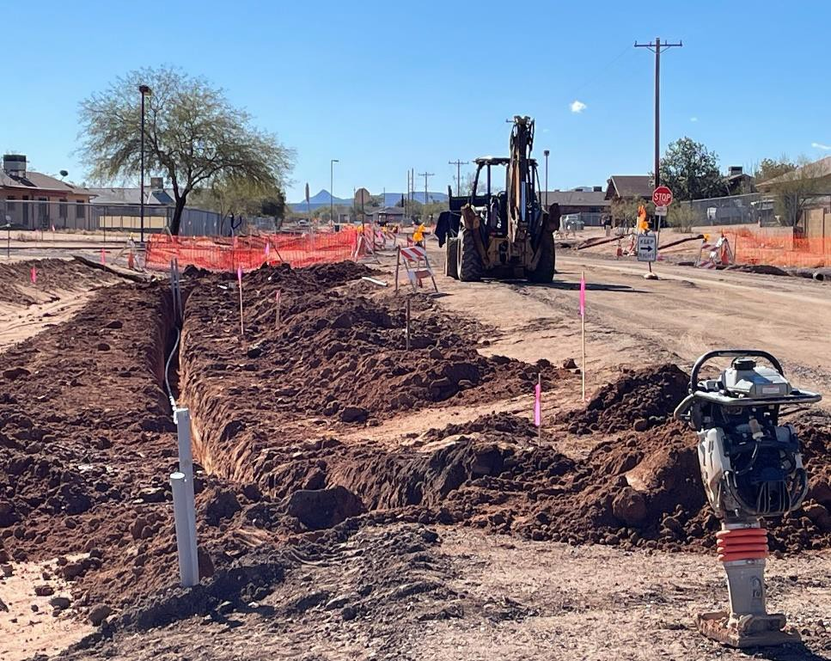
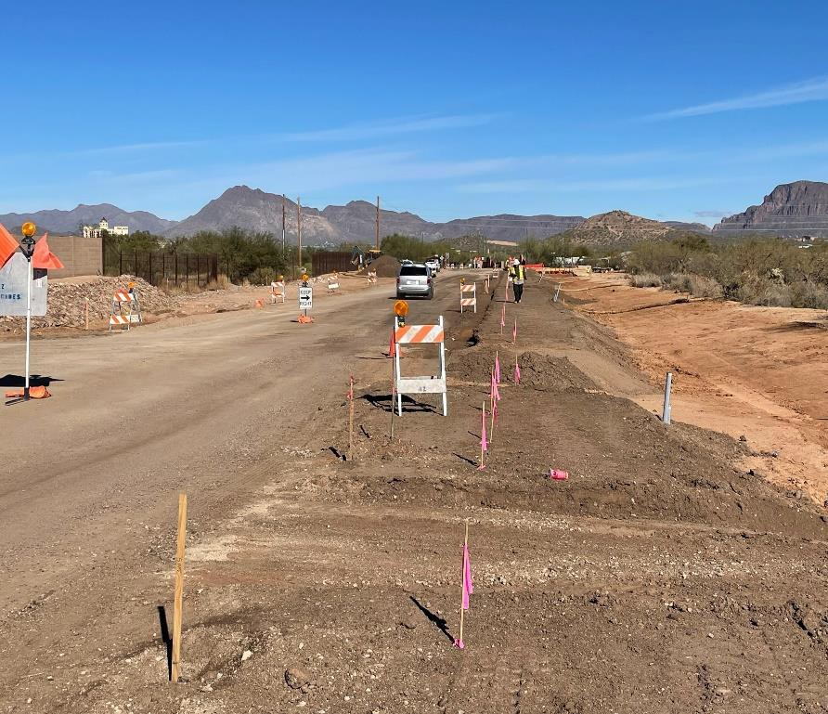
BAUMEA STREET PROJECT

Slide 18
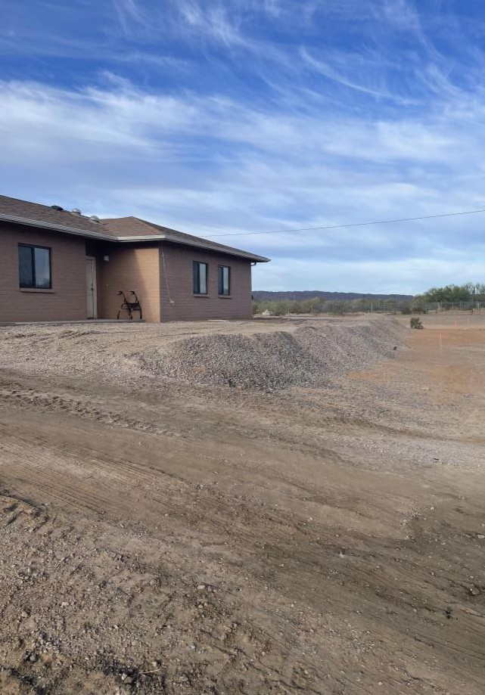
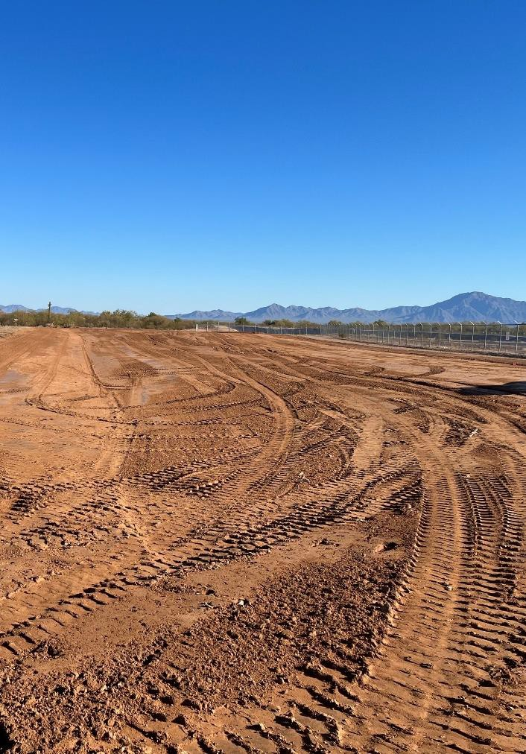
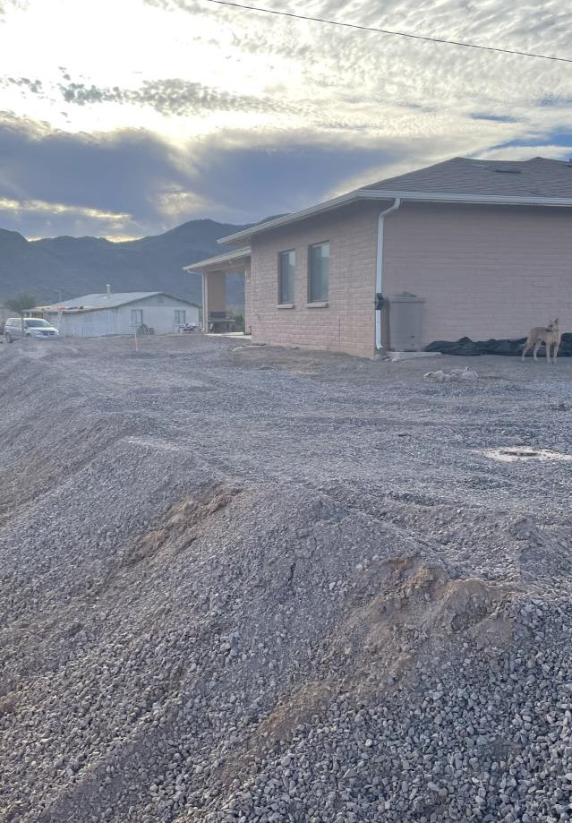
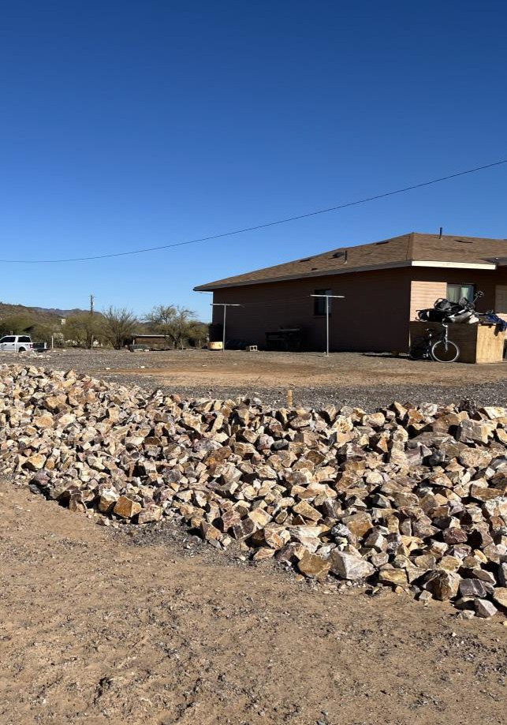
Tohono O’odham
Civil Projects
Celaya Erosion Control and Hanam Kek, AZ .

Slide 19
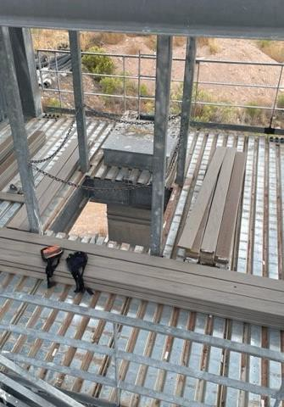
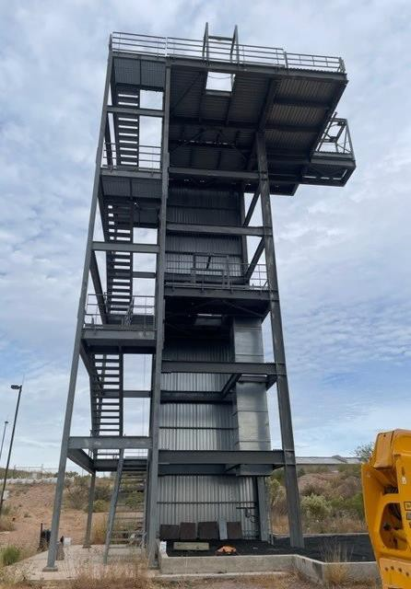
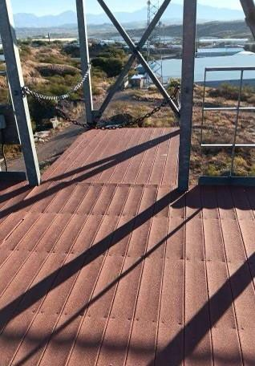
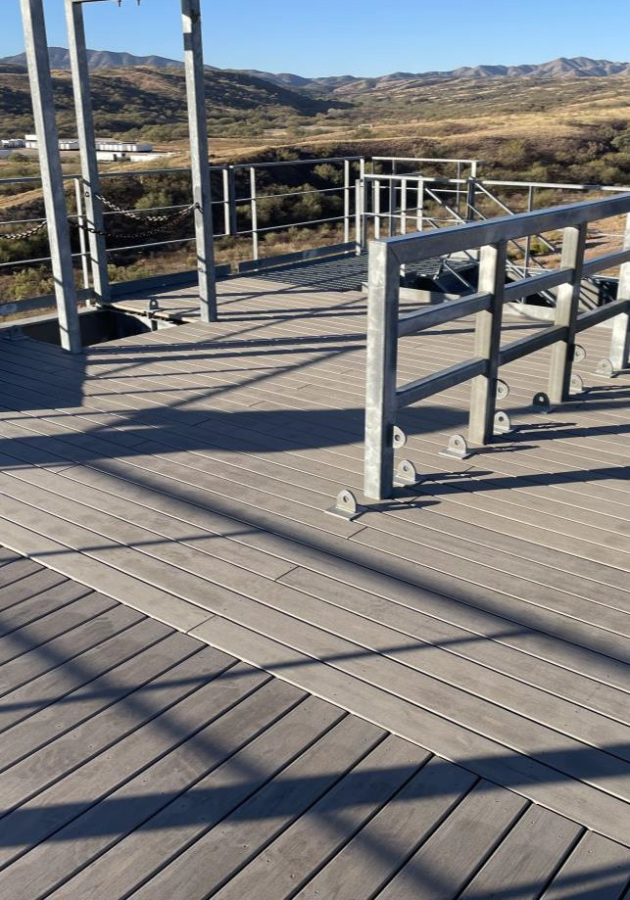
Rappel Tower Floor CBP-Nogales, AZ

Slide 20
Pascua Yaqui Tribe Collaboration: Commercial Property Management
PYDC Ventures LLC: New Commercial and Residential Opportunities
PYDC Ventures LLC: Future Federal Opportunities
PYDC
V
Notes:
PYDC Ventures began as a vehicle for the Tribe to keep its commercial properties safe and secure.
PYDC Ventures has moved into the mainstream real estate market and is managing several properties for the general public.
Next, PYDC Ventures will be moving into the mainstream commercial and federal markets.
Within the next year, PYDC Ventures is expecting to be added to the Federal GSA Schedule and become a Tribal 8(a).
Continue to provide property management services for the Tribe’s upcoming opportunities, such as the McDonald’s property, the Co-Op, the Micro Market, the incubator spaces, and any further purchases or developments on or off the reservation.

Slide 21
Considerations for A Real Estate Agent with a Tribal Client
Fee Land or Trust Land? Trust Land is Under Federal Laws, and Fee Land is Under State Laws
Trust Land: Land Assignment
Trust Land: Is there a process under the Tribal Code to transfer the home into the purchaser’s name?
Probate on Trust Land: Can the homeowner leave their home to their child in their will?
Selling a Tribal Home: Who can the homeowner sell their home to on Trust land?
Who owns trust land?
Fee Land: Does the Tribe Provide Down Payment Assistance, and What is the Process?
Timing of Financing: FHA, VA, USDA, Section 184, etc
Home Ownership Classes
PYDC
V
Notes:
PYDC Ventures began as a vehicle for the Tribe to keep its commercial properties safe and secure.
PYDC Ventures has moved into the mainstream real estate market and is managing several properties for the general public.
Next, PYDC Ventures will be moving into the mainstream commercial and federal markets.
Within the next year, PYDC Ventures is expecting to be added to the Federal GSA Schedule and become a Tribal 8(a).
Continue to provide property management services for the Tribe’s upcoming opportunities, such as the McDonald’s property, the Co-Op, the Micro Market, the incubator spaces, and any further purchases or developments on or off the reservation.

Slide 22
Questions
Contact Information
PYDC: Daune Cardenas, CEO
Cell 520-330-9355
Daune.Cardenas@pydcorporation.com
SPC: Raymundo Baltazar
Cell 520-289-1360 Office 520-638-5638
r.baltazar@sonoranpueblo.com
PYDC Ventures LLC: Veronica Escobar
Cell 520-282-0961
Veronica.Escobar@pydcorporation.com
PYDC
V

Slide 23
Native American Home Loan Programs
Welcome Home: A Guide For Tribal Homeownership
Tribal Leaders
02/28/2024
Services provided by BOKF, NA. Member FDIC. Equal Housing Lender. BOK Financial® is a trademark of BOKF, NA.

Slide 24
We go above.
So you can
go beyond.
Native American Home Loan Programs
For tribal members:
Commitment to housing options
Personalized consultation for tribal members
Education to help make homeownership possible
S Services provided by BOKF, NA. Member FDIC. Equal Housing Lender. BOK Financial® is a trademark of BOKF, NA

Slide 25
Program and Eligibility Highlights
Native American Home Loan Programs
Federally recognized tribal members, may be eligible for a Native American home loan program (FHA Section 184), backed by HUD's Office of Native American Programs.
A few eligibility highlights include:
On or Off Tribal Land
Can be used to purchase or refinance a new or existing home.
Credit scores –manual underwrite.
Low down payment 2.25%
Down payment can be gifted and seller can contribute up to 6% of the purchase price.
Tribal down payment assistance (if available) can also be used in conjunction with other forms of down payment assistance.
Reduced mortgage insurance.
Mortgage insurance drops at 78% loan-to-value.
Loan limits up to $530,150 in Arizona (varies by county).
Exceptional service and expertise.
Services provided by BOKF, NA. Member FDIC. Equal Housing Lender. BOK Financial® is a trademark of BOKF, NA

Slide 26
Other Specialized Programs
Native American Home Loan Programs
Specialized Home Loan Programs :
Native American FHA 184 Program
3% Down Payment Conventional Mortgage
FHA Traditional Program
Veteran's Administration Loan
HomePlus
Advanced Medical Professional (AMP)
USDA (Rural Development)
Services provided by BOKF, NA. Member FDIC. Equal Housing Lender. BOK Financial® is a trademark of BOKF, NA

Slide 27
ELIGIBLE AREAS

Slide 28
Low down payment 2.25% vs. 3 or 5%
Lower monthly payment due to lower rates and NO monthly Mortgage Insurance
Lowest “Guarantee fee” of all federally insured loans.
You can buy up to 4 units!
BENEFITS OF THE PROGRAM

Slide 29
Thank you
Erin Halbert
NMLS #630265
VP, Mortgage Sales Manager
BOK Financial
Erin.Halbert@bokf.com
M 480.399.0369
901 N. Dobson Road
Mesa, AZ 85201
BOKFinancial.com/Erin-Halbert
Mario Noriega
NMLS #476048
Mortgage Banker
BOK Financial
MNoriega@bokf.com
T 602.508.7888 M 480.694.3014
901 N Dobson Road
Mesa, AZ 85201
BOKFinancial.com/Mario-Noriega
Services provided by BOKF, NA. Member FDIC. Equal Housing Lender. BOK Financial® is a trademark of BOKF, NA

