Slide 1


Braided Funding
Effective Utilization of Medicaid funding in the support of HUD funded programs.

Slide 2


Presenters
Cindy Stotler- Deputy Director, ADOH
Terrance Watkins- Housing Director, Community Partners, Inc.
David Bridge- Director of Housing Programs, AHCCCS

Slide 3

Introduction
Cindy Stotler
Deputy Director, ADOH

Slide 4

Housing Director,
Community Partners, Inc.
Terrance R. Watkins

Slide 5

Brief History
Community Partnership of Southern Arizona-
Regional Behavioral Health Authority
Notes:
Good afternoon everyone,
I want to start by giving you fair warning; I go by the moniker of “Transparent Terrance”. You can always count on me to tell the full story, in painstaking detail, and sometimes that means providing too much information. I will try my best to boil it down a little, but no promises☺
I want to provide you with a little bit of background. Community Partnership of Southern AZ (CPSA) was the Regional Behavioral Health Authority for Southeastern AZ for 20 years. During this time, CPSA utilized a variety of funding to build 222 affordable apartments for individuals and families with disabilities and was either the direct recipient or sub-recipient of 11 HUD funded TBRA programs. CPSA was strictly an administrative program and contracted with other agencies to provide all direct support services to program participants. In 2015, the RBHA contract was awarded to Cenpatico (Now AZCH), and CPSA transitioned to providing direct services to the program participants.

Slide 6

Transitioning
Transitioning from an administrative agency to a direct provider of Medicaid reimbursable services was NOT an easily accomplishable feat.
Notes:
As an administrative agency, we had limited experience in billing Medicaid for reimbursement of direct services, and we had a lot to learn. I hope to share our journey, including trails/tribulations, lessons learned, and benefits reaped from undertaking the process of becoming an agency able to bill Medicaid for the services provided to HUD program participants.
Disclaimer: This presentation should only serve as a high level “30,000 ft view” of the process and should not be considered an exhaustive list of needed steps.
So, let’s start with discussing the cons…

Slide 7

AHCCCS Contractor Operations Manual (ACOM)
The Arizona Health Care Cost Containment System (AHCCCS) provides a contractor’s manual, that itemizes the Administration, Claims, Finance, and Operational requirements needed to become and remain in compliance as a Medicaid provider in Arizona.
Notes:
We had a steep learning curve in learning what services are reimbursable through Medicaid, reimbursement justification, and administrative requirements. This was accomplished through a thorough examination and application of the AHCCCS Contractor Operations Manual (ACOM).
The ACOM itemizes every requirement for providers pertaining to:
Administration,
Claims,
Financial, and
Operations

Slide 8

Provider Registration
Agencies seeking to be reimbursed from Medicaid will need to register through the AHCCCS Provider Enrollment Portal (APEP).
Agencies will need:
A National Provider Identifier number (NPI)
Certified W-9
Professional Certifications and Licensure
Provider Enrollment Application
Supporting Documentation
Notes:
Initially we had the hurdle of becoming a provider within a Managed Care Organization (MCO). This involved several steps including enrollment through the AHCCCS Provider Enrollment Portal (APEP). In order to register with the portal, providers will need: (see PowerPoint).
Please note: Professional Certifications and Licensure requirements will vary based on the services that each agency provides.

Slide 9

Licensure
Billing Medicaid for reimbursable services will require some providers to be independently licensed to provide the eligible services.
Licensure requirements will depend on the services provided (i.e., Therapy/Counseling, medical, Substance Use Treatment, etc.), and providers should verify requirements through AHCCCS and the Arizona Board of Behavioral Health Examiners.
Notes:
CPSA already had a Contract Officer responsible for coordinating licensing, and had a multitude Licensed clinicians on staff, so this was not that heavy of a lift for us but it will require some effort and the hiring of a licensed clinician.

Slide 10

Managed Care Organizations (MCO’s)
Depending on their geographical location, AHCCCS members can choose to enroll in one of twelve different MCO’s, commonly referred to as health plans. This does not include special plans such as ALTCS, DDD, CRS, etc. A crucial step in Medicaid reimbursement is contracting with the applicable MCO’s in your service area.
Notes:
See PowerPoint

Slide 11
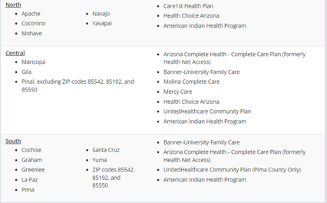
Managed Care Organizations- Continued…
Available MCO’s are divided by region:
Northern Arizona
Central Arizona
Southern Arizona
Notes:
North: Care 1st, Health Choice, and American Indian Health Plans
Central: AZCH, Banner-University, Molina Complete Care, Mercy Care, Health Choice United Healthcare, and American Indian Health Plans
South: Banner- University, AZCH, United Healthcare Community Plan, and American Indian Health Plans

Slide 12

Implementation
Electronic Health Records
Training Staff
Data Validation
Hiring additional staff
Budgeting
Notes:
Having a thorough understanding of the requirements, we were now tasked with practical application of these requirements, and this did take a lot of time, money, training, and effort.
Through a lot of coordination with our Claims, Utilization Management, and Compliance departments, we were able to fully realize the extent of the journey we had embarked on. For instance: We needed to have:
An Electronic Health Record capable of meeting billing requirements (Avatar, NextGen, HMS),
We needed to train staff to be able to understand which service they are providing and write medical notes to justify the service being submitted for reimbursement,
Understand the requirements to bill each service (such as credentialing, what credentials are required to provide each service, etc.)
Due to the amount of time that staff would be completing this documentation, we had to hire more staff to meet the needs of the members,
Budgeting and productivity requirements

Slide 13

Trials & Tribulations
High staff turnover rates
Delayed Processing of Claims
Long position vacancy times
Loss of revenue
Notes:
Some of the hardships that we faced included:
Staff turnover: As most employees with experience in subsidized housing had never been required to submit bills for their services, staff found the work too overwhelming, which led to them leaving. This caused us to shift to hiring individuals with experience working in public behavioral health.
Delayed claims: When processing claims you can expect reprocess rejected or denied claims. Claims processing is sensitive to meeting specific contractual and legal requirements. Thus, you can wait up to 120 days to get paid.
Long position vacancy times: Due to the specialty of the position, the company had longer than usual training times. Coupled with the high turn over rates, it made the company more selective with the hiring process. With an average training time of 3-6 months before you have a fully independent seasoned Housing Specialist, you can’t afford to continue hiring individuals that leave in six months.
It took about six months of implementation before we were financially stable

Slide 14

Positives
Greater range of available services
Smaller Caseload sizes
Ability to serve more members
Increased revenue
Ability to re-invest in projects
Reduced strain on public resources
Increased quality of life for members
Notes:
Okay, so now that I have been a total buzz kill with my transparency, let’s discuss the benefits to embarking on this journey…
Available Services: As a licensed behavioral health provider, many of the HUD CoC and ESG eligible activities, as defined by Code of Federal Regulations 576 and 578, were now eligible for reimbursement to include: Annual Assessment of Service Needs, Case Management, Counseling, Education Services, Employment Assistance and Job Training, Housing Search and Counseling Services, Life Skills Training, Mental Health Services, Outpatient Health Services, Substance Abuse Treatment Services, and the Direct Provision of Services.
Smaller Caseloads: As previously mentioned, in order to preserve staff, we have hired more staff, which results in smaller caseloads.
Serve more members: Since we can’t bill Medicaid and HUD for the same hours worked, we have reduced the amount of money charged to HUD to cover the cost of staff. These additional funds have been diverted from Supportive Services to rental assistance, resulting in a greater number of households that we can serve.
Increased revenue: Once we found our grove, the revenue generated from Medicaid Reimbursements now exceeds the expenditures required to maintain the program.
Re-investment: This revenue also provides us with the ability to invest in additional housing projects to meet the needs of the communities that we serve.
Public Resources: Increased engagement with participants in the community leads to reduction in hospital visits, first responder engagement, correctional involvement, which in turn leads to less public funding spent on hospitalizations, incarcerations, and crisis services.
Quality of Life: Members experience greater stability, increase educational engagement, increase income levels (through benefits and employment) all leading to an improved quality of life.

Slide 15

Current Services
Currently employing thirty-one full time staff members
Serving 800+ members
Providing Services in 6 Counties (Pinal, Pima, Cochise, Santa Cruz, Graham, and Greenlee Counties)
Providing Services participants in:
  Project-Based Rental Assistance programs
  Tenant-Based Rental Assistance programs
  Rapid Re-housing programs
  Transitional Housing programs
  Section 8 Housing programs
  Section 8-11 Housing programs
  AHCCCS Supported Housing

Slide 16
Current Services
Providing Fully-Integrated Medical/Behavioral Health Services:
  Comprehensive Assessments
  Case Management
  Skills Training
  Peer Support
  Counseling
  Therapy
  Health Promotion
  Prevocational Services
  Ongoing Support to Maintain Employment
  SSDI/SSI Outreach and Recovery (SOAR) services
  Intensive Outpatient Substance Use Treatment
  Crisis Services
  PCP Medical Services
  Prescription Medication Pickup

Slide 17
Summary
The majority of the services that we are providing to our program participants are being provided by most housing providers that provide Supportive Services to formerly homeless individuals.
While it took some time to fine tune the process it, the advantages to this model benefit the members and their families, HUD, AHCCCS, other behavioral health entities, first responders, correctional institutions, and the overall community in general.
Notes:
now I’d like to introduce David Bridge

Slide 18

David Bridge
Director of Housing Programs, AHCCCS
Special Needs Program Administrator, ADOH

Slide 19
Housing Supportive services
BRAIDED FUNDING
David Bridge
Special Needs Administrator
AZ Department of Housing

Slide 20
BRAIDED FUNDING:
Weaving together of multiple federal, state, local and/or private funding streams to ensure successful program implementation.
Housing
Services

Slide 21
Individualized Services (Voluntary – for member)
  Client Centric – client defined goals
    Harm Reduction to Start
    Maintain Tenancy
  Intensity and Duration based on Member/Client Need
Housing not Contingent on Services
  Natural Consequences
Flexible – follow member/client
  Meet people where they are
Address Multiple “Social Determinants of Health”
  Housing Navigation and Coordination
  Substance Abuse Treatment
  Connection to Behavioral and Physical Health
  Meet Basic Needs
  Life Skills
  Connection to Community
  Reduce Institutional Recidivism

Slide 22
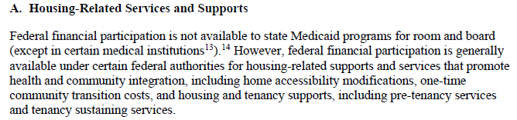
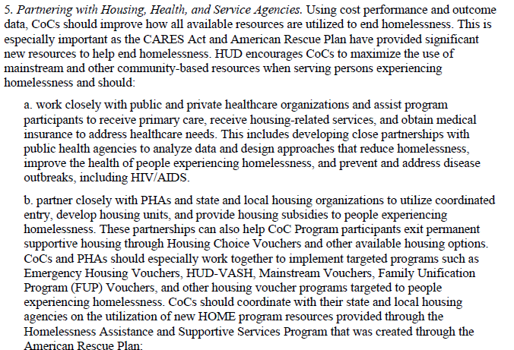
What they all say
CMS: State Health Official (SHO) Letter HO21-001 (1/7/21)
HUD: 2022 Continuum of Care NOFO

Slide 23
Local (County/City)
General Funds
State
State General Funds
Private
Foundations
Federal
Continuum of Care
Fed Grants
DES: ESG
AHCCCS: SABG, MHBG, PATH
CARES/ARPA
Fed Entitlement Communities (CDBG, ESG)
United Ways
Individual Donors
Corporate Giving
Fed Pass Through:
Housing Trust Fund
CONSIDERATIONS
Target Population
Match Requirements
Referrals and Coordination
Partial Funding
Reporting and Record Keeping
Program Flexibility
Sustainability
Agency Capacity
Collaboration?

Slide 24




American Rescue Plan – Eligible Uses
EARH (Rural)
HOME/
Homeless
Treasury
ERAP/LAATCF
Capital Fund
ERAP/EHV
Other: Tribal, Energy,TANF, Counseling
State/Local Fiscal Recovery
✓
✓
✓
✓
Rental Assistance: Rent, arrears, search, utilities, administrative
Planning & Data: Technical assistance, data collection, capacity building, workforce
✓
✓
Permanent Housing: Acquisition, Rehab, Construction, flexible funding pools,
✓
Services: counseling, stabilization, flexible services pool, medical care coordination, shelter services, supportive housing services
✓
✓
✓
✓
✓
Temporary Housing: Stabilization, shelter,
✓
✓
✓
✓
Notes:
1.Snapshot of both short term and long term uses of each pot of money
•This includes emergency response, shelters including funding hotels, motels for non-congregate sheltering, housing assistance, filling Medicaid gaps, capital, services, and also how to reinforce or introduce data sharing especially tracking for distribution of cares funding to ensure equitable distribution of funding
A more detailed breakdown is available by clicking on the link at the top of the slide
2.Couple things to take away from this overview
•Several different pots of money can cover both short term/emergency response and some can cover long term response.
•Depending on what money you have access to or the ability to coordinate with may dictate where you dip in; it’s important to think about sequencing and how each can be maximized
•Underscore the opportunity to maximize and align local dollars
•May states have emergency response dollars and some also have issued things like rental assistance post-eviction moratorium so ensure coordination and advocate for resources to go to those who are most in need
•There is also an opportunity to consider long-term advocacy needs
•We know that states and jurisdictions are financially depleted and budgets will be slashed
•How can we use this to fundamentally change out approach to shifting housing from short term/emergency to permanent supportive housing
•How can we reprioritize where resource go or introduce new funding secure additional funding

Slide 25
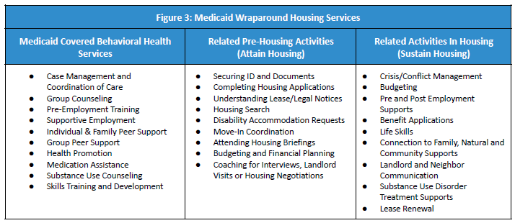

Slide 26
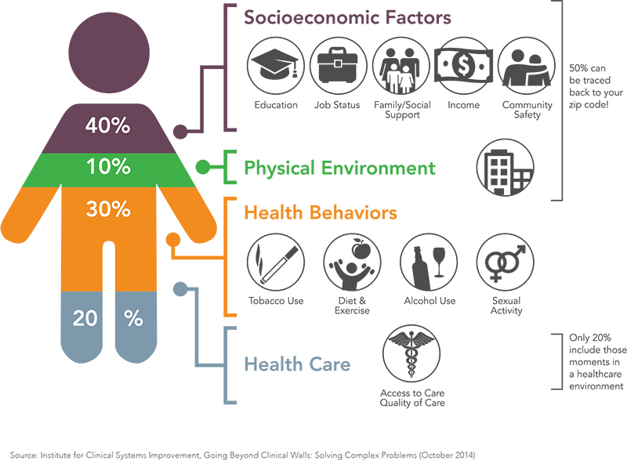
Medicaid coordination
Health Care recognizes impact of Social Determinants of Health Impacts. Account for up to 80% of health costs
Housing has been demonstrated to reduce health care spend
  https://www.azahcccs.gov/Resources/Downloads/1115Waiver/AddressingHealthcareAndHousing_Infographic.pdf
Current Opportunities:
  Licensed Providers (PSH Services)
  CSA
  Grants
Future: Housing and Health Opportunities (H2O) 1115 Waiver
  https://www.azahcccs.gov/Resources/Federal/HousingWaiverRequest.html
  Proposed Services
    -Outreach -Bridge/Transitional Housing
    -Move In Expenses -Eviction Prevention
    -Expanded population -Home Modification
    -Potential CBO participation

Slide 27



Questions?
Feedback?

