Slide 1
2023 Arizona Housing Forum
Emily Cadik, CEO, Affordable Housing Tax Credit Coalition
David Gasson, Executive Director, Housing Advisory Group
August 24, 2023

Slide 2
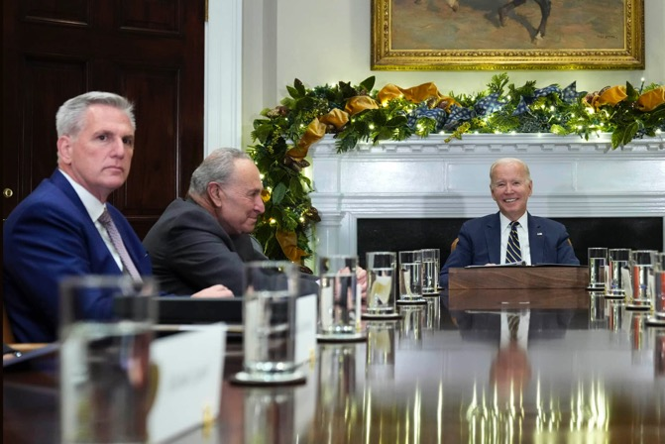
Congressional Landscape
2023 Year-end Outlook
  Must-pass legislation
    Government funding deadline September 30
    ​Defense authorization ​
    ​Other expirations: farm bill, airport & airway trust fund (FAA) reauthorization
  Other bipartisan legislation could be difficult, but not impossible, to enact​ - would likely attach to other legislation
    Tax extenders?
    Disaster relief?
2024 is an election year and not likely to yield major legislation
2025 expected to be a major year for tax legislation with expirations of many TCJA (tax reform) provisions
Notes:
Insert any graphics messages from the two-pager here

Slide 3
The Affordable Housing Credit Improvement Act of 2023: What’s New?
New lead sponsors
  3 new Republicans and 1 new Democrat
  10 lead sponsors total
Minor changes from prior version
  Clarification to reflect newly enacted law
  Technical clarifications
  “Sense of Congress” provisions to demonstrate commitment to additional policy changes
Unprecedented bipartisan support

Slide 4
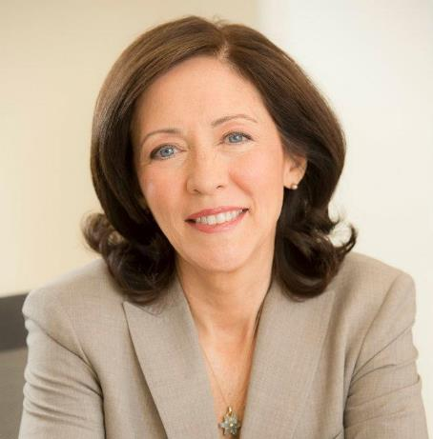
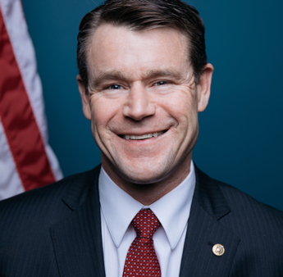
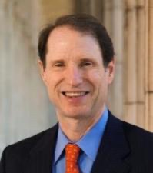
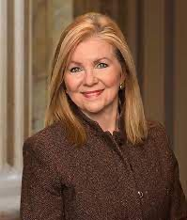
AHCIA of 2023 Lead Sponsors - Senate
Sen. Maria Cantwell (D-WA)
Sen. Todd Young (R-IN)
Sen. Ron Wyden (D-OR)
Sen. Marsha Blackburn (R-TN)
New

Slide 5
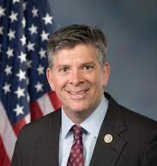
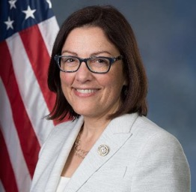
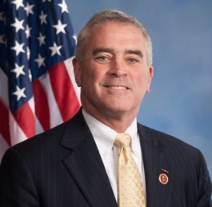
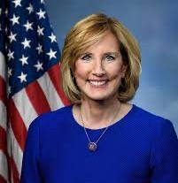
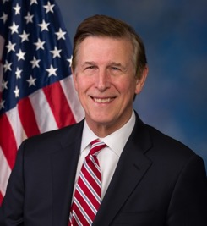
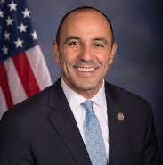
AHCIA of 2023 Lead Sponsors - House
Rep. Darin LaHood (R-IL)
New
Rep. Suzan DelBene (D-WA)
Rep. Brad Wenstrup (R-OH)
Rep. Claudia Tenney (R-NY)
New
Rep. Don Beyer (D-VA)
Rep. Jimmy Panetta (D-CA)
New

Slide 6
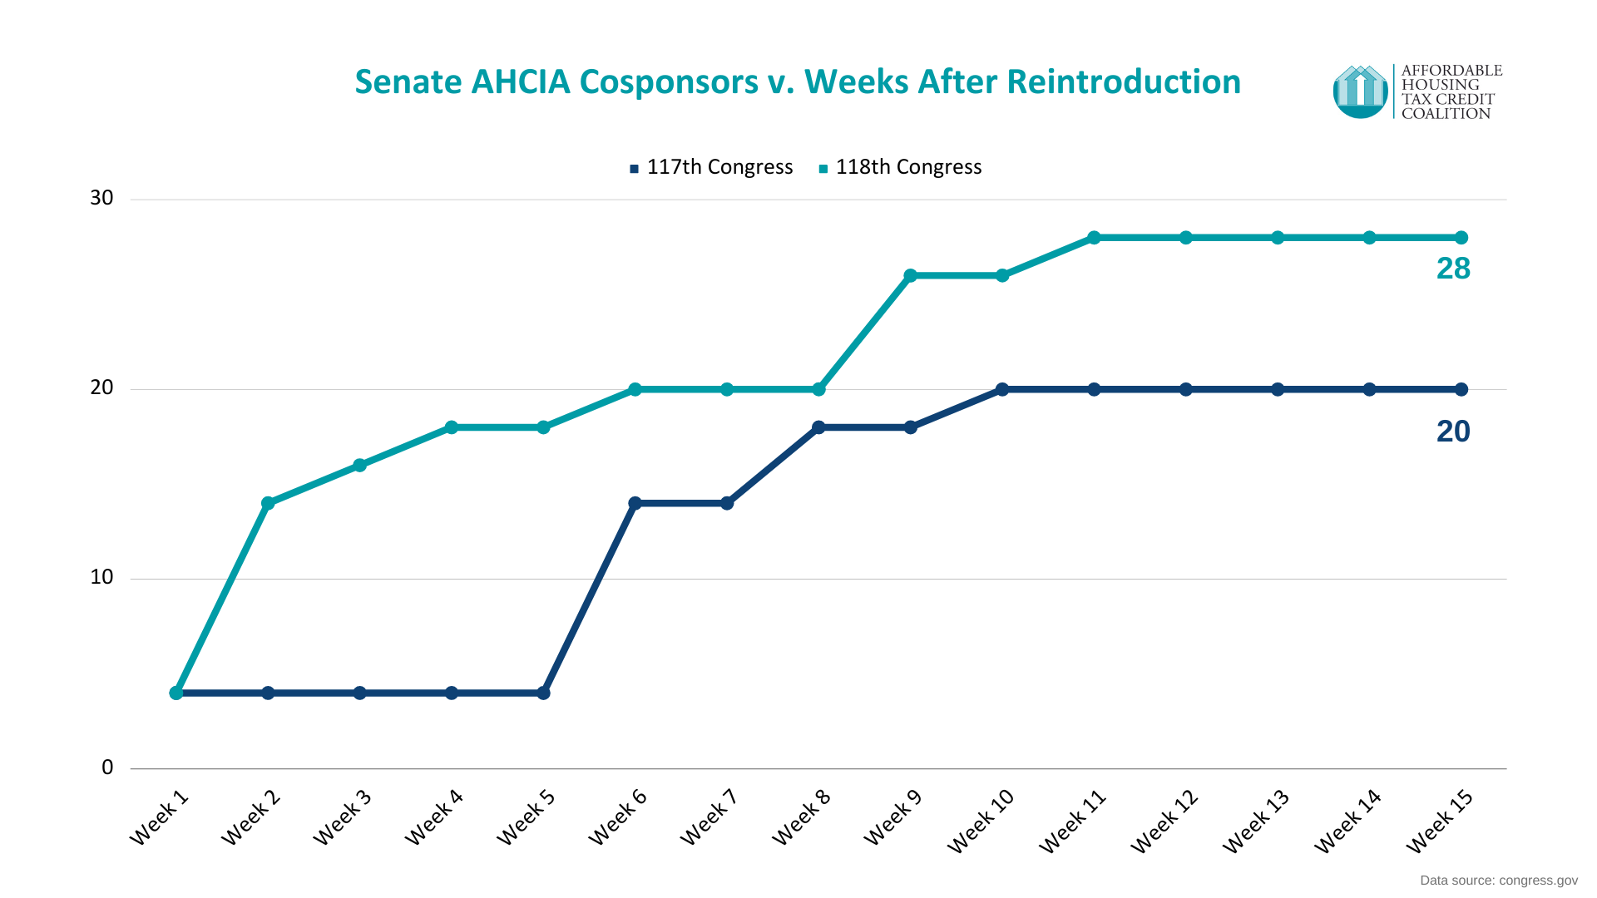
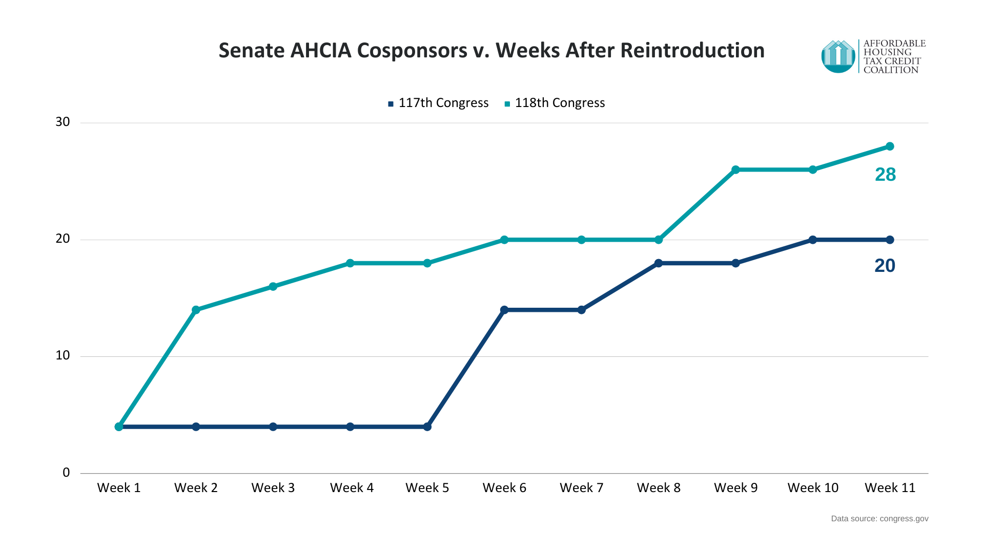
As of August 22, 2023

Slide 7
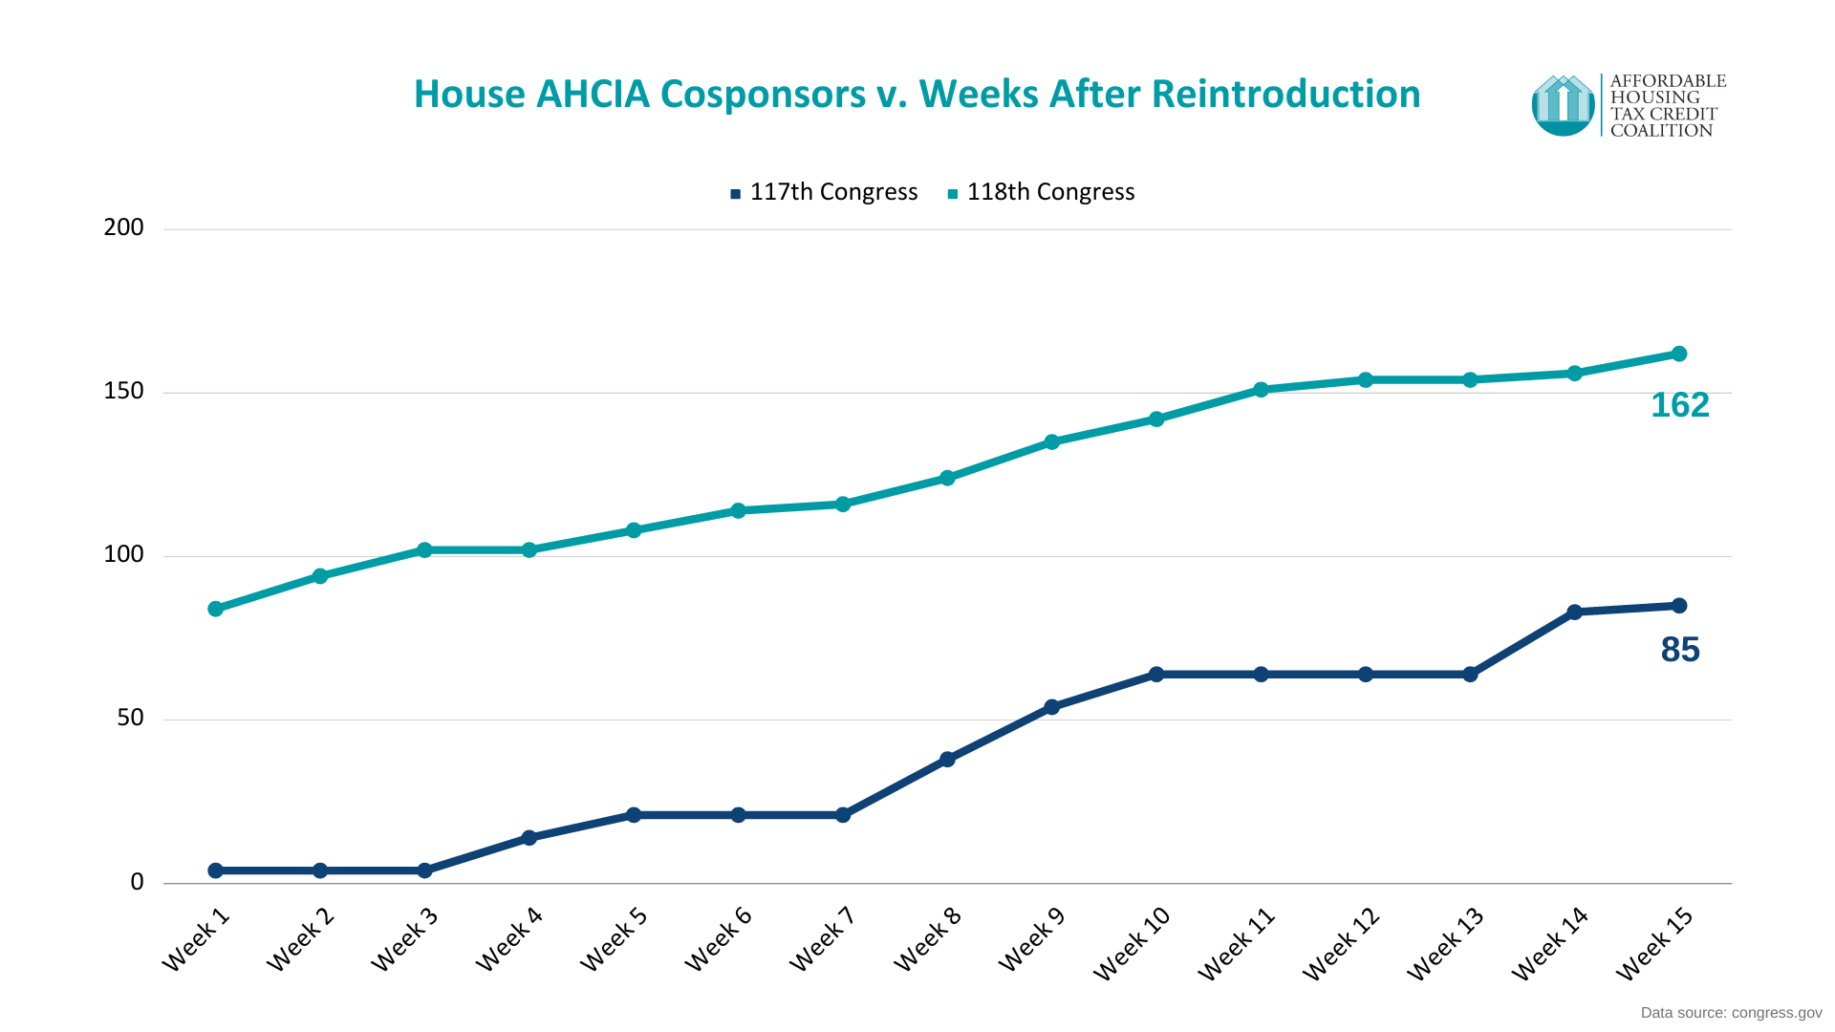
As of August 22, 2023

Slide 8
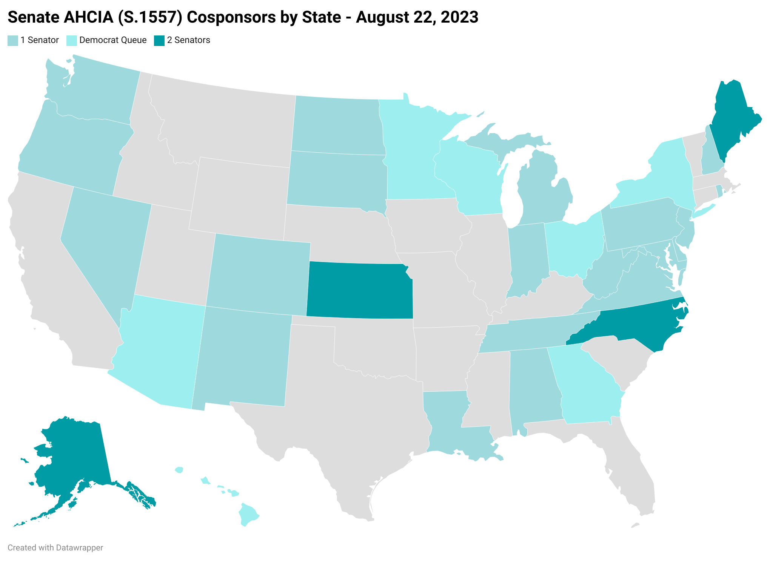
  28 Senate Co-sponsors
    14 Republicans
    14 Democrats
  16 Dems in the queue

Slide 9
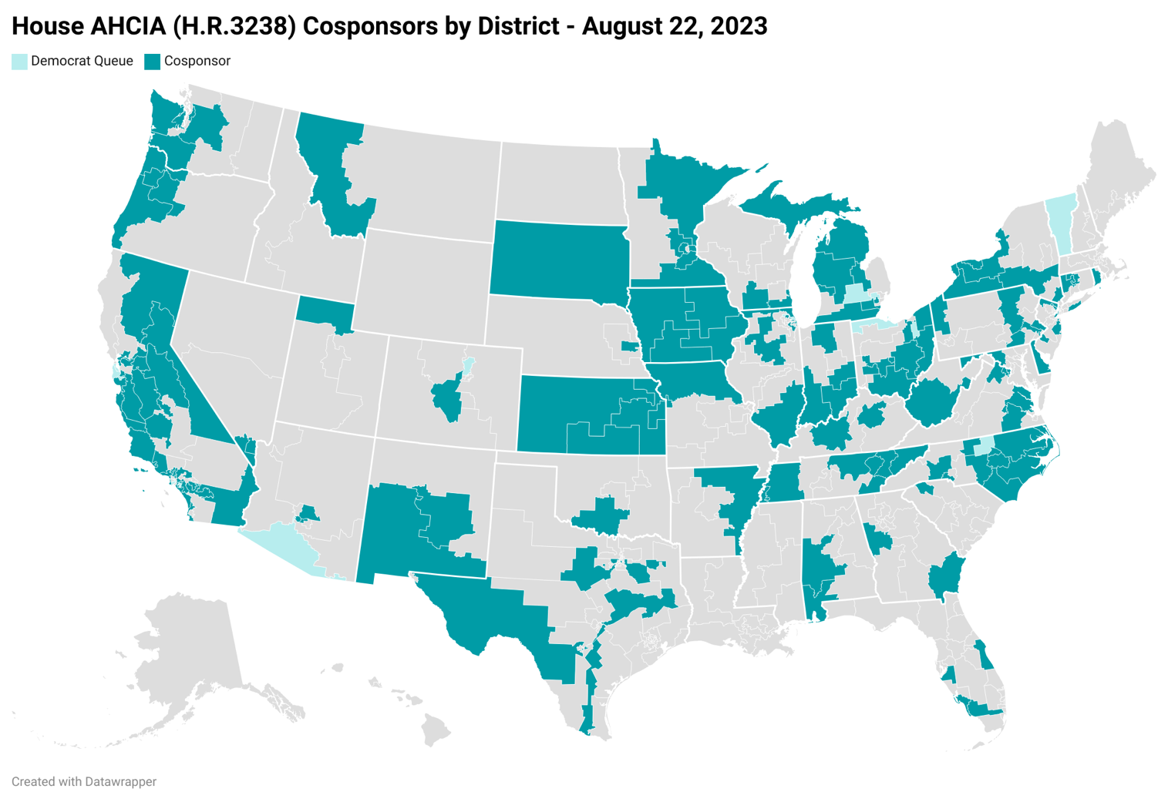
  162 House Co-Sponsors
    81 Republicans
    81 Democrats
  14 Dems in the queue

Slide 10
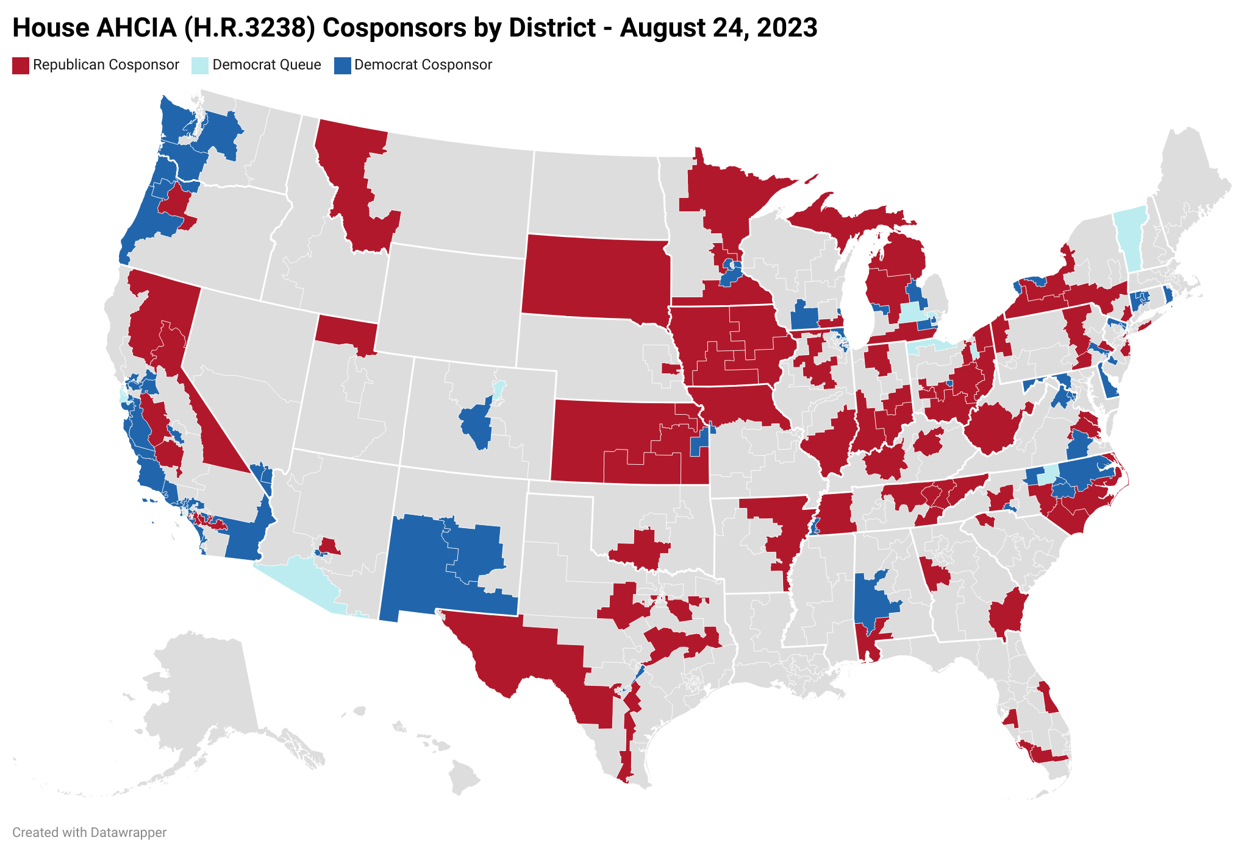

Slide 11
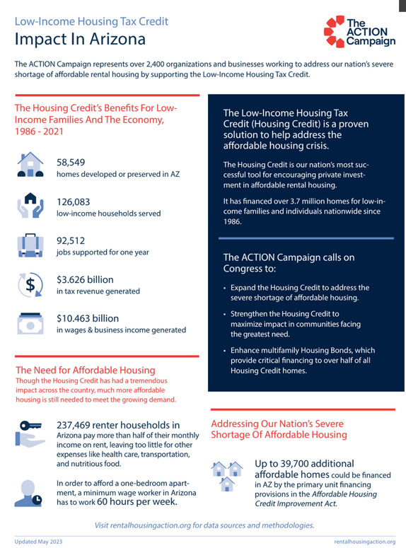
Arizona Congressional Outreach
AHCIA co-sponsors
  Rep. David Schweikert (R)
  *House Ways and Means Committee Member
  Rep. Greg Stanton (D)
  Rep. Ruben Gallego (D)
In the queue to co-sponsor the AHCIA:
  Sen. Kirsten Sinema (I)
  Sen. Mark Kelly (D)
  Rep. Raul Grijalva (D)
Top targets:
  Juan Ciscomani (R) *freshman
Notes:
*Other bipartisan possibilities (history – housing finance reform)

Slide 12



Other Affordable Housing Regulatory Issues: CRA
85% of $22 billion Housing Credit market is CRA-motivated
Proposed CRA modernization rule threatens investment in affordable housing
    Eliminates investment test, and combines investments and loans into one test
    Prioritizes retail activities
    Reduces incentive for banks to aim for outstanding rating
Comments were due August 5, 2022, regulators aiming for final rule “before the first snow falls” in 2023
In a survey of large bank investors, 42% of respondents thought they might somewhat reduce their Housing Credit investments because of the elimination of the investment test

Slide 13




Other Affordable Housing Regulatory Issues
  Global minimum tax – could have major impact on Housing Credit investment, but regulations headed in the right direction for now
  GSE – final determination of tax status
    Determination will dictate level of equity investment in Duty to Serve areas
  Biden Administration is looking for other opportunities to support affordable housing
    Action to bring down insurance costs?
    Other ideas?

Slide 14
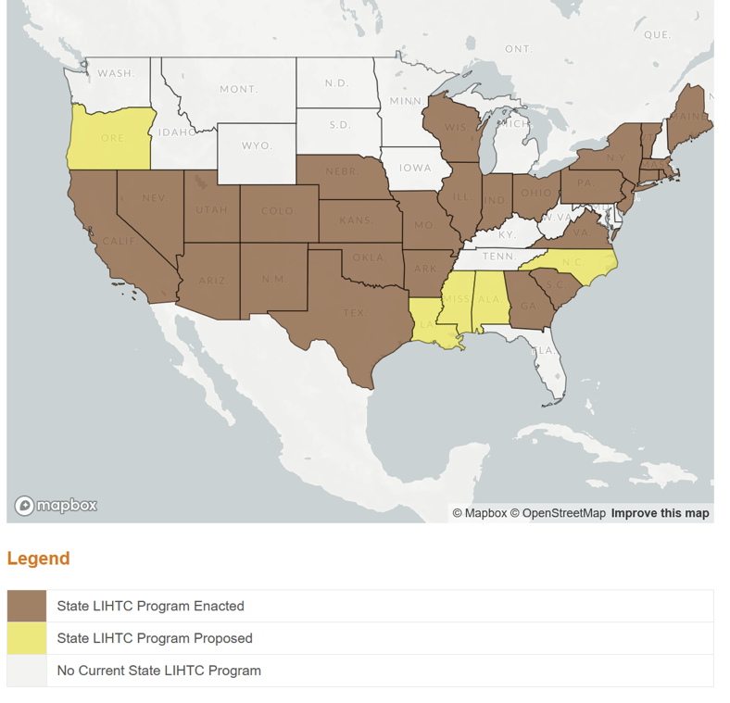
State Low-Income Housing Tax Credits
Source: Novogradac & Co

Slide 15
HUD Budget
Source: National Leased Housing Association

Slide 16
Questions?
  Emily.Cadik@taxcreditcoalition.org
  taxcreditcoalition.org
  @EmilyCadik
  @AHTCCoalition
  dgasson@housingadvisorygroup.org
  housingadvisorygroup.org
  @dsgasson
  @HousingAdvGroup

