Slide 1
City Solutions: Developing a City Centered Homeless Alliance
Notes:
Self introduce

Slide 2
Agenda
Introductions
Overview
Defining a Master Services Agreement
In Theory & Practice: Allying 16 Organizations
In Theory & Practice: Managing a 24-7 Line
In Theory & Practice: Providing Integrated Homeless Prevention & Rapid Rehousing
In Theory & Practice: A Single Point of Entry
Lessons Learned, If We Were To Do It Again, How to Move Forward

Slide 3
Introductions
Lisa Glow – Central Arizona Shelter Services
Jennifer Sikorski – Norton Ramsey Empowerment Center
Jussanne Goodman –Phoenix Rescue Mission
Matt Hess – City of Glendale

Slide 4
The Big Picture
A Working Collaboration
Client-Centric
Positive Community Impact
No Wrong Door
Reaching for Functional Zero
Notes:
WHAT ABOUT ADDING THE LOGOS OF THE CURRENT PARTNERS to this slide, INCLUDE CASS AND GLENDALE TOO. I will cover this one as the big picture principles.

Slide 5
Why A Master Services Agreement?
Notes:
Have Matt go first here and then I will speak how we saw it when we applied. You can just have this as the question with no text, the light bulb and then Matt, then I speak about how we approached it when we applied to become the Master Services Provider. Flexibility to move dollars where needed.

Slide 6
How this presentation will work
The theory was and how the idea was conceptualized, what our goal was, and what we expected it to look like.
How it worked in practice (if it matched what we expected in theory), and what we learned from doing it for real.
Notes:
THIS IS VERY AMBITIOUS and rather than voting, I think we should say the above and also allow for questions after each subsection is discussed.

Slide 7
Theory: Allying 16 Organizations
At the beginning of the GHA, we identified 16 separate partners to work with us to form this alliance – several of whom are surely in the room today.
We aimed through the combination of a 24-7 line and a no-wrong-door approach to identify the many different needs our clients had and bring together providers that could support those needs.
Notes:
Lisa take this slide. Initially 16 partners. Some funded, some not. Some stayed on, some not as could not handle the billing challenges with this much funding to be spent so fast. 3.4 Million and how we divided it….Lisa will explain. MAYBE ADD THE LOGOS HERE, I HAVE THEM IN MY OTHER PPT.

Slide 8
Theory: Allying 16 Organizations
Clarity of Roles
Collaborative Service Delivery
Expeditious client solutions through no wrong door
Leveraging of Funding
Regular meetings could include:
Program Managers
Outreach Workers
Invested Community Members
Case Managers
Partner Leadership
All in spirit of collaborative service delivery
Notes:
Lisa, Nate as lead on street outreach. What we needed to make sure we ere doing.
Jussane Goodman from PRM to talk about their role in this partnership. Talk about the street outreach coordination they have led and continue to lead.
Jennifer: On a day to day basis, how do we coordinate with partners and tell me about a typical day. WHEN WITH US, WE GET PEOPLE SIGNED UP FOR HOUSING, SO IT IS A DRAW.
First, and foremost get to know each others, and which agency is available and phone numbers. We triage to others, Family Promise. Lisa to add: Know librarians by first name, and the CAP office too. Intermingled with the City and City push out bra drive out broadly, get much more for us. Az Kosher pantry and Black Bz Association did a feeding event at NREC, v. the park.
Second, How it works/unusual collaborations.—talk about Wednesday. Line out the door. Showers and laundry. The doctor is there circle the City. Client navigators? cE for both single adults and families. Also, can sit with a cases management, 4 days a week office hours for walk in, make appointments.
PRM: what do you at the center.
Matt: Anything to add? Lots rolled out via Glendale first, because a city is staffed by people who live in that community.

Slide 9
Practice: Allying 16 Organizations
Client Centric focus was strong
Strong relationships were built
Agency staffing and using the funds was a challenge
Meeting attendance was inconsistent
Imperfect communication
Notes:
Lisa, Nate, City to share: This is where we share what worked for the clients here, what did not always work. Having such a large number of partners was a challenge (Lisa), but also a benefit. We are finding our sweet spot but not done evolving.
Lisa will also talk about the CAP offices and new partners that have been some of our strongest.
More familiarity with partner staff
Clean hand-offs between partner agencies as clients seek assistance.
Efficient communication about programs and assistance available in these programs.

Slide 10
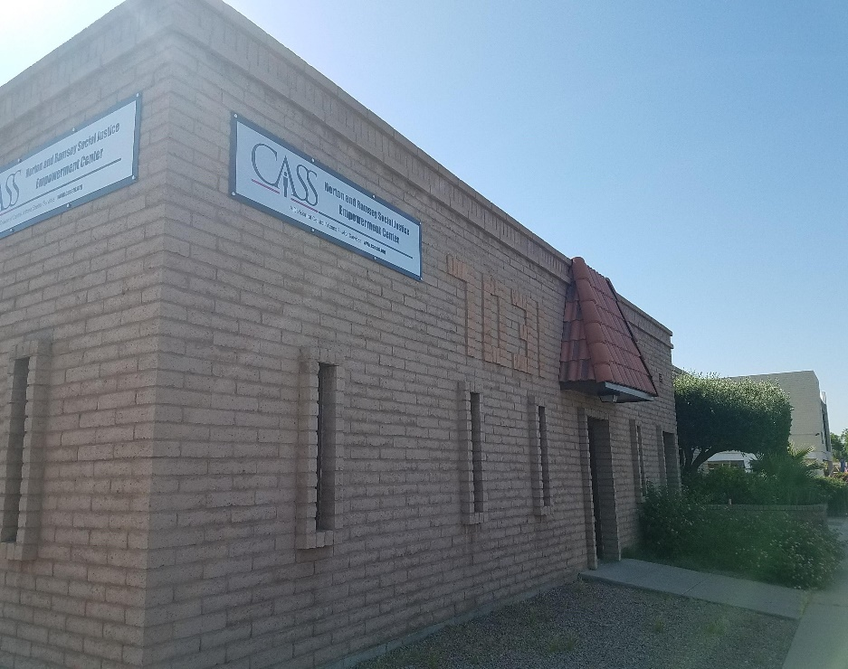
Theory: Managing a 24/7 Line

Slide 11
Practice: Managing a 24/7-Line
Eventually dedicated one full time position to the job
Tied to main CASS shelter
Notes:
Jennifer: Matt first to call on July 21, 2021. In many ways, the 24/7-line works in practice just as it did in theory. We have a dedicated staff member who answers the phone during business hours, and program leadership and other locations manage it during off-hours. Clients who call are screened by staff to determine if they’re eligible for direct assistance or can be provided contact information for partners that may be able to assist.
Average number calls a month: 460-500 monthly, went down some a bit. At height of Feb. 2023 we had 800++ calls. Lined up with rates of eviction and expiration.
What kind of calls do we get?
Matt: How use the line? To report encampments to us. CAP used the line to refer for resources. Glendale fire, crisis response and police all carry 24/7 line cards.

Slide 12
Practice: Managing a 24/7 Line
The 24/7 line has been a key resources for the community since it’s inception.
The line averages 27 calls per day, 21 of them being within normal business hours of 8 to 6pm.
570 calls on average over the course of a month.
Challenges around residents knowing about the resource line and contacting it earlier in their imminent homelessness.
Challenges around ensuring potential clients are connected to the right person at partner organizations.
Notes:
Lisa will share we eventually had to hire a full time person to manage the line. Story of 6 kids.
Heard all the Banner Health’s call us too, partner from CTC.
As word has spread.

Slide 13
Theory: Providing Integrated Homeless Prevention and Rapid Rehousing
Rapid Rehousing
Homeless Prevention
Non-Financial Assistance
Notes:
Lisa: Why city wanted money to hosuing, and what conceptualization looked like fromt eh state. We did it this way because of the pandemic, why vochers and assistance.
Matt: Use this slide to talk about the value of each types of assistance. Use this slide to talk about the value of each types of assistance. We identified that ending homelessness would mean more than serving people who were imminently homeless, but also preventing further homelessness. Parts of the funding for the master services agreement was thus used to established to be used for the purposes of both Rapid Rehousing & Homeless Prevention. This could look like a few different things:
Paying off evictions arrears to allow someone to become eligible for housing.
Paying move-in costs to get someone off the street, or into new housing that they could better afford.
Paying diversion costs such as Greyhound tickets & overnight motel costs

Slide 14
Practice: Providing Integrated Homeless Prevention & Rapid Rehousing
Over 450 households provided assistance directly through the NREC, with additional people served through partner services.
Challenges of meeting burden of requirements for assisting many people who were seeking help.
Unable to provide assistance to people who did not have direct financial needs to be met.
Noting often clients situations were worse because they did not contact us sooner.
Notes:
RICHARD: HOW MANY SINCE THE START??? WAS 450 THE TOTAL SINCE 2021? PLS PUT IN THE NUMBER ON THIS. YOU SHOULD COVER THIS ONE.
SINCE JULY 2021. Day to Day to get folks under the 30% AMI—Richard call upon. Fed. Money.

Slide 15
Practice: Providing Integrated Homeless Prevention & Rapid Rehousing
Notes:
RICHARD COVER THIS ONE. What became clear was the importance of flexible financial assistance and how unrestricted funding can contribute to positively ending someone’s homelessness or assisting in reducing their risk of returning to homelessness. Through the use of a flexible financial assistance source roughly 400 additional people were able to be provided different types of minimal assistance to contribute to their stability. PUT IN A CLIENT PHOTO HERE, MAYBE THE FAMILY OF 6 WITH THE MOM AND KIDS AND WE CAN TELL THAT STORY HOW THEIR EVICTION WAS REVERSED….THEY GOT A MOTEL STAY, BACK IN THEIR HOUSE 3 DAYS LATER
JENNIFER: SOMEONE KNOWS WHEN AT RISK BUT MAY STILL NOT MEET THE FED. DEFINITION. WE HAD 50K FROM APS CREATED THE flaps AND GAVE US THE FLEXIBLITY. We had partners drop as well, ID and SVDP.

Slide 16
In Theory: Single Point of entry
While we have talked about the value of a no-wrong door approach, that does not preclude that we have a single point where we aim for the journey to begin. By installing a community center that can be accessed by the general public and be used a single-point of entry, we create an opportunity to maximize how clients are connected to services.
By emphasizing a single point of entry, we aimed to reduce the labor of partner services who often have to dedicate valuable time and resources to assisting or redirecting people not eligible for their services, which could also result in discouraging potential clients from further seeking assistance.
Notes:
Lisa, Matt, Nate: how the NREC has been a value as an entry place, for office space too. While we have talked about the value of a no-wrong door approach, that does not preclude that we have a single point where we aim for the journey to begin. By installing a community center that can be accessed by the general public and be used a single-point of entry, we create an opportunity to maximize how clients are connected to services.
By emphasizing a single point of entry, we aimed to reduce the labor of partner services who often have to dedicate valuable time and resources to assisting or redirecting people not eligible for their services, which could also result in discouraging potential clients from further seeking assistance.

Slide 17
Practice: Single Point of entry
Struggling to consistently communicate with all the partners resulted in a select few partners collaborating on a regular basis and utilizing this process while many partners did not.
Specifically Phoenix Rescue Mission who was partially housed within the NREC became very embedded in the procedural approach to assisting clients.
Notes:
Emphasize the value of a community site that can operate as a single point of entry even if it doesn’t actually become one. On-site services provide opportunity for rapport building and system familiarization.
JUSSANE: TALK ABOUT BENEFIT OF CO-LOCATING VOC AND OTHER, AND GLENDALE WORKS
NEED CONSISTENT INTERACTION
AND ON SITE BEST-PRM
Between 70 – 100 showers per month
30 – 50 laundry services per month

Slide 18
Lesson Learned
A lot of partners is good, but they need to either be supported in a way that allows full commitment to the process, or incorporated into the process in a way that is low demand on them.
A 24/7 line helps in reducing the burden on state resources like 211, but requires dedicated staffing, emotional labor, and intentionality.
Rapid Rehousing & Homeless Prevention are powerful tools, but flexible financial assistance without regulatory restrictions massively benefit many people who will otherwise decline without assistance.
A Community Site is a very low-stakes way to build rapport with the local community and reduce the public burden of homelessness.
More effective messaging around services that can reach people who are imminently homeless early can prevent more extreme circumstances.
Notes:
Jennifer: needs to be low demand, and easy for partners to work.
Jennifer: 2 parts: first, emotional labor and staffing go together. Second, taxing on the staff.
Lisa: FFA
Matt: community site. Value in his own words of a site.
Early prevention.
Open up too: lots of administrative behind the scenes we might have done better. Monthly outreach meeting
VISION MATT FOR WHAT NEXT? Sustainbilyt long term, abiilty to pivot as the needs of the community pivot, e.g. evicitons served. Allowed to spend dollars flexibly.

Slide 19
Thank you!

