Slide 1
INTRODUCING…
Home is where it all starts
homeiswhereitallstarts.org
© 2023 ALL RIGHTS RESERVED • MADE WITH HOME IS WHERE IT ALL STARTS
Notes:
INTRODUCE OURSELVES
DENISE LEAD US OFF
THEN CATHERINE
THEN AMY

Slide 2
AGENDA
What We’re Sharing Today
About the Collaborative
Sample Messaging
How We Work Together
What We’re Aiming to Achieve
Core Identity of the Campaign
About The Toolkit
Alternatives to
“Affordable Housing”
What’s Next
2
© 2023 ALL RIGHTS RESERVED • MADE WITH HOME IS WHERE IT ALL STARTS
Notes:
AMY
Excited to see you and share this work
We are all collaborators in launching the campaign
Feel free to ask questions throughout, look forward to your expertise and insights
We all come to this work from different perspectives and with different filters
Sometimes so embedded in our own experience that we do not see other perspectives and how different feelings can create different outcomes/perceptions
Council meeting with protestors
Critical to engage early and often, come together in civil discourse, listen and learn
Campaign included in Pathways Home
Needs to resonate with diverse groups- be relevant in different circles
Transition to Denise

Slide 3
© 2023 ALL RIGHTS RESERVED • MADE WITH HOME IS WHERE IT ALL STARTS
3
ABOUT THE HOUSING COMMUNICATIONS COLLABORATIVE
Aiming for greater impact
Demonstrate tri-sector leadership
Leverage resources & adding value
Advance community integration
Be understood through universal terms & emotions
Track/report progress
Notes:
DENISE
Housing Communications Collaborative - Aiming for greater impact
Demonstrate tri-sector leadership
Leverage resources & adding value
Advance community integration
Be understood through universal terms & emotions
Track/report progress
Rallying Arizonans – Like an orchestra, everyone has an important role to play
Launch-Ready (Q2) Awareness Campaign
Strategic Messaging
Cox Digital Campaign
Public Relations
Moving the Needle: Data-Driven Outcomes
Tracking the impact of well-located and supported housing on the health of families, individuals and their communities

Slide 4
How We Work Together
WITHIN THE COLLABORATIVE
AND WITH STAKEHOLDERS
4
© 2023 ALL RIGHTS RESERVED • MADE WITH HOME IS WHERE IT ALL STARTS
Notes:
AMY
Research informed and data driven, higher legal standard because asking others to share
Collaborative- weekly meetings, at times intense conversations as we seek common/higher ground
Extensive outreach
Open communication and precise language
Transition to Catherine

Slide 5
HOME IS WHERE IT ALL STARTS
Core Identity
Why
What
How
Who
5
© 2023 ALL RIGHTS RESERVED • MADE WITH HOME IS WHERE IT ALL STARTS
Notes:
CATHERINE

Slide 6
Why
A future where every Arizonan has a place to be at home, empowering them to live stable and purposeful lives
6
© 2023 ALL RIGHTS RESERVED • MADE WITH HOME IS WHERE IT ALL STARTS
Notes:
CATHERINE

Slide 7
What
Inspiring Arizonans to be champions for communities where everyone has a home that meets their needs
7
© 2023 ALL RIGHTS RESERVED • MADE WITH HOME IS WHERE IT ALL STARTS
Notes:
CATHERINE

Slide 8
How
As a collective of experts, we offer key decision makers resources & support so they can overcome obstacles to housing, ensuring everyone can be at home in the communities they lead. This includes:
Shaping & sharing the narrative to create new perspectives
Educating on the value & impact of attainable homes
Providing information & data on policies that put homes within reach for every member of their communities
8
© 2023 ALL RIGHTS RESERVED • MADE WITH HOME IS WHERE IT ALL STARTS
Notes:
CATHERINE

Slide 9
Who
Arizonans experiencing barriers to finding a suitable home in their community
9
© 2023 ALL RIGHTS RESERVED • MADE WITH HOME IS WHERE IT ALL STARTS
Notes:
CATHERINE

Slide 10
CHANGING THE NARRATIVE
Alternatives to Affordable Housing
10
© 2023 ALL RIGHTS RESERVED • MADE WITH HOME IS WHERE IT ALL STARTS
Notes:
CATHERINE
One of the pillars of the campaign is that we won’t be using the phrase “affordable housing”

Slide 11
© 2023 ALL RIGHTS RESERVED • MADE WITH HOME IS WHERE IT ALL STARTS
11
A Home That Meets Our Needs
We believe every Arizonan needs a home their meets their needs
Notes:
CATHERINE
In this variation, we’re subtly acknowledging the breadth of the housing crisis, not just the affordability problem. Some folks need more space – some folks need less. Some places and zoning laws are really conducive to dense, affordable housing, and other places aren’t. But the common goal for everyone, whether or not they’re experiencing a housing crisis, is to have their housing needs met.

Slide 12
© 2023 ALL RIGHTS RESERVED • MADE WITH HOME IS WHERE IT ALL STARTS
12
A Home Within Reach
We believe in putting homes within reach of every Arizonan
Notes:
CATHERINE
A way of saying “attainable housing” that is a bit more accessible to the average person and also conjures up the same concept of opportunity and “giving people a chance” - by putting homes within reach, we give everyone the chance to have a stable home. The concept of providing opportunity is one that is exciting, compelling, and will resonate with many audiences.

Slide 13
© 2023 ALL RIGHTS RESERVED • MADE WITH HOME IS WHERE IT ALL STARTS
13
Affordable Rents & Mortgages
We believe every Arizonan needs an affordable rent or mortgage payment
Notes:
CATHERINE
“Affordable housing” is often understood as a type of housing – a euphemism for low-income housing that is built for that explicit purpose. Most people have never lived in “affordable housing” designated for that purpose. But the concept of a housing payment you can afford is far more relatable. To the Frameworks Institute’s point about writing a “Story of Us” rather than a “Story of Them,” almost everyone knows what it’s like to pay rent or pay a mortgage. The onus of “affordability” comes away from a type of housing and moves to the payment itself.

Slide 14
© 2023 ALL RIGHTS RESERVED • MADE WITH HOME IS WHERE IT ALL STARTS
14
At Home in Arizona
We believe every Arizonan should be at home in Arizona
Notes:
CATHERINE
This option, more slogan-esque, is speaking to the Frameworks Institute’s recommendation: “Make it clear that where you live affects you.” People generally understand that housing is easier to find in some places than others. Often, this is where they bring in a ‘personal responsibility’ argument – ”why don’t you just move?” Here, we assert that every Arizonan deserves a place here, no matter what neighborhood they live in.

Slide 15
Sample Messaging
Home is where it all starts is working to put a home within reach for every member of our communities, so that we are all able to live stable and purposeful lives. Learn more about our collective of champions for housing and discover how you can help at homeiswhereitallstarts.org
© 2023 ALL RIGHTS RESERVED • MADE WITH HOME IS WHERE IT ALL STARTS
Notes:
CATHERINE

Slide 16
Sample Messaging
The average cost of a home in Arizona has risen 54.2% over the past two years. Meanwhile, the median income in Arizona has increased just 5% since 2019. Home is where it all starts is working to shift that trend, so we all have a place to call home.
© 2023 ALL RIGHTS RESERVED • MADE WITH HOME IS WHERE IT ALL STARTS
Notes:
CATHERINE

Slide 17
OUR GOALS FOR THE CAMPAIGN
What We Are Aiming to Achieve
17
© 2023 ALL RIGHTS RESERVED • MADE WITH HOME IS WHERE IT ALL STARTS
Notes:
AMY
Important to measure our progress
Keeps us focused on tangible outcomes
Holds us accountable and helps to clearly articulate impact

Slide 18
WHAT WE’RE AIMING TO ACHIEVE
Our Long-Term Goals
1
New framing is being used
3
More attainable housing options
2
Coalitions of support
4
Fewer barriers to stable housing
18
© 2023 ALL RIGHTS RESERVED • MADE WITH HOME IS WHERE IT ALL STARTS
Notes:
AMY
We know we are successful in our efforts when:
Our new framing for attainable housing is being used by a variety of stakeholders across the state. Elected officials and decision makers, voters, and other key stakeholders position themselves as advocates for attainable housing and consistently tell the story of why it matters.
There are coalitions of support for attainable housing in communities across the state, empowered with consistent and effective messaging and outreach.
An increased number of government agencies and key stakeholders are actively pursuing a diversity of attainable housing options.
Fewer Arizonans experience barriers to stable housing.

Slide 19
WHAT WE’RE AIMING TO ACHIEVE
Our Short-Term Goals
Messaging
An intentional framework
Coalitions
Statewide support
Leaders
More champions
Tools
Equip our audiences
19
© 2023 ALL RIGHTS RESERVED • MADE WITH HOME IS WHERE IT ALL STARTS
Notes:
AMY
To meet our long-term goals, this year we will:
Messaging: Create an intentional messaging framework in support of varied and attainable housing options in communities across Arizona.
Leaders: Increase the number of attainable housing champions within our community, including elected officials and HOA members, leading to newly approved properties and setting the stage for more.
Coalitions: Build active coalitions of support for attainable housing options in communities across the state
Tools: Equip our target audiences with tools and content to inform their constituencies as to why attainable housing matters for our communities.
Transition to Catherine

Slide 20
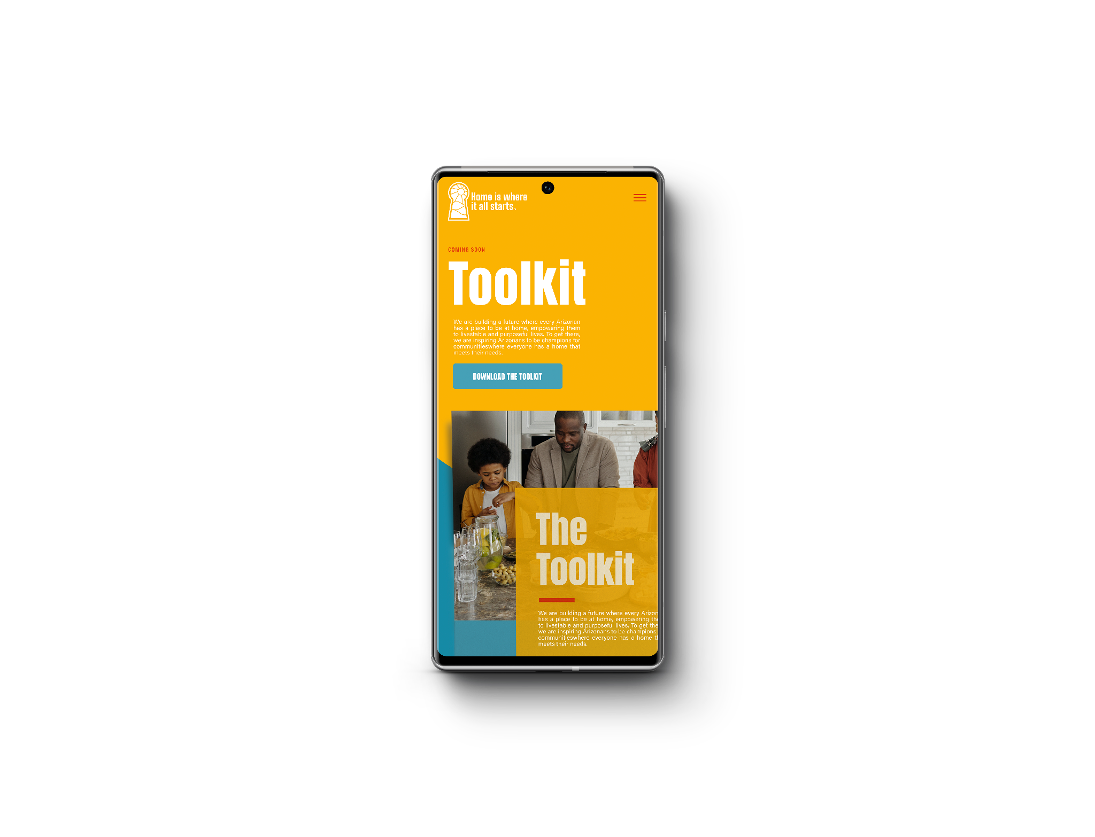
© 2023 ALL RIGHTS RESERVED • MADE WITH HOME IS WHERE IT ALL STARTS
20
HOME IS WHERE IT ALL STARTS
The Toolkit
Specific calls to action
Sample digital ads
Sample web copy
Sample digital flier
Sample social media posts
Brand guidelines
Sample emails
Email & social guidelines
Notes:
CATHERINE
What will be included in the stakeholder toolkit / How to use it

Slide 21
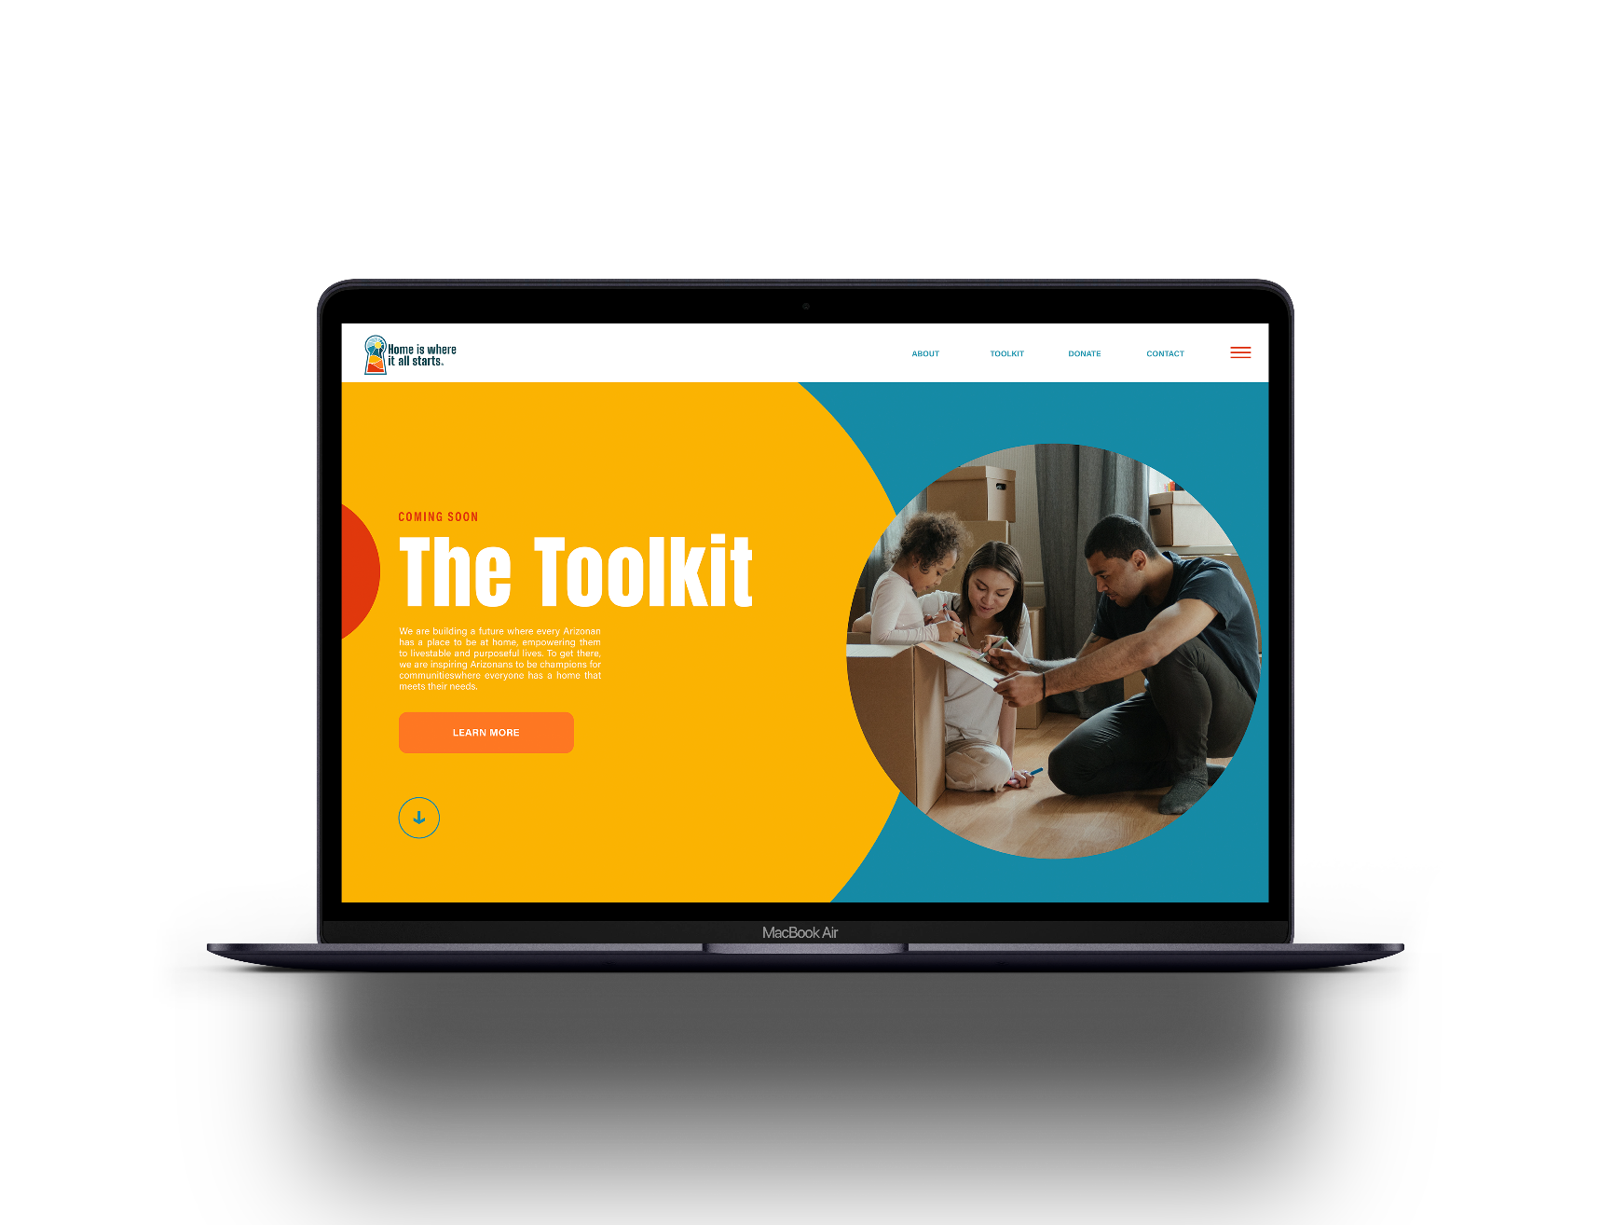
© 2023 ALL RIGHTS RESERVED • MADE WITH HOME IS WHERE IT ALL STARTS
21
HOME IS WHERE IT ALL STARTS
The Toolkit
Sign up to receive the
toolkit at:
homeiswhereitallstarts.org
Expected late March
Notes:
CATHERINE
Where to get the toolkit & when to expect it

Slide 22
© 2023 ALL RIGHTS RESERVED • MADE WITH HOME IS WHERE IT ALL STARTS
22
HOME IS WHERE IT ALL STARTS
What’s Next
What does home mean to you?
Finish the sentence: “Home is where….”
Share your stories with us - post on social and tag @homeiswhereitallstarts
What are your ideas for promoting this campaign?
Notes:
DENISE AND AMY
Introduce Hannah, the graphic artist

Slide 23
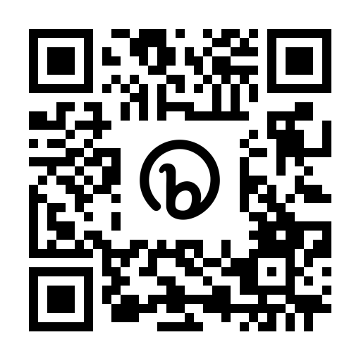
Thank You!
Visit www.homeiswhereitallstarts.org
Use our toolkit and spread the word!
© 2023 ALL RIGHTS RESERVED • MADE WITH HOME IS WHERE IT ALL STARTS
homeiswhereitallstarts.org
Notes:
DENISE
Discussion - what has worked and what hasn’t, in their own campaign experiences? What would be helpful to you?

