Slide 1
LOW INCOME HOUSING TAX CREDIT QUALIFIED ALLOCATION PLAN (QAP) FOCUS GROUP
Facilitators:
Assistant Deputy Director Keon Montgomery
Rental Development Administrator Melanie Brewer

Slide 2
Program Highlights
LIHTC 9% Round
15 Projects
1,049 Units
LIHTC 4% Allocations
43 Projects
7,807 Units
AZ State Credits
8 Projects
1,042 Units

Slide 3
Results Are In
9% Schedule
Maximum Credit Award
Innovation/ Unique Opportunity
Underserved Areas

Slide 4
Major Themes
Preservation of Affordability
Shovel- Ready Projects
Increase Affordable Units
Notes:
Annual State LIHTC cap of $4 million
Five years
8609 issued by ADOH
Coordination with sister departments
Can not be layered with other tax exemptions
Developers will need to asses the value of the tax exemption vs. The credit to determine which is more beneficial.

Slide 5
General Revisions
Max Two Projects or $3.5M
Compete in One Set-Aside
Zoning in Place

Slide 6
General Revisions Continued
Qualified Contract Waiver
Mandatory Construction Start
Recycled Allocations

Slide 7
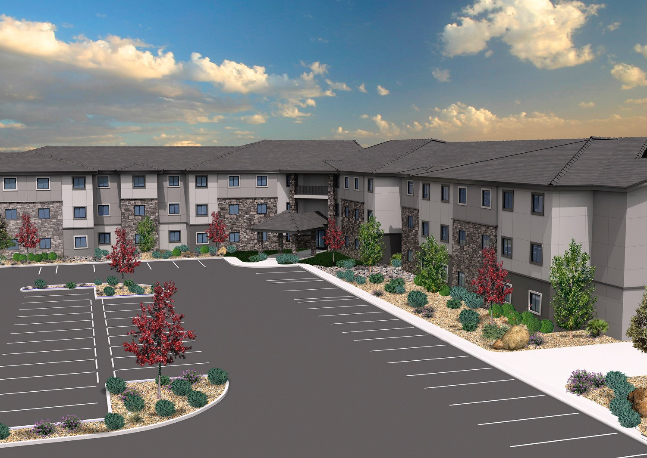
9% Rehab
Set-Aside
•Limited to Two Awards
•Scoring Clarified

Slide 8
9% Scoring New Construction
Community Revitalization
Below Market Loans
Extended Use & Home Ownership
Notes:
Concern that it creates more expensive projects
Current efficiency requires large apartments to maximize amenity space, which leads to a more expensive project
Efficiency definitions not created for single family homes/duplexes, especially re: multigenerational living
Section is so complicated that most feel only architects can understand it

Slide 9
Clarifications
Tribal Set-Aside
Underwriting

Slide 10
Timeline
First Draft | August 22nd
First Draft Comment Deadline | September 8th
Second Draft | October 1st
Final Comment Deadline | October 15th
Final QAP | November 5th

Slide 11
Future Evaluation
Amenities
9% Scoring Criteria
ADOH Fees
Developer Fees
Notes:
Offer relief/guidance when QAP and local code don't line up
Change deadlines (suggestions to both move it forward and push it back stakeholders)
Speed up ADOH paperwork process/turnaround; slow times make AZ less desirable to lenders and investors
Quicken 4% turnaround times

Slide 12
Discussion
Submit written comments to:
rental-qap@azhousing.gov

