Slide 1
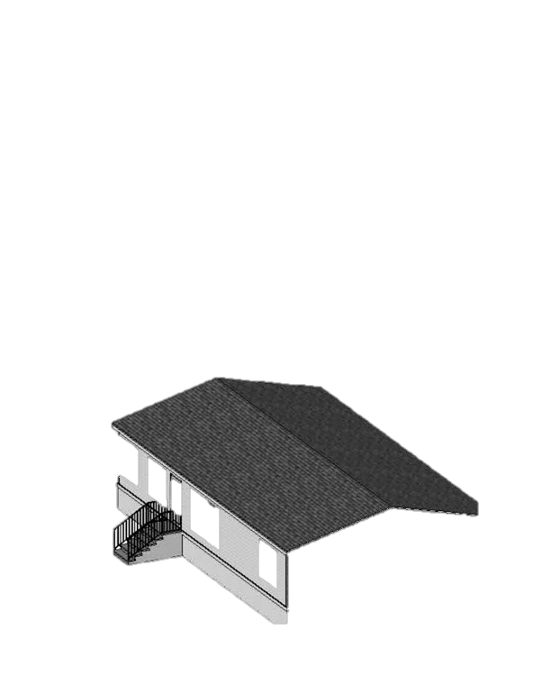
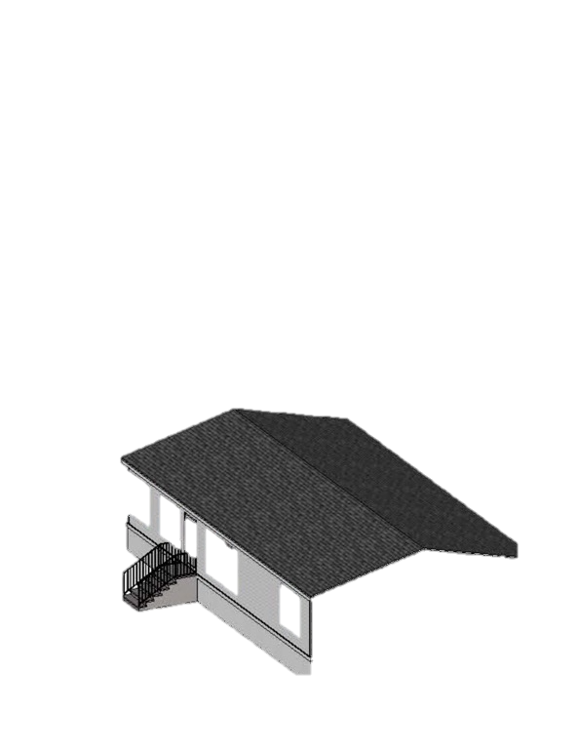
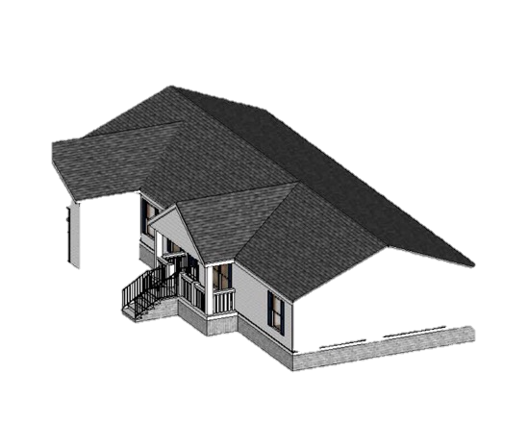
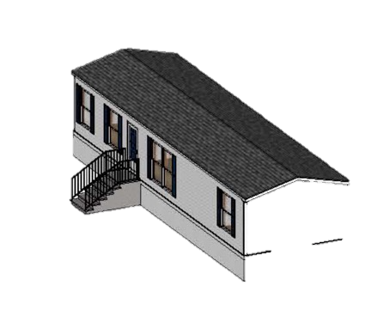
The Promise of Manufactured Homes
Mark Kear, Assistant Professor
August 25, 2023
Starr Pass, Tucson

Slide 2
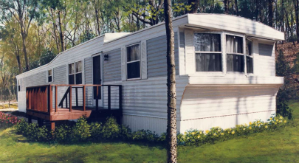
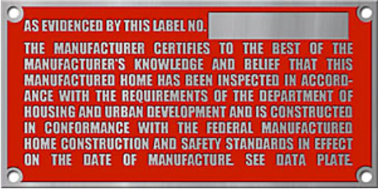
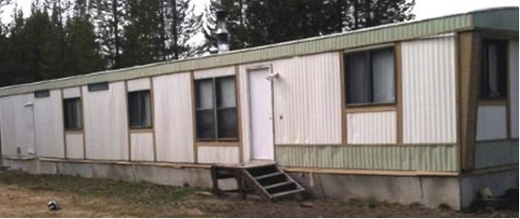
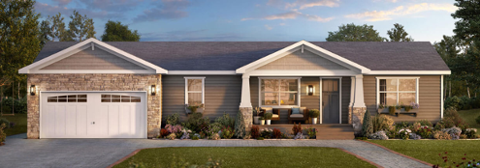
What is a Manufactured Home (MH)?
Pre-1976
A manufactured home is a factory- built home on a permanent chassis built after 1976 when the HUD instituted the Manufactured Home Construction and Safety Standards Act (the “HUD code”).
A mobile home is a factory-built home on a permanent chassis built prior to the 1976 HUD code.
Post-1976

Slide 3
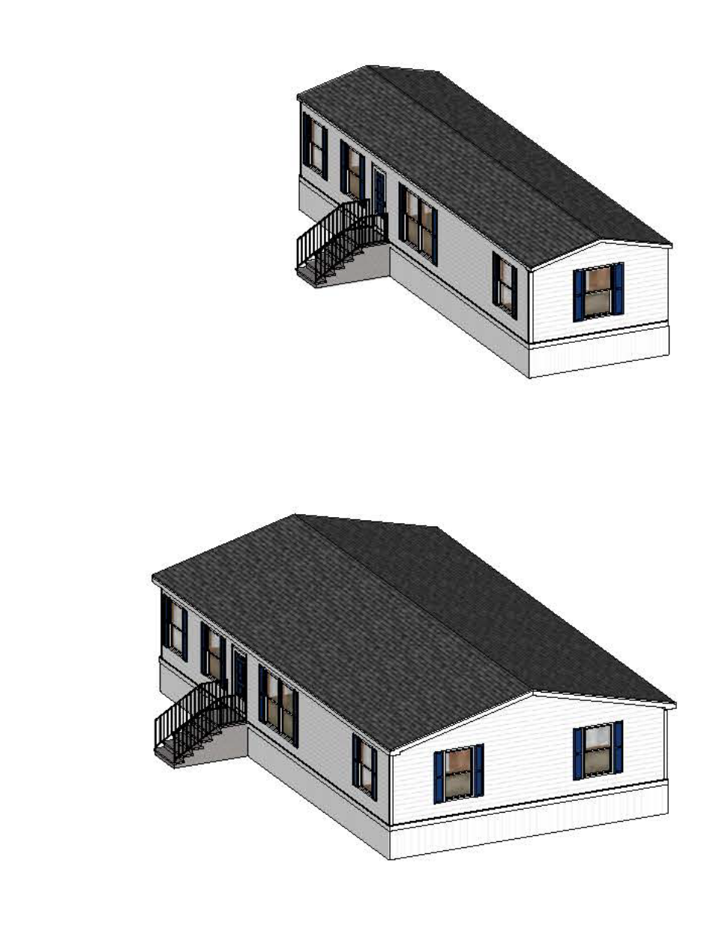
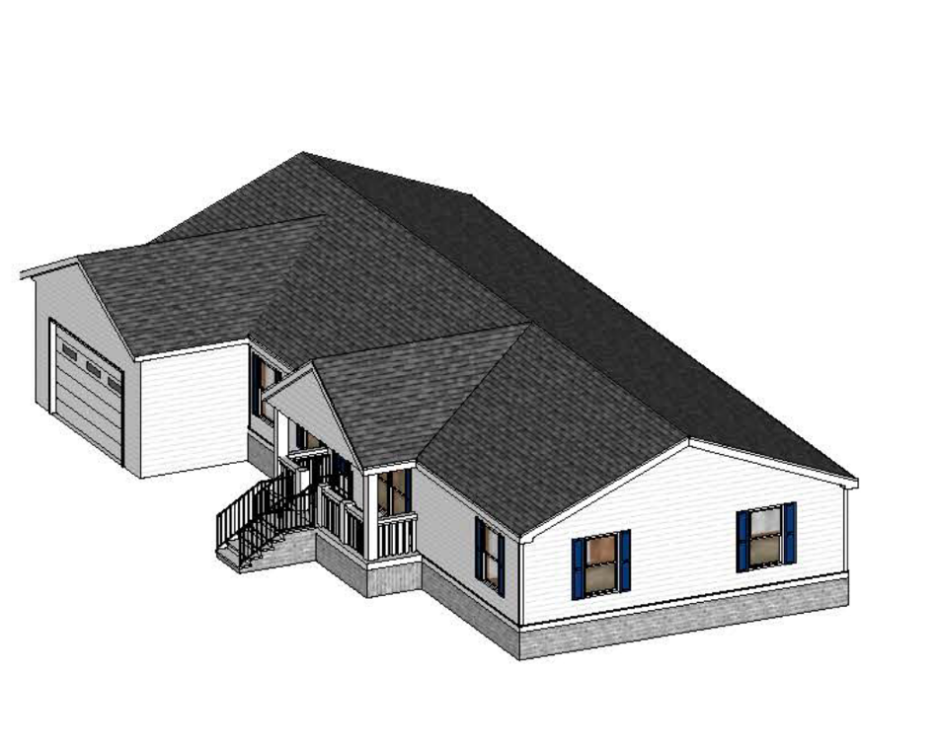
Single Section
3/12 roof pitch
36” typical height from exterior grade to entry elevation
47% of site-built construction cost
“CrossMod”
Blend of on and off-site housing
Special financing treatment (e.g. MHAdvantage)
5/12 roof pitch
Masonry perimeter wall
Engineered Wood Siding
6-inch eaves
80% of site built construction cost
Double Section
3/12 roof pitch
36” typical height from exterior grade to entry elevation
64% of site-built construction cost
Source: Herbert et al. 2023

Slide 4
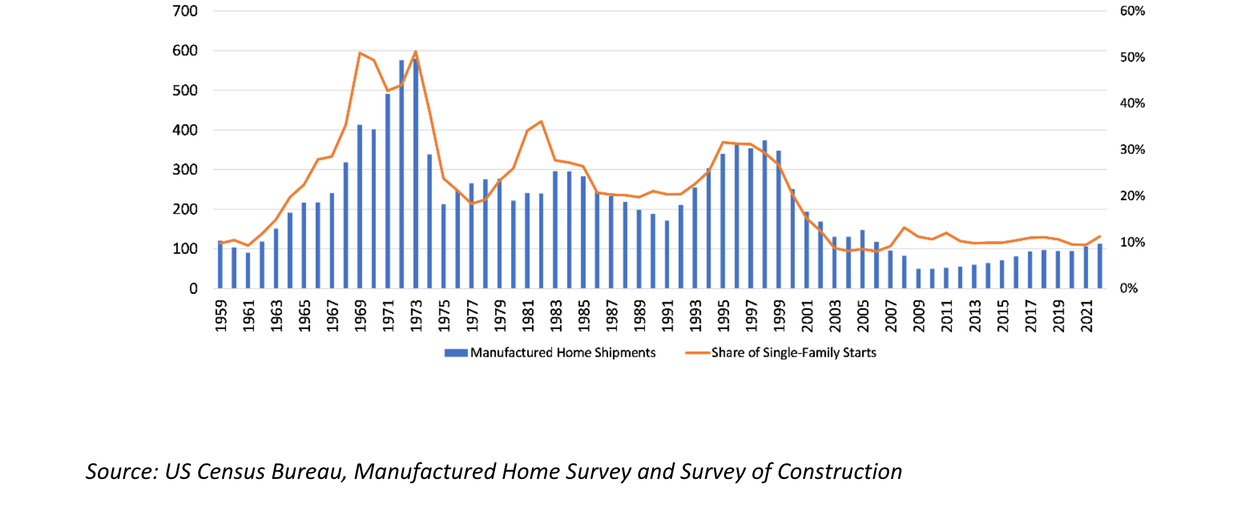
Manufactured and “Mobile” Housing Booms and Busts
MH Shipments & MH Share of Single-Family Starts, National
Total Annual MH Shipments (000)
HUD Code Implemented
June 1976
MH ”Subprime Crisis”
Year

Slide 5
MH Landscape Mostly Built/Placed in the Past
In Pima County 35% of the MH stock is pre-1976 – nearly old enough to be eligible for historic status in Arizona!
Based on MHI database (Fannie Mae 2018)

Slide 6
The Importance of the Manufactured & Mobile Housing (MH) Supply in Arizona: Key Challenges & Remedies
MH: Gap between Promise and Reality
“Double Edged” Affordability and Insecurity
Challenge 1: Stigma and Housing Supply
Challenge 2: Home Lending and Housing Supply
Challenge 3: Threats to Affordability
Challenge 4: Eviction and Relocation
Challenge 5: Condition of Existing Stock
Summary of Recommendations

Slide 7
MH Gap
The Manufactured Housing Gap
The gap between the promise of MH and the lived reality of many
20 million people live in MH in the US
8.5 million units of MH
Approximately equal to total number of subsidized housing units, nationally
In 2020, MH represented more than 90 percent of all new homes sold in the US under $150,000

Slide 8
MH Gap
The Manufactured Housing Gap
The gap between the promise of MH and the lived reality of many
Poorer: 31% in MH parks live in poverty compared to 15.5% of renters (Rumbach and Sullivan 2021)
Increasingly Minoritized: farming communities, amenity destinations, colonias, large Sunbelt cities.

Slide 9
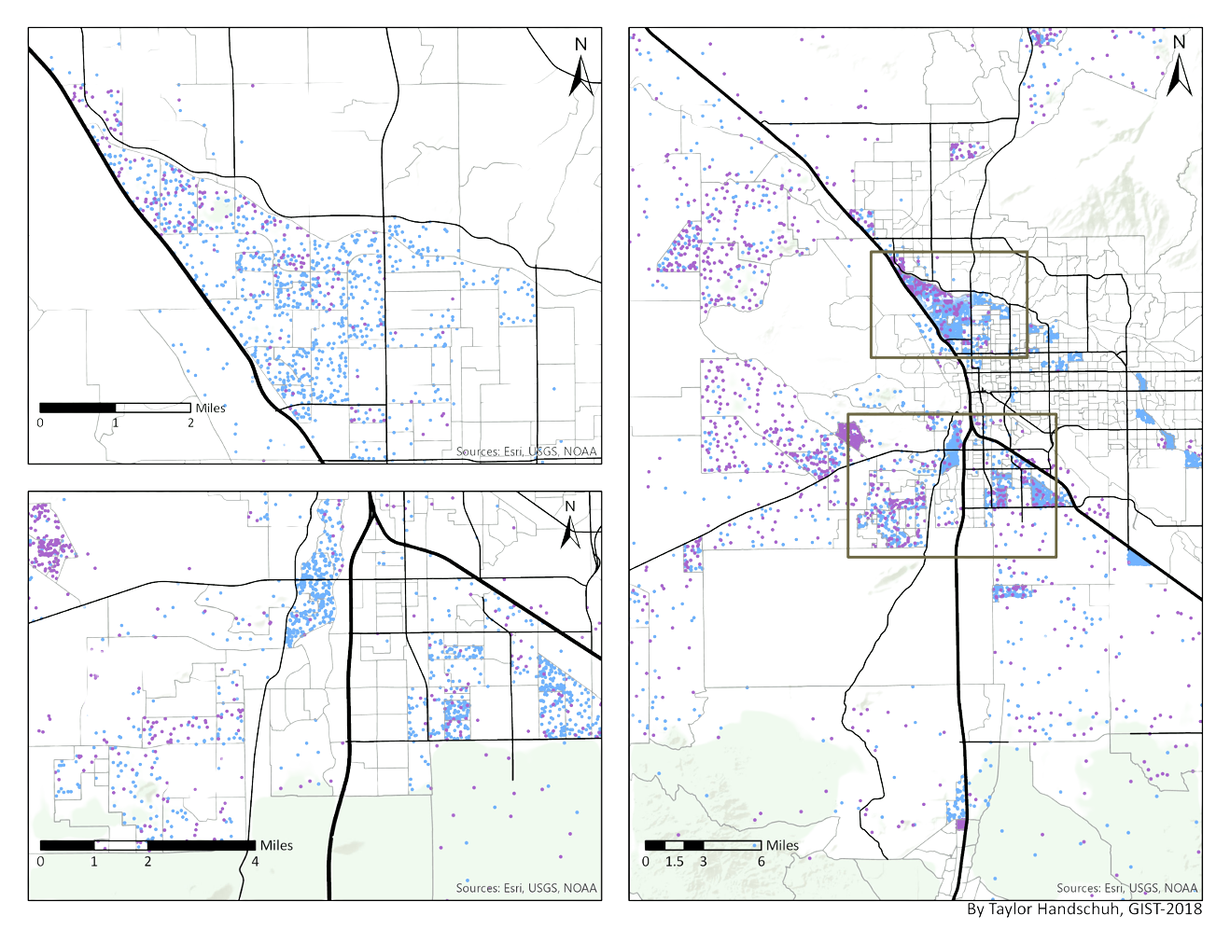
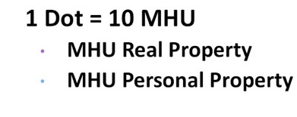
MH Gap
The Manufactured Housing Gap
Largest Source of Unsubsidized Affordable Housing in Country, State and County
MH in Pima County
Ten percent of the housing stock and population
Four times the number of subsidized housing units in the city
Kear et al. 2019

Slide 10
“Double Edged” Affordability and Insecurity
Why is MH so affordable? MH’s “double-edged” innovation
Allows households to buy only what they need – a house and not the land it sits on
BUT
Land Insecurity:
“Halfway Homeowners”
(Sullivan)

Slide 11
“Double Edged” Affordability and Insecurity
MH’s “Double-Edged” Innovation
Retitle as Real Property
This can be done in parks is Arizona.
Appreciates and depreciates similarly to site-built
Co-op / ROC
Only three in Pima County
“Mission-Based” Ownership
Non-Profits
Land Trusts
Cities, Counties, Other Government Agencies
Long-Term Leases
Rare and not systematically promoted. Little awareness or how to.
Land
Insecurity
Massive Scope to Expand in Pima County and Arizona
No Examples in AZ

Slide 12
Challenge 1: MH Stigma and Housing Supply
AZ MH Challenge 1: Stigma and Spatial Marginalization
EFFECTS: Reduced demand, perceived effects on neighboring land uses, reduced access to employment and services, increased travel costs.
ACTIONS:
Allow MH in more places
Better ingrate MH into cities and neighborhoods
Leverage Unlocking Possibilities Program (Federal grant program to "eliminate needless barriers” to permitting of MH)
Lower density neighborhoods and at the urban fringe and in areas zoned for non-residential uses, increasing hazard exposure and reducing public service access.
Placements outside of parks are often restricted to very large lots, effectively baring them from most single-family residential areas.
15% of MH in Tucson is in commercial, office, industrial or mixed-use areas, where MH is often a non-conforming, grandfathered land use.
MH is spatially marginalized and separated from most other residential land uses with 35% of all units located in areas zoned specifically for MH, trailers and recreation vehicles (often near airports, military bases, highways, and other non-residential land uses), or very-low density and rural areas (54%).

Slide 13
Challenge 2: MH Home Lending and Housing Supply
AZ MH Challenge 2: Home Lending
EFFECTS: Reduced demand, higher borrowing costs, predatory lending
ACTIONS:
Better consumer protections for chattel borrowers
More competition and liquidity for personal-property lending (potential role for Arizona Housing Finance Authority)
Leverage Federal and GSE Duty-to-Serve plans
Personal Property / Chattel
(80% nationally, Pima County 70%)
Shorter loan terms
Higher interest rates
Fewer rights and protections (RESPA, TILA, HMDA, HOEPA, CRA, state foreclosure and repossession laws)
Limited pool of lenders: top four firms approximately 75% of loans (CFPB 2021)
No support from GSEs
Financing from “mainstream” institutions often unavailable for homes more than a few years old

Slide 14
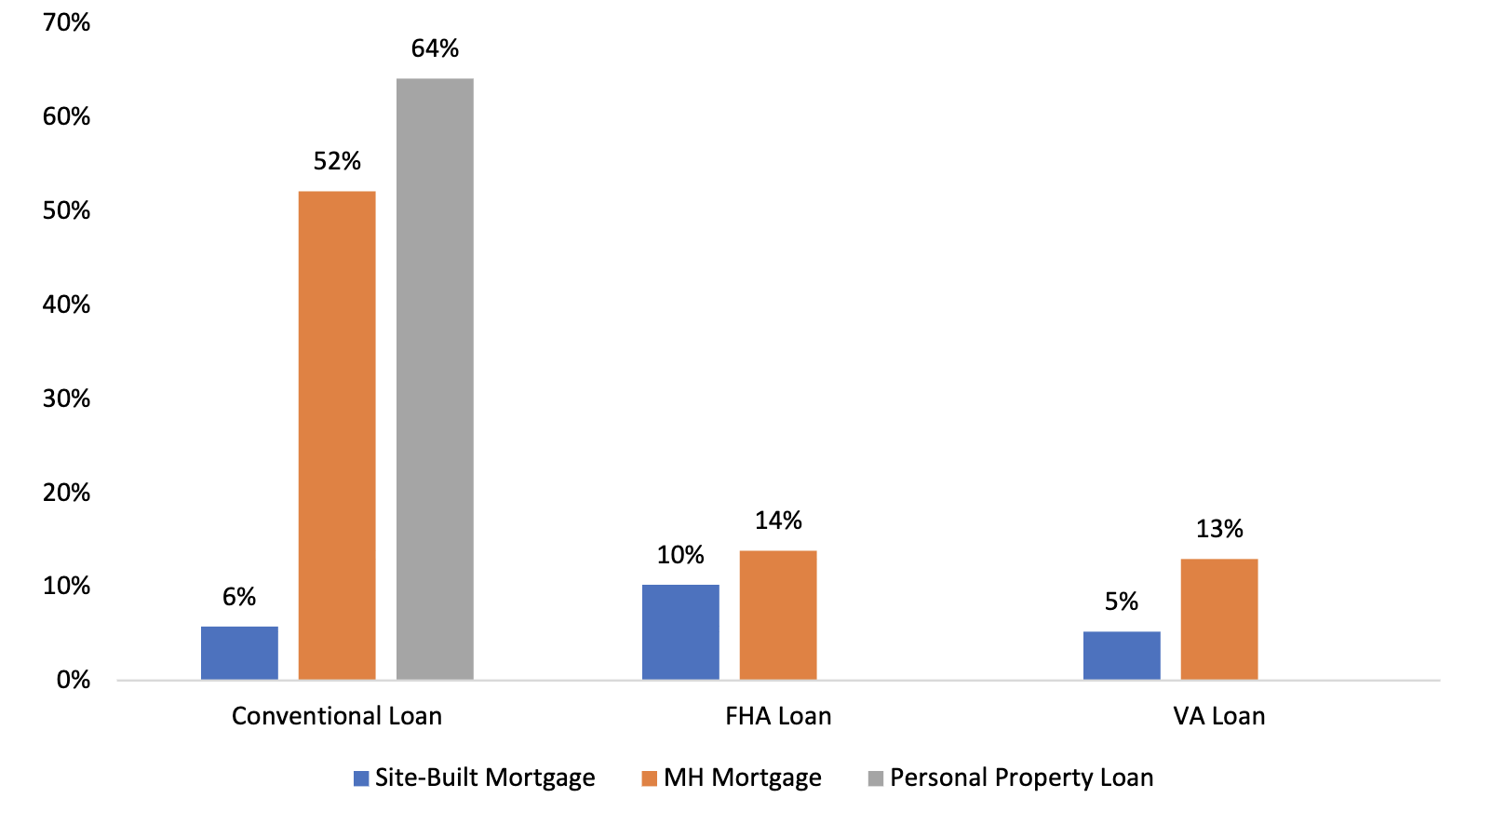
Challenge 2: MH Home Lending
Denial rates by housing type and federal backing
Arizona Spotlight:
In Az, only 34% of the applications for manufactured housing loans led to originations (HMDA 2021); among those denied, 32% identified as Hispanic or Latino.
Source: Pew 2022 https://www.pewtrusts.org/-/media/assets/2022/10/rfi-title-i-fha-and-ginnie-mae.pdf

Slide 15
Challenge 2: MH Home Lending and Housing Supply
Form of Home Loan | Description
Mortgage Financing
Mortgage | Applies to only MH legally affixed to land and titled as real property. Typically mortgage lenders will charge a premium for MH loans even if it is titled as real property.
Non-Mortgage Financing
Chattel Loan | Use only structure as collateral. No support from GSEs. Typically, only available for newer homes. Higher interest and shorter terms than mortgage loans. Lender holds lien against home and can repossess and sell.
Seller Financing | Refers to a variety of lending arrangements where the seller is also the lender, extending credit to the buyer to purchase the home.
Contract-for-Deed | A form of seller financing. Seller-lender retains title and full ownership of the home until final payment is made. Buyer may not have equity rights.
Rent-to-own or Lease-Purchase | Typically a form of seller financing, though third parties can be involved. The buyer occupies the property as a tenant, with the seller as landlord. Within a designated period, the buyer can exercise the option to purchase and the deed is transferred.
(Informed by Allen 2017; Bourke and Siegel 2020)
Forms Financing Available to MH Buyers
Forms Financing Available to MH Buyers

Slide 16
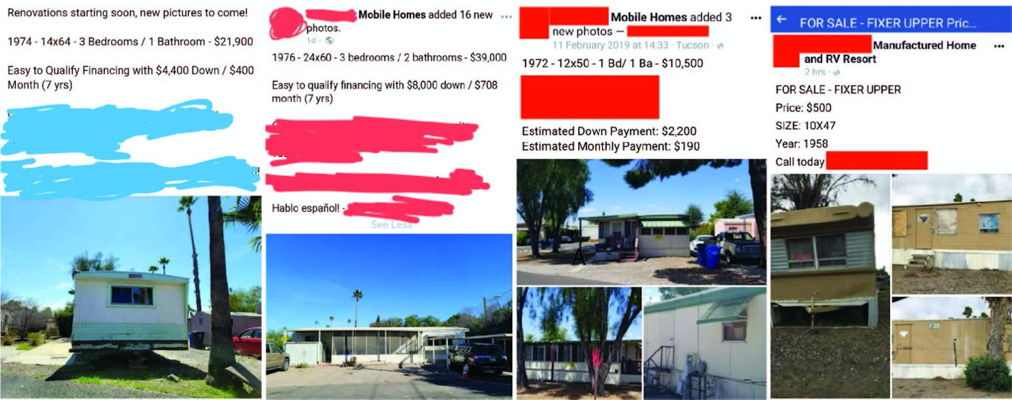
Challenge 2: MH Home Lending and Housing Supply
Lack of affordable and safe sources of credit for home buying and home improvement
21% APR with 20% down
21% APR with 20% down
25% APR with 21% down
Typical “buyer‐rehab” sale of a structurally inadequate, 1958 MH unit

Slide 17
Challenge 2: MH Home Lending and Housing Supply
Lack of affordable and safe sources of credit for home buying and home improvement
Hispanic home borrowers are more than 1.6 times as likely to use alternative financing than US households on average (Pew 2021).

Slide 18
Challenge 3: Threats to Affordability
AZ MH Challenge 3: Private Equity, REITs and BRRRR Investors
EFFECTS: Increased rent, increased evictions, increased insecurity, property improvements
ACTIONS:
Level playing field for resident and mission-oriented investors
Right of first refusal / Opportunity to purchase legislation (19 states)
Tax incentives for MH park owners (6 states)
Financing for resident groups
State-level regulation of rent increases
Strategic public investment in parks to preserve affordable housing
“What happens when investment firms acquire trailer parks”? (Kolhatkar 2021):
Money floods in
Small independent operators cash out
Rents rise, often dramatically
Residents struggle to keep their heads above water
Many cannot
Sell their homes in distress, abandon their homes or are evicted, and scramble to find new places they can afford

Slide 19
AZ MH Challenges 4: Eviction & Relocation
EFFECTS: Homelessness, social costs, lost property / wealth
ACTIONS: Stronger protections to address greater impacts on MH owners; More accessible, flexible “relocation” funding; Greater compensation for lost property (minimum or fair market value), more and new funding sources
Impacts of Eviction for MH residents:
Eviction record reduces housing options
High relocation costs
Few relocation options
Lost property / property abandonment
Arizona recognizes special impacts of eviction for MH residents:
Up to $12,500 for relocation (many too old, or too structurally unsound, to be moved).
Many cannot use for other reasons (e.g. no place to move pre-1976 unit)
Unclear percentage able to access
Compensation inadequate / below market value for residents forced to abandoned their property

Slide 20
AZ MH Challenge 5: Housing Quality and Efficiency
Aging stock can be hazardous, very expensive to heat and cool, and dangerous for vulnerable residents
EFFECTS: Housing and energy cost burdens, hazard exposure (e.g. extreme in-door heat)
ACTIONS:
Energy assistance programs for currently ineligible residents (LIHEAP+)
Community level grant programs for health and safety issues with conditionality (long term affordability and stability)
Zero-interest replacement and rehab loans (7 states piloting MH replacement programs, role for Arizona Housing Finance Authority)
Restrict landlord ability obstruct tenant cooling strategies (e.g. removal of insulation, trees, window AC)

Slide 21
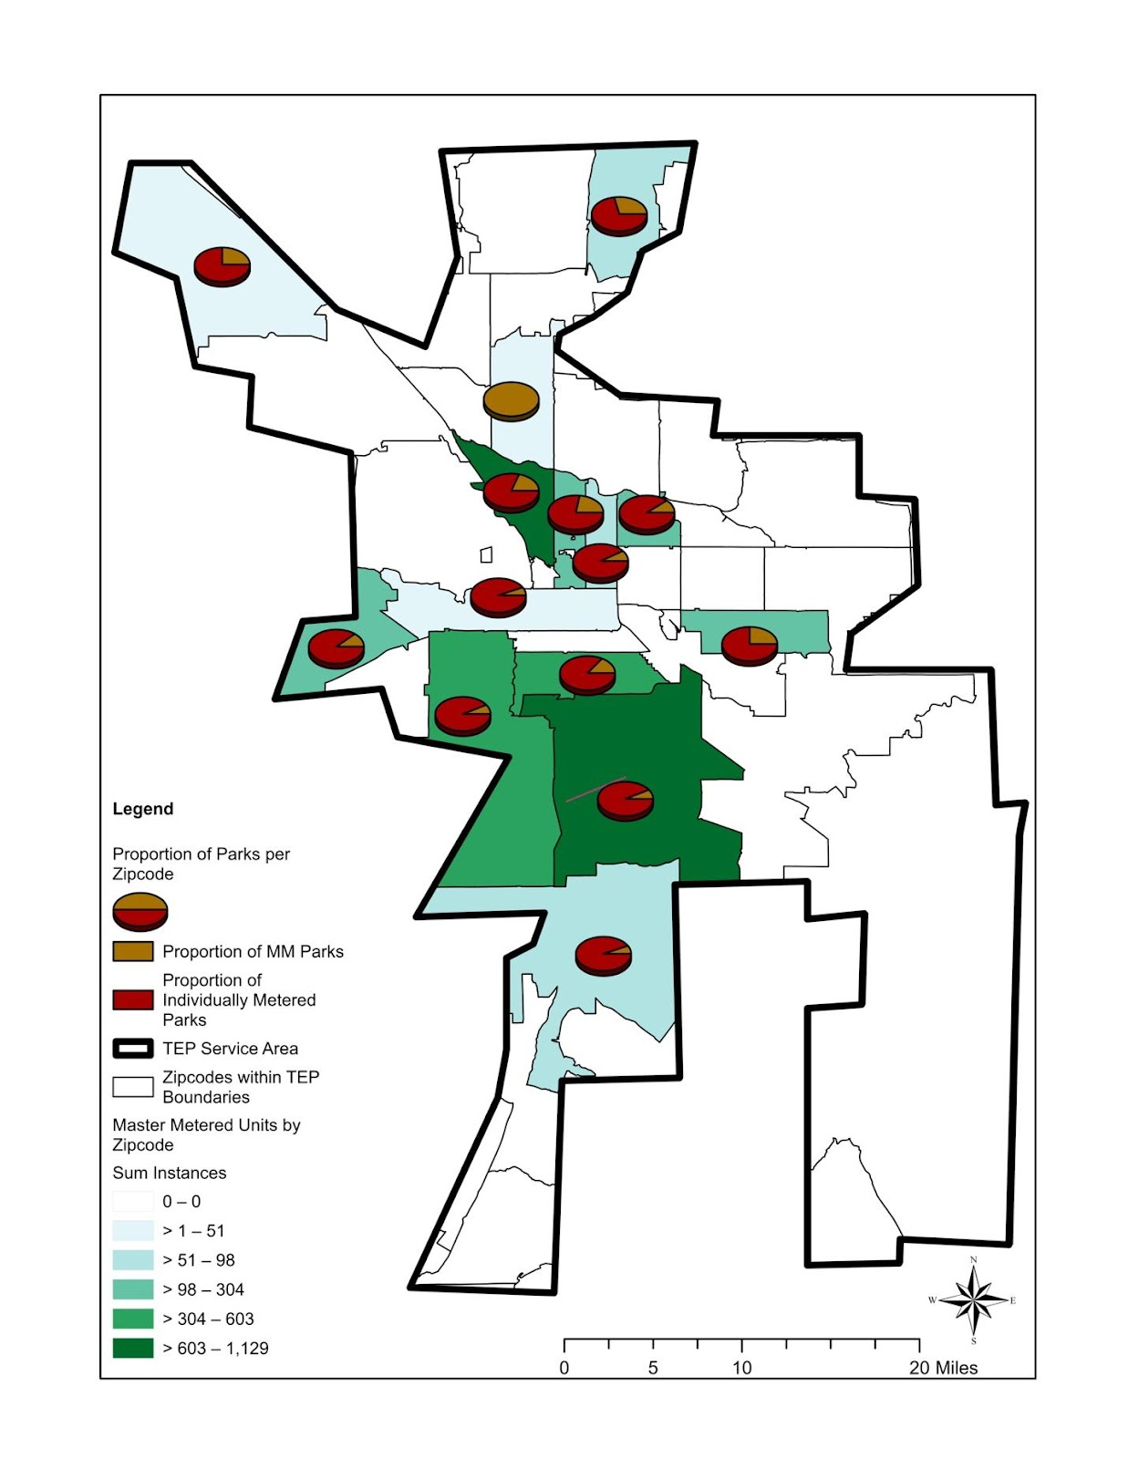
Of the approx. 500 MH parks, constituting 21,000 individual MH units, in the TEP service area, only 35% of households are direct customers of TEP, leaving most residents of the remaining 13,000 MH units in parks ineligible for LIHEAP programs!
Map by Karina Martinez

Slide 22
Summary of Recommendations
Challenge | Action
Stigma and Spatial Marginalization | Allow MH in more places (e.g. vacant property, MH accessory dwelling units) Better ingrate MH into cities and neighborhoods Leverage Federal grant programs to eliminate barriers to permitting of MH
Home Lending | Better consumer protections for chattel borrowers More competition and liquidity for personal-property lending (potential role for Arizona Housing Finance Authority)
High-Rent-Increase Investment Strategies | Right of first refusal / Opportunity to purchase legislation (19 states) Tax Incentives for MH park owners (6 states e.g. no capital gains tax if sold to residents or with affordability conditions) Financing for resident groups (potential role for IDAs, CDFIs and the Arizona Housing Finance Authority) State-level regulation of rent increases in MH Parks Strategic public investment in parks to preserve affordable housing
Eviction and Relocation | More accessible, flexible “relocation” funding Stronger protections to address greater impacts on MH owners Fairer compensation for lost property (minimum or market value, which ever is more) More and new funding sources
Housing Quality and Energy Efficiency | Energy assistance programs for currently ineligible MH residents (“LIHEAP+”) Community level grant programs for health and safety issues with conditionality (long-term affordability and stability) Zero interest replacement and rehab loans (7 states piloting MH replacement programs, role for Arizona Housing Finance Authority) Restrict landlord ability obstruct tenant cooling strategies (e.g. removal of insulation, trees, window AC)

Slide 23
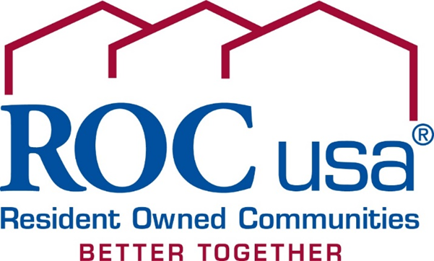
Angela Romeo, VP Acquisitions

Slide 24
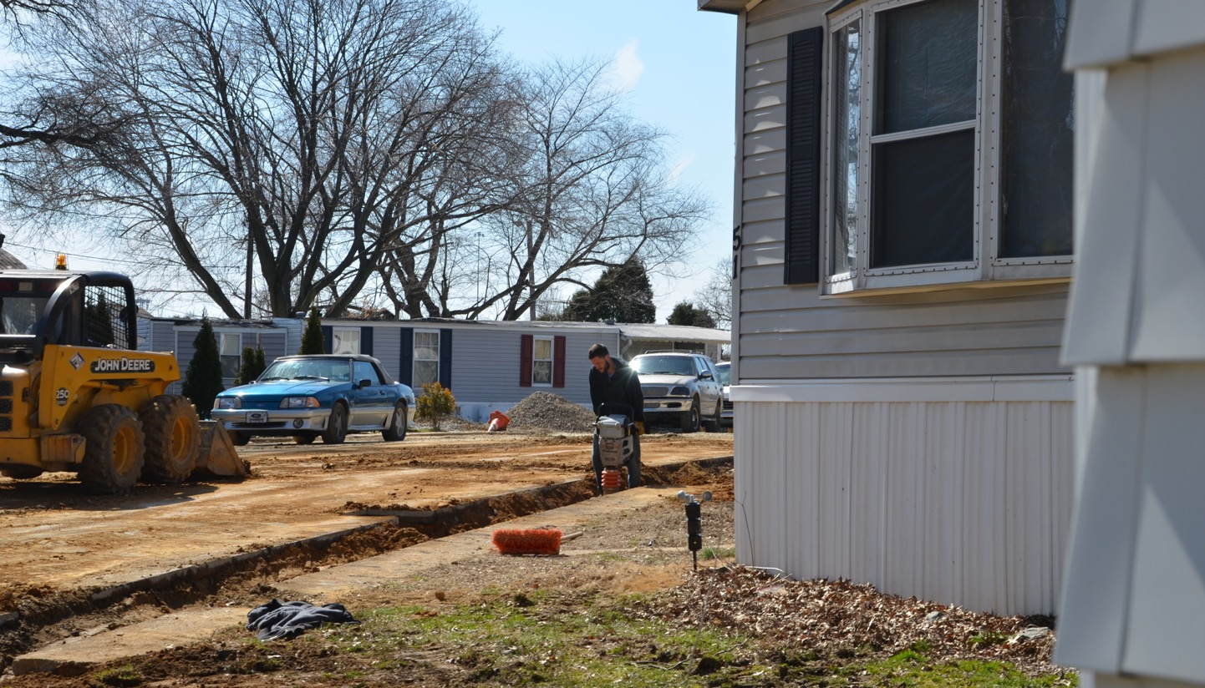
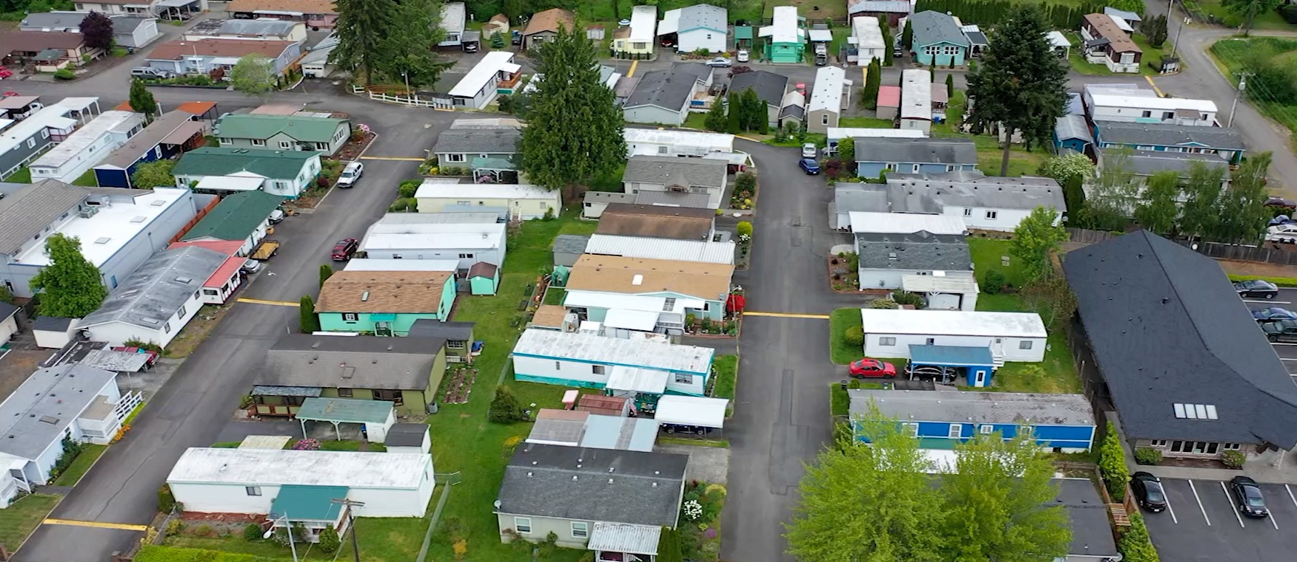
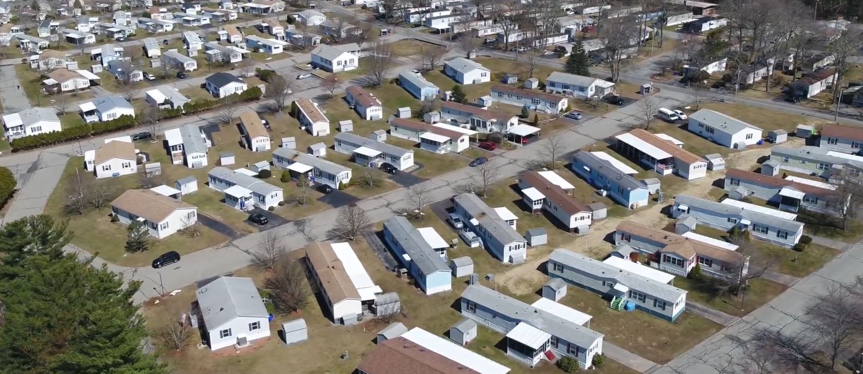
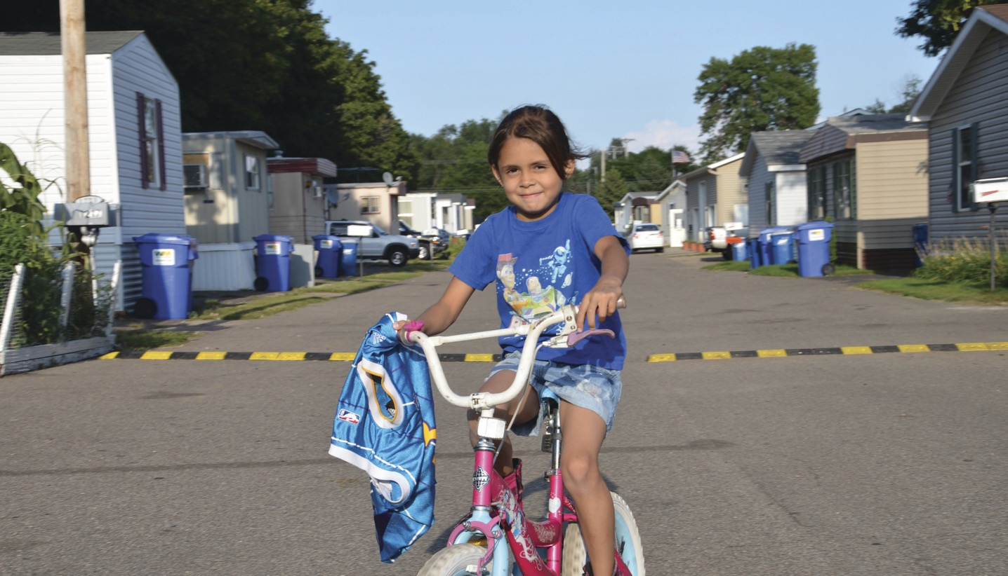

Slide 25
“This is one of our nation’s largest sources of deeply affordable housing, and it’s deeply affordable without any federal subsidy.” Esther Sullivan, Associate Professor of Sociology, University of Colorado Denver and author of Manufactured Insecurity: Mobile Home Parks and Americans’ Tenuous Right to Place
45,600 communities nationwide
3M homeowners and renters
Median incomes half of national median
Detached, modest size factory-built homes in dense neighborhoods

Slide 26
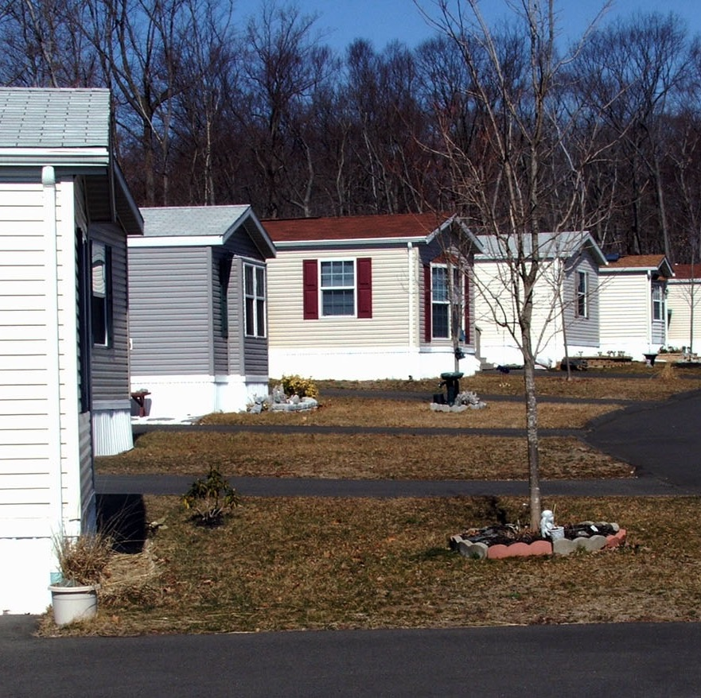
Owning a home on rented land …………
Lack of secure land tenure makes homeowners vulnerable to:
No control over owner’s rent increases
Threats to quality of life / health and safety if community infrastructure poor or failing
No certainty land will remain a mobile home park
Limited and expensive financing options

Slide 27
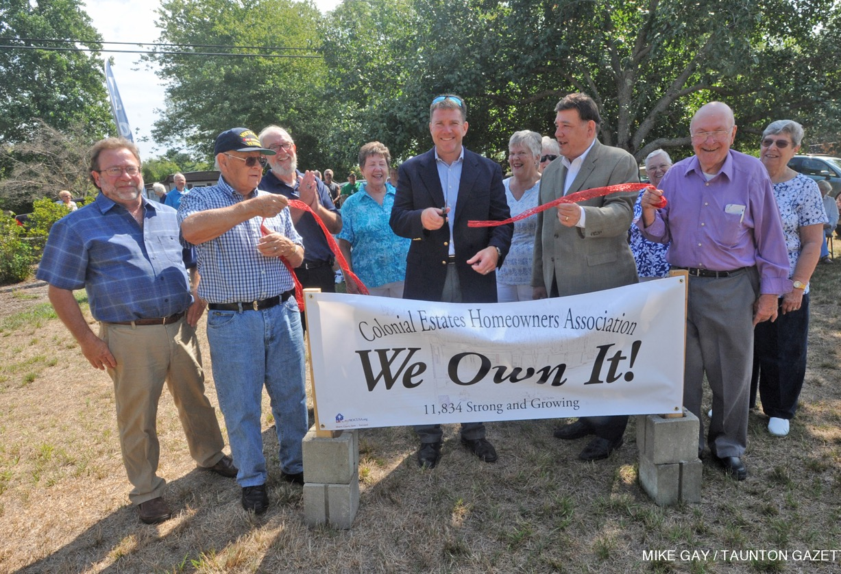
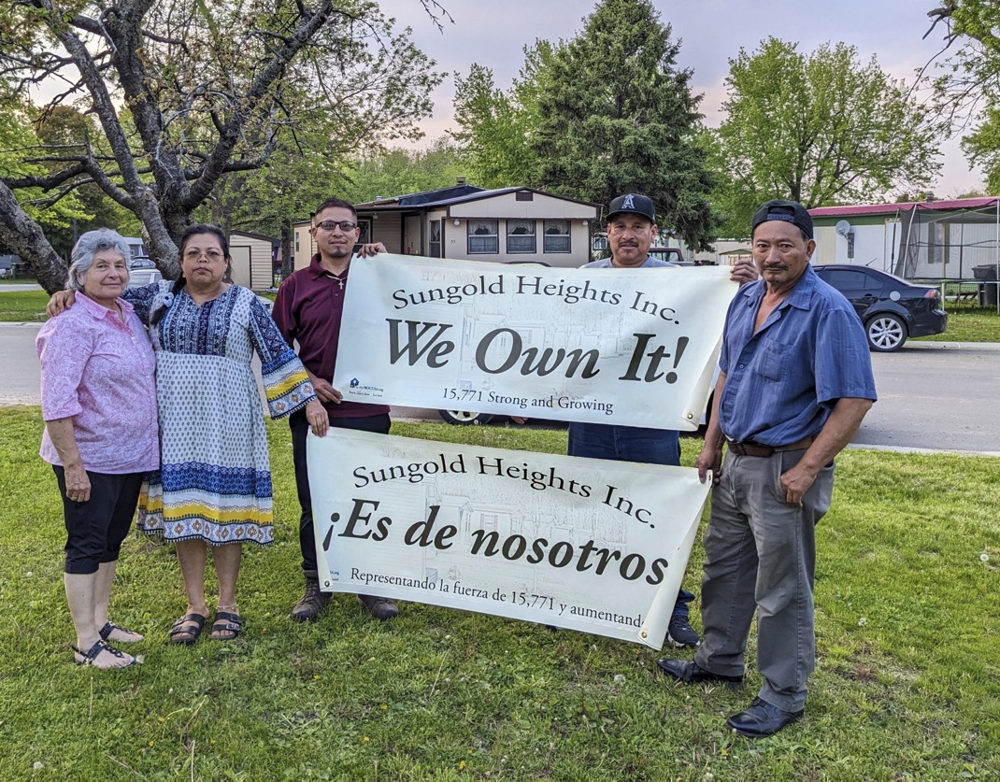
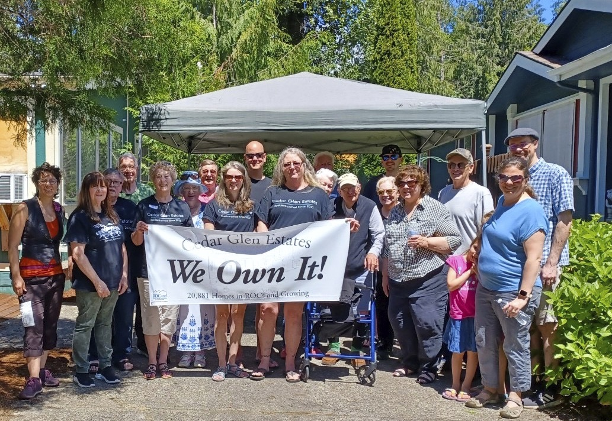
Resident Owned Communities - 312 ROCs - 21 states - 22,000 homes preserved - Limited equity co-op model

Slide 28
The Co-op corporation is the is the owner/operator, the borrower, holds title to the property
The corporation is governed by an elected Board of Directors
The property is professionally managed by hired PM
Site rents are revenue to support expenses and capital improvements
Property is valued based on cashflow
Homeowners’ homes appreciate not Member shares

Slide 29
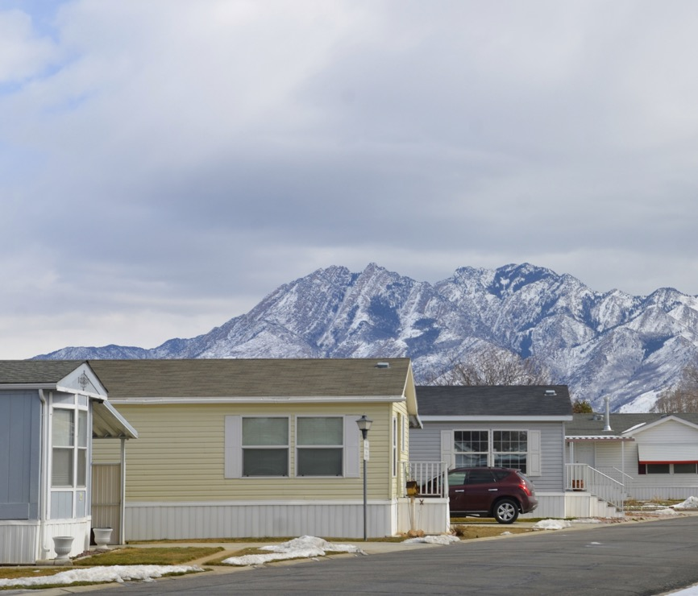
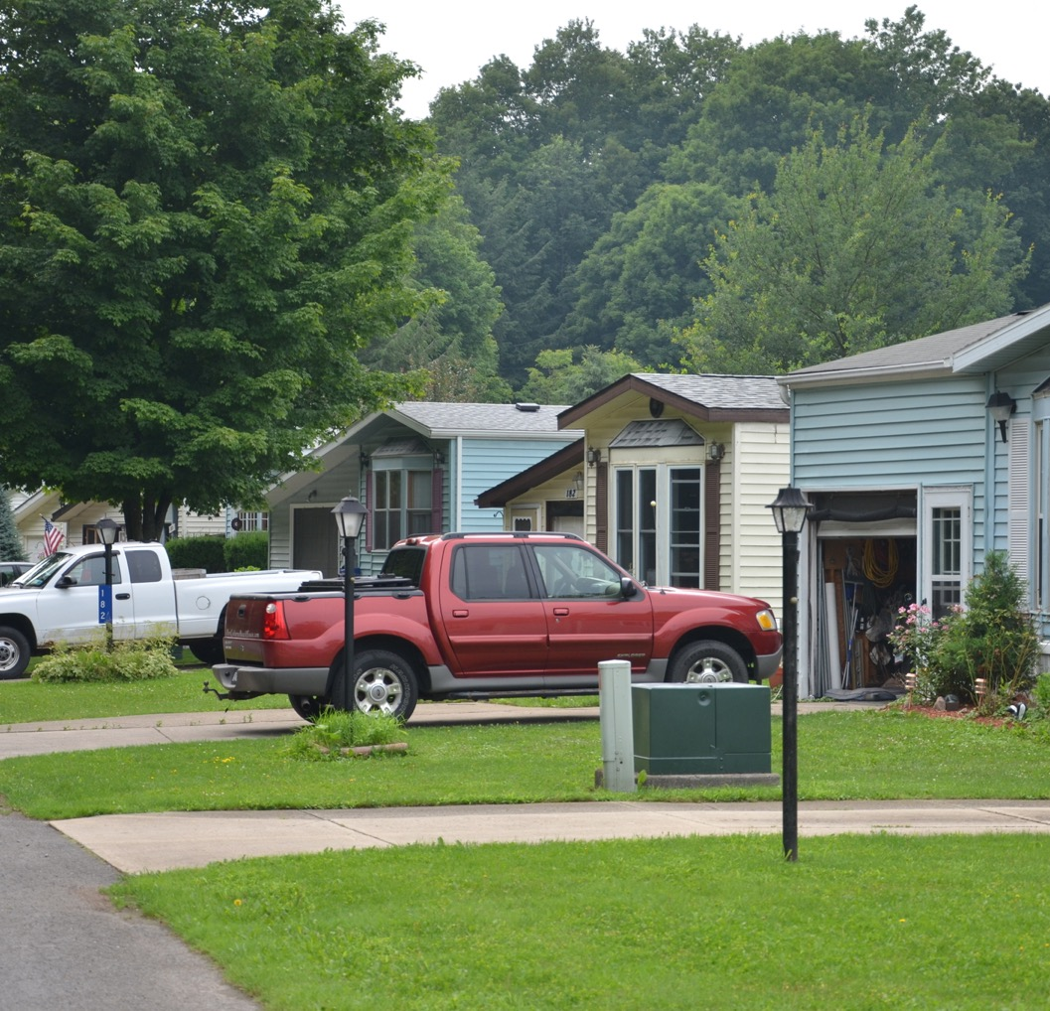
Market Conditions:
Surge in profit-oriented institutional
investing in MHCs
high and sustained prices for MHCs, and rapidly increasing site-rents.
Gentrification / economic development in neighborhoods
change of use and displacement
Continued consolidation of the MHC “business”
Infrastructure (and home) deficiencies accumulating
Challenges financing homes (private property) or communities (land & infrastructure)

Slide 30
Market Conditions:
Surge in interest from entities committed to alleviating housing crisis:
Government
National
State
Local
Philanthropy
Social determinants of health
Equity and inclusion
Business
Banks
Healthcare
Tech
Other employers

Slide 31
“Manufactured housing is no longer about mobility . . . but about affordability. These homes look pretty much like your typical ranch house but, depending on where you live, they might cost half the price.” Financial Times, Feb. 7, 2020 “Why big investors are buying up American trailer parks”

Slide 32
Implementing the Resident Owned Communities solution …
Major Steps:
Agreement on shared equity model – long-term preservation and wealth-building.
High-priced markets require dedicated source of low-cost, customized and nimble financing – a mix of equity grant and low-cost debt (acquisition and infrastructure / home repair).
Support for residents and their elected boards
Market development – either Opportunity to Purchase (OTP) or extensive marketing to owners.

Slide 33
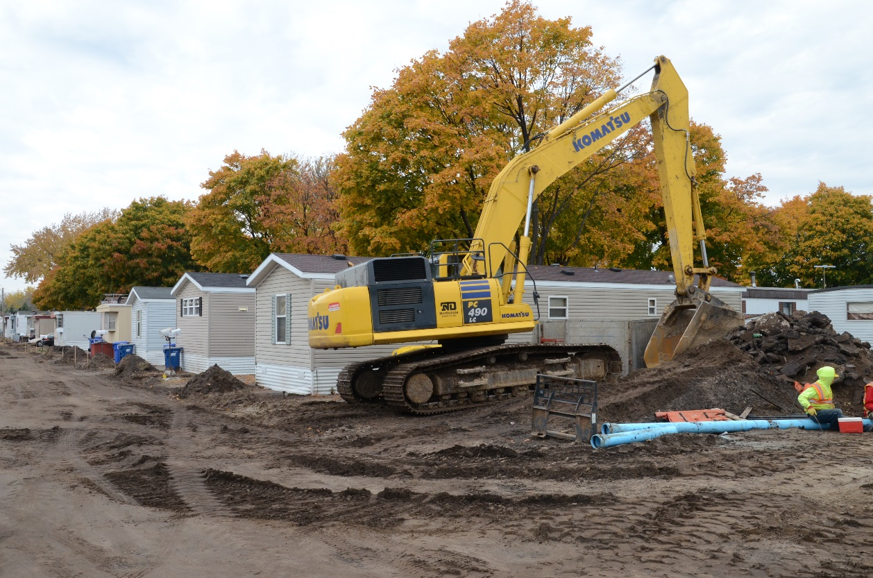
Policy Priorities
Infrastructure Resources- 2023 PRICE Initiative
Access to affordable housing resources
Equal access to commercial financing
Single Family financing

Slide 34
Opportunity to Purchase Laws
Which states have them?
What is working / what isn’t?
Several new states/regions looking at this in a new light.
Recent states adopting OTP.

Slide 35
Angela Romeo, VP Acquisitions aromeo@rocusa.org 603.545.1704 www.ROCUSA.org

