Slide 1
Preserving State LIHTC
WHY & HOW
February 27, 2024
Nicole Newhouse, Arizona Housing Coalition
Ruby Dhillon-Williams, Arizona Department of Housing
Julie Rees, Triadvocates
Roxanna Pitones, Triadvocates

Slide 2
program set to expire in 2025
2024 Legislative Session
Preserving State LIHTC
Gov Executive Budget Proposal
Advocacy
How you can help

Slide 3
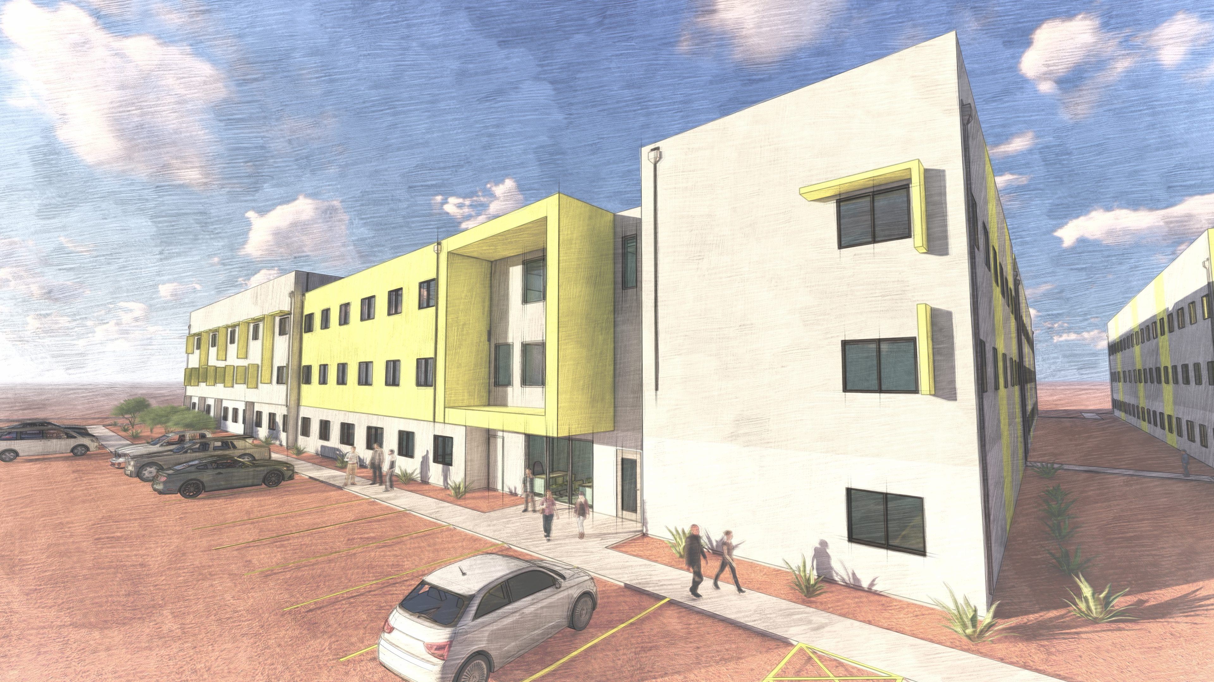
Program Accomplishments & Pipeline
Since Inception – July 2021
Guidelines & Application Process
4 STC Rounds
8 Projects Awarded
1,042 Affordable Units
LIHTC Programs Pipeline
Over 8,000 units underway
9%, 4% and STC projects

Slide 5
State LIHTC Equity
$ 1,000,000 State LIHTC Award
$7,400,000 Development Equity

Slide 6
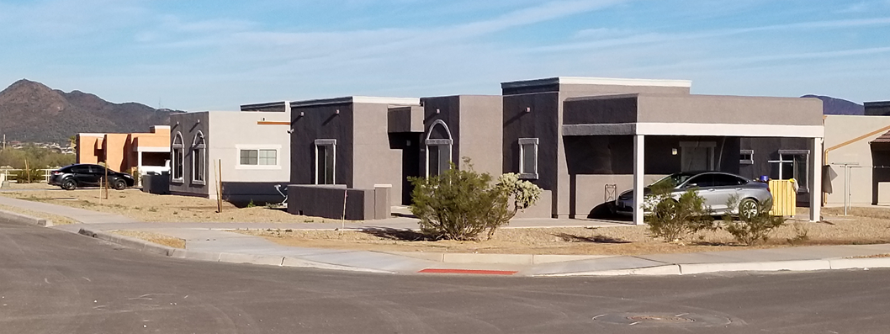
Nonprofit Participation
QAP Nonprofit Set-aside
10% of all LIHTC awards
Minimum of one project per round

Slide 7
STATE ADVOCACY

Slide 8
STATE LIHTC
PROGRAM EXTENSION & EXPANSION
Established in 2021 (SB 1124)
4 year program (expiring Dec 31, 2025)
$4 million annual allocation
Bipartisan support
Prescott Valley
Statewide impact (rural & urban)
Camp Verde
Stakeholder Coalition
Glendale (2)
Miami
State LIHTC included in Gov exec budget proposal
Globe
Chandler
Tucson
Notes:
Since its passage, State LIHTC has enabled eight projects creating 1,042 new affordable housing units, with guaranteed affordability.

Slide 9
STATE ADVOCACY
FY 25 BUDGET
GOVERNOR
SENATE
HOUSE

Slide 10
CHALLENGES & OPPORTUNITIES
CHALLENGES
OPPORTUNITIES
Included in Governor’s Executive budget proposal
Budget shortfall @ $2.2 B
Lawmaker experience & lack of exposure to the program
Bipartisan support
Sponsors & cosponsors
Budget process is political
Coalition of stakeholders
Proven program success

Slide 11
YOUR SUPPORT NEEDED
Engage with lawmakers, including key leaders & request their support of state LIHTC in the state budget
ENGAGE
CONNECT
ADVOCATE
THANK YOU!

Slide 12
THANK YOU!
Questions? Reach out.
Nicole Newhouse: nicole@azhousingcoalition.org
Ruby Dhillon-Williams: ruby.dhillon@azhousing.gov
Julie Rees: Julie@triadvocates.com
Roxanna Pitones: Roxanna@triadvocates.com
Calle Cualquiera 123, Cualquier Lugar

