Slide 1
Stakeholder Feedback State Housing Trust Fund & Homeless Shelter Services Fund
JOAN SERVISS, DIRECTOR
RUBY DHILLON-WILLIAMS, DEPUTY DIRECTOR
August 25, 2023
Notes:
Thank you for joining us, today we will be covering:
Eligible Uses
Historic Uses
Timeline
Stakeholder Feedback

Slide 3
Timeline
July – August
Stakeholder Feedback
September
Consolidate Feedback
October – December
Release NOFA's

Slide 4
Funding Amounts
$150 Million
State Housing Trust Fund
$60 Million
Homeless Shelter & Services Fund
$20 Million allocated

Slide 5
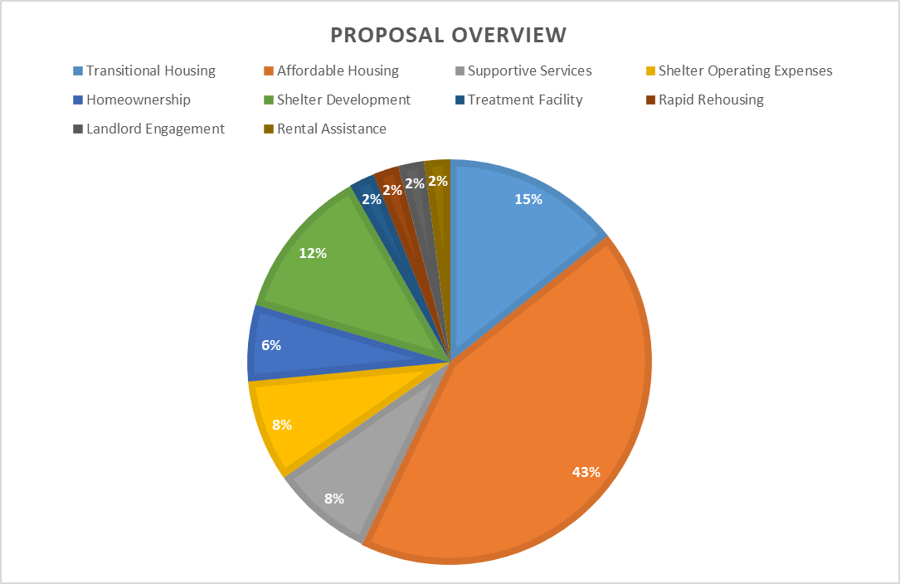

Slide 7
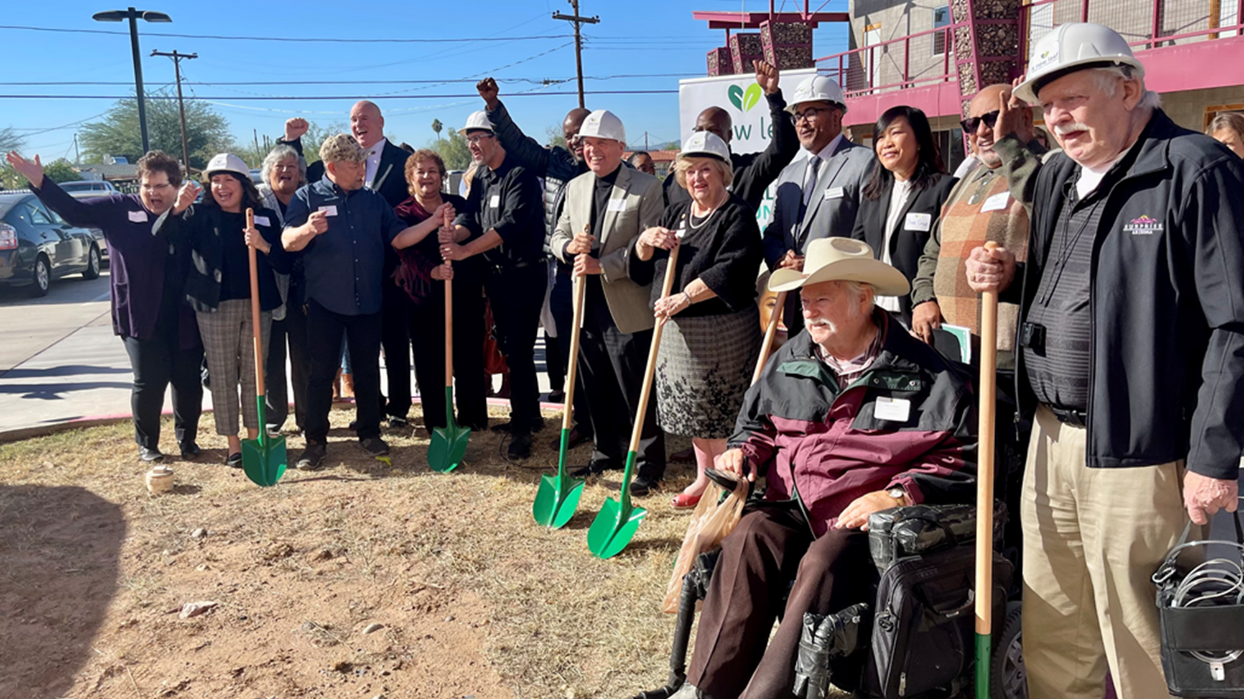
Homeless Shelter & Services Fund Eligible Activities
Service Programs
Unsheltered Populations

Slide 8
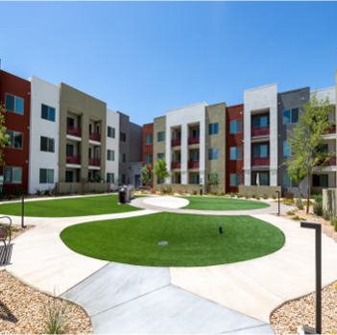
Housing Trust Funds Eligible Activities
ARS 41-3955
Affordable Housing Opportunities
Programs and Projects

Slide 9
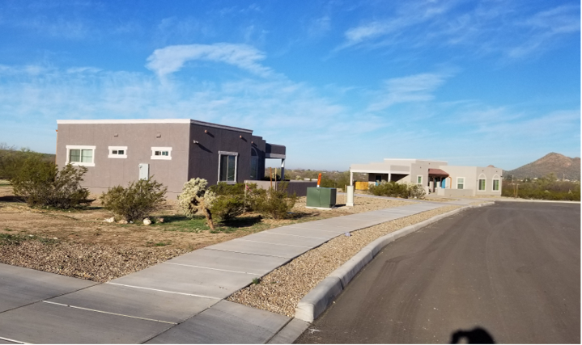
Historical Uses
Gap Financing Housing Construction
Rental Assistance
Service Contracts
Homeless Prevention

Slide 10
Stakeholder Sessions and Portal Submissions https://housing.az.gov/portals/document-upload-portals/FY24-State-HTF-Proposals-portal
Notes:
Stakeholders will have opportunities to provide feedback today in this session, and at future stakeholder feedback sessions:
2023 Housing Forum
League of Cities and Towns

