Slide 1
Reframing Housing Assistance to Landlords: Implementing Source of Income Protection
March 1, 2023
Notes:
Terry
Do Introductions
HCD Team
RAB Members

Slide 2
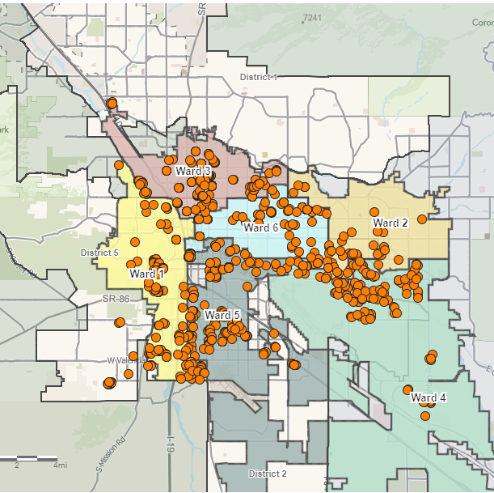
Federal Assistance Housing Programs
Public Housing
Housing Choice Voucher Program
Rapid Rehousing
VASH Program
Emergency Rental Assistance (ERAP)
Program Components
Waitlist
Eligibility
Amount of Assistance
Timeframe – permanent or temporary
Notes:
This subject is not new. Housing affordability has been identified as a high-priority area by the Tucson Mayor and Council. Some of the actions that Mayor and Council have taken to support affordable housing development in recent years include:
Creating the Commission on Equitable Housing and Development
Adopting a UDC amendment to increase the ability to build ADUs
Creating the Sunshine Mile Overlay with the city’s first density bonus for affordable housing
Maintaining an Impact Fee Waiver for affordable housing development
Adopting the People, Communities, and Homes Investment Plan (P-CHIP) that prioritized affordable housing
Directing PDSD and HCD to conduct a Housing Market Study to understand the changing housing conditions in Tucson
Purchasing hotels to model Housing First

Slide 3
Introduction and Background

Slide 5
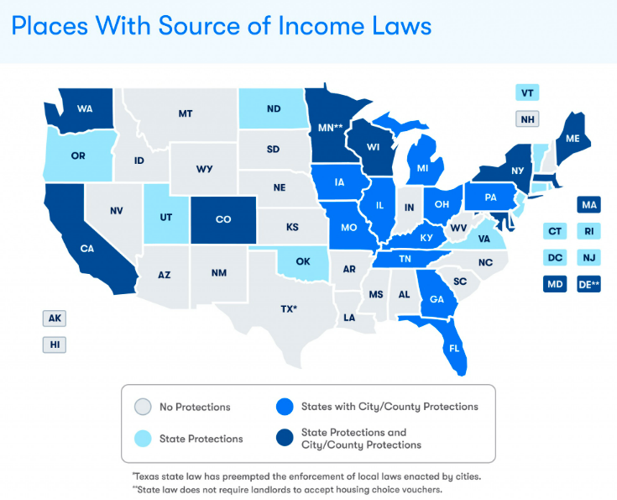
What is Source of Income (SOI)
Source of income protections are an increasingly common, evidence-based approach to increase housing choice voucher (HCV), formerly known as Section 8, utilization.
Consequently, the number of local jurisdictions that have adopted source of income protections has been on the rise since the early 2000s.
2018, there was a bipartisan effort in Congress to amend the federal Fair Housing Act to include source of income protection.
https://sourceofincome-cotgis.hub.arcgis.com/
Notes:
Liz
Tucson’s M & C adopted a source of income ordinance to provide protection for persons who have sources of income like a housing subsidy of some type. This came as a result of the majority of rental owners and property managers who have refused to accept applications from persons who have a voucher or other type of assistance. This has left these households with little to no options for housing even when they have the means to afford it.
This is not just a Tucson issue, it is a national issue. In fact, there are 20 states, 112 cities and counties that have adopted a similar ordinance. Although in its creation, the Section 8/HCV program is voluntary, it does not preclude local jurisdictions from requiring landlords to accept the program, if a tenant meets all other tenancy qualifications. This ordinance does not interfere with a landlord’s ability to charge the rent they have set, nor does it take away their ability to screen under their tenancy requirements. In fact, all it does is require that a landlord allow a person regardless of income or assistance to apply and to be considered for tenancy.
It is my opinion, that Landlords and management companies refuse to rent to voucher holders because they lack awareness of the program, or they hold inaccurate stereotypes about the households who participate in public assistance programs. In addition, refusing to rent to a voucher holder for some may be nothing more than a proxy for discrimination based on other protected demographics such as race, disability or familial status. Our current demographics for the program include 72% of voucher holders self identify as non-white, and 70% of voucher holder households are female-headed households with children, 48% are disabled and 27% elderly.
The ordinance passed on Sept 27 and in the first three months we saw a significant increase of landlords accepting the voucher holders. The local ordinance was challenged in December by State Rep Toma and was reviewed and determined by the AG that it violated a state statute. Since then, and with the change in the state administration, the new AG is currently reconsidering the ordinance and M & C has suspended the ordinance immediately to comply with the AG’s determination. More to come.

Slide 6
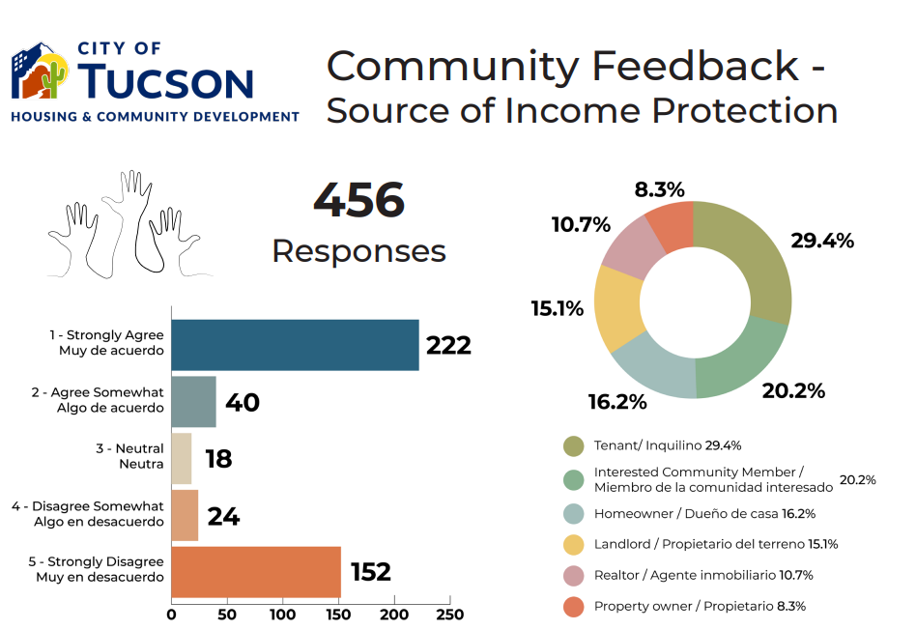
Public Process and Stakeholder Response
Notes:
Stakeholder Input- Liz
AMA, TAR
Education and FAQ – Fernando – Education
Jennifer – FAQ

Slide 7
Landlord Education
Known Concerns
RTA processing
Inspection time frames
Contract turnaround times
Rental increases
Staff response time

Slide 8
Landlord Education Formation of Landlord Support Team
Create a point of Contact for Landlords
Restructure Team Responsibilities
RTA’s done within 48 hrs.
Inspections reduced to 4 days
Contracts completed within 15 days
One agent to process all rental increases

Slide 9
Source of Income: Legal Topics
Review of Source of Income Definitions
Legal Considerations and FAQs
Does the Ordinance Apply to Me?
Applicant Screening
Landlord FAQs
City of Tucson Internal Processes for Current Human Relations Ordinance and Investigations

Slide 10
Definitions – City of Tucson
City of Tucson [T.C. § 17-50(f)]
“…any lawful source of income or support that provides funds to or on behalf of a renter or buyer of housing and is verifiable as to amount, regularity, receipt, and length of time received or to be received, including, but not limited to,
wages, salaries, child support, spousal support, foster care subsidies, rental assistance, security deposit or downpayment assistance, income derived from social security or disability insurance, veterans' benefits, or any other form of governmental assistance, benefit, or subsidy.
Source of income includes any requirement of any such program, assistance, benefit, or subsidy.”
Tucson Defines Source of Income Broadly for Renters and Buyers

Slide 11
Definitions – Other Jurisdictions
State of Washington [RCW 59.18.255]
“…benefits or subsidy programs including
housing assistance, public assistance, emergency rental assistance, veterans’ benefits, social security, supplemental security income or other retirement programs, and other programs administered by any federal, state, local, or nonprofit entity…”
District of Columbia [§ 42–2851.06]
“The monetary assistance provided to an owner of a housing accommodation under section 8 of the United States Housing Act of 1937 or any District law or program authorizing the payment of rental housing assistance, either directly or through a tenant, shall be considered income and a source of income under § 2-1402.21.”
Other Jurisdictions Definitions are Narrower – Limited to Subsidy Programs

Slide 12
Does the Ordinance Apply to Me?
Source of Income Exceptions for Owners of Rental Units
Own three or less single-family dwellings
Own four or less units or rooms if the owner occupies one as their residence
Housing is for older persons
(55+ or 62+ depending on the circumstances)
For the situation above, the owner does not use a real estate broker, agent, salesman, or similar or post an advertisement indicating preference for source of income
Yes, if you own or have any partial interest in dwellings sold or rented in the City, unless:
You are renting 3 or fewer of your own dwellings without the help of someone in the business of selling or renting dwellings (i.e. a real estate broker, agent, or salesman);
You are renting 4 or fewer additional rooms or units in living quarters you also occupy; or
You own/operate “housing for older persons.”
For general informational purposes only. See T.C. §§ 17-51 and 17-53 for additional information.
In General, Ordinance is Intended to Apply to “Professional” Landlords

Slide 13
Applicant Screening: Income
Proof of Income that is 3x the Rent
Commonly, landlords may require applicants to meet a minimum income (usually between 2.5-4x the monthly rent).
Landlords may only require that applicants meet their portion of the rent.
No need to apply income screen to zero-income tenants (rent 100% subsidized) as their rent payment is guaranteed by the PHA.
Applicant Responsibility
Applicant Responsibility
Source: www.equalrightscenter.org
Income Screens Still Apply, But Only For the Applicant’s Share of the Rent

Slide 14
Applicant Screening: Other Criteria
Landlords may continue to use other legal screening criteria, including:
Relevant criminal background check
Rental history
Credit history
However, higher security deposits or different criteria or qualifications based solely on source of income may be a violation of the ordinance.
Other Criteria May Still Apply Provided They Do Not Discriminate Based on SOI

Slide 15
Common Landlord Misconceptions
“I am forced to accept any tenant that applies.”
Ordinance does not require property owners to rent to tenants because they have HCVs nor force them to prioritize HCV holders over other qualified applicants. Property owners may continue to apply non-discriminatory screening criteria for prospective tenants.
“I am not allowed to increase the rent.”
Rent increases are allowed but must be submitted to the PHA at least 60 days in advance so the PHA can determine the share of the PHA and the tenant. It could be that the tenant pays the entire increase, but the PHA will notify the landlord of the new tenant rental portion.
“Inspection and maintenance requirements are burdensome.”
Turnaround time for inspections in the City of Tucson is now four days.
Inspections are de minimus (A.R.S. § 33-1324).
Most Questions Received Were About HCVs Generally and Not SOI

Slide 16
Misconceptions, Cont’d
“I’m not allowed to evict tenants.”
Landlords may evict if tenants fails to pay their portion of the rent or any other violation of the lease.
Landlords may not evict because the PHA is late on subsidy payments.
Common HCV questions …
Many other questions due to influx of landlords new to the HCV program.
Direct landlords to Landlord Resource page.
Most Questions Received Were About HCVs Generally and Not SOI

Slide 17
Investigations
A detailed process was created to :
Determine when to refer
Determine when to notify different parties
Prioritize conciliation over litigation
Whenever it would be reasonable and fair to do so, grant leave to the Complainant and respondent to file amended complaint and answers.
Any amended documents will be forwarded to PHA, and respondent/charging party, as appropriate.
Created a Process to Keep Parties Informed As Necessary

Slide 18
Investigation Process Summary
Refer for Investigation
(Start of 45-day Investigation)
Distribute Complaint to Respondent
Respondent Provides Answer
Complaint Received
Investigation is Complete
Filed Before 180 Days of Alleged Violation
Filed After 180 Days of Alleged Violation
Close Complaint
Provide Findings to Respondent
Reasonable Cause
Written Findings Provided to OEOP
No Reasonable Cause
Conciliation Not Reached
Reasonable Cause
HRC Meets to Review Reasonable Cause
File in Court
Attempt Conciliation
Charging Party has 15 Days to Request a Review of Findings
Conciliation Reached
No Reasonable Cause
Close Complaint
Close Complaint
Process Prioritizes Conciliation Over Litigation

Slide 19
Post Passage of Ordinance
Landlord Education
Landlord Outreach
Outcomes
Notes:
Stakeholder Input- Liz
AMA, TAR
Education and FAQ – Fernando – Education
Jennifer – FAQ

Slide 20
Landlord Education
Landlord briefings were revamped to educate and specifically target areas of concern. Briefings are held twice a month.
Briefings are help develop a relationship with our community partners.
Outreach is designed to strengthen relationships with our landlords.
SOI has been introduced to the briefings as part of the outreach to our landlords.

Slide 21
Outcomes of Ordinance
The ordinance became effective on September 27, 2022.
In September 2022, the average number of RTAs received was 4 per day / 120 per month.
In October 2022, those numbers doubled to 8 RTAs per day / 248 per month.
As a result of the ordinance, 122 new landlords joined the program.

Slide 22
Website: Sourceofincome.tucsonaz.gov

Slide 23
Questions?

