Slide 1
Systemic Change Through LGBTQ+ Education

Slide 2
Land Acknowledgement
We are currently occupying unceded lands of the Tohono O'odham and Pascua Yaqui peoples. With a land acknowledgement, action must follow. Action looks like being in solidarity with Indigenous resistance and fighting for land back*, which includes demanding the rightful return of colonized land to Indigenous peoples.
*“But when we say “Land Back” we aren’t asking for just the ground, or for a piece of paper that allows us to tear up and pollute the earth. We want the system that is land to be alive so that it can perpetuate itself, and perpetuate us as an extension of itself. That’s what we want back: our place in keeping land alive and spiritually connected.”
-briarpatch
Notes:
We are currently occupying unceded lands of the Tohono O'odham and Pascua Yaqui peoples. With a land acknowledgement, action must follow. Action looks like being in solidarity with Indigenous resistance and fighting for land back, which includes demanding the rightful return of colonized land to Indigenous peoples.

Slide 3
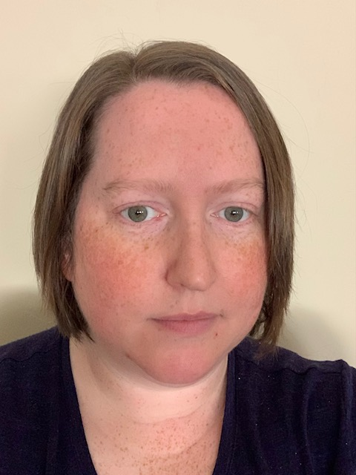
Introduction
Shannon Fowler
(she/her)
Assistant Social Science Researcher at the University of Arizona SIROW
Vice Chair of the TPCH Board
Chair of the Homeless Youth Coalition
Facilitator of the Pima County Task force for LGBTQ+ Court Involved Youth

Slide 4
Introduction Activity
A WALK IN THE PARK

Slide 5
Overview
Introduction-why are affirming agencies so important
Lighthouse Project
LBGTQ+ Equity Project
LGBTQ+ Equity Deep Dives

Slide 6
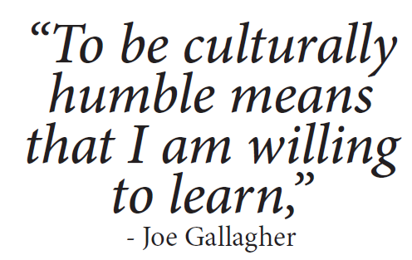
Understandings and Agreements
“To be culturally humble means that I am willing to learn.”
– Joe Gallagher, CEO First Nations Health Authority
Cultural humility
Growth mindset
Making space for discomfort
Notes:
To help guide us as we jump into the training series. QUOTE. In this training series, we’re not going for cultural competency, we can’t really be competent in cultures that are not our own, even as members of those cultures, there is no one way to be LGBTQ+. And so, we’re entering this conversation from a space of humility, where we are open to learning, willing to take risks, make mistakes, mess up, apologize, move on, do better, be better.
And it’s really a space to feel safe to explore and think and grow and make space for discomfort. There may be some ideas that come up in this training series that are new to you or things that maybe you hadn’t considered before, and when we come upon new ways of looking at things it can feel uncomfortable because it pushes the boundaries of what is familiar. So we really encourage you to lean into that because that’s where the growth happens! Take some time to personally reflect and think about how you can maybe shift or adjust your behaviors or practices or mentality and move into a different space of consciousness.
Establish understandings and frameworks that guide the modules and folks’ participation with them
- cultural humility vs. cultural competency
- some of the frameworks from Nicky’s 101 for SAAF – harm reduction, self-determination
Encourage a growth mindset, a place for learning, goal of getting and doing better ourselves (starts with us) so that we can better serve
Making space for discomfort (= growth)
Keeping an open heart and open mind
First Nations Health Authority CEO Joe Gallagher

Slide 7
LGBTQ+ Youth Homelessness
20-40%
of youth experiencing homelessness identify as LGBTQ+ while
5-10%
of the population identifies as LGBTQ+
(Choi, Wilson, Shelton, & Gates, 2015).
Conron, K.J. LGBT Youth Population in the United States. (September 2020). The Williams Institute, UCLA, Los Angeles, CA.
Photo by Scott Webb on Unsplash
Notes:
Photo by Scott Webb on Unsplash
2021 Gallup poll for that 5.6% of US adults identify as LGBTQ
Stat is alarming
Must align with best practices
YHDP mission statement – system change, disrupting how it’s being done to help prevent and end homelessness (especially for LGBTQ+ youth and youth of color)
this 40% of youth is a widely accepted percentage of those experiencing homelessness are LGBTQ
Choi, S.K., Wilson, B.D.M., Shelton, J., & Gates, G. (2015). Serving Our Youth 2015: The Needs and Experiences of Lesbian, Gay, Bisexual, Transgender, and Questioning Youth Experiencing Homelessness. Los Angeles: The Williams Institute with True Colors Fund. Retrieved at: https://williamsinstitute.law.ucla.edu/wp-content/uploads/Serving-Our-Youth-June-2015.pdf

Slide 8
Homelessness and Housing Instability Among LGBTQ Youth
28% of LGBTQ youth reported experiencing homelessness or housing instability at some point in their lives — and those who did had two to four times the odds of reporting depression, anxiety, self-harm, considering suicide, and attempting suicide compared to those with stable housing.-Trevor Project February 3, 2022

Slide 9
reasons for disparity
Lower income for trans and gender expansive individuals (James, Herman, Rankin, Keisling, Mottet, & Afani, 2016)
Higher rate of being in a juvenile detention facility (Morton, Dworsky, & Samuels, 2017)
Higher rate of touching the welfare system (Wilbur, Ryan, & Marksamer, 2006)
Difficulty finding accepting shelters (National Center for Transgender Equality)
Higher rate of violence in homes and dating violence (National Center for Transgender Equality)
HOMOPHOBIA & TRANSPHOBIA
Notes:
ADD REFERENCES
Photo by Scott Webb on Unsplash
2021 Gallup poll for that 5.6% of US adults identify as LGBTQ
Stat is alarming
Must align with best practices
YHDP mission statement – system change, disrupting how it’s being done to help prevent and end homelessness (especially for LGBTQ+ youth and youth of color)
this 40% of youth is a widely accepted percentage of those experiencing homelessness are LGBTQ
Choi, S.K., Wilson, B.D.M., Shelton, J., & Gates, G. (2015). Serving Our Youth 2015: The Needs and Experiences of Lesbian, Gay, Bisexual, Transgender, and Questioning Youth Experiencing Homelessness. Los Angeles: The Williams Institute with True Colors Fund. Retrieved at: https://williamsinstitute.law.ucla.edu/wp-content/uploads/Serving-Our-Youth-June-2015.pdf

Slide 10
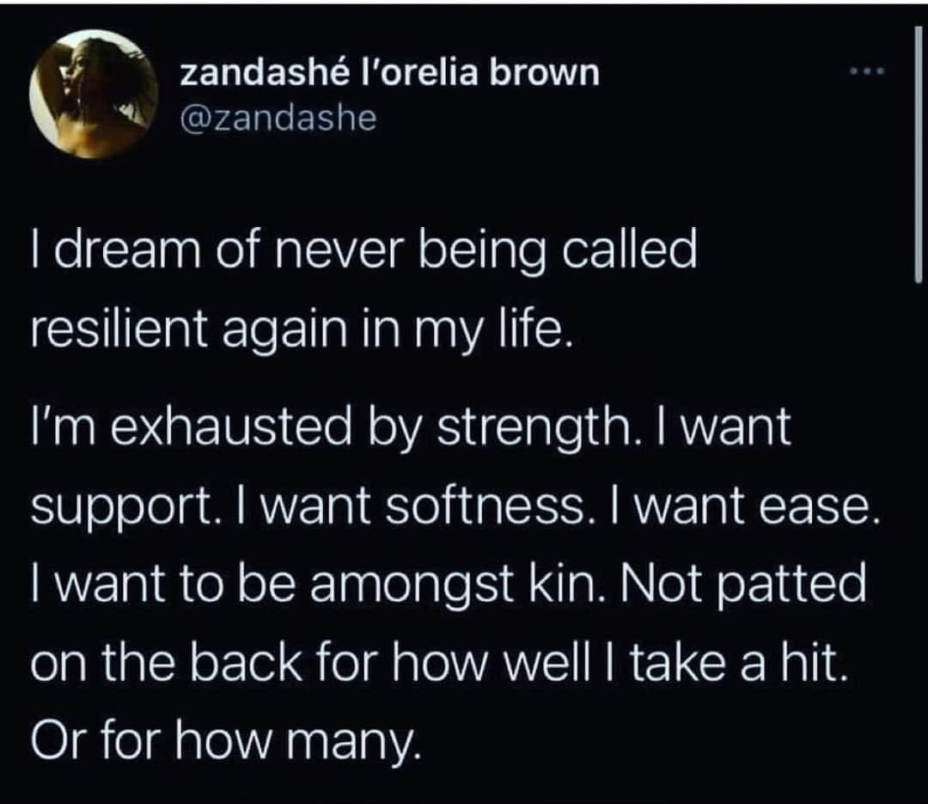

Slide 11
Lighthouse Project SAMHSA- Grants for the Benefit of Homeless Individuals (GBHI) Grant #1H79TI021367
University of Arizona SIROW
Our Family Services
Southern Arizona AIDS Foundation
Notes:
SAMSHA funded 5 year grant

Slide 12
Training Opportunities
LGBTQ+ Cultural Responsiveness
live training for groups
in-person or virtual
dfowler@saaf.org
Notes:
101-level training for groups
Individualized TA for orgs who want more tailored support – is this called TA?

Slide 13
Goals
Year 4
1075 individuals
41 Unique Agencies
Train 14 Unique Agencies on LGBTQ+ Cultural Responsiveness
Year 5
228 individuals
5 Unique Agencies

Slide 14
Expected and Actual Demographic Characteristics of Participants
Demographic Characteristc | Expected Percentage of Participants | Actual Percentage of Participants
Gender
Female | 22% | 42%
Male | 39% | 21%
TGNC | 39% | 37%
Race and Ethnicity
Hispanic/Latinx | 35% | 38%
American Indian, Native Hawaiian or Pacific Islander | 13% | 14%
African American or Black | 10% | 13%
Multiracial | 3% | 5%
Asian | 2% | 0%
White | 35% | 59%
Sexual Orientation
Lesbian or Gay | 27% | 23%
Bisexual | 15% | 38%
Queer, questioning, Two-Spirit, pansexual | 46% | 31%
Straight | 11% | 12%
Veteran status | 8% | 1%

Slide 15
Age Groups of Participants (N=150)

Slide 16
National Outcome Measures (N=105)
% of Individuals Receiving Services Who: | # Valid Cases | Percent at Intake | Percent at 6-month Follow-up | Rate of Change
Abstinence: did not use alcohol or illegal drugs | 105 | 39.0% | 39.0% | 0.0%
Crime and Criminal Justice: had no past 30 day arrests | 105 | 98.1% | 100.0% | 1.9%
Employment/Education: were currently employed or attending school | 105 | 30.5% | 50.5% | 65.6%
Health/Behavioral/Social Consequences: experienced no alcohol or illegal drug related health, behavioral, social consequences | 105 | 91.4% | 96.2% | 5.2%
Social Connectedness: were socially connected | 105 | 81.0% | 88.6% | 9.4%
Stability in Housing: had a permanent place to live in the community | 104 | 13.5% | 40.4% | 200.0%

Slide 17
LGBTQ+ Equity Project
University of Arizona SIROW
City of Tucson

Slide 18
Equality vs. Equity
“Equality is the idea that because everybody has the same worth, everybody deserves the same treatment. But equity is the idea that everybody has the same worth and therefore they deserve to have treatment they need in order to be their best selves.”
- Shain Neumeier
Notes:
Over the past few years, national conversations, in the public health and social service arenas and other fields, have shifted from equality to equity. Equality is grounded in the values of fairness and justice and [] that everyone should have access to the same resources. Equity, on the other hand, acknowledges that different people have different needs and [] that resources should be tailored to meet the varying needs of different groups and people. Equity requires consideration of everyone’s needs and abilities and moves away from the logic that everyone should be treated the same.
Shain Neumeier, a disability justice advocate and attorney, articulates the different between these two concepts like this, “Equality is the idea that because everybody has the same worth, everybody deserves the same treatment. But equity is the idea that everybody has the same worth and therefore they deserve to have treatment they need in order to be their best selves,”

Slide 19
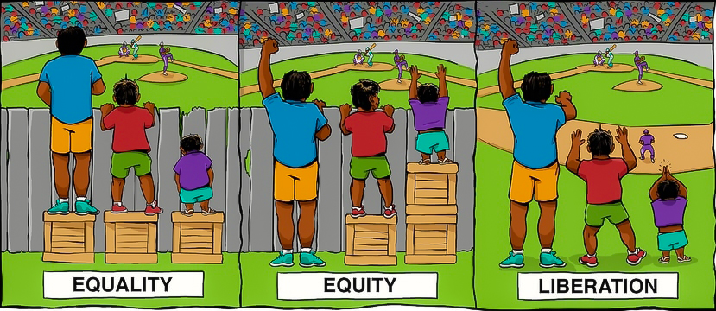
“Equality is the idea that because everybody has the same worth, everybody deserves the same treatment. But equity is the idea that everybody has the same worth and therefore they deserve to have treatment they need in order to be their best selves.”
- Shain Neumeier
Interaction Institute for Social Change | Artist: Angus Maguire.
Notes:
Over the past few years, national conversations, in the public health and social service arenas and other fields, have shifted from equality to equity. Equality is grounded in the values of fairness and justice and [] that everyone should have access to the same resources. Equity, on the other hand, acknowledges that different people have different needs and [] that resources should be tailored to meet the varying needs of different groups and people. Equity requires consideration of everyone’s needs and abilities and moves away from the logic that everyone should be treated the same.
Shain Neumeier, a disability justice advocate and attorney, articulates the different between these two concepts like this, “Equality is the idea that because everybody has the same worth, everybody deserves the same treatment. But equity is the idea that everybody has the same worth and therefore they deserve to have treatment they need in order to be their best selves,”

Slide 20
Purpose
To advance LGBTQ+ equity through individual, organizational, and systems-level change.
Goal
To provide education and tools to enhance providers’ capacity to serve and meet the needs of LGBTQ+ young people.
Objective
To develop a comprehensive training series consisting of on-demand modules and a companion resource and reflection guide
Notes:
Youth Homelessness Demonstration Project
TPCH Vision: We envision communities and systems throughout Tucson/Pima County in which the causes of youth homelessness are disrupted and its solutions are permanent. This requires radical systems change built on intersectional equity and youth power. In these systems, young people drive individual housing solutions and hold equal power at all levels of community decision-making.
Among the many efforts that have been taking place, TPCH launched an online training center to support the professional development of housing providers and others serving young people in our community.
The LGBTQ+ Equity Equity Training Series seeks to advance equity for LGBTQ+ communities by providing education along with individual and organizational-level tools to affirm, serve, and ultimately help meet the needs of queer young people.
Audience
systems reform to end youth homelessness including diverting pathways into homelessness with her specific focus being on LGBTQ+ youth.
TPCH was selected to participate in two national initiatives to address youth homelessness in 2019. These include HUD’s Youth Homelessness Demonstration Program (YHDP) through which the Tucson/Pima County Continuum of Care was awarded $4.558 million to accelerate community efforts to prevent and end youth homelessness
We envision communities and systems throughout Tucson/Pima County in which the causes of youth homelessness are disrupted and its solutions are permanent. This requires radical systems change built on intersectional equity and youth power. In these systems, young people drive individual housing solutions and hold equal power at all levels of community decision-making.

Slide 21
The modules and Companion guide will…
Provide a thorough understanding of contextual, historical, and cultural factors that contribute to the oppression of LGBTQ+ people
Highlight social justice, organizing, and advocacy that has improved conditions for LGBTQ+ people and advanced efforts toward equity and liberation.
Describe aspects of LGBTQ+ identities so that providers have a better understanding of complex and unique needs that LGBTQ+ people may have.
Compile national, state, and local LGBTQ+ resources for providers to refer LGBTQ+ clients who are in need of support and/or services.
Offer tools and strategies for taking action, for being affirming as an individual provider and at the organizational level, for showing up and being in solidarity with LGBTQ+ people, and for fighting for broader structural change.
Encourage viewers to personally examine and reflect on ways that they can grow and adapt to best serve LGBTQ+ communities and other marginalized groups, and to apply what they’ve learned in meaningful ways.
Notes:
Youth Homelessness Demonstration Project
TPCH Vision: We envision communities and systems throughout Tucson/Pima County in which the causes of youth homelessness are disrupted and its solutions are permanent. This requires radical systems change built on intersectional equity and youth power. In these systems, young people drive individual housing solutions and hold equal power at all levels of community decision-making.
Among the many efforts that have been taking place, TPCH launched an online training center to support the professional development of housing providers and others serving young people in our community.
The LGBTQ+ Equity Equity Training Series seeks to advance equity for LGBTQ+ communities by providing education along with individual and organizational-level tools to affirm, serve, and ultimately help meet the needs of queer young people.
Audience
systems reform to end youth homelessness including diverting pathways into homelessness with her specific focus being on LGBTQ+ youth.
TPCH was selected to participate in two national initiatives to address youth homelessness in 2019. These include HUD’s Youth Homelessness Demonstration Program (YHDP) through which the Tucson/Pima County Continuum of Care was awarded $4.558 million to accelerate community efforts to prevent and end youth homelessness
We envision communities and systems throughout Tucson/Pima County in which the causes of youth homelessness are disrupted and its solutions are permanent. This requires radical systems change built on intersectional equity and youth power. In these systems, young people drive individual housing solutions and hold equal power at all levels of community decision-making.

Slide 22
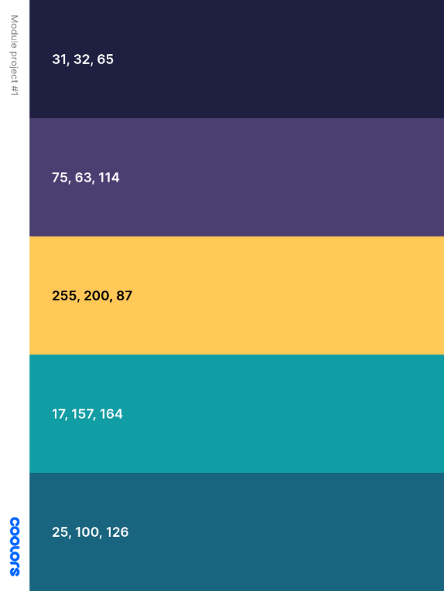
This project was led by University of Arizona SIROW, with funding from the Tucson-Pima Collaboration to End Homelessness (TPCH)’s Youth Homelessness Demonstration Project ©2021
Notes:
Check that language is okay
Add acknowledgements slide that credits the creators

Slide 23
Training Series outline
3 HOURS!
CONTEXT
Module 1: Social Justice & Intersectionality
Module 2: Trends in LGBTQ+ History
FOUNDATIONS
Module 3: LGBTQ+ 101
Module 4: Trans & Non-binary Identities Part I
Module 5: Trans & Non-binary Identities Part II
PRACTICE
Module 6: Coming Out
Module 7: Solidarity & Confronting Oppression
Module 8: Best Practices for LGBTQ+ Inclusion
Notes:
Total series is about 3 hours
The Context modules offer an overarching framework and historical perspective that will help situate the series in our modern world. We’ll explore how intersecting layers of identity can exacerbate oppression for certain people, underscoring the importance and need for a social justice approach to this work. These modules will also summarize key organizing efforts that LGBTQ+ activists have led for decades in an effort to advance equity for LGBTQ+ people.
The Foundations modules lay the groundwork for later modules by providing conceptual information related to LGBTQ+ communities and identities. The Foundations modules offer an in-depth exploration of trans and non-binary identities and give a taste of what you’ll find more of in the Practice modules by reviewing tips and strategies for supporting trans and non-binary clients.
The Practice modules are action-oriented, taking the intellectual knowledge from the previous presentations and offering concrete strategies for centering and uplifting LGBTQ+ communities. These modules challenge viewers to examine their own beliefs, behaviors, workplaces, and practices in an effort to propel meaningful action for change.
It is with education and action that we can advance equity for LGBTQ+ people and other oppressed groups. Thank you for being a part of this training series!

Slide 24
Module Format & Companion Guide
Companion Reflection and Resource Guide contains:
Module content
Activities and exercises
National and local resources
Links to helpful toolkits
Each module contains:
Questions to Consider
Scenarios
Reflection Questions
Notes:
Format of the modules – reflection opportunities, scenarios with feedback, workbook to accompany modules
*Check out your resource guide for tips on how to handle the scenarios in the presentations.

Slide 25
Organization Checklist
Best Practices for LGBTQ+ Inclusion Organization Checklist
Best Practice | Yes | No
Non-discrimination policies which include sexual orientation and gender identity
Diversity and Mission Statements They are visible on your website and in your space
Mandatory LGBTQ+ training Personal growth comes from learning and training opportunities
Internal Forms Affirming
Client Forms Affirming Disclosing who has access What will the information be used for How can the information be changed Policy around legal name

Slide 26
LGBTQ+ Equity Deep Dive
University of Arizona SIROW
City of Tucson

Slide 27
Technical Assistance
3 Local Agencies
Deep Dive Trainings
General Scenarios
Agency Specific Scenarios
Marketing Review
Website Review
Supervisor Debriefing
Document/Policy Review

Slide 28
questions to consider
Consider your childhood – what specific messages do you recall receiving about your behavior or actions that were based on your gender? (e.g., “boys shouldn’t cry” or “only girls can wear dresses.”)
What was or might have been the impact of deviating from these imposed norms?
sosiukin - stock.adobe.com
Notes:
Shannon

Slide 29
Closing
How can my organization support the LGBTQ+ community?
Questions?

Slide 30
References
Choi, S.K., Wilson, B.D.M., Shelton, J., & Gates, G. (2015). Serving Our Youth 2015: The Needs and Experiences of Lesbian, Gay, Bisexual, Transgender, and Questioning Youth Experiencing Homelessness. Los Angeles: The Williams Institute with True Colors Fund. Retrieved at: https://williamsinstitute.law.ucla.edu/wp-content/uploads/Serving-Our-Youth-June-2015.pdf
“Issues: Housing and Homelessness” National Center for Transgender Equality. https://transequality.org/issues/housing-homelessness
Trevor Project https://www.thetrevorproject.org/research-briefs/homelessness-and-housing-instability-among-lgbtq-youth-feb-2022/
James, S. E., Herman, J. L., Rankin, S., Keisling, M., Mottet, L., & Anafi, M. (2016). Executive Summary of the Report of the 2015 U.S. Transgender Survey. Washington, DC: National Center for Transgender Equality; available at: https://transequality.org/sites/default/files/docs/usts/USTS-Full-Report-Dec17.pdf.
Morton, M. H., Dworksy, A., & Samuels, G. M. (2017). Missed opportunities: Youth homelessness in America. National Estimates. Chicago: Chapin Hall at the University of Chicago
Wilber, S., Ryan, C., & Marksamer, J. (2006). The model standards project: creating inclusive systems for LGBT youth in out-ofhome care. Child Welfare, 85(2). Link: http://familyproject.sfsu.edu/sites/default/files/bestpracticeslgbtyouth.pdf

