Slide 1


Slide 2


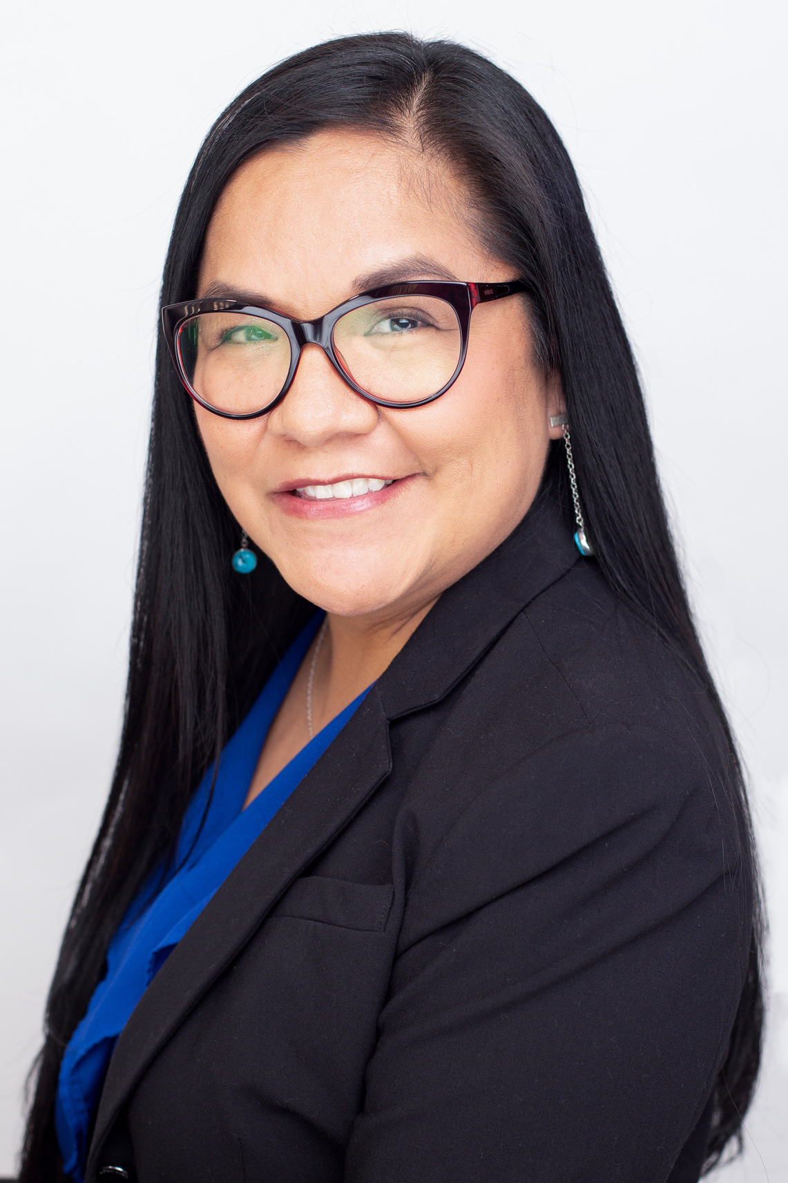
Jolyana Begay-Kroupa, MA
Chief Executive Officer
Phoenix Indian Center

Slide 3
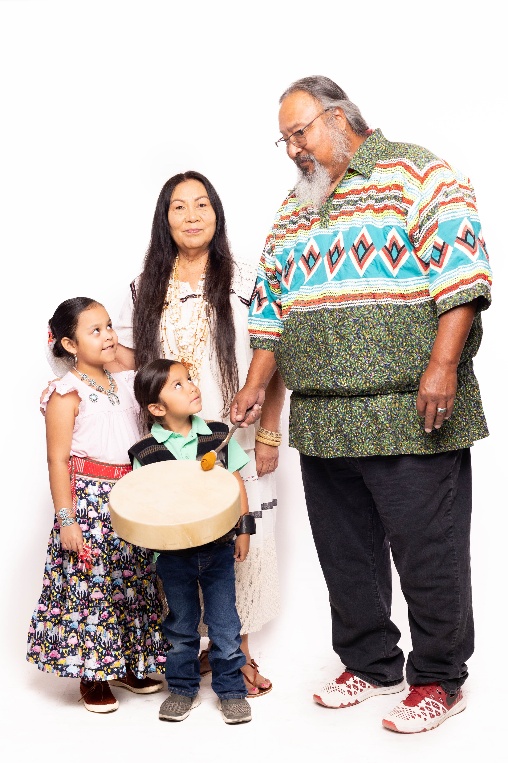

Our Mission:
As the oldest American Indian Center, we serve as the hub for the advancement of our urban American Indian relatives with culturally relevant essential services, programs, and initiatives.

Slide 4
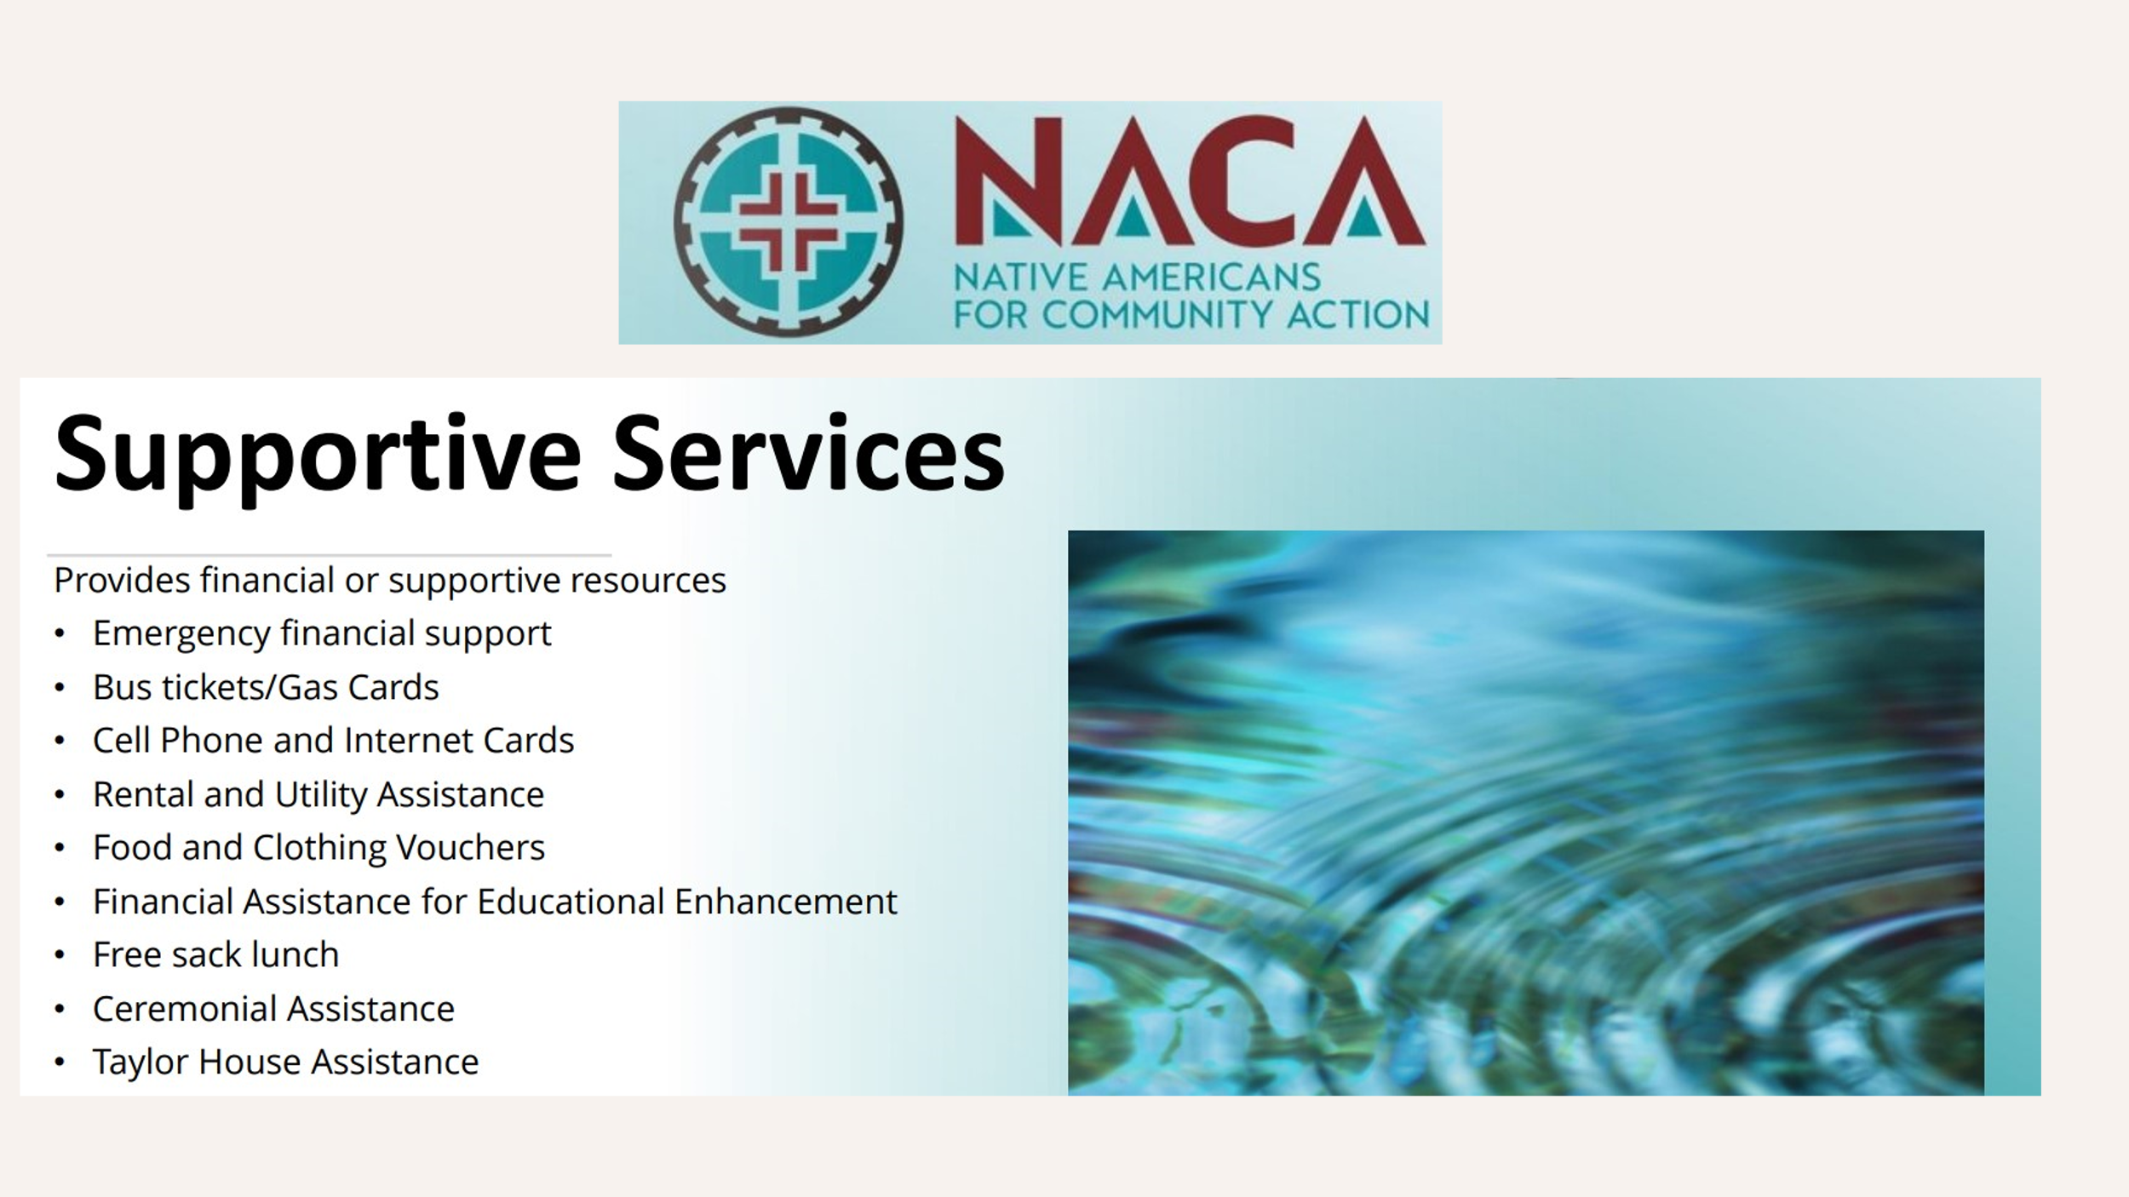

Slide 6
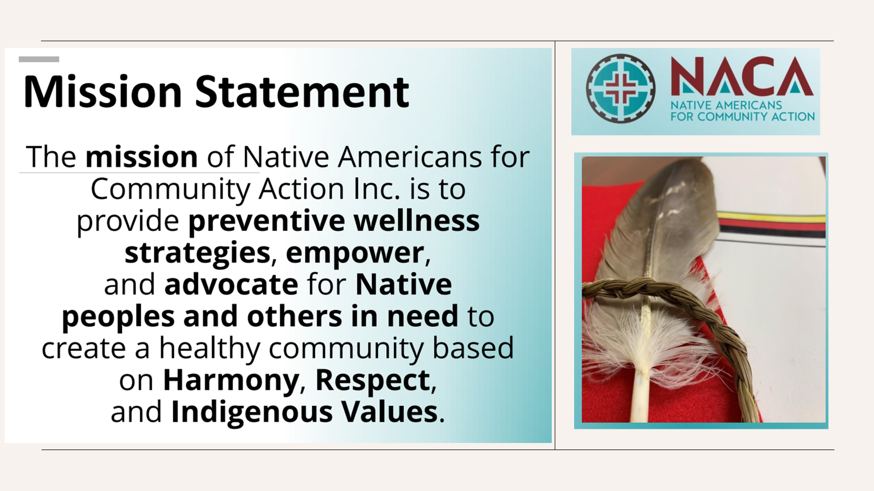

Slide 7
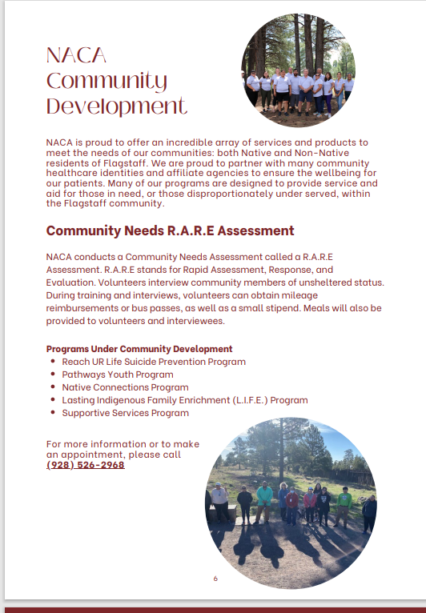

Slide 8
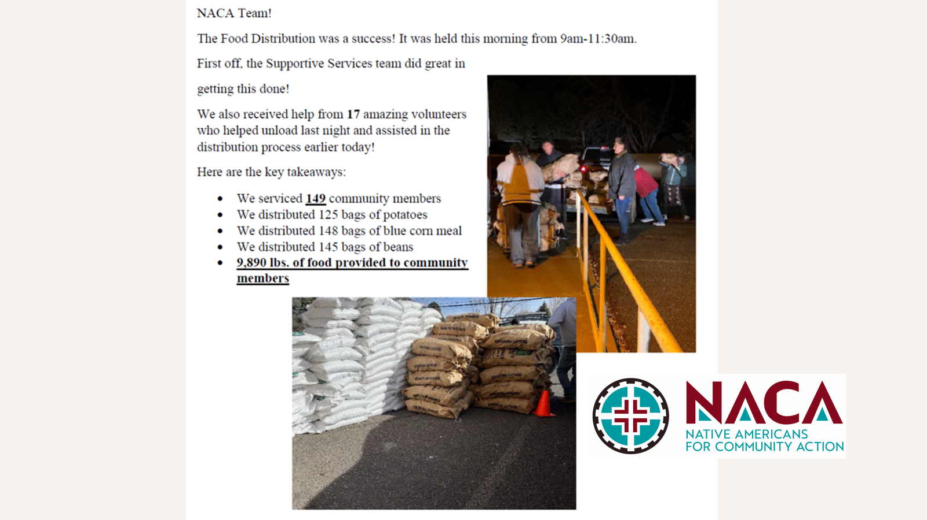

Slide 9
AACIHC Mission and Vision
Mission Statement
The mission of the AACIHC is to serve as a resource for all Tribal governments and the State of Arizona by supporting prevention, training, education, workforce development, policy and legislation to meet the unique health care needs of American Indian and Alaska Native (AI/AN) populations in Arizona. We seek to educate and advocate for improved health outcomes.
Vision Statement
The AACIHC strives to be recognized as a trusted resource on health equity for all Tribal Nations and American Indian/Alaska Native (AI/AN) communities throughout Arizona.
A - Authenticity A - Accountability C - Culture I - Integrity H - Holistic C - Community
Notes:
he AACIHC is a State Agency, exactly how the Arizona Department of Health Services (ADHS), the Arizona Health Care Cost Containment System (AHCCCS), the Arizona Department of Economic Security (DES), and even the Arizona Department of Transportation (ADOT) are all State agencies.
The AACIHC is not an Indian Health Services (IHS) entity and is not run by the Tribes under Public Law 638. We do, however, work with IHS 638 providers.
Our agency was first established in Fiscal Year 1990 by Arizona Revised Statute 36-2902.01.

Slide 10
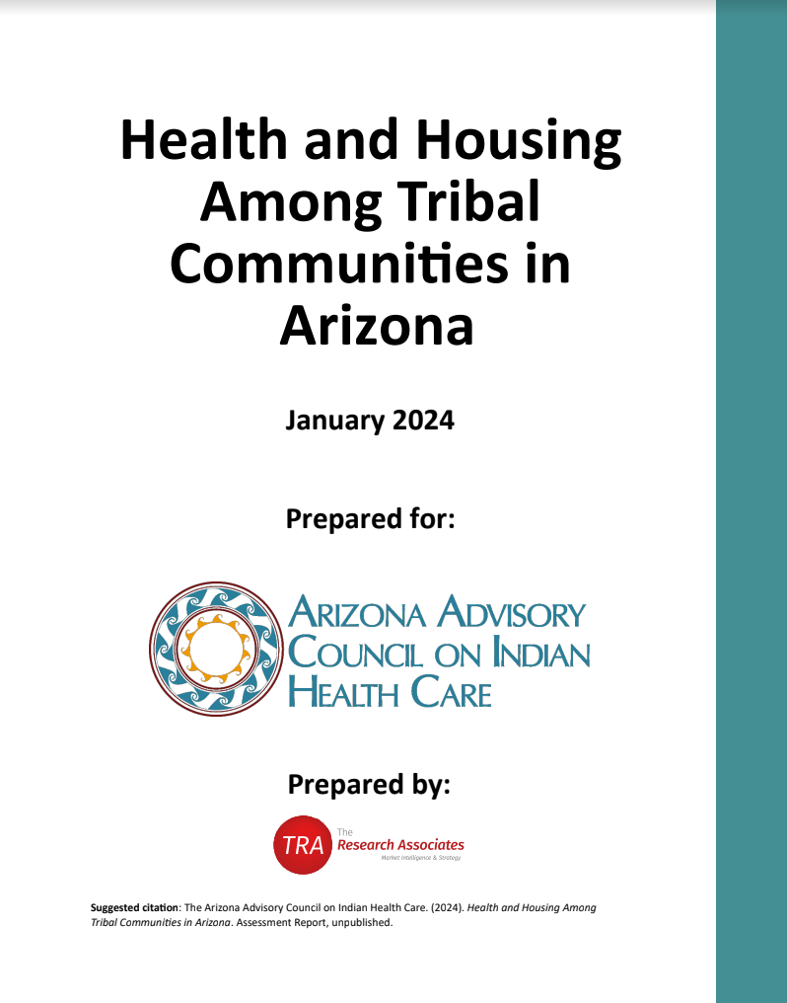
2024 Health and Housing Report
Increase funding for healthcare & housing programs
Increase coordination between agencies and resources
Provide incentives for healthcare organizations to collaborate with housing providers
Create shelters and transitional housing for people in need
Utilize mobile clinics
Provide cultural competency training for healthcare providers and housing specialists
Develop and implement comprehensive education program in health literacy, home ownership, and financial management
Focus on gaining system-wide involvement in the development and implementation of policies
Ensure that tribal members get more involved in elected government
Implement GIS within tribal communities
Understand the unique challenges, priorities, and needs of each tribe individually as well as all 22 tribes collectively
Notes:
Our tribal stakeholders consisted of:
Tribal Health Directors
Urban Indian Health Directors
IHS Officials
Tribal 638 CEOs
Tribal Early Childhood Directors
Community Health Representatives
Behavioral Health Directors
Tribal Housing Directors
Tribal Domestic Violence Advocates
The objective of the survey, interviews, and focus groups was to better understand key health and housing challenges among tribal communities in Arizona
Surveys were completed by 28 stakeholders representing organizations that serve the following tribal communities (21 of the 22 federally-recognized tribes in Arizona)
Interview and Focus Group Participants
Participants included 23 stakeholders representing 14 of 22 federally recognized tribes in Arizona, plus the Urban Indian Organization.
A thematic analysis was conducted with transcripts from the interviews and focus groups.

