Slide 1


Slide 2
Tribal Housing Symposium
Corey Hemstreet, Legislative Liaison

Slide 3


Slide 4
Overview of Legislative Priorities
Per A.R.S. 36-2902.01 the AACIHC is established…to give tribal governments, tribal organizations and urban Indian health care organizations in this state, representation in shaping Medicaid and health care policies and laws that impact the populations they serve.
Every year, the AACIHC creates a legislative agenda comprising of priorities that will positively impact the Indian healthcare system. AACIHC'S role includes identifying and tracking legislation, providing updates to stakeholders, and providing information and educational opportunities on various topics.
Traditional Healing
Murdered & Missing Indigenous Peoples
Fraud, Waste & Abuse
Housing
Medicaid Expansion
Oral Health

Slide 5
Housing
SB1140 - telehealth program; homeless; recovery services
Sponsor(s): Miranda: Alston, Gabaldón, Gonzales, Sundareshan; Representative Abeytia
Bill Overview: This bill wants to establish the Homeless Recovery Telehealth Pilot Program which aims to improve access to healthcare services for homeless individuals, with a focus on mental health, addiction, and primary care, through a public-private partnership with a telehealth provider.
Status: Assigned to HHS, Appropriations and Rules committees on 01/22/25 (No movement)
SB1379 - landlord tenant; domestic violence; documents
Sponsor(s): Senators Ortiz: Shamp
Bill Overview: DV victims can utilize two additional forms of documentation to break the lease: Emergency Order of Protection and Written Verification of Victim Status from a healthcare professional. The process of breaking the lease for victims of DV will be easier and quicker, affecting primarily urban Indian communities. Status: Assigned to Judiciary and Rules on 02/03/25 (No movement)
SB1482 - appropriation; homeless shelter services fund
Sponsor(s): Senators Alston: Burch, Epstein, Kuby Bill Overview: Establishes the homeless shelter and services fund. The department shall administer the fund consisting of legislative appropriations, other monies directed to be deposited in the fund and investment earnings on monies in the fund. Status: Assigned to Government, Appropriations and Rules committees on 02/04/25 (No movement)

Slide 6
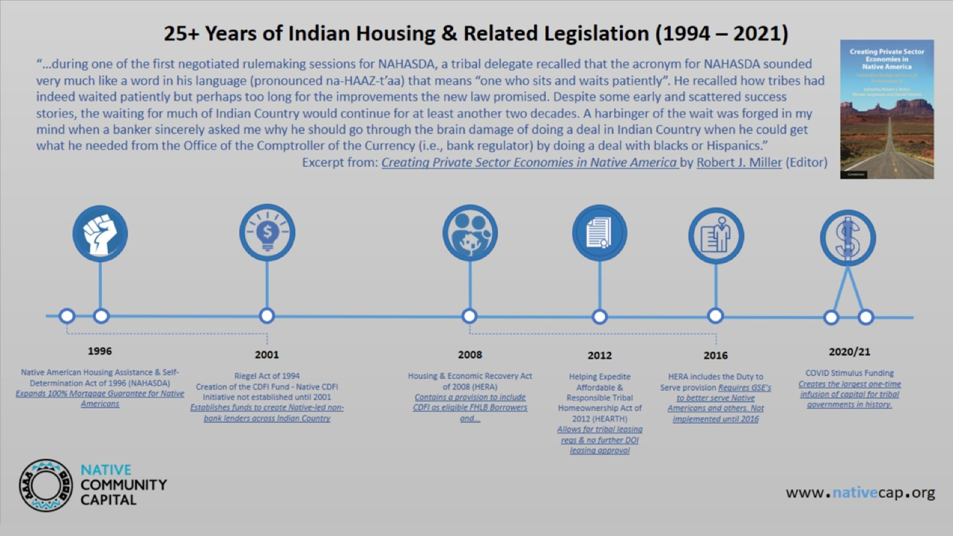

Slide 7
